Slide 1
Project Presentation of CO-OP Project at Industry (Module-2) (22CS421)
On
WEB PATTERN ANALYZER
Automated UX Design Pattern Extraction from Live Websites Using a Headless Browser Pipeline
Submitted by: Gurkunwar Singh (2210991595) Anshik Singh (2210991302)
Piyush (2210992038)
Supervised By
Dr Lalit Sharma
Department of Computer Science and Engineering,
Chitkara University, Punjab

Slide 2
Introduction
Manual design analysis is slow, subjective, and inconsistent across evaluators. Existing tools like Lighthouse focus on performance metrics (load time, SEO) and accessibility tools like axe-core check only WCAG compliance. No existing solution holistically extracts visual design patterns like color palettes, typography scales, framework detection, and layout structures from live websites. Web Pattern Analyzer solves this by providing an automated, reproducible pipeline using a headless browser that extracts 8 distinct design dimensions from any public URL in under 10 seconds
2

Slide 3
Problem Statement
Identifying design patterns across websites is slow, subjective, and does not scale — existing tools focus on performance, not design
Manual Inspection — Expert review takes 2-4 hours per website. A UX researcher analyzing 100 competitor sites would need 200-400 hours of manual work. This is not viable at scale for design audits, competitive analysis, or design system research.
Tool Gaps — Lighthouse checks performance (load time, CLS, LCP). axe-core checks accessibility (WCAG violations). WAVE checks contrast. But nothing covers design patterns holistically — no tool extracts color palettes, typography scales, framework detection, and layout patterns together from live URLs.
Subjectivity — Human design ratings vary widely. Two senior designers rating the same site on visual hierarchy or color harmony often disagree by 2+ points on a 10-point scale. A consistent, reproducible, quantitative metric is needed for design quality assessment.

Slide 4
System Overview
User enters any public website URL in the frontend
Backend validates the URL and launches a headless Chrome browser
Images, fonts, and media are blocked to save memory
A single DOM query collects up to 400 elements from the page
Eight algorithms run inside the browser in one pass
Results are returned as a structured JSON response
React frontend displays the data across 6 interactive panels
The entire process completes in under 10 seconds

Slide 5
Methodology – Color Palette
Collects background, text, and border colors from 400 elements
Filters out transparent and white/black values
Converts each color to RGB format
Applies K-means clustering to find dominant colors
Dynamically chooses 3 to 6 clusters per page
Returns hex codes like #1F3864, #028090, #02C39A

Slide 6
Methodology – Framework & Typography
Framework Detection, Typography & Accessibility
CSS Framework: Scans class names to detect Bootstrap, Tailwind, or Bulma
Typography: Extracts font sizes from h1 to h6 and finds modular scale ratio
Accessibility: Checks WCAG 2.1 contrast between text and background
Layout Patterns: Detects grid vs flex layouts from computed CSS
All 8 algorithms run from a single DOM query for speed

Slide 7
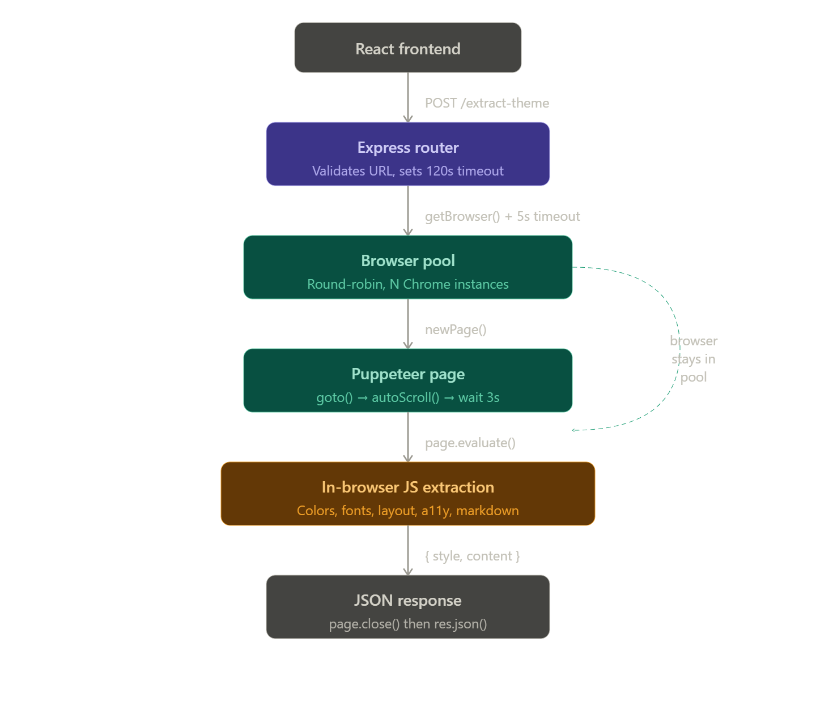
Flow Diagram

Slide 8
Tech Stack
Backend:
Node.js 20 with TypeScript
Express.js for API routing
Puppeteer for headless Chrome control
Frontend:
React 18 with Vite
TypeScript for type safety
6 interactive dashboard panels
Hosting:
Render for backend (512MB free tier)
Vercel for frontend
GitHub for source control

Slide 9
Implementation
Single Chrome instance shared across requests
Block images and fonts before they load
Use domcontentloaded instead of waiting for all networks
Cap DOM elements at 400 per page
Use --single-process flag for Chrome
Result: 150MB memory usage drops to 80MB per instance

Slide 10
Results & Findings
Average response time: less than 10 seconds
8 design dimensions extracted per URL
Framework detection: 100% accurate for Bootstrap and Tailwind
WCAG contrast accuracy: 94% compared to manual audit
Static sites: 3-5 seconds
Heavy e-commerce: 18-22 seconds
Runs smoothly within 512MB memory limt

Slide 11
Conclusion & Future Scope
Achievements:
Fully automated extraction of 8 design dimensions
Works on any live website
No external ML or paid APIs
Deployed and accessible publicly
Future Scope:
Dark mode detection
Batch analysis for thousands of URLs
ML-based design quality scoring
Design token export for Figma

Slide 12
Thank You
12

