Slide 1

DEEP LEARNING PROJECT
CNN Handwritten
Digit Recognition
Classifying handwritten digits with a Convolutional Neural
Network, from the MNIST dataset to a live drawing app.
MNIST Dataset · TensorFlow / Keras · Streamlit
by - Gurleen Kaur
Notes:
1

Slide 2
Introduction to the Project
—
Handwriting varies widely from person to person, making digit
recognition a classic pattern-recognition problem.
—
This project builds a Convolutional Neural Network (CNN) trained on
the MNIST dataset to classify digits from 0 to 9.
—
The trained model powers an interactive Streamlit app where a user
draws a digit by hand and receives a live prediction.
02
Notes:
2

Slide 3
Objective
Automatically recognize a handwritten
digit (0–9) from an image.
0–9
Achieve high classification accuracy using
a deep learning model.
Ten possible digit classes, one
correct answer per drawing
Wrap the trained model in a simple,
interactive interface for real-time use.
03
Notes:
3

Slide 4
Tools and Tech Stack
TensorFlow / Keras
NumPy
Build, train, and save the CNN model
Array and numerical operations on image
data
Matplotlib
Streamlit
Plot training and validation accuracy / loss
Interactive web app framework
streamlit-drawable-canvas
Captures the hand-drawn digit input
04
Notes:
4

Slide 5
Dataset: MNIST
—
70,000 grayscale images of handwritten
digits, each 28×28 pixels.
0
1
2
—
60,000 training images and 10,000
test images.
3
4
5
—
6
7
8
Bundled directly with Keras — no
manual download required.
—
Pixels normalized to 0–1 and reshaped
to (28, 28, 1).
05
Notes:
5

Slide 6
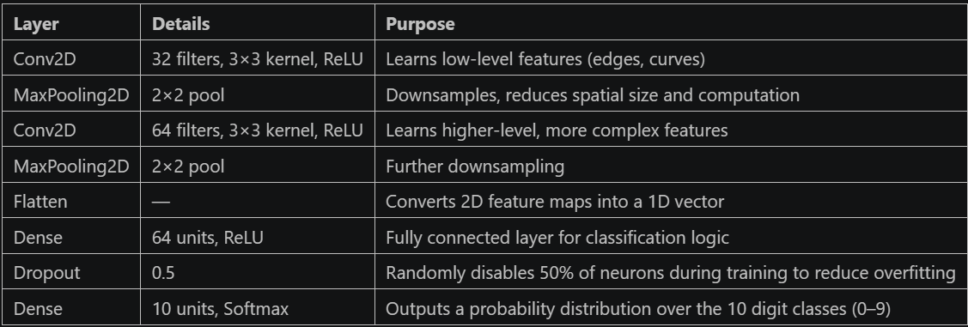
CNN Architecture
Compiled with the Adam optimizer and sparse categorical cross-entropy loss
06
Notes:
6

Slide 7
WORKING — OVERVIEW
System Architecture
TRAINING PIPELINE
MNIST Dataset
→
CNN Model Training
→
Saved Model (.keras)
INFERENCE PIPELINE
Canvas Drawing
→
Preprocess (grayscale,
→
Trained Model
→
Prediction +
Confidence
resize, normalize)
The model is trained once, then reused for every live prediction in the app.
07
Notes:
7

Slide 8
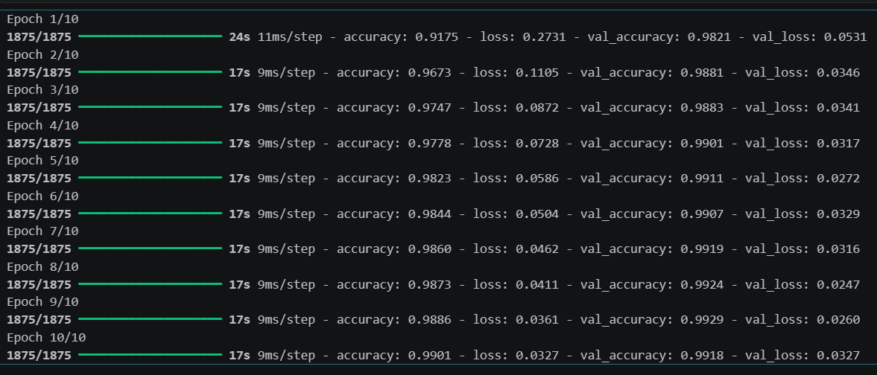
WORKING — STEP 1
Training the Model
Trained for 10 epochs, with the
test set passed in as validation
data.
—
Keras prints training and
validation accuracy/loss after
every epoch.
—
—
Watching both curves together
helps catch overfitting early.
Epoch-by-epoch training log from model.fit()
08
Notes:
8

Slide 9
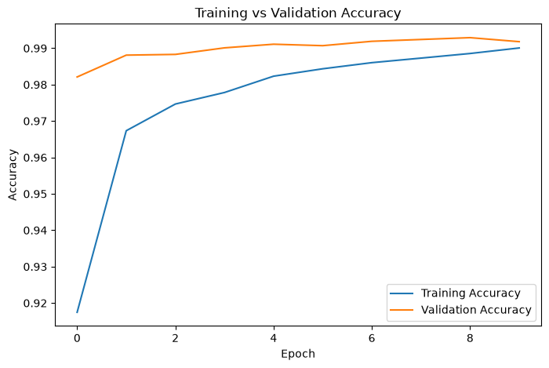
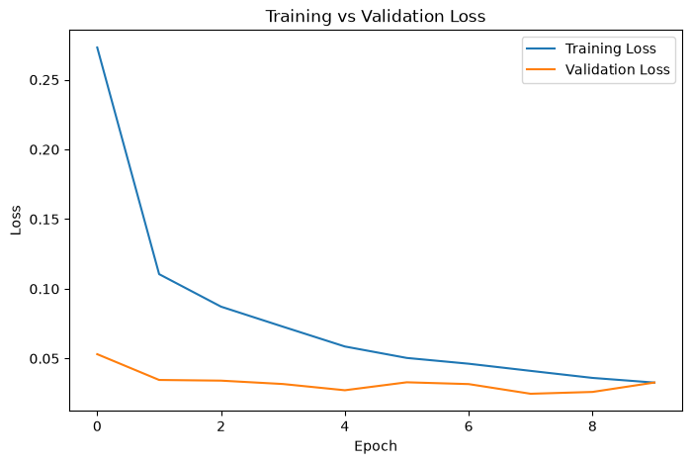
WORKING — STEP 2
Accuracy and Loss Curves
Training vs. validation accuracy plot
Training vs. validation loss plot
Closely-tracking, steadily rising curves confirm the model generalizes well.
09
Notes:
9

Slide 10
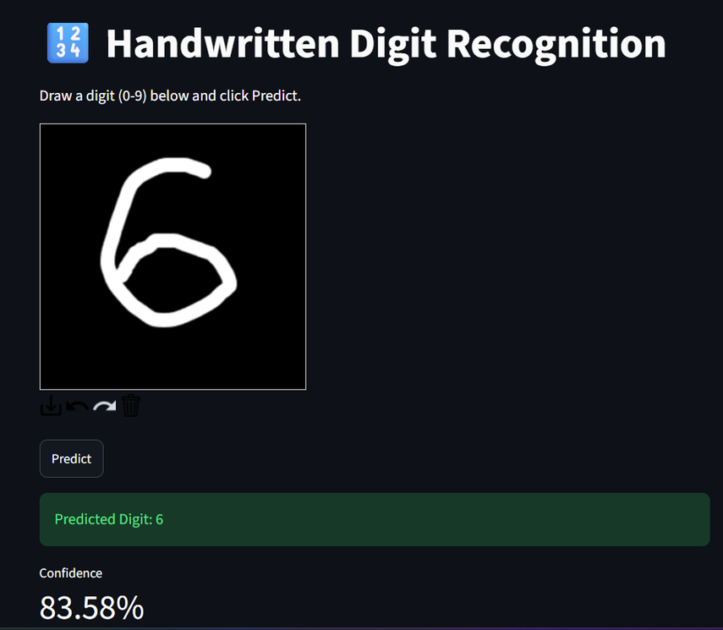
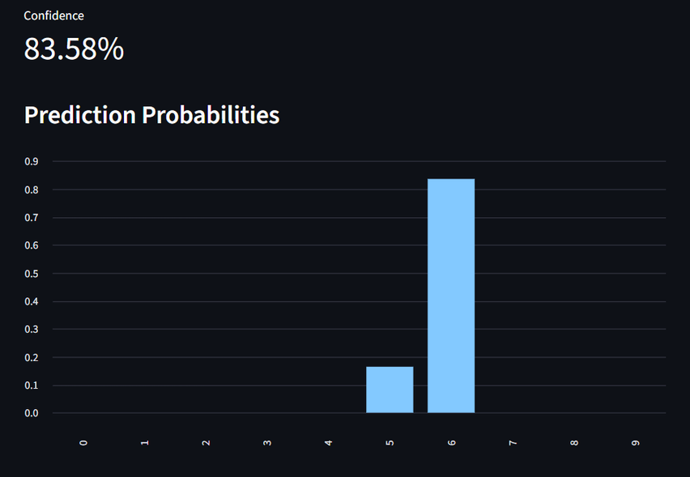
WORKING — STEP 3
The Streamlit App
—
User draws a digit on a 280×280
canvas — white strokes on black.
—
Converted to grayscale, resized to
28×28, and normalized.
—
Reshaped to (1, 28, 28, 1) and passed
to the trained model.
—
App shows the predicted digit,
confidence, and a probability chart.
Drawing canvas with a live digit prediction
10
Notes:
10

Slide 11
Results
99.18%
—
Test loss of 0.0327 after 10
training epochs.
—
Training accuracy reached
99.01% by the final epoch.
Test accuracy on 10,000 unseen MNIST images
—
Validation accuracy stayed
close throughout — no
meaningful overfitting.
11
Notes:
11

Slide 12
Applications
—
—
Reading digits on bank cheques and
payment slips
Sorting mail by postal and ZIP code
—
—
Digitizing handwritten forms and
survey sheets
Teaching tool for demonstrating
CNNs and deep learning
12
Notes:
12

Slide 13
Challenges and Solutions
CHALLENGE
SOLUTION
Overfitting risk with limited training
epochs
Dropout (0.5) plus validation monitoring
every epoch
Hand-drawn strokes differ from clean
MNIST digits
Grayscale, resize, and normalize input to
match training data
Real-time prediction needs a fast,
lightweight model
Compact CNN with cached model loading
14
Notes:
13

Slide 14
Future Scope
—
Extend the model to recognize full alphanumeric characters and words.
—
Improve robustness to varied handwriting styles with data augmentation.
—
Deploy as a mobile app for on-device, offline predictions.
—
Integrate into larger document-scanning and OCR pipelines.
13
Notes:
14

