Slide 1
CUSTOMER PERFORMANCE DASHBOARD

Slide 2
INTRODUCTION
This project focuses on creating a comprehensive Customer Performance Dashboard using Power BI. The dashboard provides insights into customer demographics, revenue segmentation, and profiling, drawing from a dataset that includes customers from various countries. Key metrics and visualizations help in understanding the customer base better and making data-driven business decisions.
Importance of Data Visualization in Decision-Making
Data visualization plays a critical role in modern business environments by transforming complex data sets into visual representations like charts, graphs, and dashboards. This approach aids in:
Improved Understanding: Makes it easier to comprehend large amounts of data quickly.
Better Communication: Visuals are effective in communicating insights to stakeholders.
Trend Identification: Helps in identifying patterns and trends that might not be obvious in raw data.
Faster Decisions: Visuals enable quicker data analysis, leading to timely decision-making.
Strategic Planning: Facilitates strategic planning based on actionable insights derived from data.

Slide 3
PURPOSE OF THE SYSTEM
Analyze and Visualize Customer Data -
The system aims to consolidate customer data and visualize it effectively. This involves transforming raw data into interactive and easy-to-understand visual formats.
Gain Insights into Customer Demographics, Behavior, and Revenue -
By analyzing various aspects of customer data, the system provides insights into customer demographics (age, gender, etc.), behavior (purchasing patterns), and revenue (income generated from different segments).
Support Data-Driven Decision-Making for Businesses -
The primary goal of the system is to support businesses in making informed decisions based on data. The insights gained from the dashboard enable businesses to tailor their strategies, improve customer engagement, and enhance overall performance.

Slide 4
SCOPE
The proposed system will cover the following aspects:
Customer Demographics: Analyze average customer age and total customer count.
Revenue Segmentation by Age Bracket: Visualize revenue distribution across different age groups.
Customer Profiling: Categorize customers into loyal, periodic buyers, and VIP customers.
Earnings Based on Gender: Compare earnings generated by male and female customers.
Identification of Top-Ranking Customers: Highlight key customers contributing significantly to revenue.

Slide 5
PROPOSED SYSTEM
Dynamic and Interactive Power BI Dashboard -
The proposed system is a dynamic and interactive dashboard created using Power BI. It allows users to interact with the data, apply filters, and explore various metrics.
Consolidation of Various Customer-Related Metrics -
The dashboard consolidates multiple customer-related metrics, providing a comprehensive view of customer performance. This includes demographic information, revenue segmentation, and profiling.
Filtering Options Based on Country and Other Criteria -
The system includes filtering options that allow users to view data based on specific criteria such as country, age group, and customer segment. This enhances the ability to analyze data from different perspectives.

Slide 6
FUNCTIONAL REQUIREMENTS
Integration of raw sales data from multiple sources into Power BI.
Visualization of sales metrics like total revenue, profit margin, and product performance.
Real-time interactivity and filtering options for users.
Drill-down capabilities for detailed analysis.

Slide 7
NON-FUNCTIONAL REQUIREMENTS
User-friendly and intuitive interface.
High performance with fast data loading and rendering.
Scalability to accommodate growing datasets.
Data security to protect sensitive business information.

Slide 8
HARDWARE AND SOFTWARE REQUIREMENTS
Hardware Requirements:
Processor: Intel i5 or above
RAM: 8 GB or more
Storage: Minimum 500 GB HDD or SSD
Software Requirements:
Power BI Desktop for dashboard creation.
Excel or csv for data storage.
Operating System: Windows 10 or above.

Slide 9
LIMITATION OF EXISTING SYSTEM​
Manual Data Entry and Analysis: Time-consuming and susceptible to human error.
Lack of Real-Time Data Updates: Inability to provide up-to-date insights for immediate decision-making.
Limited Data Visualization Capabilities: Basic reporting tools fail to capture and present data in an easily interpretable format.
Difficulty in Identifying Trends and Patterns: Manual analysis makes it challenging to quickly spot trends and patterns in customer data.

Slide 10
FUTURE SCOPE OF THE PROJECT
The system can be further enhanced by:
Incorporating predictive analytics using AI/ML models to forecast sales.
Adding mobile accessibility through Power BI mobile apps.
Expanding data sources to include market trends and competitor analysis.
Automating data refresh processes for real-time updates.
Providing customized reports for different user roles in the organization.

Slide 11
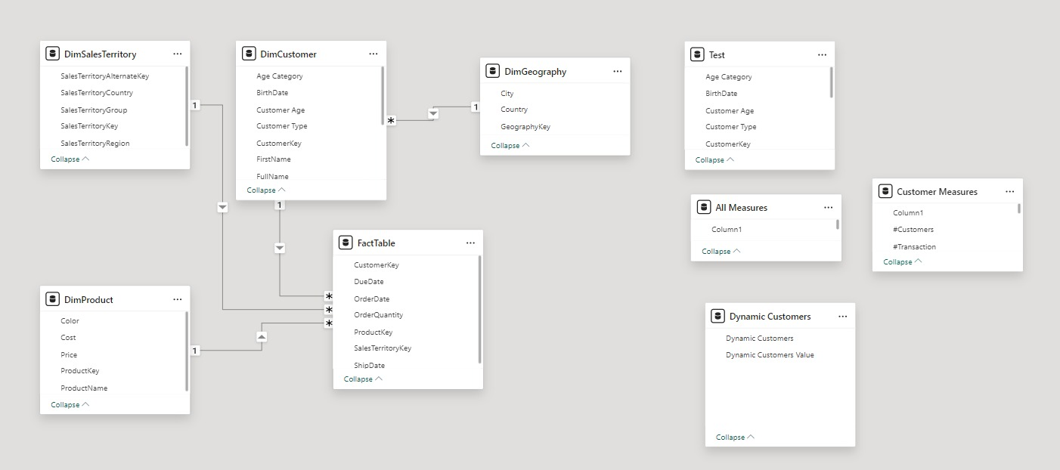
DIAGRAM Database Schema

Slide 12
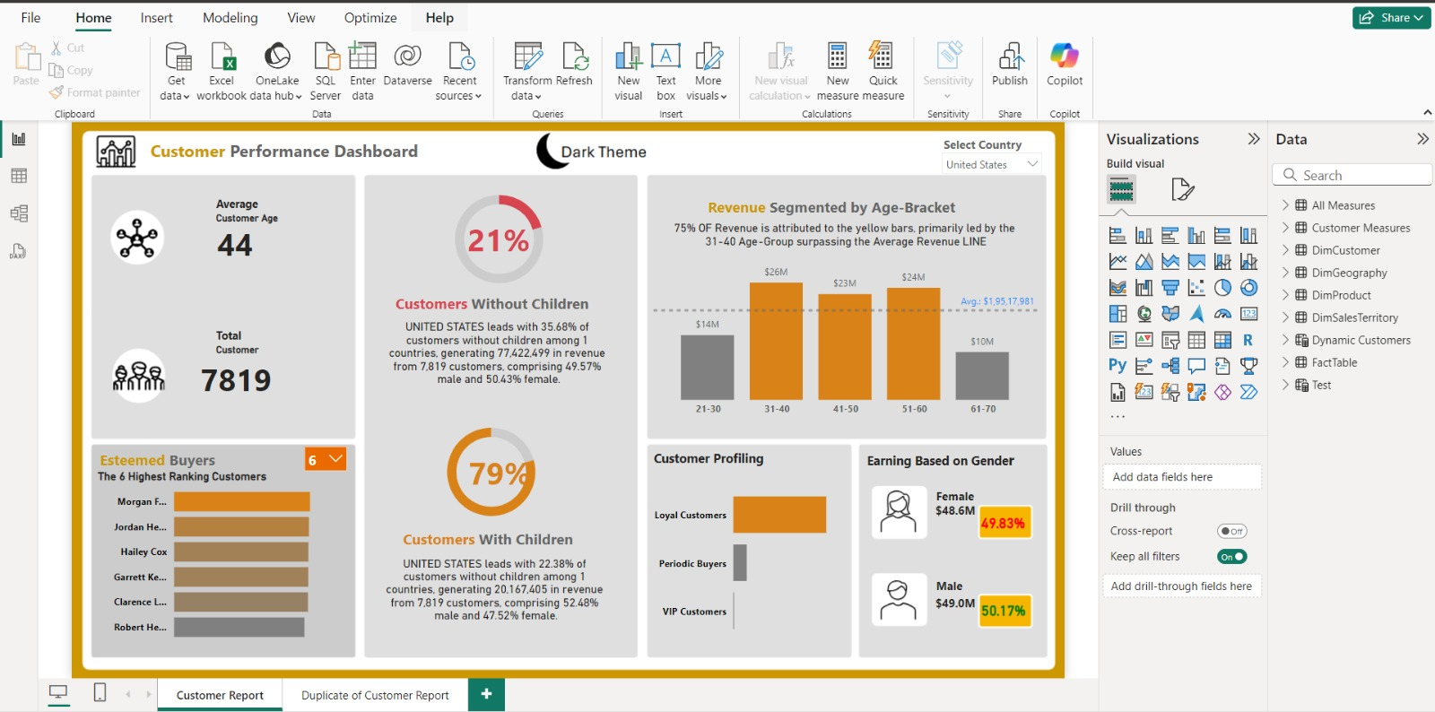
Input Screen

Slide 13
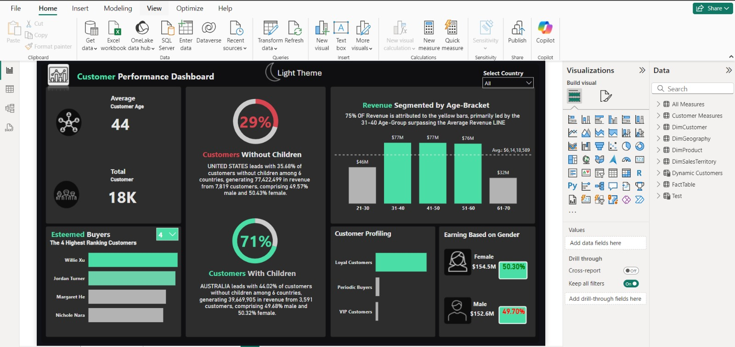

Slide 14
CONCLUSION
Enhanced Understanding: The dashboard effectively consolidates and visualizes key metrics such as average customer age, total customers, revenue segmentation by age, customer profiling, and earnings based on gender. This enhances the understanding of customer demographics and behavior.
Improved Decision-Making: The insights derived from the dashboard support data-driven decision-making, allowing businesses to tailor their strategies and improve customer engagement.
Efficiency and Usability: The system's dynamic and interactive nature, combined with user-friendly filtering options and interactive visuals, ensures that users can efficiently navigate and analyze data.
Future Potential: The project also highlights potential future enhancements such as integration with CRM and ERP systems, advanced analytics with machine learning, mobile accessibility, and more advanced visualizations.

