Slide 1
WIP
OPM Legacy
OPM NPI
OPM
Planning
Production Readiness
Product Cost
CORE, QMS & Transformation
GCR
Partnership
Cross-functional program leadership, stakeholder engagement & customer reporting
Operations business processes​ expertise (delivery focus)
Priority & Risk Management​ (operational)
Cost Structure & Control ​
Cross-functional program leadership, stakeholder engagement & customer reporting
Operations business processes​ knowledge (program lifecycle & delivery focus)
Priority & Risk Management​ (operational)
Program Cost Structure, Control & optimization
Program Lifecycle management (RLPM)
Engineering Integration & Technology Leadership (IPT based)
Budget management
Program / Project coordination
Customer Focus​(internal)
Operations business processes​ expertise
Collaborative cross-functional leadership & Stakeholder reporting alignment
Product Configuration Knowledge​
Process, Compliance & Documentation Control​
Budget Ownership & Financial Accountability​
Ownership & Governance of Production Readiness Process
Proficiency in MRL Processes & Tools
Understanding of operational & engineering practices
Cost-Conscious Decision Making
Priority & Risk Management (operational)
RLPM Expertise
Cross functional proficiency in interfacing departments Procedures & Policies
Cross functional project/ program industrialization (MRL) coordination & leadership
Digital Fluency in Process & Tools
Process, Compliance & Documentation Control​
Cost Structure & Control​
Budget Ownership and Financial Accountability
CORE proficiency
QMS, Regulatory Compliance & Industry Standards
Processes, Documentation & Records practices
Project Management​
DT strategy & implementation
Change Management, Training & Capability Building
Chemical Knowledge​
Chemical Regulatory Compliance & Risk Assessment​
Digital Tools for Chemical Compliance​
Manufacturing and Production Readiness Governance for Partners
Quality (QAP / QMS) governance for Partners
Modules configuration knowledge for delivery requirements
​*Common Disciplines across groups
Project Management
Priority & Risk Management
Communication, Presentation skills, stakeholders & executive reporting
RLPM (RTX Lifecycle Program Management) expertise
Export Classification: No Technical Data
Notes:
New proposed disciplines
Production Readiness Process IMP 07-01-01; how we integrate Procedures Knowledge, we have 20 primary + 19 supporting procedures
-Priority & Risk Management – Data driven Decision making for Risk Identification & Mitigation Planning for industrialization initiatives
General Process, Compliance & Documentation Control- How we make it specific to teams ?
OPM All - Digital Fluency in Process & Tools (SAP, PLM, etc.) - reword with deliverable sense
Continuous Improvement (CORE Proficiency)
Conflict Resolution & Influential skills
Collaboration & Networking
Operations business processes knowledge
Execution & Delivery Focus
Active Listening & Feedback
Conflict Resolution & Influential Skills

Slide 2
OPO Roles Profile
OPM Legacy
OPM NPI
OPM Planning
Production Readiness
Program operations risk management leadership enterprise wide
Well established network, knowledge of Program Management processes, R&R, and overall Operations
System thinker & Operations liaison with customer, engineering, marketing, aftermarket, and Ops Business Units
Ability to adequately support PMMT, PMT structure; coach for new OPEs
Great communicator, “boardroom ready”; experience in management 10-15 years
Extensive operational knowledge (SM, manufacturing, engine center, engineering)
Monitor and report BOM changes and approval flows + procurement activities involving RFQ and material shortages impacting engine deliveries
Place production and engineering demand + manage priority at receiving and inspection to clear material and reduce engine delivery impact
Create and monitor procurement requests
Support status tracking and follow-up of material at inspection due to QN + material with rework or modification until job order completion​
Technical acumen + analytic skills
Problem solving mindset + CORE toolbox
Action oriented + production risk management expert
Extensive manufacturing experience and engineering knowledge
10+ years Business Unit manufacturing / SM experience
Ability to effectively mobilize Program community to industrialize product
Product FSC
Partnership
Global Chemical Regulation
Process & Compliance
Ability to connect BU-level cost drivers to program-level
Sourcing / Financial exposure acumen
Ability to conduct benchmarking across Business Units, entities, and companies
Structured approach for aligning between SM, Ops, Engineering, and Finance
Engineering / Operations background
Strong product experience (parts / processes)
Ability to assess any operational gap of the partner plan based on the agreed terms and conditions of the CA
Ability to negotiate + partner/PWC requirements + partnership office/partner, so that program milestones are met on time
Be able to assess any quality gap of the partner plan based on the agreed terms and conditions
of the Quality plan
Technical competency in chemical families, design of experiments, analysis of results
Apply CMP process and other relevant regulations (PCTSR, etc.)
Apply REACH process (Candidate list, Authorizations, Restrictions, etc.) and other relevant regulations and databases (CLP, POPs, SCIP, etc.) to US, EU and Emerging countries
Material, specifications, legislations, SFI parts & suppliers
Approve new chemical products in the EMOC module
Establish, implement, and oversee quality system frameworks to ensure consistency and effectiveness
Promote operational discipline health management, process optimization, and regulatory compliance
Lead CORE & transformation initiatives by developing dashboards, leveraging data & driving process digitization
Implement and deliver training programs and develop technical skill matrix aligned with gap analysis
Provide accurate cost assessments through structured should-cost analysis

Slide 3
OPO Disciplines - Production Readiness
Vision
Transform Production Readiness from a data/process management centric to an “Industrialization Performance & Standards” team, in a structured push mode, to provide predictive Industrialization analytics supporting emerging program risks and building lessons learned to guide trade-off decisions on Advanced Industrialization readiness for future programs
End State Transformation
Drive PW MRL methodology harmonization within RLPM lifecycle management.
Achieve MRL integrity/maturity through unified real-time program dashboards structured in “push system” data.
Develop predictive industrialization analytics that catalogue lessons learned to influence future design trade-off decisions.
Create & manage an Ops “Cardinal Rules” library + grow enterprise MRL proficiency & adoption.
Centralize Industrialization governance under OPM responsibility “one voice” support by standards team.
Expand MRL methodology to engine assembly and critical legacy CO’s.
Drive PR Earned Value and MRL maturity to achieve a flawless Entry Into Production (EIP)

Slide 4
OPO Disciplines - Partnerships
Current State Activities
PWC Production Readiness Process deployment
Quality and Operations support
On time and flawless communication
Internal & external customer support
5 Major Partnership Agreements
Avio Aero
ITP Aero
MTU
Hanwha
Kawasaki
End State Transformation
Organizational Structure
Legacy Program Involvement
Quality Mandate Alignment
RLPM Alignment
Digital Tool
Process Adjustment Burn-down
Ensure production readiness by developing a partner relationship and core competences

Slide 5
OPO Disciplines - Product FSC
Current State Activities
Investment Audit / CBN
Factory Standard Cost
PW800, Elevate
Citadelle & Aspen
MMP501
RLPM
General Update
Estimates
Manual estimates
Should-cost estimates
Long Lead-Times & Inefficiencies
SME based
New designs/parts with no costs
Limited should-cost options
End State Transformation
ABC Tool
Phase 1
Phase 2
Phase 3 (TBC)
Parametric
Tubes, Gears,
Forgings & Castings
Database & Library
aPriori
New Tech MOS
Proof of Concept
Data-base P&WC
Dashboard / PowerBI
Selection
Stakeholders Review
Go-Live
Competitive Advantage
Fastest turn-around times
Best cost accuracy
Advanced cost knowledge
Cost Tools adaptability to RLPM Maturity Level & grow P&WC competitive advantage

Slide 6

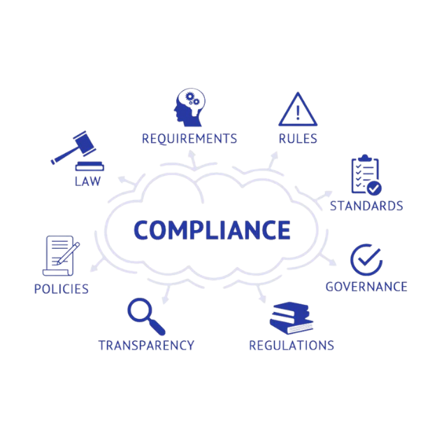
OPO Disciplines - Global Chemical Regulation
Monitor
Assess
Advocate
Chemical Substances Risk Management
Chemical
& Product Regulations
Product & Substance Data
Technology Substitution
Compliant
Business
Processes
Advocacy
Authorization
Scientific & Political Community
Sourcing Controls & Requirements
Environment, Health & Safety
Interpretation & Impact Assessment
Customer Requirements
Design
Proposed & Final Requirements
Ensure no business disruption due to global chemical regulation whilst being compliant

Slide 7
OPO Disciplines - CORE & Transformation
Quality Management System
Process Optimization, Audits & Governance, Regulatory Compliance, Risk & Controls, Monitoring & Auditing
Digital Data
DT Projects Management (digital transformation & digitization), Data (dashboards, reports, governance)
Training & TSD
Training & Development (content & platforms), Skills Matrix (competencies vs requirements)
CORE & Continuous Improvement
CORE Maturity & Alignment, CORE Engagement Events & Initiatives, Best Practices Benchmarking
Cross-Functional Support
& Ad-Hoc
Process vs Business Objectives
Should Cost
Component Should Cost Estimates (mfg value)
PO Management
Mobile Repair Team OEM Support (PWES, MTU, etc.), POs
Discipline Health Management Drives Transformation

