Slide 1

Feature-Based Vehicle Popularity Analysis
THE DATA PIT CREW
Gurleen kaur
Jashraj vashisht
Navanjot singh
Mankaran singh
Tanish dhawan

Slide 2

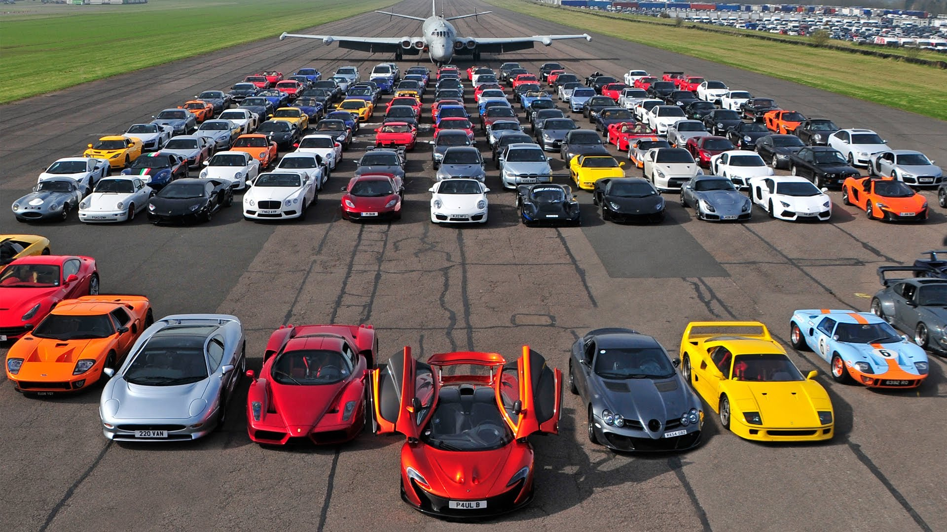
Problem
Key Question:
How can we predict the popularity of vehicles based on their features?
Why is this important?
Helps dealers understand which vehicles are likely to sell faster.
Enables better inventory management and targeted marketing.
Provides insights into customer preferences based on vehicle features.

Slide 3
Dataset Overview
Dataset Source: CBB Listings Dataset
Size: 145,114 rows, 46 columns
Key Features Used:
Numerical Features: price, mileage, model_year, days_on_market
Categorical Features: make, model, stock_type, exterior_color_catrgory,
interior_color_caategory
Target Variable:
Popularity: Defined by days_on_market (lower days = more popular).
Tasks we did:
Handling Missing Values:
Handling Zero Values:
Outlier Removal:
Feature Engineering:

Slide 4
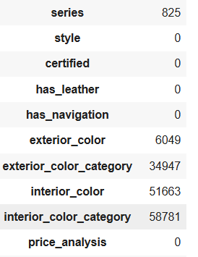
EDA ON dataset
Handling missing values:
Missing values checked by using : df.isnull().sum()
Output :
To handle missing values, we mainly used mode and mean imputation.

Slide 5
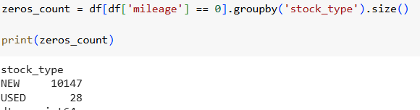
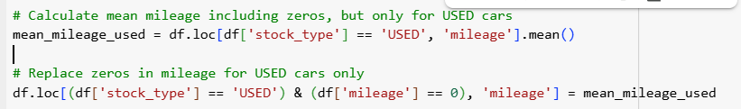
EDA CONTINUED
Handling Zero Values:
Based on stock type we handled zeros in mileage column.
For price and wheelbase_from_vin also checked
Replaced zero values in mileage and wheelbase_from_vin by mean and price with the median. By using :

Slide 6
Exploratory Data Analysis (EDA) CONT.
Key Insights:
Price Distribution: Most vehicles are priced between $20,000 and $60,000.
Mileage Distribution: Used vehicles have higher mileage compared to new vehicles.
Model Year: Most vehicles are from 2020-2024.
Stock Type: Majority of listings are for used vehicles.
Visualizations:
Boxplots for price and mileage before and after outlier handling.
Histograms for price, mileage, and model_year.
Bar charts for make and model distribution.

Slide 7
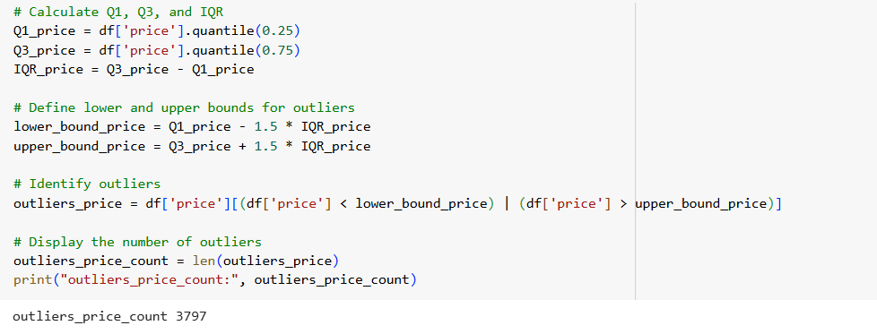
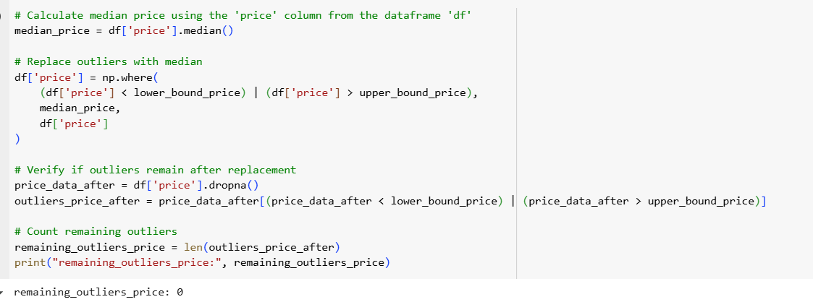
OutlIerS Detection and Handling
Checking outliers in price columns, code will count the outliers which are 3797
Capping outliers by using IQR METHOD

Slide 8
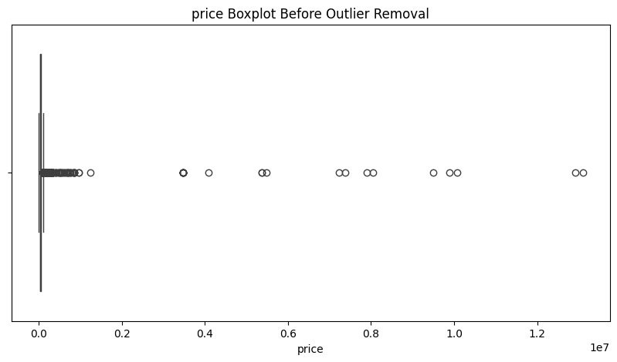
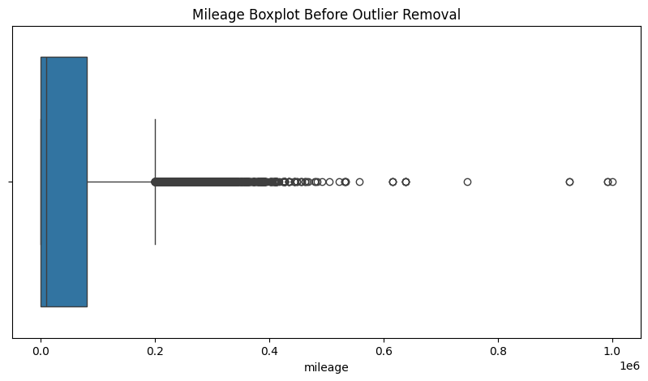
Box plots for outlier handling
Before capping outliers graphs look like above .
Number of Outliers In price column: 3797
Number of Outliers In mileage column: 4060

Slide 9
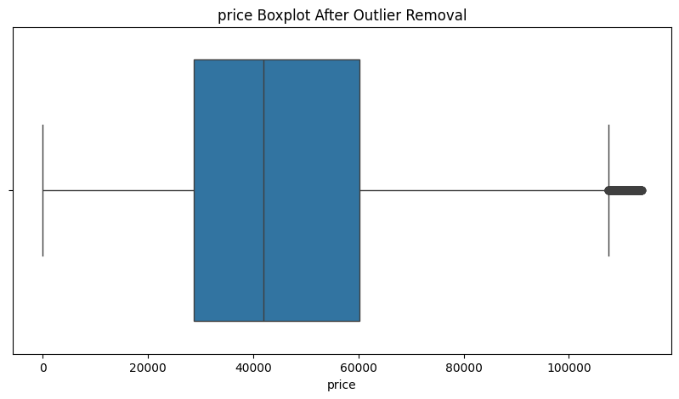
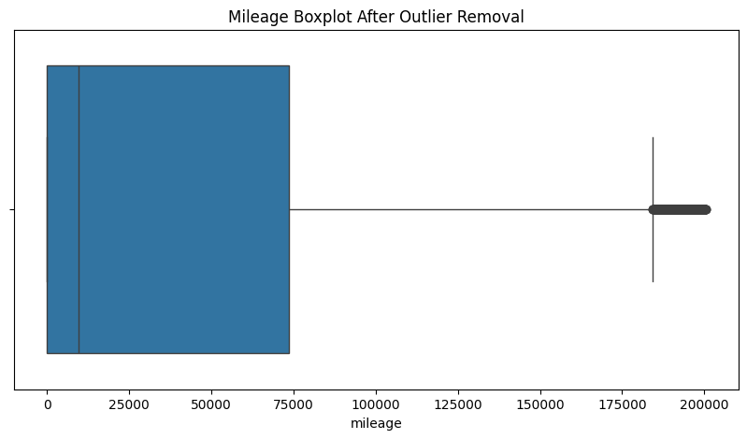
Boxplots of price and mileage after capping outliers

Slide 10
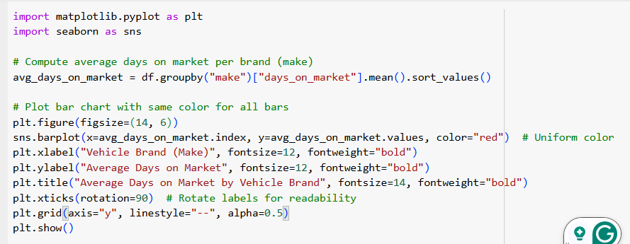
CODE OR SYNTIX EXAMPLE FOR VISUALS

Slide 11
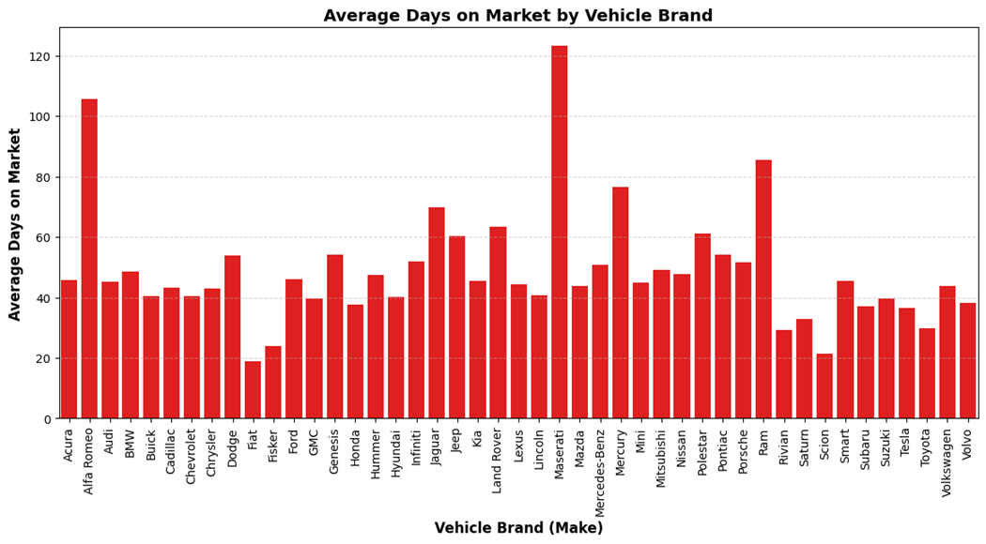
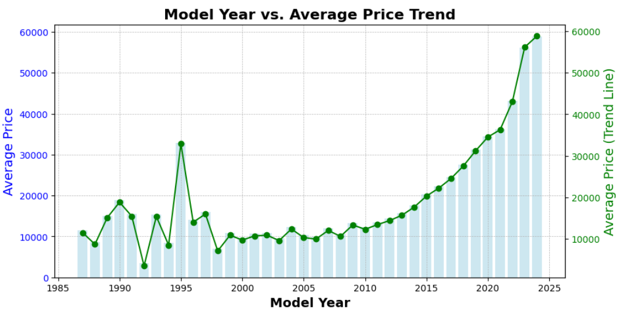
Visuals based on main featuers

Slide 12
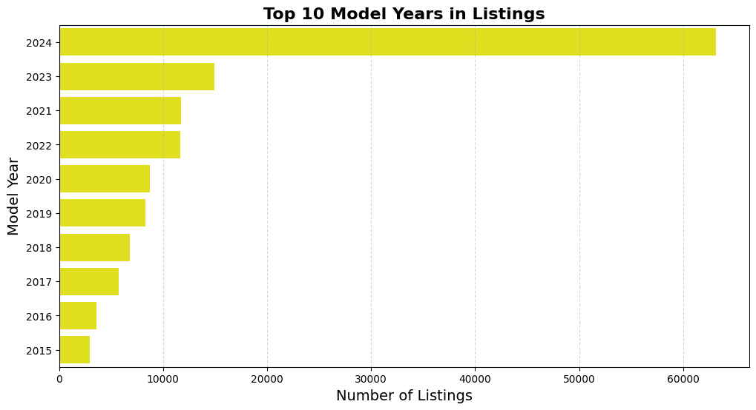
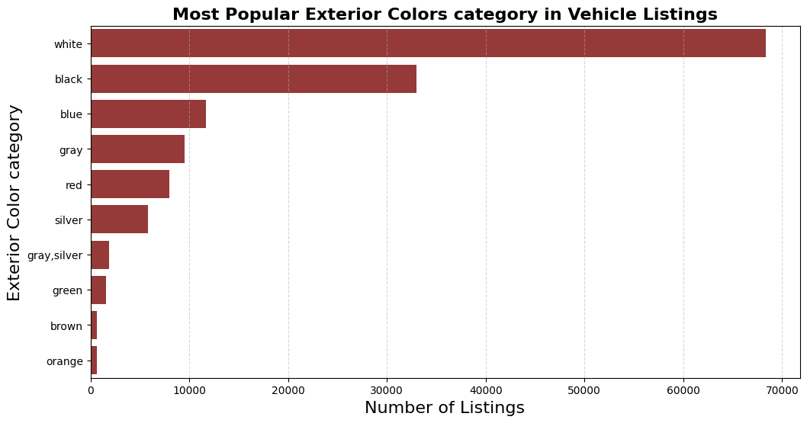
Visuals based on main features

Slide 13
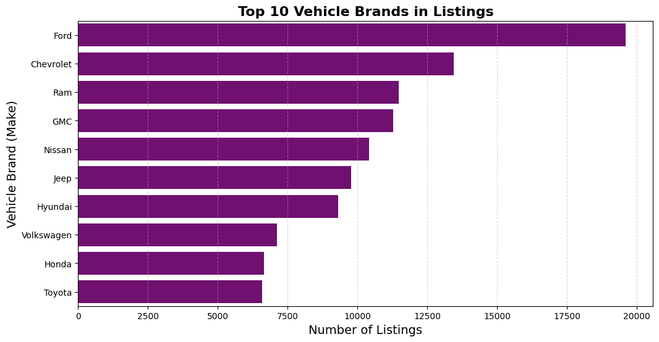
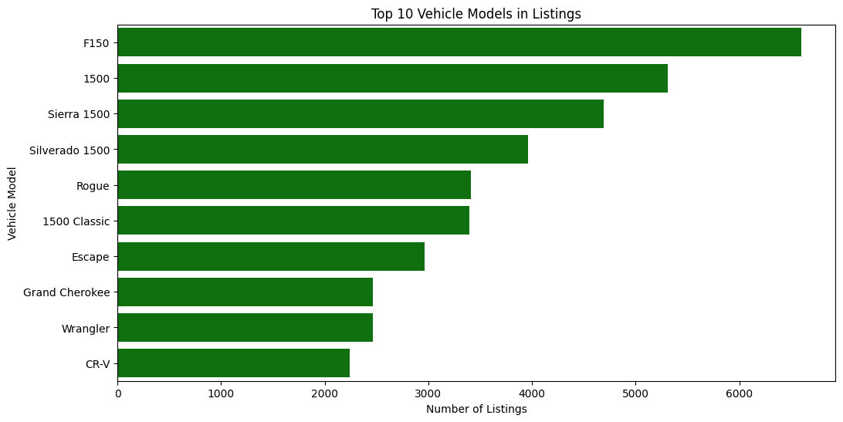
Visuals based on main features

Slide 14
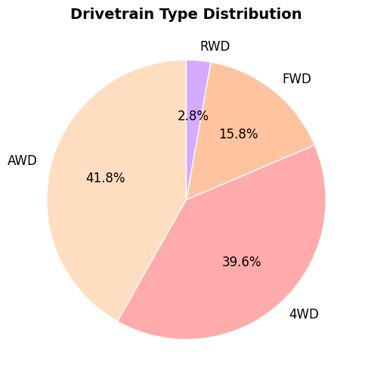
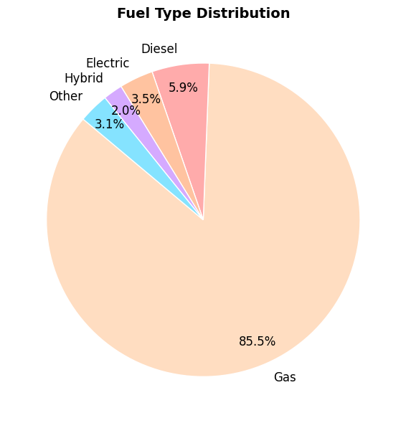
Visuals based on main featuers

Slide 15
EN-CODING AND SAVING NEW CSV FILE
One-Hot Encoding:stock_type (New vs. Used)
Label Encoding:make, model, style, drivetrain_from_vin, fuel_type_from_vin, etc.
Saving the Processed DataFinal Dataset: Encoded and cleanedSaved as CSV: encoded_vehicle_data.csv

Slide 16

Conclusion and next steps
Key Learnings:
Successfully preprocessed vehicle data for clustering.
Identified significant trends in pricing, mileage, and vehicle type.
Next Steps:
Implement clustering algorithms to segment vehicles.
Analyze which clusters result in faster sales and higher demand.

Slide 17
Thank you

