Slide 1

INVERTIS UNIVERSITY
TITANIC
SURVIVAL PREDICTION
A simple machine learning project using passenger records
COLLEGE PROJECT • B.TECH CSE
Student: [Name / ID]
Mentor: [Name]
[Section] • [Date]
Notes:
Introduce this as a college machine learning project. The ship image is generated artwork, not a historical photograph. Fill in the student, mentor, section, and date details before presenting.

Slide 2
01 • PROJECT GOAL
What does this project do?
It learns from old passenger records and estimates the recorded survival outcome.
THE QUESTION
1
Passenger details
Age • sex • ticket class
Can passenger details help a model estimate who survived?
2
Machine learning
Finds patterns in examples
The model gives an estimate, not a guarantee.
3
Website
Shows a survival estimate
Goal
Data
Patterns
ML
Results
Website
Takeaway
Notes:
Explain the goal in everyday words: the computer learns patterns from examples where the outcome is already known. It then estimates an outcome for a set of passenger details. It cannot know what would have happened to a real person.

Slide 3
02 • THE DATA
The project starts with 891 passenger records
Each row describes one passenger. “Survived” is the answer the model learns to estimate.
891
342
549
PASSENGERS
SURVIVED
DID NOT SURVIVE
One row per person
About 38 in every 100
About 62 in every 100
DETAILS IN THE FILE
Passenger class
Sex
Age
Family
Fare & port
1st / 2nd / 3rd
Female / male
Some values missing
Parents, children, siblings
Ticket fare and port
Some information is missing, so the data preparation step fills in reasonable values.
Goal
Data
Patterns
ML
Results
Website
Takeaway
Notes:
The included Titanic.csv has 891 records: 342 survived and 549 did not. The target column is Survived. Useful inputs include ticket class, sex, age, family size, fare, and port. Age is missing for 177 people. The model pipeline fills in missing values during prediction.

Slide 4
03 • WHAT WE NOTICED
Survival rates were different across groups
These are patterns in this dataset. They do not prove that one detail caused the outcome.
BY SEX
BY TICKET CLASS
Women
74.2%
1st class
63%
2nd class
47%
Men
18.9%
3rd class
24%
Women: 233 of 314 • Men: 109 of 577
The chart shows the share who survived in each group.
Goal
Data
Patterns
ML
Results
Website
Takeaway
Notes:
In this dataset, 74.2% of women and 18.9% of men survived. By ticket class, the rates were about 63% in first class, 47% in second, and 24% in third. Explain that these are descriptive comparisons; they do not prove why outcomes differed.

Slide 5
04 • HOW THE MODEL LEARNS
Four steps turn the CSV into a prediction
The notebook prepares the data, trains models, checks performance, and saves the selected pipeline.
1
2
3
4
Prepare
→
Learn
→
Check
→
Use
Fill missing values and turn categories into numbers.
Train models using passenger records and outcomes.
Test on records the model did not learn from.
Save the pipeline and connect it to the website.
A family-size feature combines the number of parents/children and siblings/spouses.
Goal
Data
Patterns
ML
Results
Website
Takeaway
Notes:
Walk through each step simply. We prepare the fields, train candidate models on part of the data, check predictions on a held-out set, and save a complete pipeline for the website. A family-size field is calculated from the family columns.

Slide 6
05 • MODEL RESULTS
The model got about 8 out of 10 test records right
This score comes from a held-out validation set of 179 passengers.
79.9%
43 of 69
26
ACCURACY
SURVIVORS FOUND
SURVIVORS MISSED
143 of 179 predictions were correct
The model found about 6 in 10 survivors
These are called false negatives
WHAT THIS MEANS
The estimate can be useful for a class demo, but it can be wrong.
A simple majority guess got 61.5% accuracy, so the model improved on that baseline.
Goal
Data
Patterns
ML
Results
Website
Takeaway
Notes:
On 179 held-out records, the chosen Random Forest correctly classified 143, giving 79.9% accuracy. It identified 43 of 69 survivors and missed 26. The majority-class baseline reached 61.5% accuracy. These results describe this split and do not guarantee future performance.

Slide 7
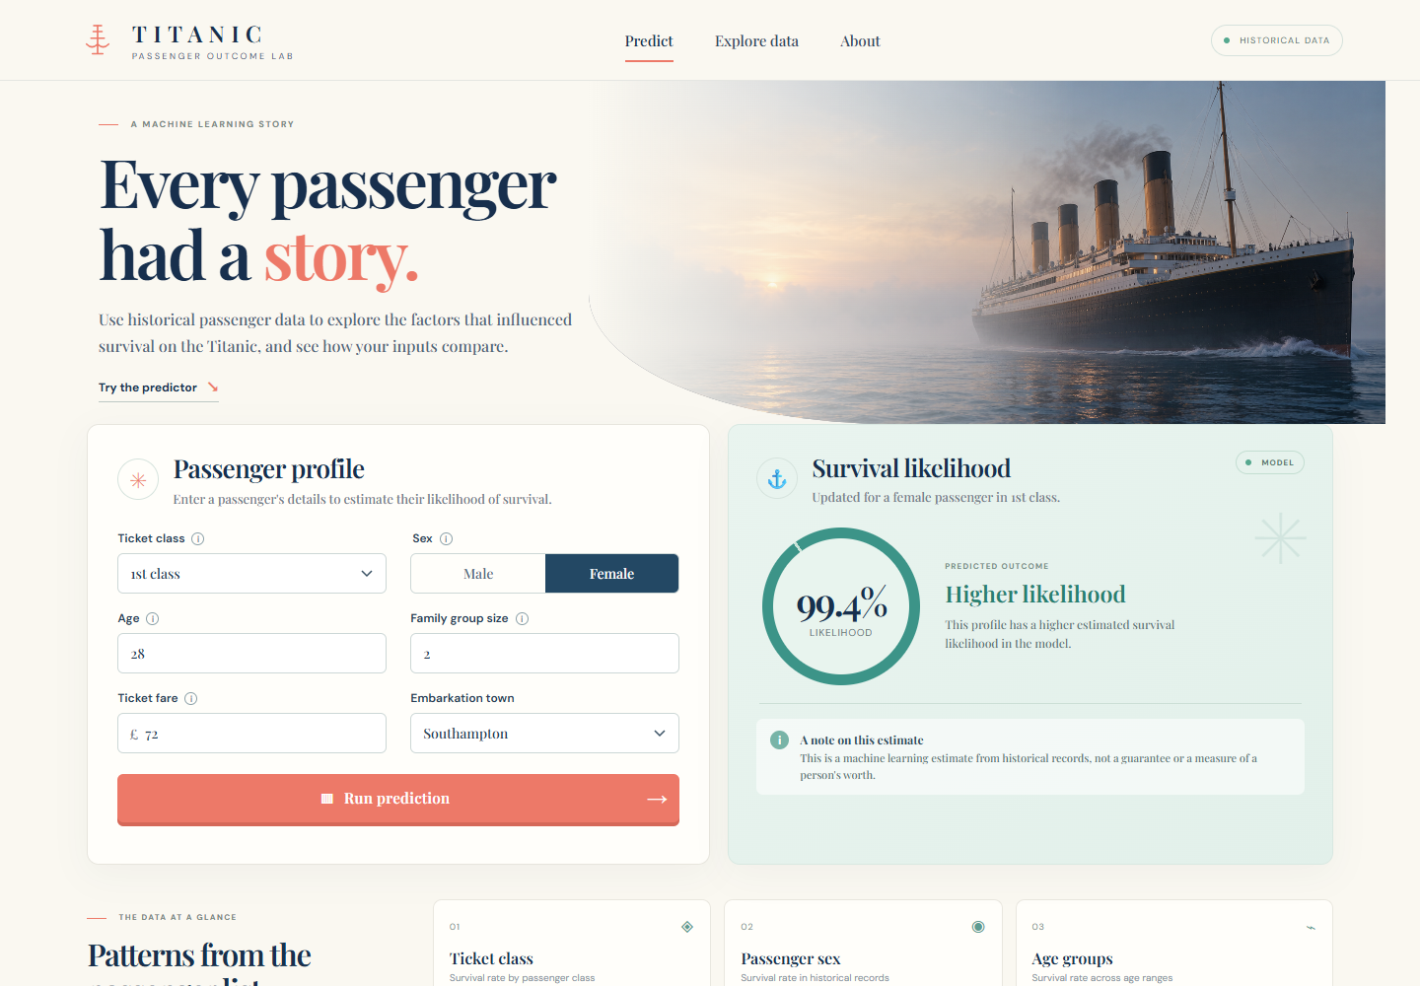
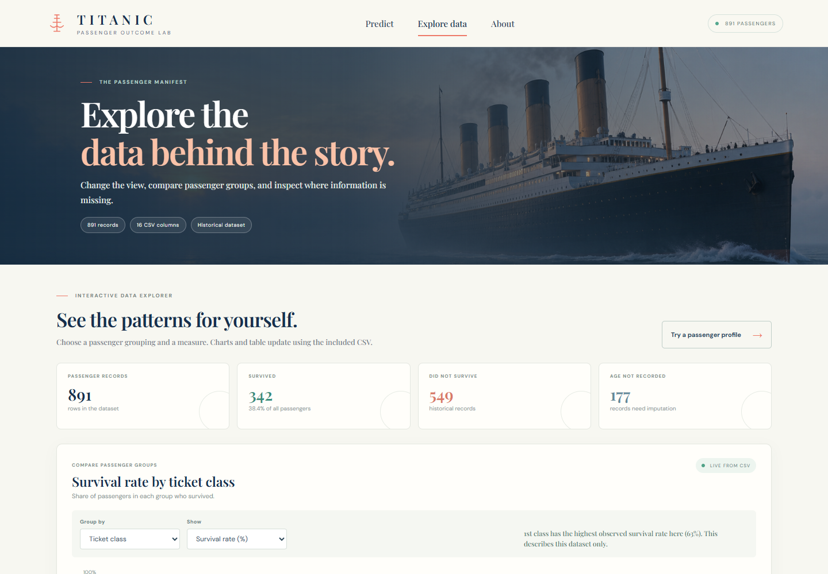
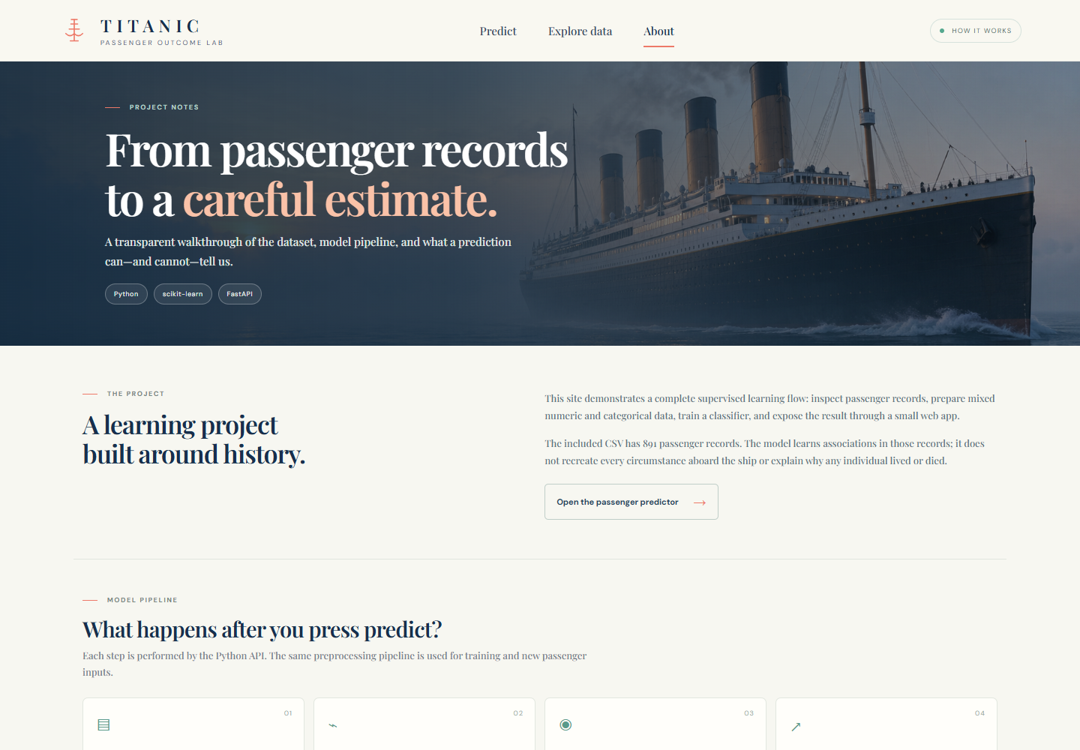
06 • THE WEBSITE
A website makes the project easy to try
Enter passenger details, explore the dataset, or read how the model works.
PREDICT
EXPLORE DATA
ABOUT
Built with Python • FastAPI • scikit-learn • HTML • CSS • JavaScript
Open local demo ↗
The link works when the project website is running on your computer.
Goal
Data
Patterns
ML
Results
Website
Takeaway
Notes:
Show the three website pages. Predict accepts passenger details. Explore Data shows dataset patterns. About explains the project. The clickable demo link opens localhost, so the FastAPI app must be running on the presenter’s computer at port 8000.

Slide 8
07 • TAKEAWAY
A complete beginner machine learning project
We explored data, trained and checked a model, then connected it to a website.
REMEMBER
BEFORE PRESENTING
This model gives an estimate based on historical passenger records.
Add student and mentor details
Run the website for the live demo
Cite the dataset source in the report
It cannot explain every individual outcome.
Project files: Titanic.csv • Titanic_Survival_Analysis.ipynb • app.py
Goal
Data
Patterns
ML
Results
Website
Takeaway
Notes:
Summarize the end-to-end project. The model offers an estimate based on historical records, not certainty. Remind the presenter to fill in names, run the web app, and confirm/cite the original dataset source.

