Slide 1



DESCRIBE → SEARCH → CONFIRM → RE-IDENTIFY → TRACE
Multi-Attribute Vehicle Re-Identification System
Gurneet Kaur Bhuller | Group 21
Pattern Recognition Systems · Final Presentation
Notes:
Hello, I'm Gurneet Kaur Bhuller from Group 21. This is V-Trace, a multi-attribute vehicle re-identification system. In the next twelve minutes I'll recap the problem, explain how V-Trace works, show how I evaluated it on the VeRi-776 benchmark and on multi-camera demo footage, share what I learned, and then demonstrate the app.

Slide 2
The Problem
A plate is powerful evidence — but CCTV does not always give us a readable plate.
01
02
03
CLEAR PLATE
PARTIAL PLATE
NO PLATE
Strong identifier
Useful, but not enough alone
Only appearance remains: colour · type · shape · cues
100.0% plate-only mAP
30.2% plate-only mAP
3.6% plate-only mAP
Objective
Search and re-identify a target vehicle across multiple camera recordings using all available visual evidence.
V-Trace ranks potential matches for human review — it does not claim definitive forensic identity.
2
Notes:
Quick recap of the problem. A licence plate is the strongest single clue, but CCTV often can't read it: too small, blurred, occluded or facing away. On the VeRi-776 benchmark a plate-only search is perfect with clear plates, drops to 30 percent mean average precision with partial plates, and to 3.6 percent when the plate is hidden. Investigators also start from a partial description, not a clean image. So the objective stays the same as in my proposal: search and re-identify a vehicle using all available evidence, with a human in the loop.

Slide 3
How the User Uses V-Trace
The user starts with what they know — and confirms each step, from the first match to the full route.
1 UPLOAD
2 DESCRIBE
3 SEARCH
4 CONFIRM
5 RE-IDENTIFY
6 TRACE
Camera A.mp4
Camera B.mp4
Camera C.mp4
(demo cameras preloaded)
Red sedan
Plate: SGX12??
Roof rack
#1 camA · 0:41
#2 camA · 0:01
#3 camC · 0:03
User selects the most plausible candidate
Ranked sightings in other videos + frames + timestamps
Route camA → camB → camC, confirmed per camera
DESCRIPTION-TO-VEHICLE RETRIEVAL
VEHICLE-TO-VEHICLE Re-ID + ROUTE
3
Notes:
This is the workflow, as in the proposal, now with a sixth step. Upload the camera videos; the demo cameras are preloaded. Describe the vehicle with whatever is known. Stage one ranks every tracked vehicle. The user confirms the right candidate, which becomes the visual query. Stage two re-identifies it in the other cameras. And the new trace step suggests the route and lets the user confirm the sighting in each camera with one click.

Slide 4
System Design
Raw videos become searchable vehicle tracks, then ranked sightings and a confirmed route.
VIDEOS
DETECT + TRACK
REPRESENT
INDEX + SEARCH
CONFIRM
Re-ID + FUSION
TRACE ROUTE
Uploaded camera footage
(one video = one camera)
YOLO11n + ByteTrack
→ tracklets
ResNet-50 · CLIP
learned metric (LDA)
colour · type · plate
User description
→ ranked candidates
Selected candidate becomes the visual query
11 evidence features
fusion / Random Forest
Top-3 per camera
confirmed hop by hop
Tracklet = observations of one tracked vehicle while it is visible in one video
Streamlit app: Search page (find → route → where else) · Analysis page (benchmark · SOM · tracking check)
4
Notes:
Here is the system as built. Each uploaded video is one camera. YOLO11 detects vehicles and ByteTrack links them into tracks; each track becomes a tracklet with four good crops and an evidence frame. From the crops V-Trace computes its descriptors, including a learned re-identification metric. The user's description is matched in stage one; after confirmation, stage two compares the confirmed vehicle with every tracklet in the other cameras using an eleven-feature evidence vector, and the route view links the sightings across cameras. Everything runs in a Streamlit app with an admin sign-in.

Slide 5
Vehicle Representation
Every tracklet gets several complementary descriptors — no single cue is required.
01
02
03
LEARNED Re-ID METRIC
APPEARANCE
COLOUR & TYPE
PCA + LDA on [ResNet | CLIP], trained on VeRi vehicle identities — the main Re-ID cue
ResNet-50 (2048-d) + CLIP ViT-B/32 (512-d) embeddings, averaged over 4 crops
Supervised linear probe on CLIP (10 colours · 9 types); zero-shot fallback
04
05
06
HSV HISTOGRAM
LICENCE PLATE
DISTINCTIVE CUES
16×4×4 hand-crafted colour histogram of the vehicle centre
EasyOCR on the largest crops; wildcard (?) Levenshtein matching
CLIP text–image score: roof rack · spoiler · dent · decal · roof cargo
5
Notes:
Each tracklet gets several descriptors. ResNet-50 and CLIP embeddings describe its appearance, and a projection learned from VeRi vehicle identities with linear discriminant analysis turns them into the main re-identification cue: it keeps what separates two cars and suppresses viewpoint and lighting. Colour and type come from a supervised probe on CLIP; an HSV histogram is a hand-crafted colour cue; EasyOCR reads plates only when confident, with question marks as wildcards; and CLIP scores distinctive cues such as a roof rack or decal.

Slide 6
Re-Identification & Route Tracing
Pairwise evidence is fused into one score; the route is suggested, then confirmed camera by camera.
EVIDENCE VECTOR (11 FEATURES)
ROUTE TRACING
learned-metric cosine
ResNet cosine
camA
far · small
camB
mid
camC
near · large
CLIP cosine
HSV histogram
colour agreement
type agreement
• Score each camera's tracklets against all known views of the car
• Suggest a camera only if its best clearly beats its runner-up
• Show the top 3 per camera — the user confirms each hop in one click
• Each confirmation re-scores the rest; a time window rejects impossible jumps
plate similarity
both plates read
cue agreement
track quality / consistency
Scorers appearance only · learned metric · weighted fusion · Random Forest (monotonic)
EVERY STEP IS A RANKED CANDIDATE FOR HUMAN REVIEW
6
Notes:
For the confirmed vehicle and every candidate in another camera, V-Trace builds an eleven-number evidence vector. Four scorers are compared: appearance only, the learned metric, a transparent weighted fusion, and a Random Forest with monotonic constraints. Route tracing suggests one sighting per camera only when it clearly beats that camera's runner-up, and shows the top three per camera so the user confirms each hop. Every confirmed sighting joins the query set, so the middle camera bridges a far, small view and a near, large view. When the cameras share a clock, a time window rejects impossible jumps.

Slide 7
Technique Groups
All four technique groups are implemented, each with a distinct role in the same pipeline.
1 SUPERVISED / UNSUPERVISED
2 MACHINE / DEEP LEARNING
Supervised: LDA metric learning · Random Forest same/different matcher · colour/type probe
Unsupervised: Self-Organising Map (+ PCA) of vehicle embeddings
YOLO11n vehicle detection + ByteTrack
ResNet-50 / CLIP embeddings · EasyOCR plates
3 HYBRID / ENSEMBLE
4 INTELLIGENT SENSING / SENSE-MAKING
Random Forest / weighted fusion combine metric + appearance + colour + type + plate + track evidence
Raw video → detections → tracks → descriptors → candidates → confirmed target → route
7
Notes:
The module asks for at least three of four technique groups; V-Trace integrates all four. Supervised: LDA metric learning on vehicle identities, the Random Forest matcher and the colour-type probe. Unsupervised: a Self-Organising Map of the embeddings. Deep learning: YOLO11, ResNet-50, CLIP and EasyOCR. Hybrid and ensemble: fusion of eleven evidence features. Intelligent sensing and sense-making: the chain from raw video to a confirmed route.

Slide 8
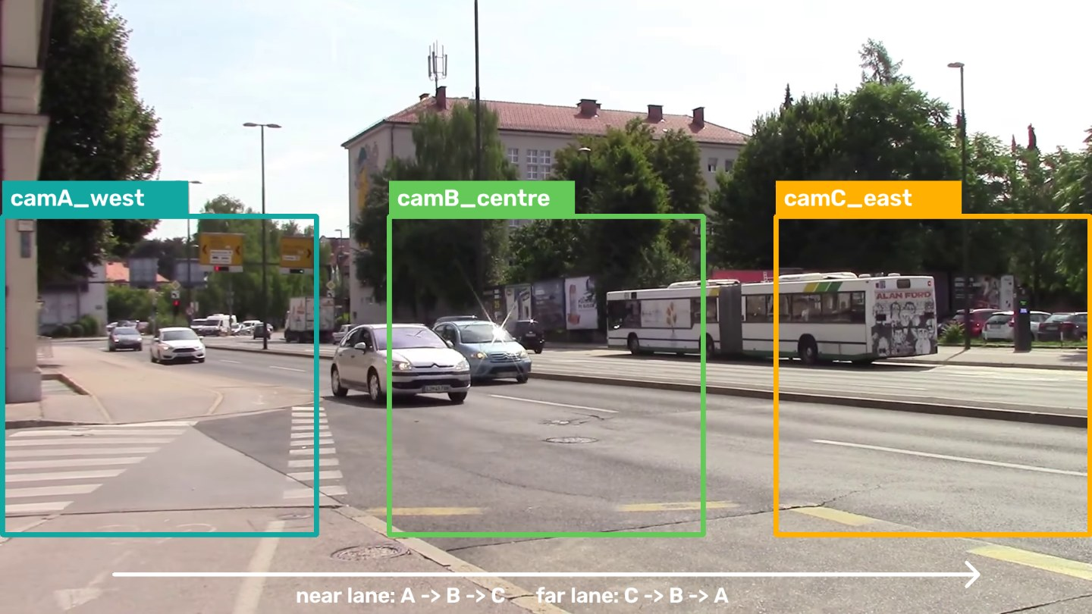
Data & Evaluation Protocol
Benchmark data measures Re-ID performance; multi-camera footage tests the complete workflow.
BENCHMARK | VeRi-776
VIDEO DEMONSTRATION | 4 CAMERAS
50K+ images · 776 vehicles · 20 cameras
150 train / 100 test vehicles (identity-disjoint)
1,290 / 830 tracklets · 300 Re-ID queries
Used for:
• learned metric, probes and Random Forest
• Rank-1 / Rank-5 / mAP · plate degradation
• attribute accuracy · SOM purity
3 zones of one CC BY 3.0 street clip (same cars pass A → B → C) + camD on another road · 187 tracklets · pseudo ground truth from full-frame tracking
Benchmark = “Does the Re-ID method work?” | Videos = “Does the software workflow work?”
8
Notes:
Two kinds of data, as planned. VeRi-776 answers whether the method works: images of one vehicle passing one camera are grouped into tracklets, the same unit my video pipeline produces, with 150 training and 100 test vehicles that never overlap. The demo footage answers whether the software works end to end: an openly licensed street recording is cut into three camera zones along the road, so the same cars really pass camera A, then B, then C, and a fourth camera on another road is a distractor. A reference tracking of the full frame gives pseudo ground truth for measuring the demo.

Slide 9
Results: Attributes & Description Search
Supervision doubles type accuracy; combined cues put the right vehicle in the top 5 for 84% of queries.
ATTRIBUTE ACCURACY (%)
STAGE 1 DESCRIPTION SEARCH (%)
9
Notes:
First results. Colour and type on 830 VeRi test tracklets: zero-shot CLIP gets 67 percent on colour but only 38 on type, because it confuses sedan, hatchback and estate; a linear probe trained on VeRi labels reaches 73 and 79. Stage one description search: each cue alone is weak, but colour plus type plus a partial plate puts the right vehicle in the top five for 84 percent of queries — exactly what a human needs to confirm from a short list.

Slide 10
Results: Plate Robustness
Plate-only search collapses as plates degrade; fused evidence holds up — the main hypothesis.
100 → 3.6
plate-only mAP, clear → hidden
63.5
weighted fusion mAP, partial plates
69.5
weighted fusion mAP, blurred plates
HYPOTHESIS SUPPORTED: MULTI-EVIDENCE RETRIEVAL DEGRADES GRACEFULLY WHEN THE PLATE FAILS
10
Notes:
This tests the main hypothesis. VeRi has no plate text, so each vehicle gets a synthetic plate that is degraded per sighting: clear, partial, blurred or hidden. Plate-only search falls from 100 to 3.6 percent mean average precision. Appearance alone is flat at 27. Fused evidence stays far above it at every level, and the transparent weighted fusion is the best fusion everywhere, ahead of the Random Forest. One honest twist: with no plate at all, the learned metric on its own is best, at 48, because colour and type are already inside the learned embedding and the attribute guesses add noise.

Slide 11
Results: Which Cues Matter?
With plates hidden, supervised metric learning is the biggest single gain.
RANDOM FOREST IMPORTANCE
metric cos
0.45
plate sim
0.13
color agree
0.13
track consist
0.07
27 → 48
Re-ID mAP after learning a metric from 150 vehicles
11
Notes:
With plates hidden, which cues matter? The generic ResNet and CLIP embeddings reach about 60 percent rank-one. Learning a projection from just 150 labelled VeRi vehicles lifts that to 77 percent and nearly doubles mean average precision, from 27 to 48. Colour, type and distinctive cues are far too coarse to rank on their own. The Random Forest puts almost half its importance on the learned metric.

Slide 12
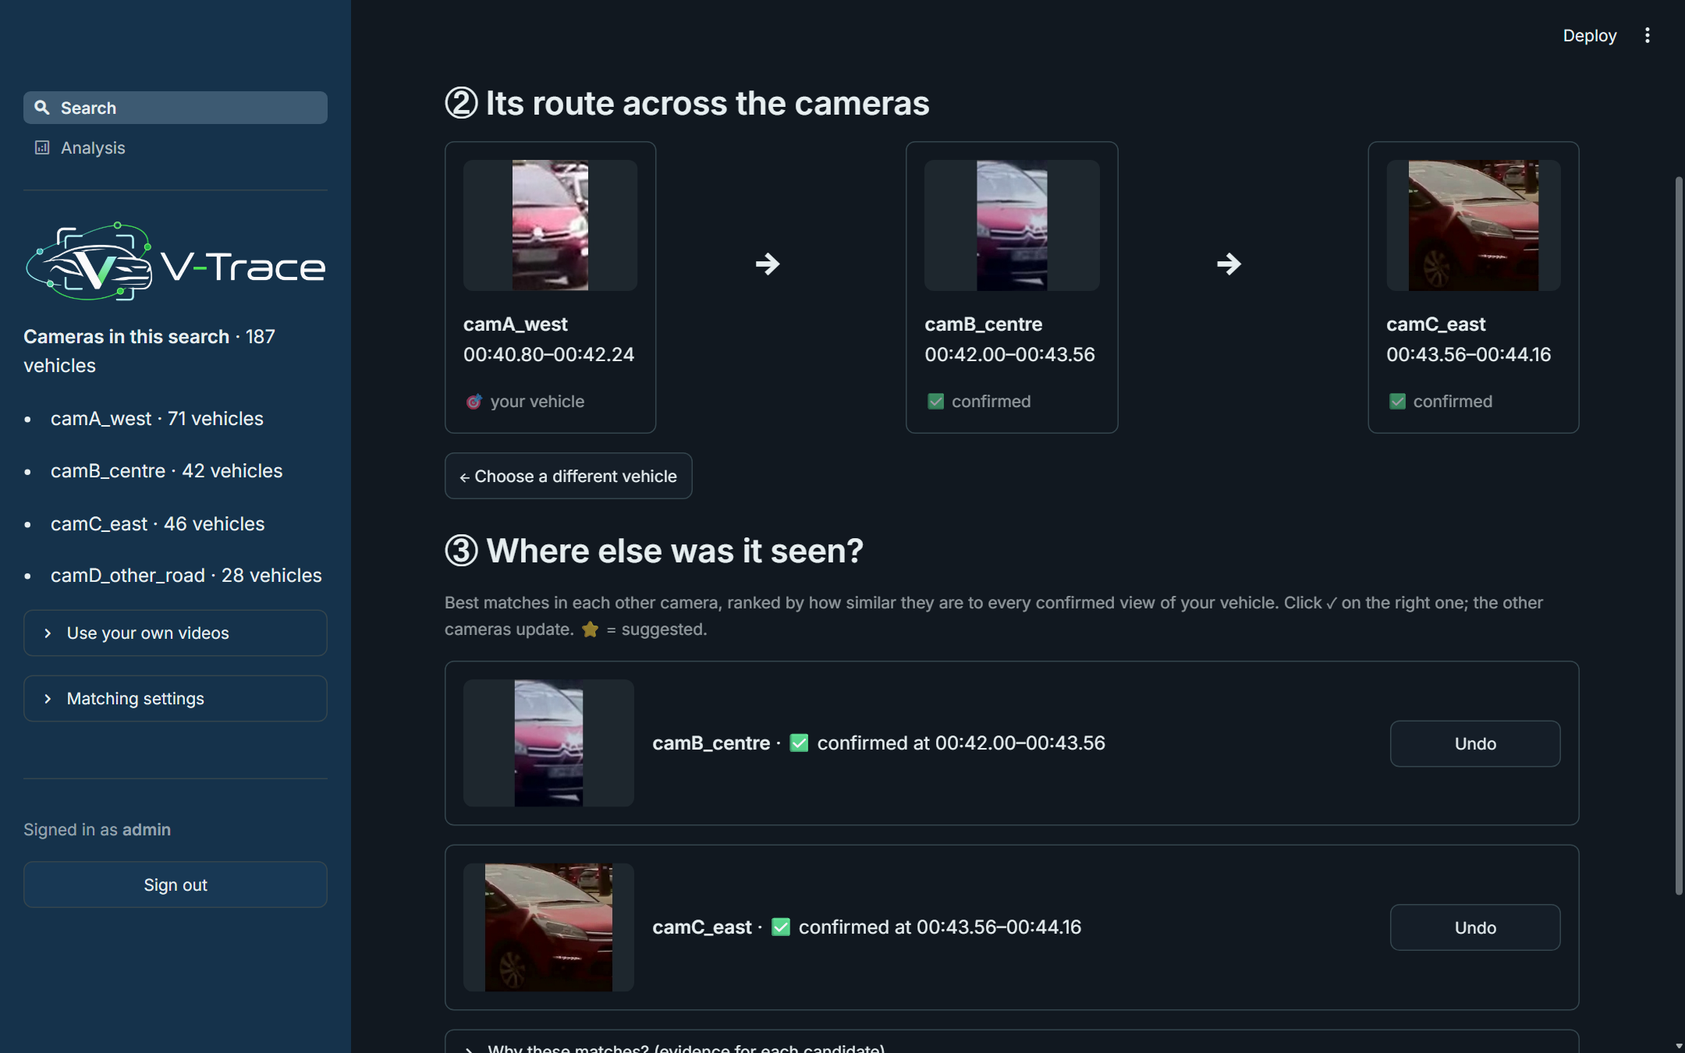
Results: Multi-Camera Demo Footage
On real video the fused matcher traces vehicles camera to camera, with the user confirming each hop.
38%
Rank-1, fused (appearance only 24%)
65%
right car among the 3 shown per camera
70%
of suggested route steps are correct
61%
of tracklets are clean (no ID switch)
12
Notes:
Back to real video. On the four demo cameras I measured re-identification against a reference: the uncropped clip is tracked once and every camera tracklet is mapped back onto it, so these numbers are pseudo ground truth. Here fusion beats appearance alone and the learned metric alone, because colour and type reject look-alike cars. The automatic route suggestion is conservative: when it suggests a camera it is right 70 percent of the time. With one click per camera the right car is among the three shown for about two thirds of hops, and the screenshot shows the red Citroën confirmed in cameras A, B and C, in time order.

Slide 13
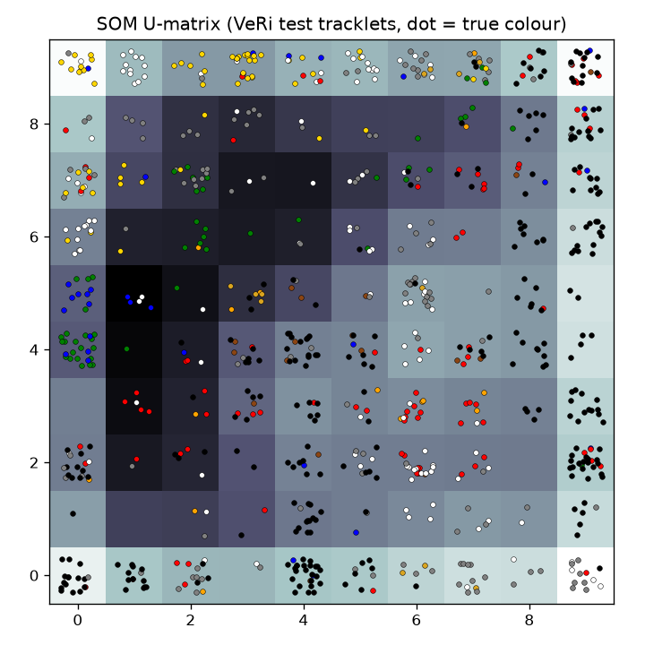
Results: Unsupervised SOM
The map organises vehicles by type and colour — useful for exploration, not as a Re-ID filter.
NODE PURITY (10×10 MAP)
type
0.75
colour
0.67
vehicle ID
0.27
SOM radius | candidates kept | true matches kept | mAP
1 | 7% | 32% | 24.6
2 | 17% | 44% | 28.9
3 | 30% | 54% | 31.7
no filter | 100% | 100% | 42.4
13
Notes:
The Self-Organising Map is trained without labels. Its nodes are fairly pure for type and colour but not for identity. Used as a candidate pre-filter it removes 70 to 94 percent of candidates but drops too many true matches, so accuracy goes down. That is a useful negative result: the SOM is good for exploring the footage, not for filtering re-identification candidates at this scale.

Slide 14
Lessons Learned
Two pitfalls found — and fixed — while evaluating the learned components.
01
02
STACKING LEAK
NON-MONOTONIC SPLITS
Problem Colour/type features for the Random Forest came from a probe fitted on the same vehicles — near-perfect, so over-trusted.
Fix Out-of-fold probabilities and LDA projections (GroupKFold by vehicle)
Problem Under large viewpoint changes, a higher similarity could lower the match score.
Fix Monotonic constraints on every similarity feature
Rank-1, plates hidden: 38 → 56
mAP, plates hidden: 21 → 30
14
Notes:
Two lessons. First, a stacking leak: the forest was trained on colour and type probabilities from a probe fitted on the same vehicles, so they looked almost perfect and the forest over-trusted them; on new vehicles it ranked worse than appearance alone. Out-of-fold features grouped by vehicle fixed it, and I applied the same rule to the learned metric. Second, the forest learned splits where higher similarity lowered the score; monotonic constraints fixed that. That second choice was informed by test queries, so the forest-versus-fusion comparison is indicative, and a validation split is the proper next step.

Slide 15
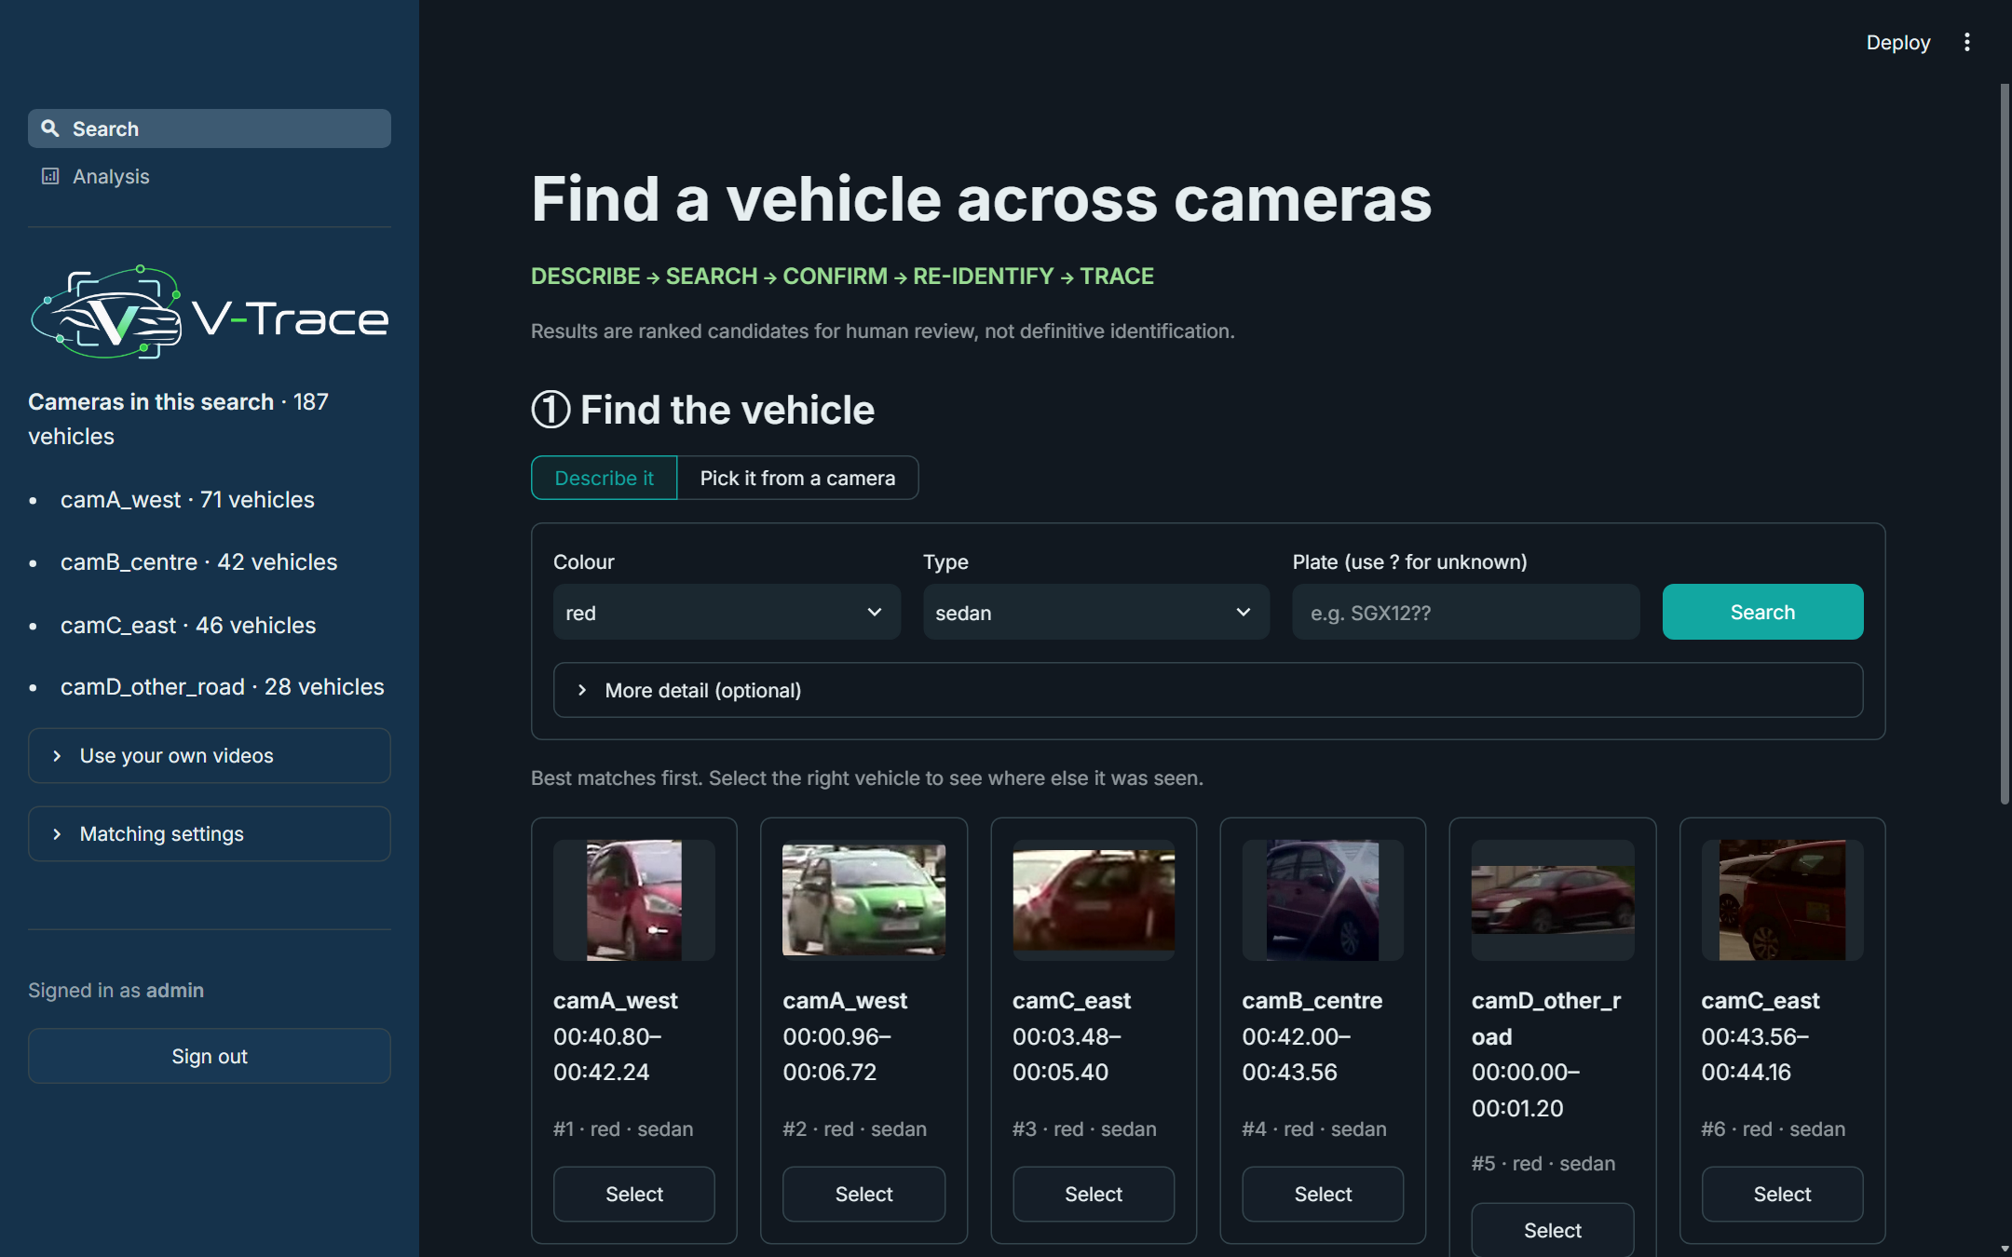
Live Demo
One page: find the vehicle → see where else it was seen → follow its route.
① Find: “red + sedan” → ranked vehicles → Select
② Route confirmed camA → camB → camC
15
Notes:
Now the app. It has one search page. After the admin signs in, the four demo cameras are already loaded. Step one: I describe the target as a red sedan; the red Citroën in camera A is ranked first and I select it. Step three shows the best three matches in every other camera, like a re-identification result list; the starred match in camera B is the same car, so I confirm it, camera C is re-ranked against both views, and I confirm the sighting there. Step two now shows the full route from camera A to B to C in time order.

Slide 16
Limitations & Next Steps
A focused proof of concept — the clearest next steps follow from the results.
LIMITATIONS
NEXT
× Linear metric, 150 training vehicles
all 576 VeRi identities · triplet-loss fine-tuning
× Synthetic plates; OCR on whole crops
plate detector + real plate data
× RF optimises pair classification
learning-to-rank · validation split for model choice
× Demo cameras = zones of one recording
separate physical cameras (e.g. CityFlow) · travel-time priors
× Recorded videos only
live RTSP camera streams
MVP: recorded-video proof of concept → future extension: live camera streams
16
Notes:
Limitations. The learned metric is linear and trained on only 150 vehicles; using all VeRi training identities or fine-tuning the backbone with a triplet loss is the clearest gain. Plates in the benchmark are synthetic and OCR runs on whole-vehicle crops. The forest optimises pair classification rather than ranking. The demo cameras are zones of one recording, not separate physical cameras. And the pipeline works frame by frame, so live camera streams are a small change.

Slide 17

84%
100 → 3.6
27 → 48
right vehicle in the top 5 from colour + type + partial plate
plate-only mAP as plates degrade; fusion stays far above appearance
Re-ID mAP, plates hidden, with a learned metric
Thank you!
In the preparation of this project, AI-based tools including Claude, ChatGPT and Gemini were used in a supporting capacity to assist with tasks such as drafting and refining text, organising content, implementation and general research support. All ideas, analysis, technical design decisions and conclusions are the work of the project team.
Notes:
To conclude: V-Trace starts from incomplete information, retrieves likely candidates, keeps a human confirmation step, and then re-identifies and traces the vehicle across cameras using several complementary kinds of evidence, with the user confirming each hop. Plate-only search collapses when plates degrade, while fused evidence holds up. Description search finds the right vehicle in the top five for 84 percent of queries, and learning a metric from 150 vehicles nearly doubles re-identification mAP. Thank you — I'm happy to take questions.

