Slide 1
Computer System Specialist
Gurnoor Samra

Slide 2

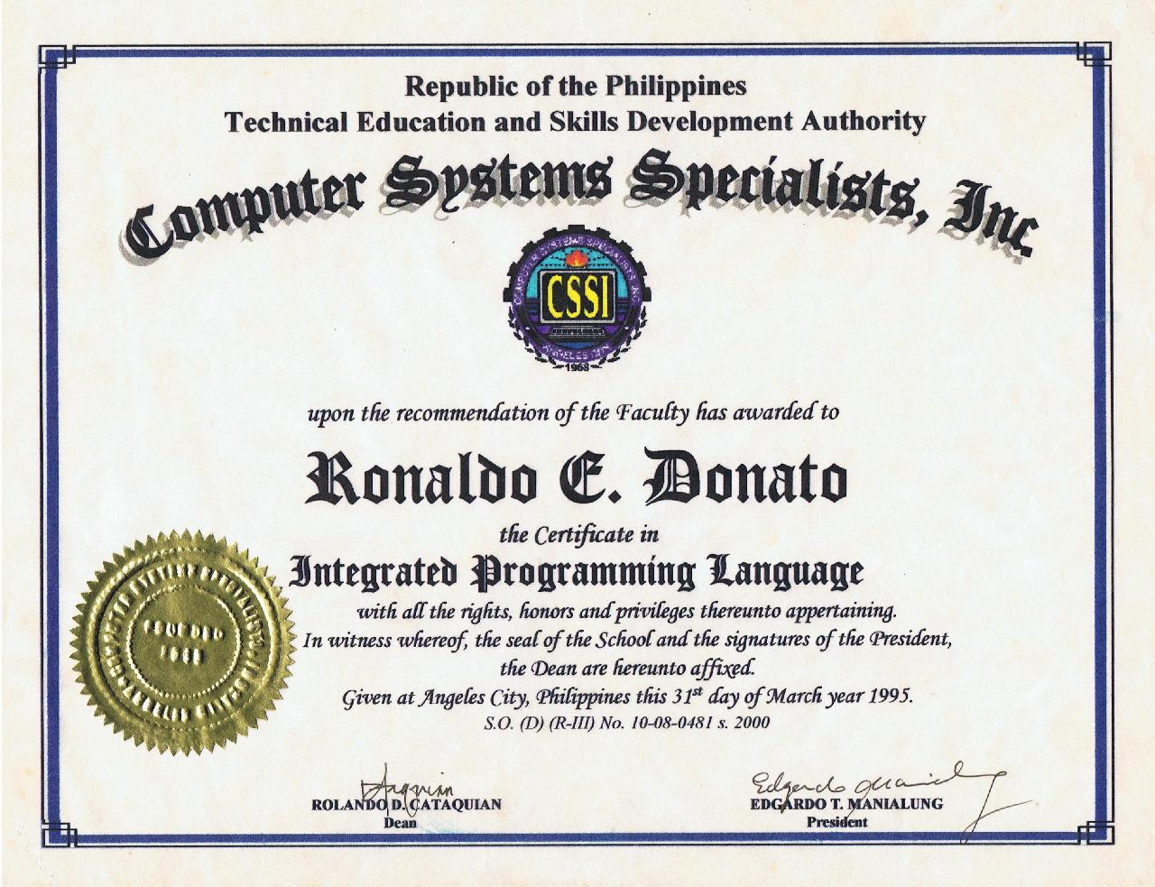
What Is a Computer Systems Specialist?
troubleshoot, analyze, plan and install computers and the software that employers need to run their businesses
determine costs and work with company managers to determine technology needs and implement what is necessary
cyber-security
short-term and long-term computer and software needs of personnel and business

Slide 3
Carrer Over view
Degree Required | Associate degree for entry level; Bachelor's degree or master's degree in business administration preferred
Education Field of Study | Computer science or information in a business science-related field
Key Skills | Analytical, organizational, verbal communication, decision-making ability
Job Growth (2014-2024) | 15%
Median Salary (2015) | $131,600

Slide 4

Duties as a compter system specilst
maintaining Internet websites
examine your company's computer systems
developing software, overseeing computer network security, designing computer systems, and training and inspecting the work of IT staff members.
offer technical support services,

Slide 5



Places that offer this Course
Waterloo
Canada technology university
University of Ontario Institute of Technology
British Columbia Institute of Technology
Seneca College

Slide 6
Example of a Computer system specialist
https://www.youtube.com/watch?v=CWZ_-qT82HY

Slide 7
Work cited
https://study.com/articles/Salary_and_Career_Info_for_Computer_Systems_Specialists.html
http://www.hr.uwaterloo.ca/.jd/00002290.html
https://www.payscale.com/research/CA/Job=Systems_Specialist/Salary

