Slide 1
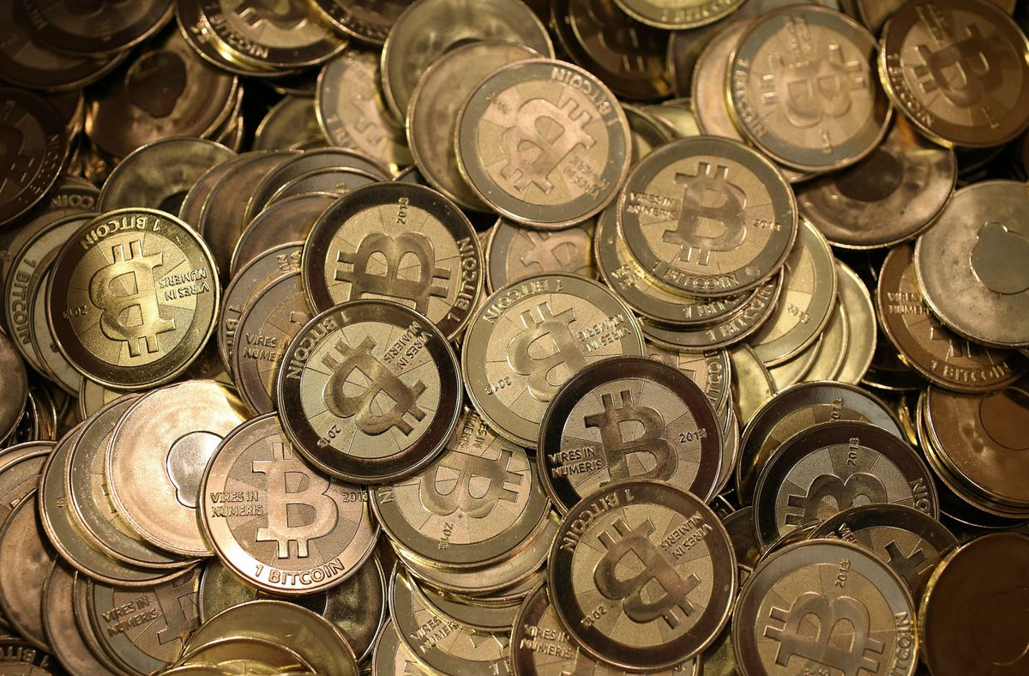
Bitcoin
By:Gurnoor Singh Samra

Slide 2
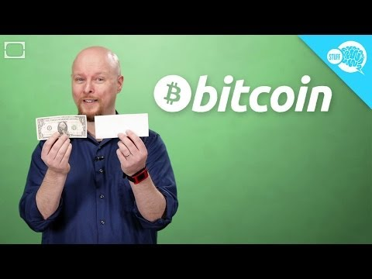

Slide 3
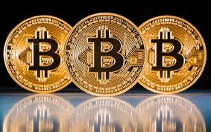

What is Bitcoin?
-Digital Currency
-Creator not known to this day
-Transactions are not made through Banks
-Mostly People use it to make money of it.
-Type of investment

Slide 4
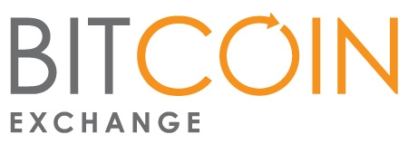
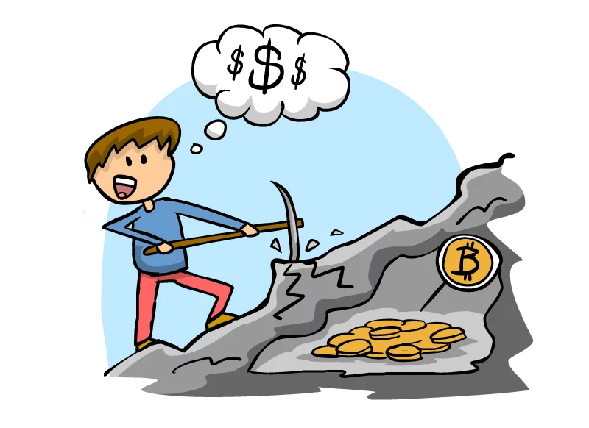
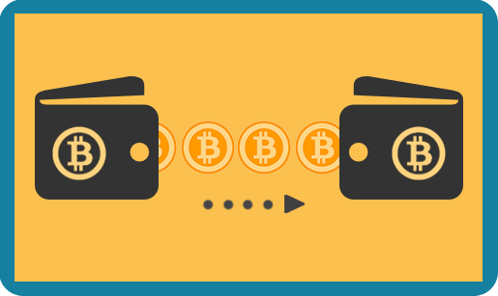
How Can you get Bitcoin
-Exchange website
-Mining
-Transferring

Slide 5

Pros Of Bitcoin
Transactions are mostly anonymous
rarely see a transaction fee
Transactions are irreversible, eliminating charge disputes
Very easy to buy
Could be used almost anywhere online
Quick accessibility
Good type of Investment at the moment

Slide 6
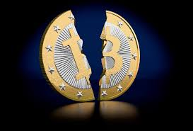
Cons
Value is based on how much is being bought
It's time to get Valid Bitcoin
Popular use of Bitcoin is for illegal stuff
Could lose all bitcoin when hacked or forgot wallet password and will never get it back.
Value of bitcoin could drop any second

Slide 7

My Opinion
-Too Popular to die
-This is the future
-it about time for knock offs

Slide 8
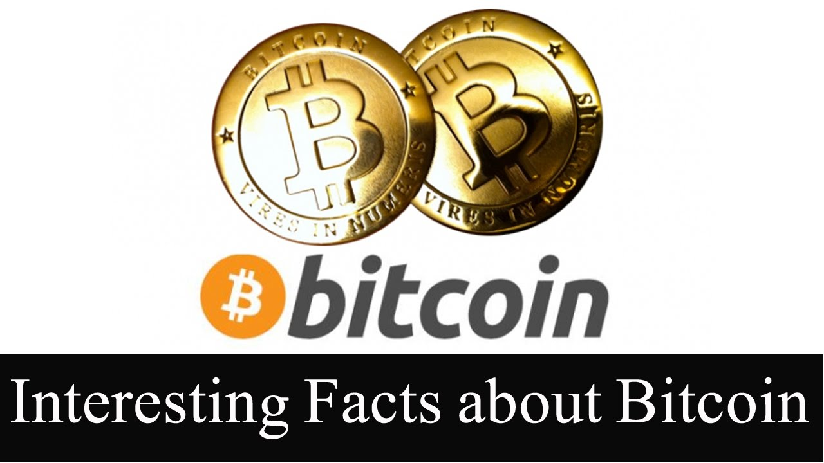
Facts
-There are Exactly 21,000,000
-Bitcoin has no set value
-Goverment has no involvement in Bitcoin
-You can see every transaction the occurs with bitcoin
-FBI owns 1.5 % of the bitcoins(315,000)

Slide 9
Kahoot
https://play.kahoot.it/#/k/2da82092-d906-4d04-b6ed-725a88f4a9cf

Slide 10
Work Cited
http://money.cnn.com/infographic/technology/what-is-bitcoin/
Stewart, David. “ Digital Currency: A New Worry for Tax Administrators?” Taxanalysts.com. 7 Nov. 2012. Web. http://www.taxanalysts.com/www/features.nsf/Articles/
C1A7ED502DD2B84685257AAF0056A2A2
Bitcoin Charts. Web. http://blockchain.info/charts
"Bitcoin Charts." Bitcoincharts.com. Web. 29 Aug. 2013. http://bitcoincharts.com/charts/mtgoxUSD .
Hill, Kashmir. "Every Important Person In Bitcoin Just Got Subpoenaed By New York's Financial Regulator." Forbes. Forbes Magazine, 12 Aug. 2013. Web. http://www.forbes.com/sites/kashmirhill/2013/08/12/every-important-person-in-bitcoin-just-got-subpoenaed-by-new-yorks-financial-regulator/ .
"How Does Bitcoin Work?" Bitcoin. Bitcoin Foundation, Web. http://bitcoin.org/en/how-it-works.
Blain, Loz. "300 Million Dollars out of Thin Air: Bitcoin Turns Four and Approaches $30 Value."

