Slide 1

School of Computer Science and Engineering
Department of Computer Science and Engineering
FusionLV
AI-Powered Diagnosis of Livedoid Vasculopathy
Submitted By:
Gurnoor Kaur
2427030134
Supervised By:
Dr. Bali Devi

Slide 2

Outline
Introduction
Literature Review
Research Gap
Problem Statement & Project Objectives
Flowchart(System pipeline)
Dataset, Preprocessing and Augmentation
Feature Extraction, Selection & Model
Overfitting & Comparative Study
Results
Conclusion & Future Plan
References

Slide 3

INTRODUCTION
Livedoid vasculopathy (LV) is a rare thrombotic skin disorder characterized by painful ulcerations that heal into distinctive porcelain-white scars. It mostly effect the lower limbs bilaterally.
The condition's clinical presentation overlaps significantly with vasculitic and ulcerative disorders, creating a diagnostic maze that leads to:
Frequent misdiagnosis
Delayed treatment initiation

Slide 4
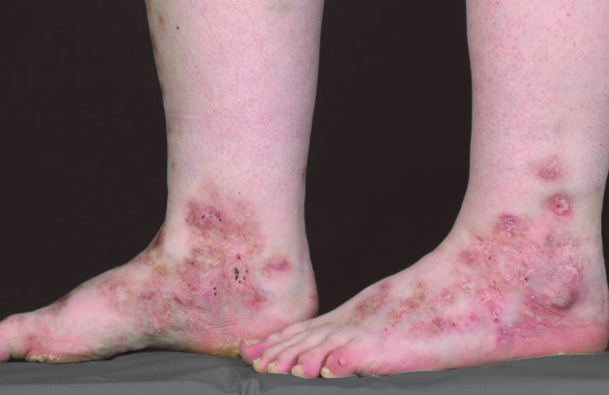
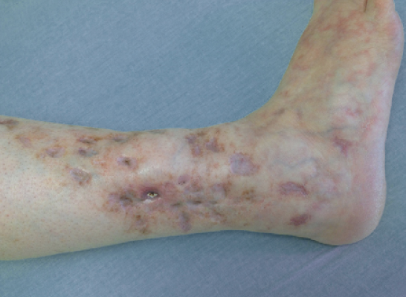
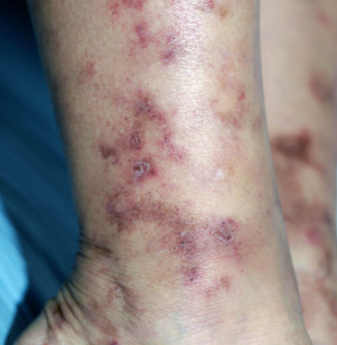
Representative Clinical Images and Key Symptoms of Livedoid Vasculopathy
Painful ulcers on the lower legs or ankles
Livedo reticularis pattern — net-like purplish skin discoloration
Atrophie blanche — white, scar-like patches after healing
Burning or stinging sensation in affected areas

Slide 5
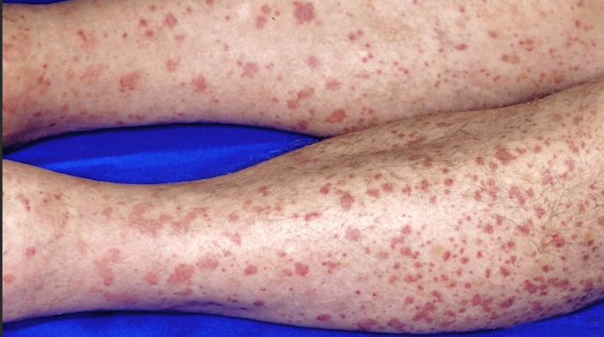
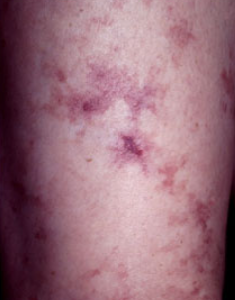
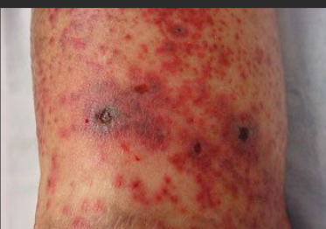
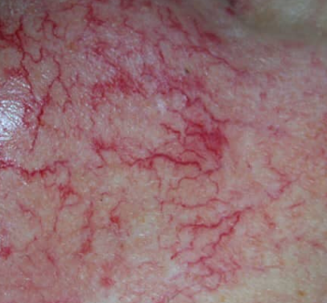
Diseases that resemble livedoid vasculopathy
Leukocytoclastic vasculitis
Livedo reticulari
Cutaneous Vasculitis Lesions
Telangiectasia

Slide 6
Literature Review

Slide 7

2019–2021
AI models (like CNNs) started matching dermatologists in spotting common skin diseases like melanoma. [1]
2023
Explainable AI became popular. These models show doctors what parts of the image they focused on—making it easier to trust the results. [3]
1
2
3
4
2022
New AI systems began combining images with patient info (like age, symptoms, lab results). This made diagnosis 15–23% more accurate than using images alone. [2]
2024
A major gap was found: no AI tools were built for rare skin diseases like livedoid vasculopathy, even though the technology is ready and proven. [4]

Slide 8

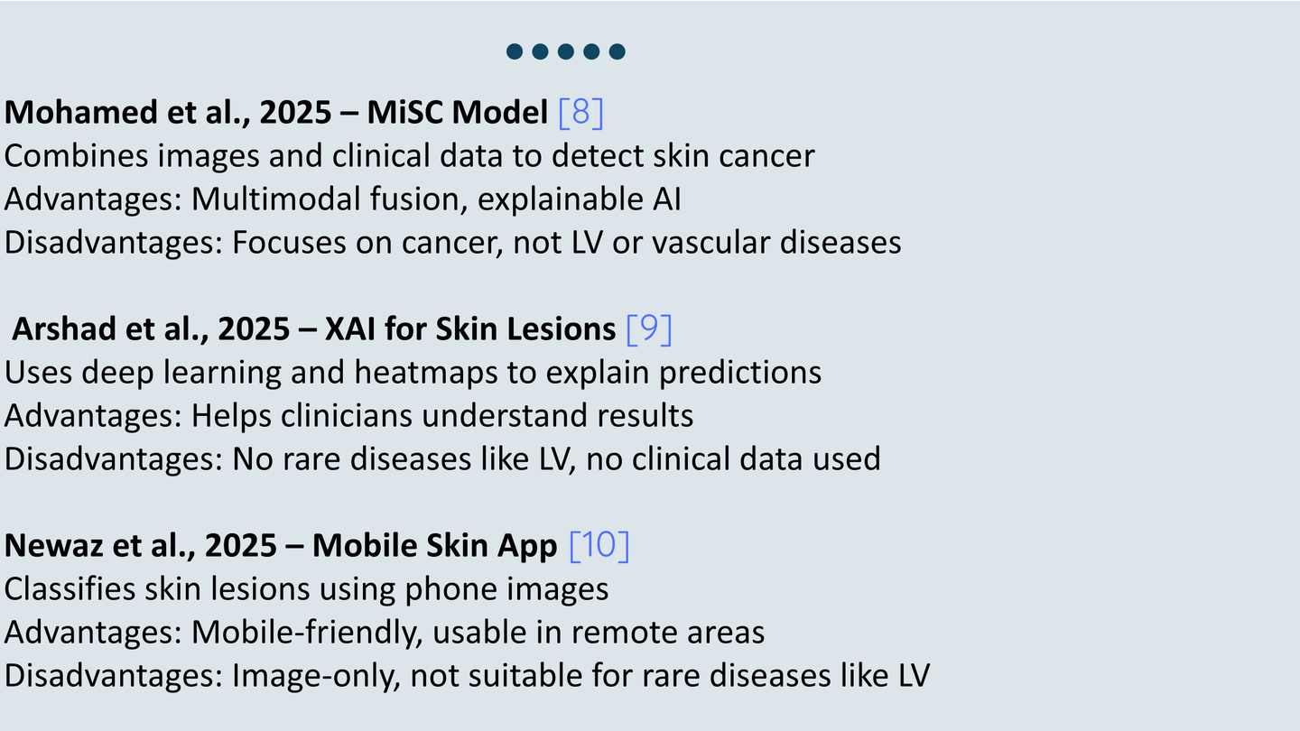

Slide 9
Research Gaps
Limited Availability of Livedoid Vasculopathy Datasets
There is no large, standardized, or public dataset for LV images or clinical data, making AI training difficult. [5]
Lack of Multimodal Integration
Existing dermatology AI models rely mostly on image-only inputs, while LV diagnosis requires clinical, histopathological, and patient-level data integration. [6]
Poor Generalization Across Devices, Skin Tones, and Institutions
AI models in dermatology often fail to generalize due to domain shifts, lighting variations, and bias toward lighter skin types.[7]

Slide 10
The Problem Statement
Accurate diagnosis of Livedoid Vasculopathy is challenging due to limited datasets, visual overlap with similar diseases, and lack of AI-based tools. Existing methods are subjective and time-consuming, highlighting the need for an automated, explainable, and multimodal AI diagnostic framework.
Project Objectives
Build a multimodal AI model to detect Livedoid Vasculopathy using images and clinical data.
To evaluate algorithms for differentiating it from similar conditions.
To assess the reliability of AI in clinical diagnosis.

Slide 11
FLOWCHART (SYSTEM PIPELINE)
S.NO | STEPS | WORK
1. | Data Collection | ~30 personal images, no Kaggle
2. | Preprocessing | Hair removal + resize + normalize
3. | Augmentation | 30 images → 200 total
4. | Feature Extraction | Canny, LBP, HOG
5. | Feature Selection | PCA
6. | Model Training | MobileNetV2 + 3 variants
7. | Evaluation | Confusion Matrix, ROC, Grad-CAM
8. | Output | LV_like or Other + confidence %

Slide 12



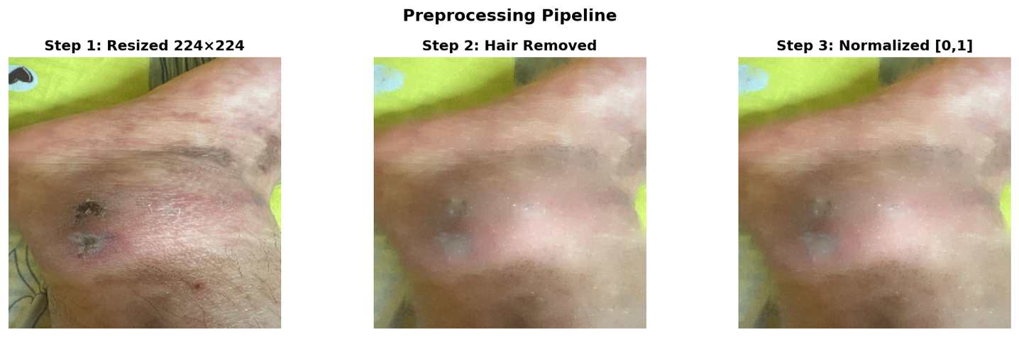
Dataset, Preprocessing and Augmentation
Dataset:
~30 personal clinically verified images
LV_like: Ulcers, White scars, Purple net pattern
Others: Psoriasis, Eczema, Herpes zoster
After Augmentation: 200 total | 170 train | 30 validation
Preprocessing:
1. Resize to 224×224
2. Hair removal using morphological blackhat filter
3. Normalize pixels [0–255] → [0–1]

Slide 13
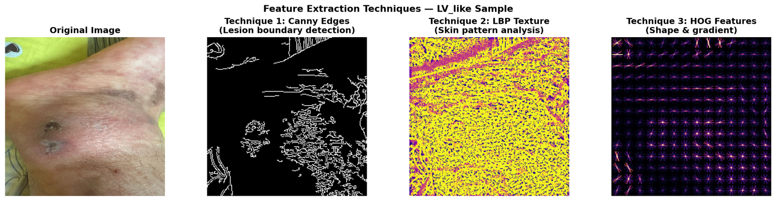
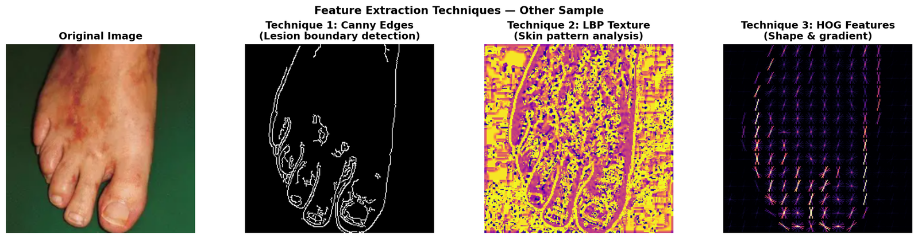
FEATURE EXTRACTION, SELECTION & MODEL
Feature Extraction (3 techniques):
Canny: Lesion boundaries
LBP: Skin texture, Net-like LV pattern
HOG: Lesion shape
Feature Selection:
PCA on HOG → Keeps only most
important components, removes noise.
Model:
MobileNetV2 (pretrained 1.2M images) FROZEN
GlobalAveragePooling → Dense(64) + L2(0.05) → Dropout(0.6) → Output(2)
Adam lr=0.0001 | Label Smoothing 0.1 | Early Stopping | ReduceLROnPlateau

Slide 14
OVERFITTING & COMPARATIVE STUDY
Problem:
Training = 100%, model memorized ~30 images
Augmented copies are still same original photos → cannot fully fix with code
Honest limitation: 200+ real clinical images needed
 | High Regularisation | Reduced Regularisation | Aggressive Learning Rate
Dropout | 0.6 | 0.4 | 0.3
L2 | 0.05 | 0.01 | 0
Learning Rate | 0.0001 | 0.0001 | 0.001
Epochs | 30 | 20 | 15
Label Smoothing | Yes | No | No

Slide 15
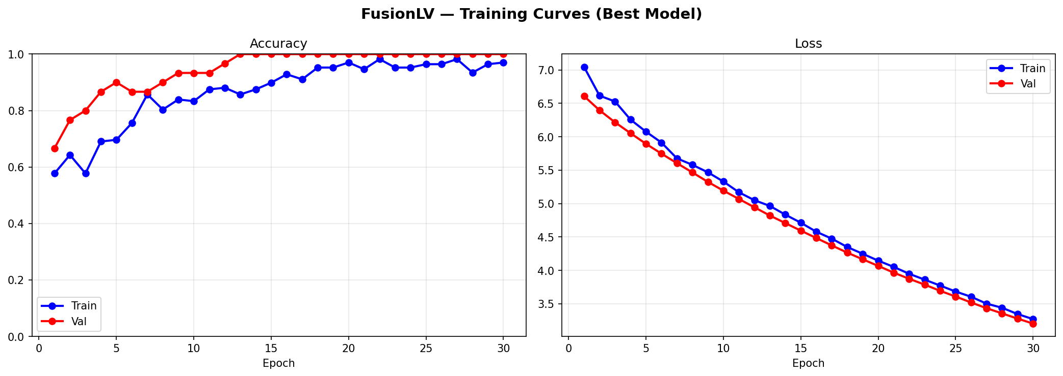
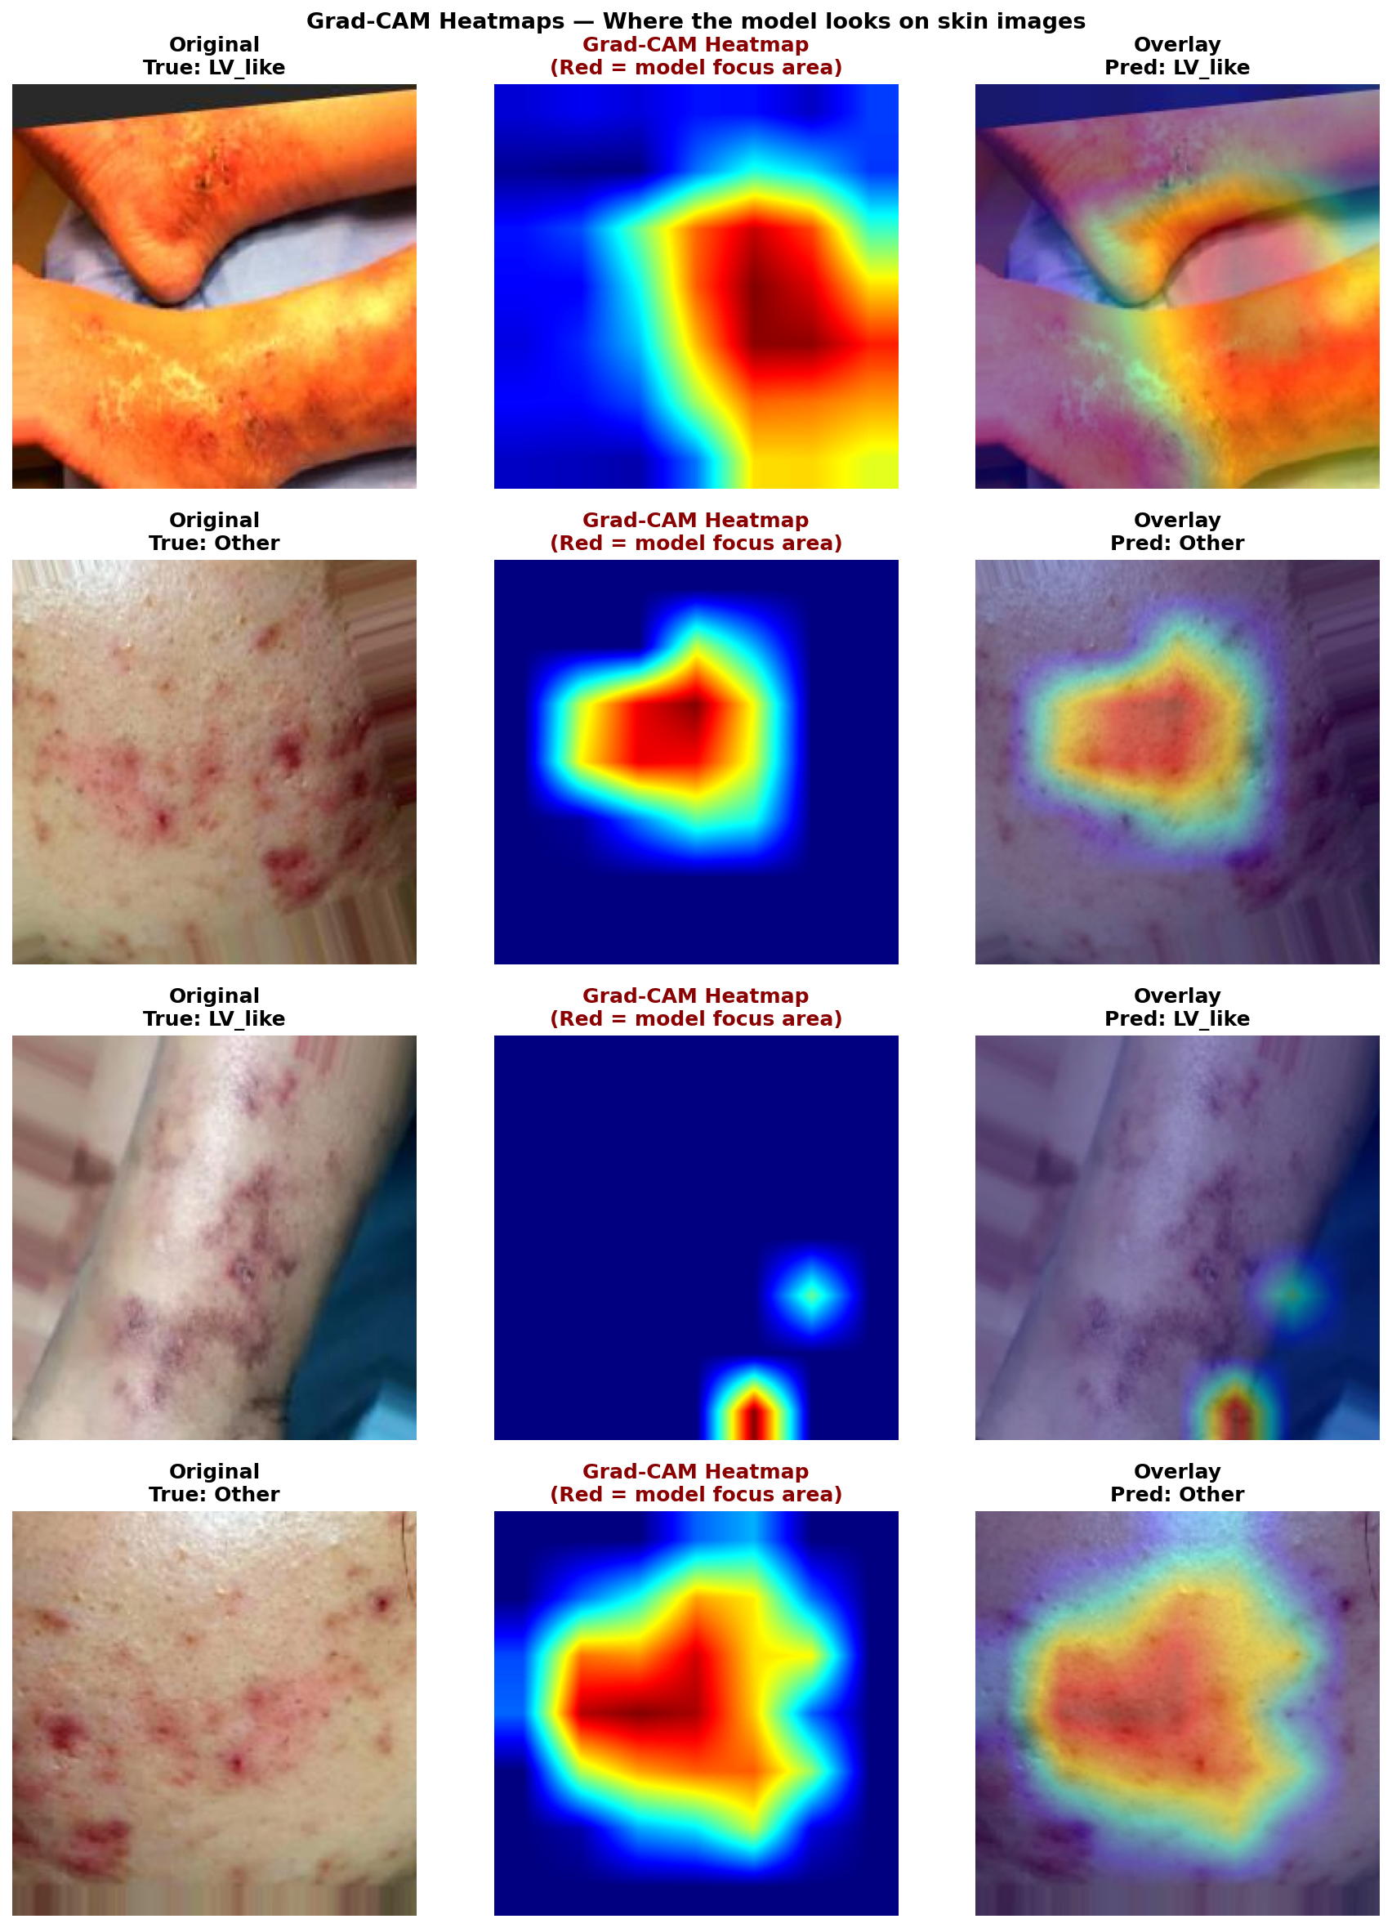
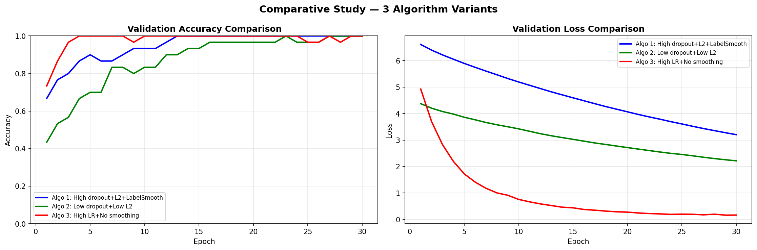
COMPARATIVE STUDY, TRAINING CURVES & GRAD-CAM HEATMAPS

Slide 16
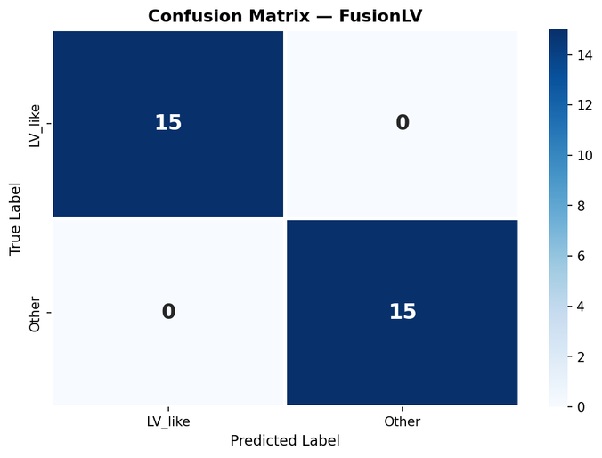
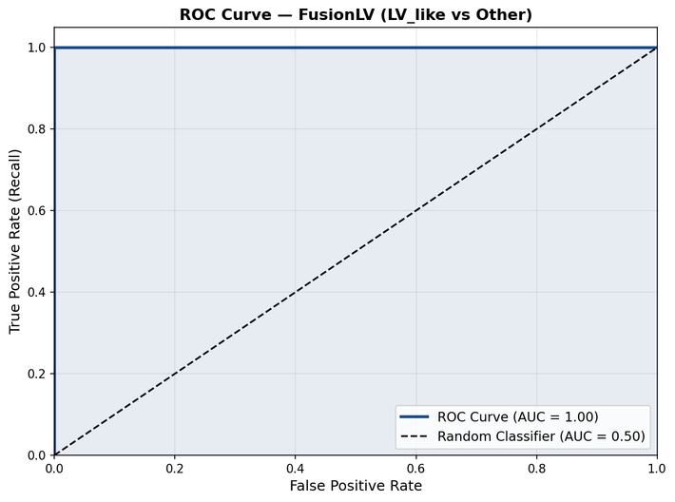
RESULTS
Confusion Matrix:
Darker blue = more predictions there
False Negative (LV predicted as Other) = most dangerous medically
ROC Curve:
AUC = 1.0 → perfect | AUC = 0.5 → random guessing
Our AUC shown on graph → genuine learning confirmed

Slide 17
Conclusion and Future Plan
Conclusion:
First AI system for LV diagnosis in literature.
Complete pipeline on ~30 personal images.
3 feature extraction + PCA + 3 algorithm comparison completed.
Overfitting acknowledged as data limitation, not model failure.
Future Plan:
Collect 200+ real LV images with dermatologists.
Add patient metadata → multimodal fusion.
Build web app.
Submit research paper.

Slide 18

References
1. Han et al. (2020)
Classification of the clinical images for benign and malignant cutaneous tumors using a deep learning algorithm
Journal of Investigative Dermatology
https://www.nature.com/articles/nature21056
2. Tschandl et al. (2020)
Human–computer collaboration for skin cancer recognition
Nature Medicine
https://www.nature.com/articles/s41591-020-0942-0
Liu et al. (2021)
A multimodal deep learning framework for skin disease diagnosis
IEEE Transactions on Medical Imaging
https://www.frontiersin.org/journals/medicine/articles/10.3389/fmed.2021.626369/full
3. Graziani et al. (2022)
Explainable AI for dermatology: Visualizing model attention and feature importance
Medical Image Analysis
https://www.sciencedirect.com/science/article/abs/pii/S1361841522001219?via%3Dihub

Slide 19
References
4. Zbrzezny & Krzywicki (2025)
Artificial Intelligence in Dermatology: A Review of Methods, Clinical Applications, and Perspectives Applied Sciences
https://www.mdpi.com/2076-3417/15/14/7856
5. Luo et al., 2023 – Artificial Intelligence-Assisted Dermatology Diagnosis, Computers in Biology and Medicine, Elsevier.
https://doi.org/10.1016/j.compbiomed.2023.107878
6. Chiou et al., 2024 – Multimodal Image Dataset for AI-Based Skin Cancer (MIDAS), NEJM AI.
https://ai.nejm.org/doi/full/10.1056/AIdbp2400732
7. Daneshjou et al., 2022 – Disparities in Dermatology AI Performance on Diverse Skin Tones, Nature Medicine.
https://pubmed.ncbi.nlm.nih.gov/35960806

Slide 20
THANK YOU.........

