Slide 1
MARKETPLACE ANALYTICS
BRAZILIAN E-COMMERCE
Olist E-Commerce Analysis
A business evaluation of scale, purchasing behavior, delivery performance, and customer satisfaction.
Executive insights review · Python, SQL, and Power BI pipeline
Based on the Brazilian public marketplace dataset
Notes:
Introduce the review: this analysis synthesizes customer behavior, logistics friction, and delivered revenue from the public Brazilian marketplace dataset.

Slide 2

The marketplace story has four lenses
Sales scale over time
01
Revenue trajectory, peak monthly volumes, and seasonality patterns across 2016–2018.
Product category concentration
02
Value contributions, top revenue drivers, and catalogue breadth across translated categories.
Customer purchasing behavior
03
Repeat rate benchmarks, customer spending distribution, and observation-window considerations.
Analytical workflow: Raw relational schemas processed via Python & pandas, validated in PostgreSQL, and modeled for exploratory review in Power BI.
Logistics performance & satisfaction
04
Delivery timelines, state-level late rates, and their correlation with review scores.
02
Notes:
Outline the four analytical themes: commercial volume, category leadership, one-time customer behavior, and fulfillment friction connecting directly to review sentiment.

Slide 3
The dataset is broad enough to connect orders to experience
TABLE | RECORDS | ROLE IN ANALYSIS
Orders | 99,441 | Lifecycle timestamps (purchase, approval, delivery, estimated delivery).
Order Items | 112,650 | Item-level pricing, freight value, and seller IDs across orders.
Customers & Geolocation | 99,441 cust. | Links customer unique IDs to destination cities and federative states.
Reviews & Products | 99,224 rev. | 1-to-5 satisfaction scores linked with translated product categories.
DELIVERED BASE
96,478
Delivered orders with completed tracking records.
REVENUE CALCULATION RULE
Gross merchandise revenue is calculated strictly using order-items item price, isolating merchandise value from freight and payment instalment fees.
The relational schema links operational logistics with post-purchase customer perception.
03
Notes:
Explain the structural scope: 99.4k total orders containing 112.6k items, filtered to 96,478 delivered orders. Clarify that revenue reflects item price rather than freight or payment charges.

Slide 4
Cleaning choices protected the analysis from false precision
AREA | CONDITION | ACTION TAKEN | METHOD RATIONALE
Missing Values | Retained | Kept null product categories as unknown; retained reviews without text titles or written survey messages. | Protects sales and order counts; numerical 1–5 score is the primary feedback signal.
IDs & Duplicates | Verified | Checked review IDs; audited multi-item order occurrences and distinct survey submissions. | Preserves legitimate multiple items within single order transactions.
Types & Dates | Verified | Checked data types and date conversions. | Keeps dates consistent for time-based calculations.
Delivery Anomalies | Excluded | Excluded cancelled, unavailable, or missing delivery timestamps only when they affected calculations. | Uses validated delivery records; prevents negative durations and unclosed fulfillment bias.
04
Notes:
Review the cleaning protocol: retaining unknown categories and score-only reviews preserves volume totals, while excluding incomplete delivery dates prevents distorting fulfillment metrics.

Slide 5
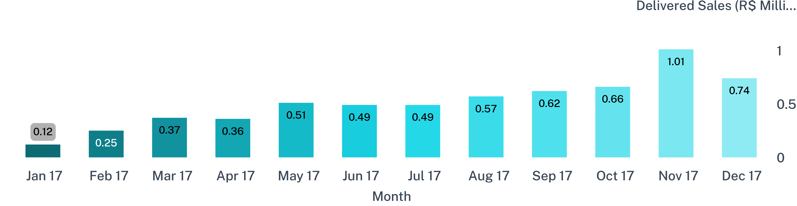
Delivered sales reached about R$13.22M
Total Delivered Sales
Delivered Orders
Average Order Value (AOV)
R$ 13.22M
96,478
R$ 137.04
Across valid delivered items
Completed transactions
Per delivered order
Early 2017 percentage growth was amplified by a small base; November 2017 delivered sales reached R$1.01M during Black Friday promotions.
05
Notes:
Walk the sales expansion: delivered orders totaled R$13.22M across 96,478 orders, averaging R$137.04. Highlight the 2017 ramp and November peak (R$1.01M) while cautioning that early triple-digit growth reflects tiny initial volume.

Slide 6
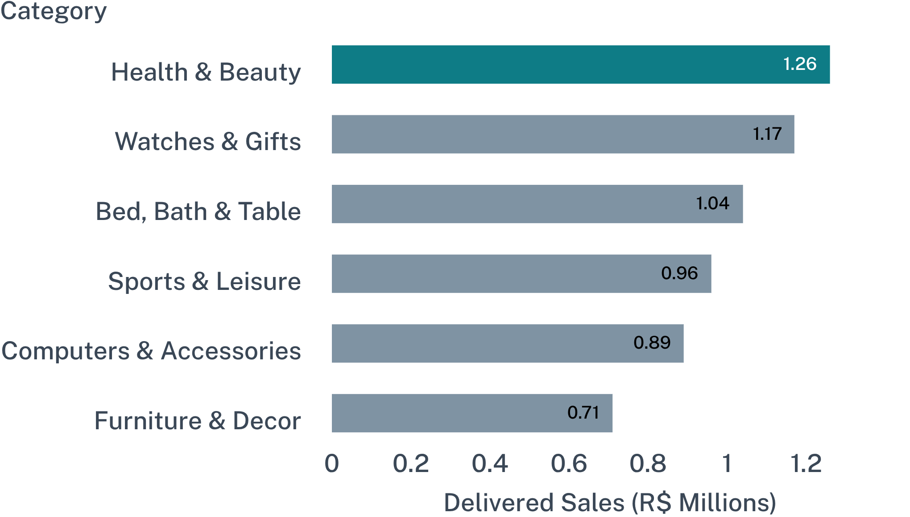
Health & beauty led delivered revenue
CATEGORY CONCENTRATION
Top 6 categories anchor marketplace turnover
Revenue is concentrated in personal care, giftware, and home furnishings. While Olist lists over 70 translated categories, commercial liquidity relies heavily on the top ten segments.
Category Strategy Takeaway
Fulfillment failures or stockouts in Health & Beauty or Watches & Gifts disproportionately damage marketplace revenue.
The top three product categories generated over R$3.47M, representing more than 26% of all marketplace sales.
06
Notes:
Present the category leaderboard: Health & Beauty (R$1.26M), Watches & Gifts (R$1.17M), and Bed Bath Table (R$1.04M) lead. Note how catalog volume is concentrated among these top sectors.

Slide 7
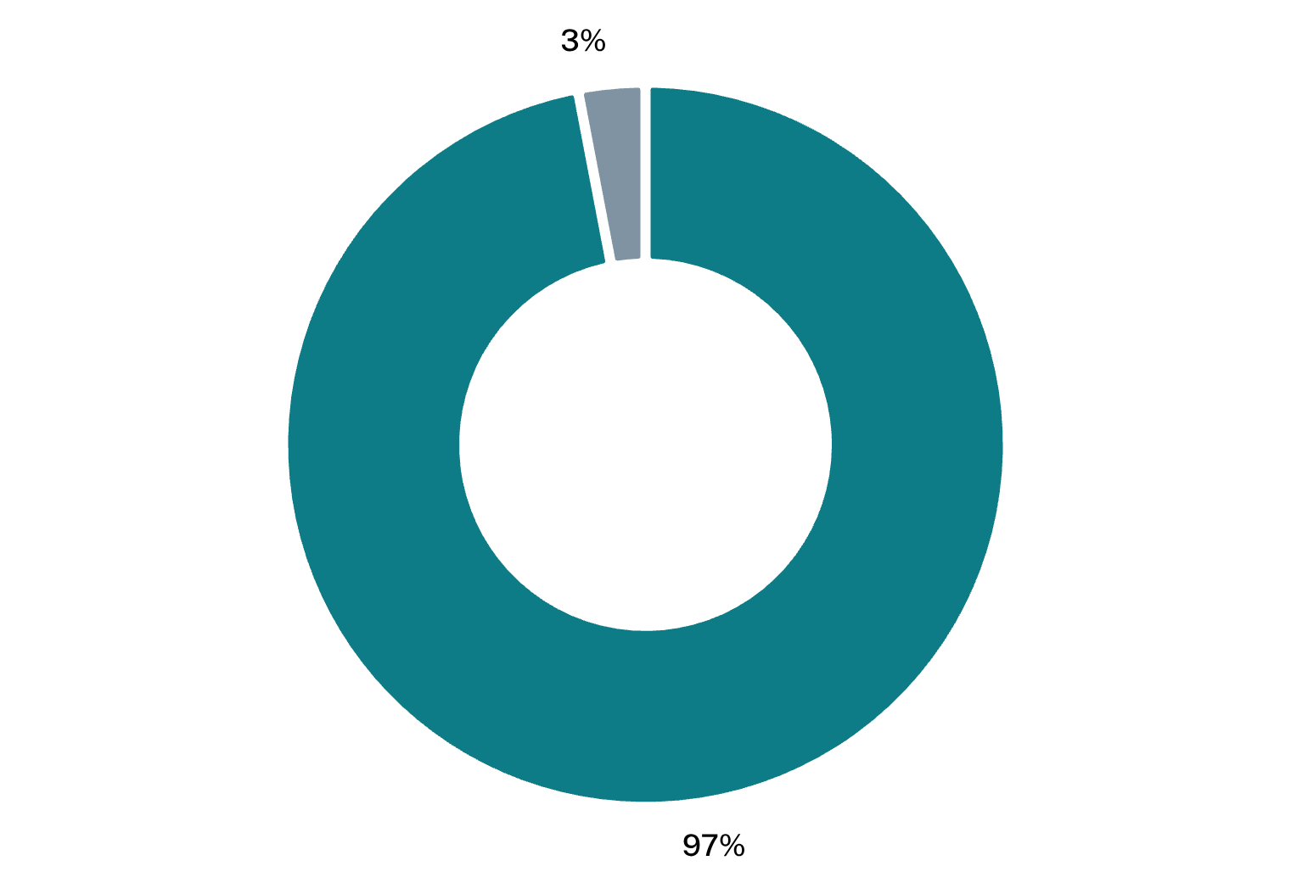
About 97% of customers made one delivered purchase
One-Time Customers
Repeat Customers (2+)
~97%
~3%
R$ 136.60 average spend per customer
R$ 254.20 average cumulative spend
OBSERVATION-PERIOD CAVEAT
A 24-month observation window naturally undercounts long repurchase cycles. However, repeat buyers demonstrate 86% higher cumulative customer value, signaling substantial retention upside.
93,358 unique customers placed orders; approximately 97% purchased only once in the dataset window.
07
Notes:
Contrast one-time buyers (97%) against repeat customers (3%). Highlight that repeat buyers spend nearly double across their relationship, while clearly articulating the observation-window limitation.

Slide 8
Delivery is the clearest friction point
STATE-LEVEL DISPARITY (MIN. 500 ORDERS THRESHOLD)
STATE (UF) | DELIVERED ORDERS · AVERAGE DAYS · LATE RATE
São Paulo (SP) | 40,494 · 8.3 d · 5.4%
Minas Gerais (MG) | 11,353 · 11.5 d · 7.1%
Rio de Janeiro (RJ) | 12,350 · 14.9 d · 11.6%
Bahia (BA) | 3,256 · 18.7 d · 15.9%
Alagoas (AL) | 502 · 24.0 d · 23.1%
OVERALL FULFILLMENT BENCHMARK
12.5
Days average delivery time
From purchase approval to customer delivery
8.11%
Late delivery rate nationwide across 96,478 valid deliveries.
Late-delivery rates vary by state; Northeast states face delays exceeding 3 weeks.
08
Notes:
Break down fulfillment friction: average shipping takes 12.5 days with an 8.11% delay rate overall. Note extreme geographic disparity: SP sits at 5.4% late, whereas RJ reaches 11.6% and AL exceeds 23%.

Slide 9
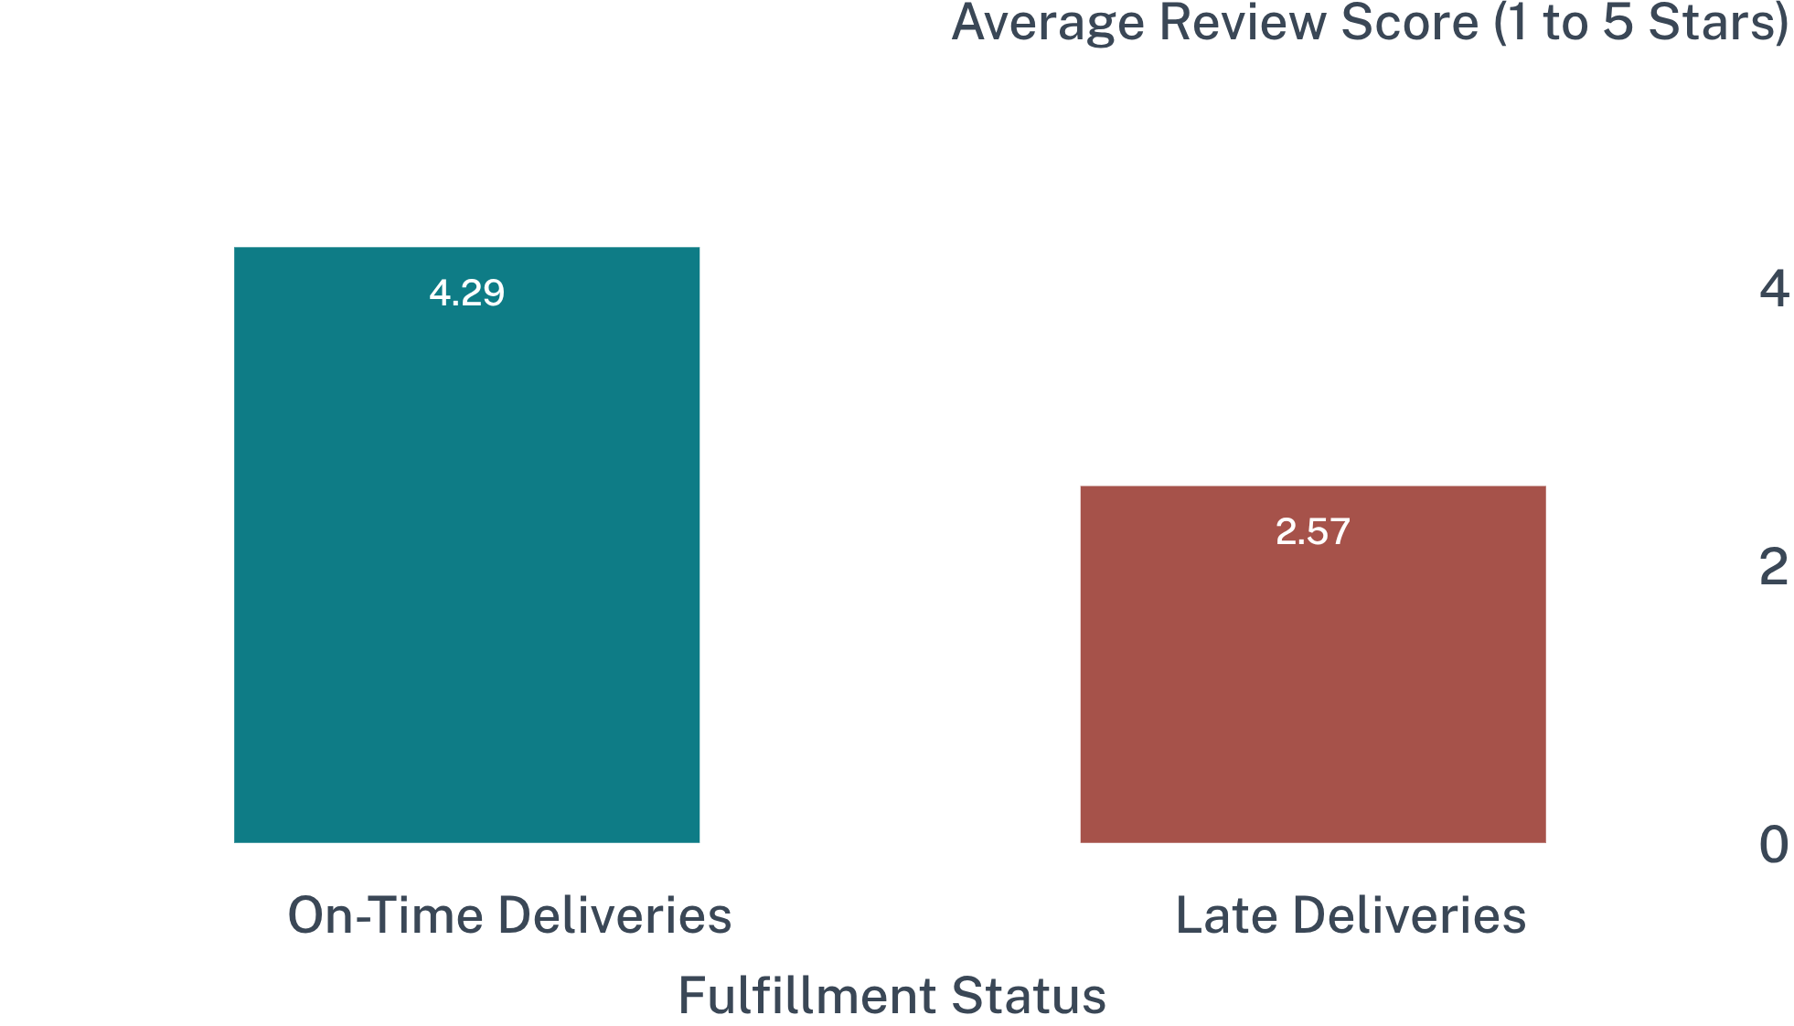
Late deliveries align with much lower review scores
Satisfaction Score Gap
−1.72
A 40% reduction in customer satisfaction between prompt and delayed deliveries.
ANALYTICAL FINDING VS CAUSALITY
This data demonstrates a strong statistical association rather than strict single-factor causality. Delayed orders frequently encounter damaged parcels, seller responsiveness issues, or stockout friction.
Review scores drop by 1.72 points on a 5-point scale when orders miss the estimated arrival date.
09
Notes:
Focus on the central customer experience insight: on-time orders score 4.29, while late orders collapse to 2.57. Explicitly state the methodological caveat that this is a strong association, not proof that delay is the sole causal driver.

Slide 10

Three business priorities emerge from the findings
PRIORITY 01 · COMMERCIAL DEFENSE
Protect core revenue-driving categories
Maintain tight stock availability, seller SLA adherence, and promo visibility across Health & Beauty, Watches & Gifts, and Bed, Bath & Table.
PRIORITY 02 · REGIONAL LOGISTICS
Investigate high-delay shipping corridors
Audit regional transit carriers and postal partner SLAs in Rio de Janeiro (11.6% late) and Northeast routes (AL 23.1%, BA 15.9%) to align delivery estimates.
PRIORITY 03 · CUSTOMER RETENTION
Treat delivery reliability as satisfaction driver
SUMMARY TAKEAWAY
Sustainable marketplace expansion depends on pairing catalog sales volume with predictable fulfillment standards.
Address delivery friction directly to protect seller ratings and unlock lifetime repeat purchasing beyond the current 3% repeat customer benchmark.
Preserving the distinction between observed evidence and operational recommendations.
10
Notes:
Synthesize the analysis into three actionable business priorities: category protection, targeted regional logistics remediation, and positioning fulfillment reliability as the primary lever for customer retention.

