Slide 1
Applied Unsupervised Learning with Python

Slide 2
Lesson 4: Introduction to Dimensionality Reduction and Principal Component Analysis
Notes:
Lesson Time: 2 hrs

Slide 3
Lesson Objectives
By the end of this lesson, you will be able to:
Understand use cases and motivations for dimensionality reduction.
An overview of the landscape of dimensionality reduction techniques.
Understand principal component analysis (PCA) in more detail.
Apply PCA algorithm to datasets.

Slide 4
Motivation
With the advent of the internet and social media, the amount of data that is being collected increased dramatically. The data is growing not only in terms of depth but also breath; meaning that there are more variables to explore and learn from.
Retailers capturing data using cameras and tracking shopper behaviour through computer vision algorithms
TV Set top boxes that collect viewing behaviour every second
Internet browsing behaviour where each website visit may be a different variable
A self-driving car that uses a combination of cameras, sensors and LIDAR to navigate autonomously
Text data that is generated by people through social media posts or tweets

Slide 5
Discussion
What are the advantages of having more data in both size and complexity?
Notes:
As self-driving cars, internet of things, robots and virtual assistants become more common and embedded in our lives, the data in the world will continue to grow in both size and complexity. From a machine learning perspective, this is a welcome development since the performance of the models depend greatly on the size and quality of the data. For any particular machine learning task, one of the aims of the data scientist is to include more variables that are potentially predictive of a target outcome.

Slide 6
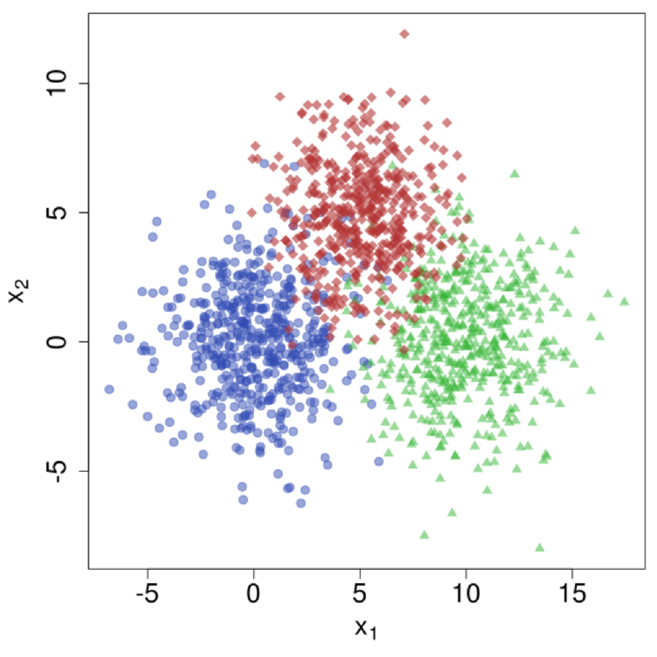
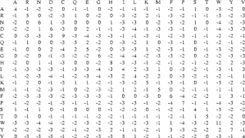
Interpretability problem
If there are thousands or even millions of variables, it will be almost impossible to identify which variables to include in a model through feature exploration. We may also want to reduce the dimensionality so that we can make visual observations of the data in a 2 or 3 dimensional space.

Slide 7
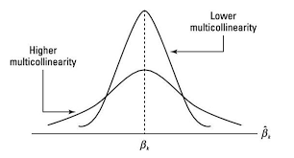
Multicollinearity
Variables in a data set may actually be very highly correlated, with the potential of adversely affecting the performance of the model. To provide an example from a regression model, imagine that A and B are perfectly correlated variables used to predict variable Y. When we train our regression model, the following weights may be allocated to the variables:
A = 0.01, B = 0.99
A = 0.99, B = 0.01
A = 0.5, B = 0.5
From this simple example, we can see that our interpretation of the parameters will be potentially wrong. Now imagine that we have hundreds of variables with messy weights, it will be very hard to generate insights from the model and create accurate simulations.

Slide 8
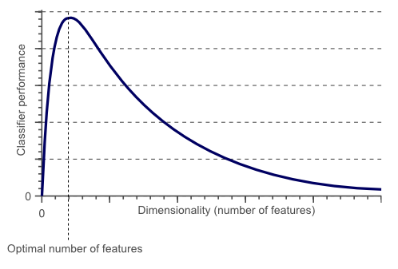
Curse of dimensionality
As the number of dimensions/variables increase in our dataset, the volume of the space increases faster and the dataset becomes sparse. According to Hughes Phenomenon, as the number of features increases, so does the performance of a classifier, until it reaches a point where the performance gradually drops. It is advised to have at least 5 training examples for each dimension in the representation. (2)

Slide 9
Motivation
Due to the above mentioned reasons, it may be a good idea to reduce the dimensionality of a dataset before embarking on training a predictive model or building a data driven product. To summarize the benefits of dimensionality reduction:
Avoid multi-collinearity in order to set weights of the parameters in a model accurately
Reduce the storage space and computational challenges when processing the data
Visualize data in a 2D or 3D space to generate insights
Prevent curse of dimensionality

Slide 10
Discussion
Who here is familiar with dimensionality reduction? Please share examples
Can you give examples from past work experience where dimensionality reduction has proven valuable?

Slide 11
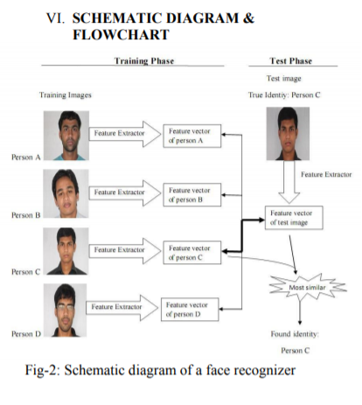
Facial Recognition with Principle Component Analysis (PCA)
One important use case for dimensionality reduction is computer vision exercises such as facial recognition. In one particular facial recognition methodology called Eigenface approach, the PCA algorithm (that we will cover in more detail) is used to match images with associated identities.
In first step, data is split into training and test images where each image in the training set also has an identity label associated with it.
PCA algorithm is employed on the pixels of the image to create a reduced representation of the image through feature extraction so that we end up with the feature vector for each person.
The trained PCA algorithm is then fitted on the images of the test set to create another reduced representation.
The final step is to match the most similar representations generated from the test set to the representations in the training set, thereby recognizing the identity of the person from the image.
https://arxiv.org/pdf/1807.03283.pdf
Notes:
Please feel free to read the article for more information, especially after we cover PCA algorithm in more detail.

Slide 12
Text Categorization
In this real world example, any type of text based documents can be categorized using a bag of words approach and then applying a dimensionality reduction algorithm.
E-mails as an example can be grouped into spam or not spam by counting the occurrence of each word in an email where words such as “lottery” or “pay” would be better features for spam classification than “girl ” or “boy”.
The next step would be to compute the low-dimensional projection of the bag-of-words vectors and use these vectors in classification algorithms such as Logistic Regression or Random Forest instead of original emails.
Using the projections instead of original emails would enable the training to run much faster and overfitting will be reduced.

Slide 13
Overview of Dimensionality Reduction Techniques

Slide 14
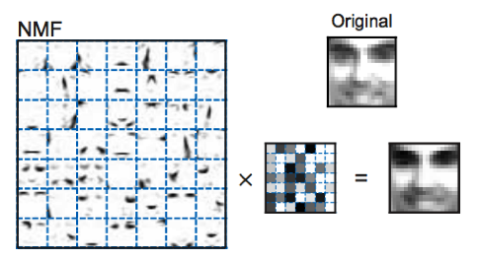
Non-negative matrix factorization (NMF)
Non-negative matrix factorization is a group of algorithms in multivariate analysis and linear algebra where a matrix V is factorized into (usually) two matrices W and H, with the property that all three matrices have no negative elements:
This non-negativity makes the resulting matrices easier to inspect. NMF finds applications in such fields as astronomy, computer vision, document clustering, recommender systems, and bioinformatics. We will get a chance to work with this algorithm in Chapter 7
W
H
V

Slide 15
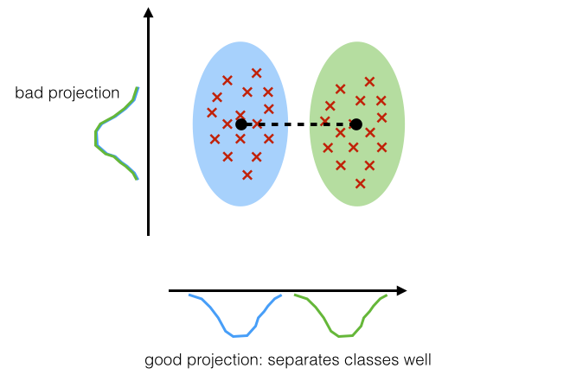
Linear discriminant analysis (LDA)
Linear discriminant analysis (LDA) is a generalization of Fisher's linear discriminant, a method to find a linear combination of features that characterizes or separates two or more classes of objects or events. LDA is also closely related to principal component analysis (PCA) in that they both look for linear combinations of variables which best explain the data. LDA explicitly attempts to model the difference between the classes of data where PCA on the other hand does not take into account any difference in class. LDA has been used in many applications such as bankruptcy prediction, facial recognition, biomedical studies classifying diseases and topic analysis from textual data. This algorithm will also be used in Chapter 7.

Slide 16
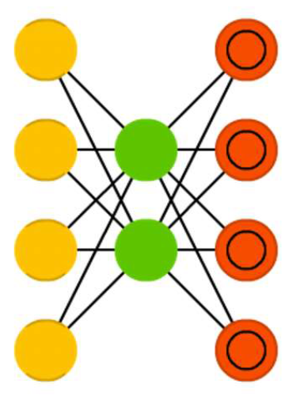
Autoencoder
Autoencoders are a deep learning method employing feed-forward neural networks with a bottle-neck hidden layer. The basic idea behind autoencoders is to encode information (as in compress, not encrypt) automatically, hence the name.
• The entire network always resembles an hourglass like
shape, with smaller hidden layers than the input and
output layers.
AEs are also always symmetrical around
the middle layer(s) (one or two depending on an even
or odd amount of layers).
• The smallest layer(s) is|are almost always in the
middle, the place where the information is most
compressed (the chokepoint of the network)
We will cover autoencoders in more detail in the next chapter.
Hidden
layer
Input layer
Output layer

Slide 17
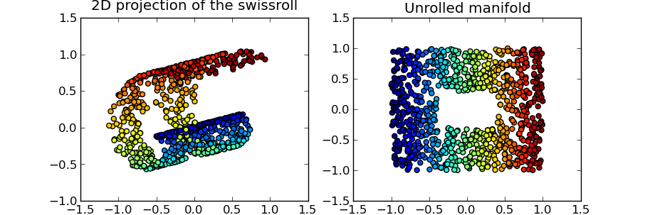
T-distributed Stochastic Neighbor Embedding (t-SNE)
T-SNE is a non-linear dimensionality reduction technique well-suited for embedding high-dimensional data for visualization in a low-dimensional space of two or three dimensions. T-SNE has been used for visualization in a wide range of applications, including computer security research, music analysis, cancer research, bioinformatics, and biomedical signal processing. We will cover T-SNE in more detail in the sixth chapter.

Slide 18
Principal Component Analysis (PCA)

Slide 19
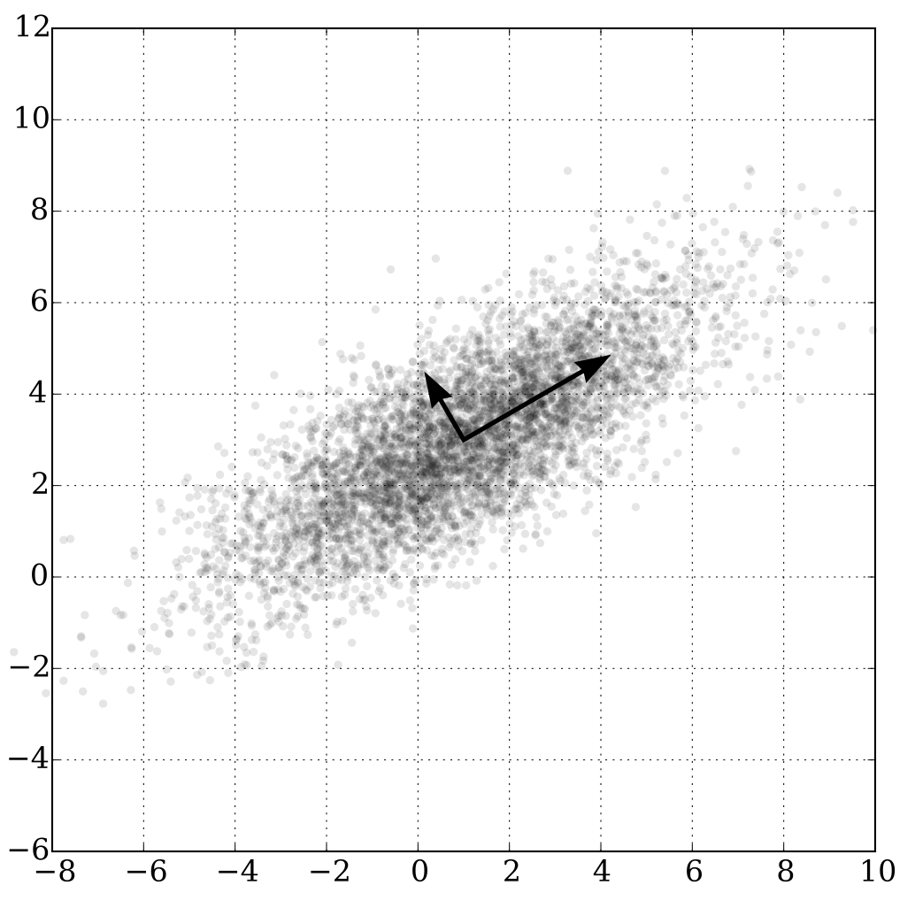
PCA Overview
PCA is mathematically defined as an orthogonal linear transformation that transforms the data to a new coordinate space such that the greatest variance (basically how widely the data is spread out) by some projection of the data comes to lie on the first coordinate (called the first principal component), the second greatest variance on the second coordinate, and so on.
PCA can be thought of as fitting an n-dimensional ellipsoid to the data, where each axis of the ellipsoid represents a principal component. If some axis of the ellipsoid is small, then the variance along that axis is also small.
Second principle component
First principle component

Slide 20

PCA Step 1- Calculate Covariance Matrix
To find the axes of the ellipsoid, we compute the covariance matrix of the data.
Covariance is a measure of the joint variability of two random variables. If the greater values of one variable mainly correspond with the greater values of the other variable, and the same holds for the lesser values, (i.e., the variables tend to show similar behavior), the covariance is positive.
Consider the 2x2 covariance matrix below:
(
0.5
0.5 0.7
)
This means that the variance of variable x is 1 and variance of y is 0.7 and the covariance between them is 0.5.

Slide 21
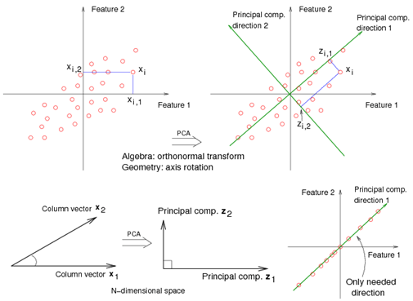
PCA – Step 2: Orthogonal Transformation
Then the next step is to calculate the eigenvalues and corresponding eigenvectors of this covariance matrix. The mathematics of the calculation can become complicated, however for our purposes to understand the intuition behind the algorithm we should know that eigenvectors can tell us about the direction of maximum variance in our data and eigenvalues will tell us which eigenvectors are the most important. It follows that the direction of the first principal component is given by the first eigenvector of the covariance matrix. The second principal component direction (the direction orthogonal to the first component that has the largest projected variance) is the eigenvector corresponding to the second largest eigenvalue and so on.
Notes:
https://onlinecourses.science.psu.edu/stat508/book/export/html/657

Slide 22
Exercise 1: Applying PCA algorithm
In this activity, we will use PCA algorithm and apply it on a sample data to understand the intuition behind it.

Slide 23
Exercise 2: Applying PCA algorithm for Facial Recognition
In this exercise we will apply the PCA algorithm to the faces of some famous people. As discussed earlier, this is a real world example of how PCA is being used to reduce dimensionality of images where data size is significantly reduced so it is easier to train machine learning algorithms while maintaining the most important features of the image data.

Slide 24
Activity 1: Applying PCA algorithm on Iris Dataset
In this activity, please pair up with someone else in the class.
First we will load the Iris dataset which consists of 50 samples from each of three species of Iris (Iris setosa, Iris virginica and Iris versicolor). Four features were measured from each sample: the length and the width of the sepals and petals, in centimeters.
Then the aim will be to:
1a) Fit the PCA algorithm with 3 components and visualize the explained variance ratio by number of components. Therefore we should have the explained variance ratio on one axis, and the number of components on the second axis.
1b) Fit the PCA algorithm with 2 components and visualize the data on a two dimensional space.

Slide 25
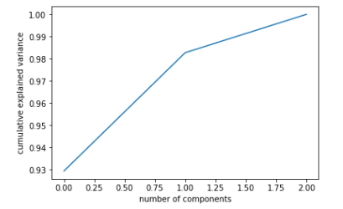
Solution 1: ) Fit the PCA algorithm with 3 components and visualize the explained variance ratio by number of components
1

Slide 26
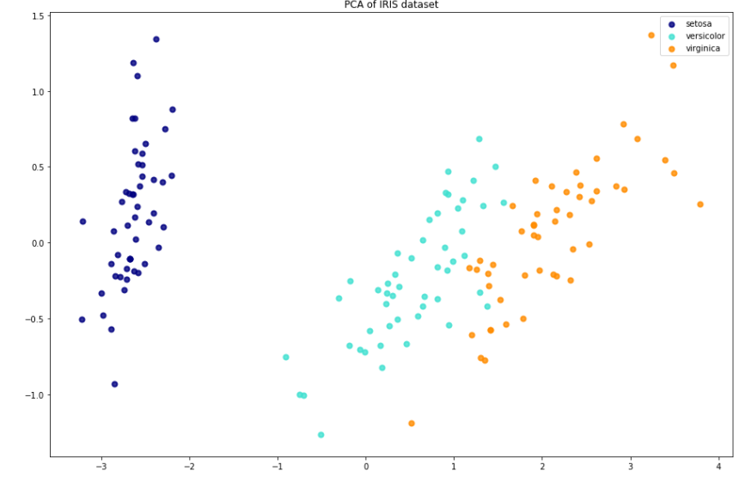
Solution 2: ) Fit the PCA algorithm with 2 components and visualize the data on a two dimensional space.
2

Slide 27
Discussion
Now that we know about the PCA algorithm, can you think of any more use cases where PCA can be potentially applied?
Notes:
Instructor Notes
- To deal with potentially negative values after subtraction.

Slide 28
Summary
In this lesson, we
Explored some use cases and motivations for dimensionality reduction.
Provided an overview of the landscape of dimensionality reduction techniques.
Understand principal component analysis (PCA) in more detail.
Apply PCA algorithm to different datasets.

Slide 29
Practice Questions
1) Which one of the below is not a downside of having thousands of features?
Curse of dimensionality
Interpretability
Increased bias (underfitting)
2) Which one is a dimensionality reduction algorithm?
Non-negative matrix factorization
Linear regression
Random Forest
3) Which layer in a autoencoder creates a bottle-neck that is used to compress input data?
Input layer
Hidden layer
Output layer
Notes:
Answers:
1) Which one of the below is not a downside of having thousands of features?
Curse of dimensionality
Interpretability
Increased bias (underfitting)
2) Which one is a dimensionality reduction algorithm?
Non-negative matrix factorization
Linear regression
Random Forest
3) Which layer in a autoencoder creates a bottle-neck that is used to compress input data?
Input layer
Hidden layer
Output layer

Slide 30
Practice Questions
4) Which one of the below is a non-linear dimensionality reduction algorithm?
LDA
PCA
T-SNE
5) What is the characteristic of the first component in a PCA algorithm?
It has the most variance
It has lowest log-loss error
6) What do we try to maximize when fitting a PCA algorithm?
Explained variance
Mean square error
Notes:
Answers:
4) Which one of the below is a non-linear dimensionality reduction algorithm?
LDA
PCA
T-SNE
5) What is the characteristic of the first component in a PCA algorithm?
It has the most variance
It has lowest log-loss error
6) What do we try to maximize when fitting a PCA algorithm?
Explained variance
Mean square error

Slide 31
Practice Questions
7) Which one of the below can tell us about the direction of maximum variance?
Eigenvectors
Mean of the vector
Eigenvalues
8) How can we determine the best number of components/features to reduce our dataset?
Calculating explained variance by number of components and identifying the plateau of diminishing returns
Finding out the maximum eigenvector and the corresponding component
9) PCA Algorithm is susceptible to large values. What would be a good way to alleviate this?
Normalization/scaling of data
Mean-centering
10) Which one would be a good use case for PCA algorithm?
Identifying different cluster of objects within an image
Reduce size of images prior to image recognition
Notes:
Answers
7) Which one of the below can tell us about the direction of maximum variance?
Eigenvectors
Mean of the vector
Eigenvalues
8) How can we determine the best number of components/features to reduce our dataset?
Calculating explained variance by number of components and identifying the plateau of diminishing returns
Finding out the maximum eigenvector and the corresponding component
9) PCA Algorithm is susceptible to large values. What would be a good way to alleviate this?
Normalization/scaling of data
Mean-centering
10) Which one would be a good use case for PCA algorithm?
Identifying different cluster of objects within an image
Reduce size of images prior to image recognition

