Slide 1
1
Applied Unsupervised Learning with Python

Slide 2
2
Lesson 3: Neighborhood Approaches and DBSCAN
Lesson Time: [not sure]

Slide 3
3
Lesson Objectives
By the end of this lesson, you will be able to:
Explain the intuition behind neighborhood approaches – mainly DBSCAN
Implement the DBSCAN algorithm from scratch and using packages
Understand the differences between K-Means, Hierarchical Clustering, and DBSCAN

Slide 4
4
Introduction
So far we have covered 2 clustering approaches:
K-Means
Hierarchical Clustering
Powerful algorithms, however not perfect. Often there will be a trade off in complexity vs. time taken to build when it comes to clustering.
The approach you decide to take will depend on a case by case basis. Understand your data and you will understand how to tackle clustering.
Notes:
Instructor Note: Have a discussion in class around the innovative uses of clustering students can come up with.
Start with a concise self-introduction. Provide your educational qualifications, your experience in teaching and working with the technology, as a user in a professional setting and as teacher.
Give a short synopsis of how this class will be conducted. Mention any attendance or pertinent policies.
11/25/2018
4

Slide 5
5
Discuss
What are some examples of how you’ve used K-Means or Hierarchical Clustering after the previous lessons? If you have not implemented them yet, what will you use these methods for?
Why would you choose K-Means over Hierarchical Clustering or vice versa?
Notes:
Instructor Notes:
Responses to this slide will be variable due to highlighting the work of your students. The key point to drive home as a result of this slide should be that K-Means is great for large volumes of data that are easily separable (think discrete blobs of data), whereas Hierarchical Clustering will be helpful for more complex, interwoven data.
Hierarchical Clustering also benefits from not needing to know exactly how many clusters you want a priori.

Slide 6
6
K-Means vs Hierarchical Clustering
K-Means –
Powerful but simple implementation of solving clustering.
Random initialization of centroids leads to quality performance on discrete data sets.
Less likely to converge properly on complex data sets (think crescent moons)
Still valuable for simple data and “big” data applications due to efficiency.
Hierarchical Clustering –
More complex clustering implementation – takes longer
Iteratively moves through data points to build a structured hierarchy of potential clusters.
Slower but more capable of adapting to complex data applications.

Slide 7
7
Discuss
Why is K-Means better suited to what we have been calling “simple” data?
Why might Hierarchical Clustering be better if we don’t know how many clusters we want before running our clustering approach?
Notes:
Instructor Notes:
K-Means is better suited for simple data because it works by simply calculating Euclidean distance from a centroid to all points in a dataset and grabbing its closest neighbors. This approach to searching doesn’t care to capture important information about the overall structure in your data. It just grabs closest points.
Hierarchical Clustering is better if you don’t know how many clusters you will want because it iteratively builds different potential clusters on its own, which you can then review for clusters in a dendrogram. It is more exhaustive and will take longer but it gives you a great overview of how you can carve your data into groups.

Slide 8
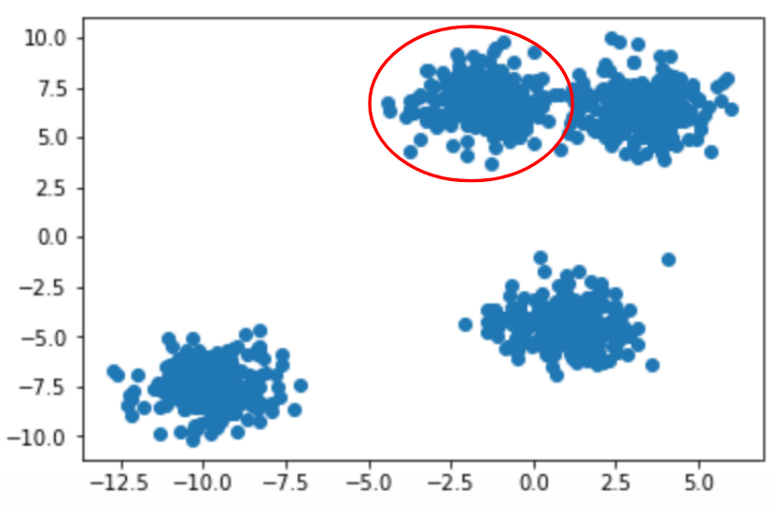
6
Who are my neighbors?
Almost all clustering techniques deal with the notion of neighbors in your data set.
In the past we’ve seen the neighbor search conducted with straightforward Euclidean distance.
Depending on how close the nearest point is, they can be considered a neighbor
Example on the right shows 4 “neighborhoods” with one circled in red.

Slide 9
9
Discuss
How do we know if every data point in your set is considered a quality neighbor?
Is just using Euclidean distance the best we can do to evaluate neighbor candidacy?
Notes:
Instructor Notes:
With the approaches we’ve covered so far, every point in your data set will be classified into a cluster. This is a blanket approach since we do not consider the possibility that some data points are random noise and should not be part of any neighborhood.
No, Euclidean distance only as an approach feeds into the shortcomings related to the prior question. If you had an extremely sparse data set, K-Means will still find clusters since it doesn’t have much to stop it from exploring globally.

Slide 10
6
DBSCAN: Intro
DBSCAN = Density-Based Spatial Clustering of Applications with Noise
Builds clusters using the concept of density as the primary driver.
Uses hyperparameters of neighborhood radius (often seen as eps) and minimum points threshold.
For any given point in your dataset, DBSCAN evaluates cluster membership by seeing which nearby points fall into its neighborhood radius, and then checks to see if the number of neighbors exceeds the minimum points threshold.

Slide 11
6
DBSCAN: In Depth
Steps to implementing DBSCAN -
Given n unvisited sample data points, move through each point in a loop and mark as visited.
From each point look at the distance to every other point in the data set.
For all points that fall within the neighborhood radius hyperparameter, connect them as neighbors.
Check to see if the number of neighbors is at least as many as minimum points required.
If minimum point threshold reached, group together as a cluster. If not, mark point as noise.
Repeat until all data points are categorized in clusters or as noise.

Slide 12
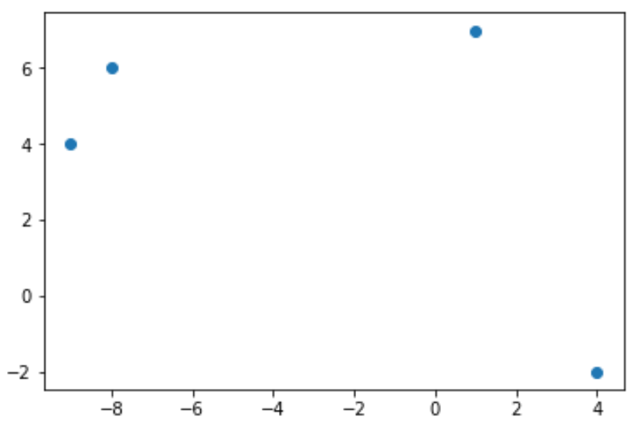
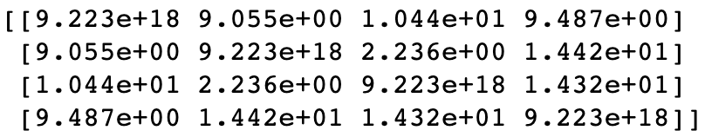
6
DBSCAN: In Depth Example
Given 4 sample data points, view each point as its own cluster.
[ (1,7) ], [ (-8,6) ], [ (-9,4) ] , [ (4, -2) ]
Calculate pairwise Euclidean distance between each of the points.

Slide 13
6
DBSCAN: In Depth Example
Original Points Reference: [ (1,7) ], [ (-8,6) ], [ (-9,4) ] , [ (4, -2) ]
From each point expand out a neighborhood size and form clusters.
For the purpose of this example, lets imagine we passed through a neighborhood radius of 3.
This means that any two points will be neighbors if the distance between them is less than 3.
Points (-8,6) and (-9,4) are now candidates for clustering.
Points that have no neighbors are marked as noise and remain un-clustered.
Points (1,7) and (4,-2) fall out of our frame of interest as useless in terms of clustering.

Slide 14
6
DBSCAN: In Depth Example
Original Points Reference: [ (1,7) ], [ (-8,6) ], [ (-9,4) ] , [ (4, -2) ]
Points that have neighbors are then evaluated to see whether they pass the minimum points threshold
In this example, if we had passed through a minimum points threshold of 2 then points (-8,6) and (-9,4) can formally be grouped together as a cluster.
If we had a minimum points threshold of 3, then all 4 data points in this set would be considered superfluous noise.
Repeat this process on remaining un-visited data points.

Slide 15
6
Exercise 1: Evaluating the Impact of Neighborhood Radius Size
Scenario: For any given data set you will need to tailor the hyperparameters of DBSCAN to fit the problem appropriately. Evaluate how small differences in neighborhood radius size can drastically affect the output of your DBSCAN clustering algorithm.
Use Sci-Kit Learn DBSCAN implementation for this exercise. You will build your own DBSCAN from scratch for Activity 1.
Read DBSCAN documentation to learn what field corresponds to Neighborhood Size
Keep Minimum Points threshold constant for this exercise.

Slide 16
16
Discuss
Was modifying the neighborhood radius size impactful in changing the final cluster label outputs for your data set?
What were the ideal hyperparameters for your data set?
Notes:
Instructor Notes –
Modifying your neighborhood radius size should drive a sizeable change in output labels if the data set is in the same scale. For example with the dataset we provided in the Notebook, you will see large changes with 0.1 magnitude changes in neighborhood radius size.
Answers will vary. Using the data set we provided in your Notebook, you will reach acceptable results with neighborhood radius of 0.7 and 10 minimum points.

Slide 17
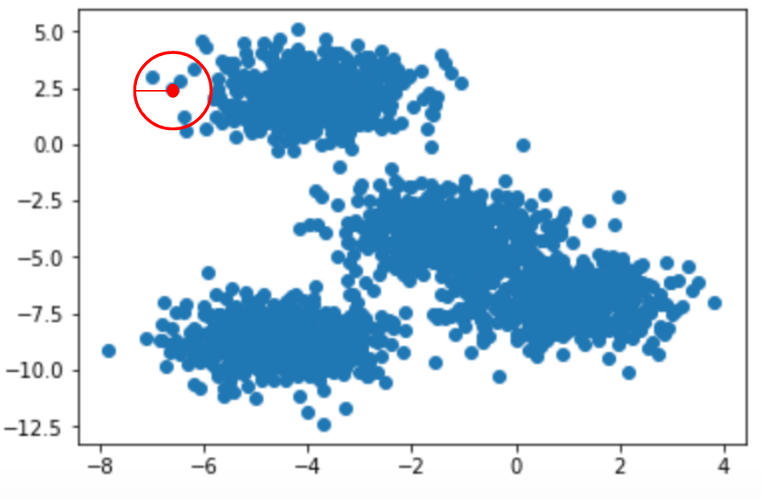
6
DBSCAN Attributes: Neighborhood Radius
Neighborhood radius is often tied to the ‘eps’ field in DBSCAN implementations.
Radius size dictates how large of an area is searched around a given point to find neighbors
A smaller radius size means fewer neighbors, a larger one means more options to choose from.
Example to left shows a sample neighborhood search radius in red.

Slide 18
6
Activity 1: DBSCAN from Scratch
Scenario: You are given a data set without prior background information and are requested to find the clusters that fit the data set best.
Aim: Given what you’ve learned about DBSCAN and distance metrics from prior lessons, build an implementation of DBSCAN from scratch in Python. You are free to use NumPy and SciPy to evaluate distances here.
You may not use the Sci-Kit Learn implementation or functions here.
Follow the workflow seen in Slide 11 to implement your DBSCAN approach

Slide 19
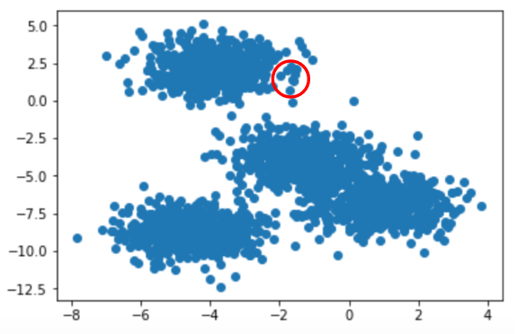
6
DBSCAN Attributes: Minimum Points
In addition to Neighborhood Radius, Minimum Points Threshold is a key hyperparameter that affects DBSCAN performance.
Dependent on the number of samples in your data. Smaller data set may call for lower minimum points.
Helps deal with the concept of noise – just because points are close doesn’t mean they are good cluster candidates.
Example on right shows a potential neighborhood in red, with ~7 points. If minimum points is 10 then all 7 points will be marked as NOISE, not in a cluster.

Slide 20
6
Exercise 2: Evaluating the Impact of Minimum Points Threshold
Scenario: For any given data set you will need to tailor the hyperparameters of DBSCAN to fit the problem appropriately. Evaluate how small differences in minimum points threshold can drastically affect the output of your DBSCAN clustering algorithm.
Use Sci-Kit Learn DBSCAN implementation for this exercise.
Read DBSCAN documentation to learn what field corresponds to minimum points threshold.
Keep Neighborhood Radius Size constant for this exercise.

Slide 21
21
Discuss
Was modifying the minimum points threshold impactful in changing the final cluster label outputs for your data set?
What were the ideal hyperparameters for your data set?
Notes:
Instructor Notes –
Modifying your minimum points threshold should result in a noticeable change in output labels if the data set based on how many points are in your data set. More data points, less impact, unless minimum points is scaled up accordingly.
Answers will vary. Using the data set we provided in your Notebook, you will reach acceptable results with neighborhood radius of 0.7 and 19 minimum points.

Slide 22
6
Activity 2: Compare DBSCAN with K-Means and Hierarchical Clustering
Scenario: Your manager is asking you to evaluate different clustering approaches to see which works best for your use case. You need to be able to report back on which clustering method is most relevant based off the data you have available.
Aim: Using Sci-Kit Learn implementations, evaluate how each of the clustering methods we’ve learned thus far perform on sample data you generate. You should explore blob-like data features as well as more complex data landscapes such as swiss-roll.
- Tune hyperparameters until you reach ideal implementations of all models. Then compare how they do in practice.

Slide 23
23
Discuss
How much did you have to change hyperparameters for each model depending upon the dataset you were applying it to?
Which model performed best across the majority of data sets you tried? Why?
Notes:
Instructor Notes:
Student will likely have had to change their hyperparameters a lot given the data sets we provided in the Notebook. Key lesson here is to constantly drive home that each of the clustering approaches we’ve discussed so far is just a tool framework, and not perfect out of the box.
If students use the data sets we provided in the Notebook, they will see quality performance from Agglomerative Clustering and DBSCAN. These perform best for complex data like the crescent moons and circles because they have constraints in their neighbor search.

Slide 24
24
Summary
DBSCAN is a powerful clustering algorithm that can perform well on complex data sets
It works by dealing with the notion of neighbors through density
The two key hyperparameters for DBSCAN are neighborhood radius size and minimum points threshold
DBSCAN works well but it is not perfect. For any clustering challenge you will face, it is worth exploring K-Means, Hierarchical Clustering, and DBSCAN to find the best fit.

