Slide 1
Applied Unsupervised Learning with Python

Slide 2
Lesson 1: Introduction to Clustering
Notes:
Lesson Time: 2 hrs

Slide 3
Lesson Objectives
By the end of this lesson, you will be able to:
Explain how unsupervised learning fits into the larger machine learning landscape
Prove a real world use case where unsupervised learning is valuable
Explain the importance of clustering
Understand the theory behind K-Means clustering
Implement K-Means clustering algorithms from scratch in Python
Apply pre-packaged K-Means clustering algorithms to your own data

Slide 4
Introduction
Not all data comes packaged nicely for machine learning optimization.
Many times you will be tasked with finding meaning that exists in a large, unknown dataset.
There are frameworks that exist, such as unsupervised learning, that will help with this goal.
This course will cover clustering (hinted at above) first, and then teach concepts of dimensionality reduction, which will help lower the amount of data you need to understand.

Slide 5
Discussion
If you were asked to understand a dataset, how would you do it?
How many people in this class are familiar with supervised learning?
What would you do if you got a dataset without labels, or targets, to train on?

Slide 6
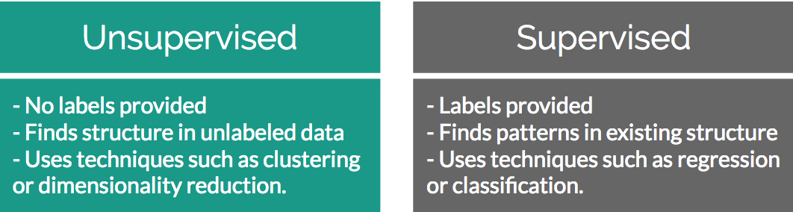
Supervised versus Unsupervised Learning
Unsupervised learning solves problems where a label is unavailable
Supervised learning solves problems where a label is available
Notes:
Instructor Note
A label in this case is whether or not there is a “target” outcome in your dataset. If you want to find the connection in how A impacts B, you will need a label. If you just have A then a label is not available.

Slide 7
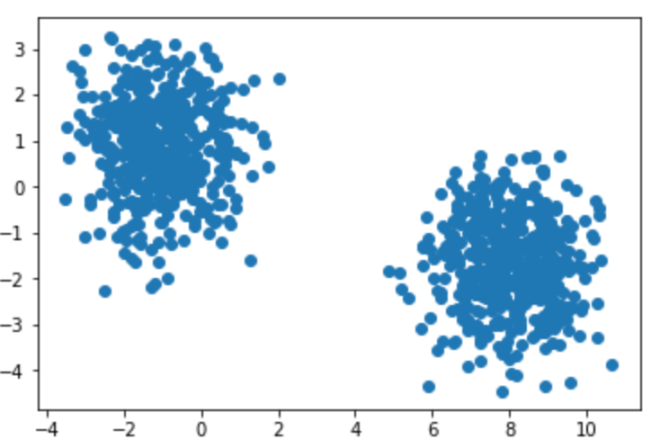
Unsupervised Learning - Clustering
Clustering is all about finding groups of similar data points in your larger data set.
Knowing which groups are similar can be extremely valuable in many use cases:
A very common one is segmentation in marketing. Your customers are all quite different yet still have similarities among them. By finding similar customers you can offer more personalized marketing offers.

Slide 8
Discussion
Who here is familiar with clustering?
Can you give examples from past work experience where clustering has proven valuable?
If you haven’t used it before, can you provide some examples of why knowing what records are similar in your data set may be valuable?

Slide 9
Identifying Clusters

Slide 10
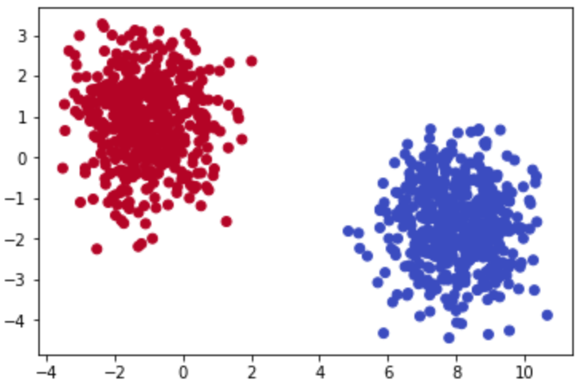
Identifying Clusters
In a two-dimensional space it is quite easy to identify what data points belong to which group
In the real world your datasets will probably have many more than 2 features. This is where unsupervised learning becomes valuable.

Slide 11
Activity 1: Identify Clusters in Data
In this exercise, please pair up with someone else in the class and see if you can identify the number of clusters and where they exist in the data…

Slide 12
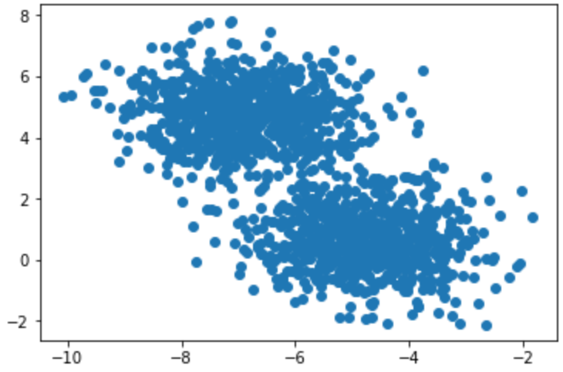
Activity 1: Identify Clusters in Data
1

Slide 13
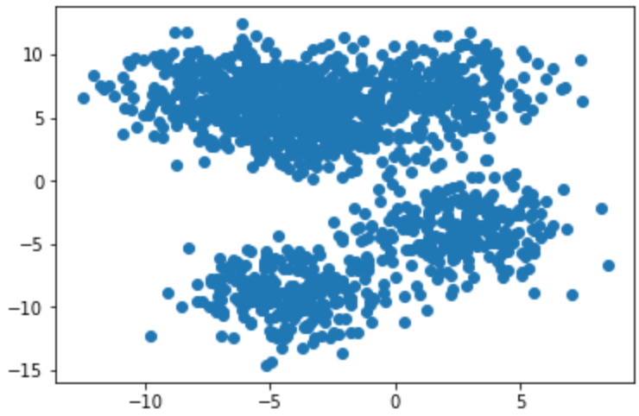
Activity 1: Identify Clusters in Data
2

Slide 14
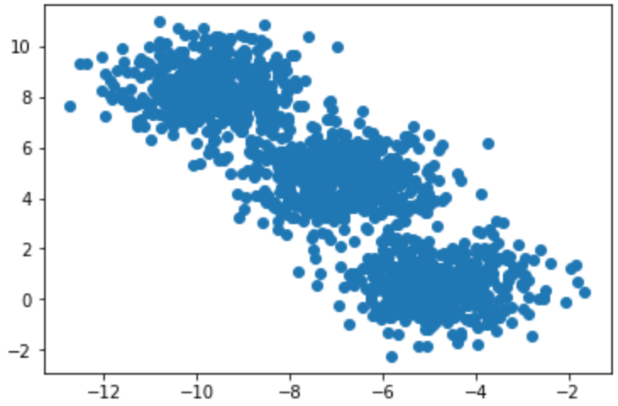
Activity 1: Identify Clusters in Data
3

Slide 15
Discussion
If you felt that exercise was easy, can you please explain why you think so?
Notes:
Possible answers
It is only in 2D space and the clusters are quite well defined.

Slide 16
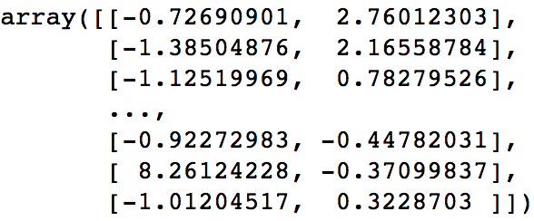
What is “2-dimensional” data?
A dimension in a dataset is another way of simply explaining how many columns it has.

Slide 17
K-Means Clustering

Slide 18
K-Means Clustering
One of the simplest yet most popular clustering algorithms available.
Works by finding arithmetic mean center points among the data and assigning surrounding data points to their group.
The “K” in K-Means corresponds to the number of clusters you expect are in the data, and is the number of unique center points plotted in your feature space.

Slide 19
K-Means Clustering: No Math Intro
Here are the high-level steps behind K-Means:
Pick K centroids (K = expected distinct # of clusters)
Randomly place K centroids anywhere amongst your existing training data
Calculate the Euclidean distance from each centroid to all the points in your training data
Training data points get grouped in with their nearest centroid
Amongst data points grouped into each centroid, calculate the mean data point and move your centroid to that location.
Repeat the above process until convergence, or when membership in each group no longer changes.

Slide 20
Discussion
Does anyone have an idea of what a centroid is?
Notes:
(A centroid is basically just a fancy way to say the geometric center of a figure. This is the mean of all points in the plane. When randomly set at first they are simply random points in the space)

Slide 21
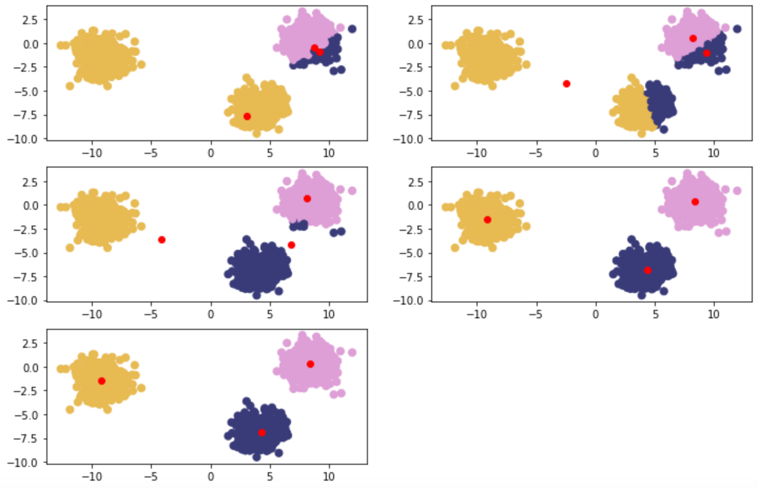
K-Means Clustering: No Math Intro
Notes:
Clockwise from top left – Red points are randomly initialized centroids, and closest data points are assigned to groupings of each centroid (denoted by distinct color).

Slide 22
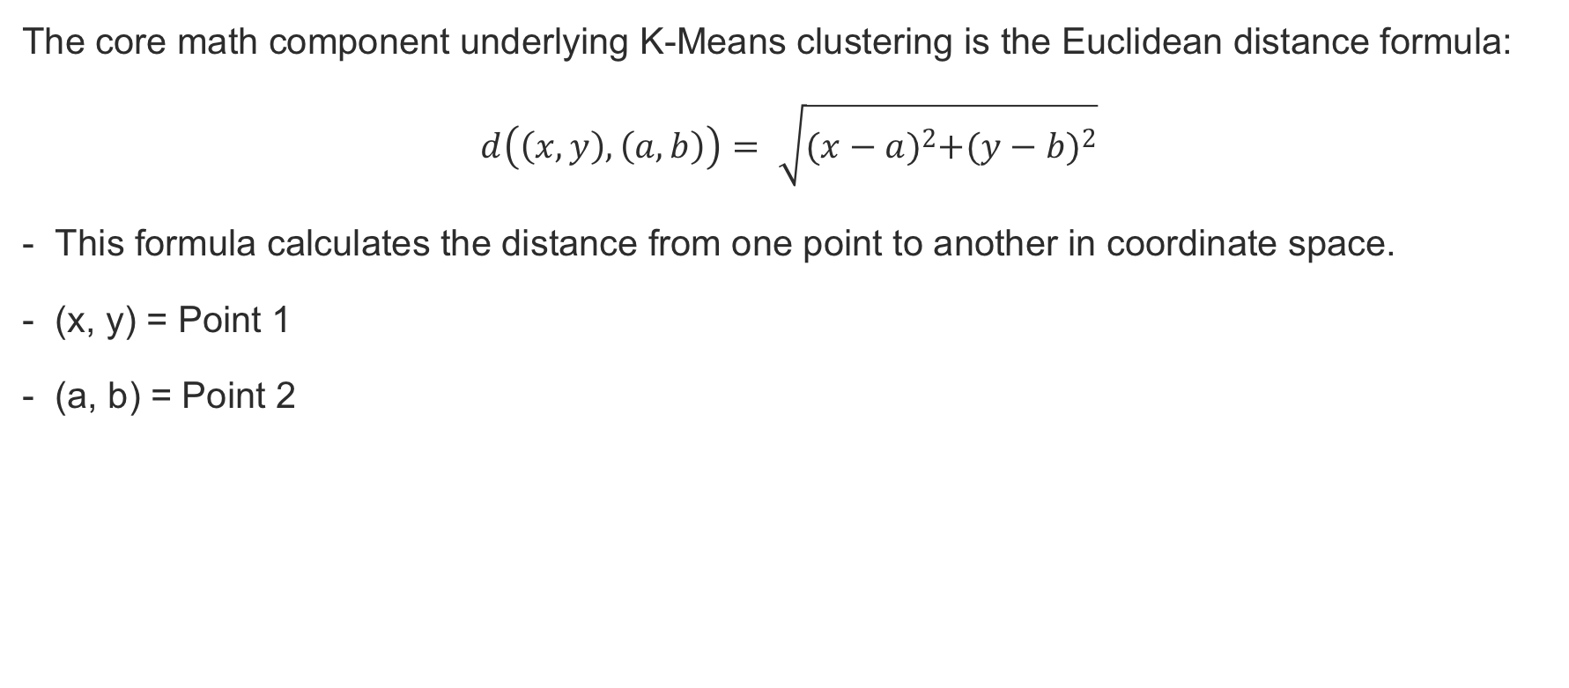
Euclidean Distance
The core math component underlying K-Means clustering is the Euclidean distance formula:
$$d\left(\left(x,y\right),\left(a,b\right)\right)= \sqrt{{(x−a)}^{2}+{(y−b)}^{2}}$$
This formula calculates the distance from one point to another in coordinate space.
(x, y) = Point 1
(a, b) = Point 2

Slide 23

Discussion
The core math component underlying K-Means clustering is the Euclidean distance formula:
$$d\left(\left(x,y\right),\left(a,b\right)\right)= \sqrt{{(x−a)}^{2}+{(y−b)}^{2}}$$
- Why are the points squared after subtraction?
Notes:
Instructor Notes
- To deal with potentially negative values after subtraction.

Slide 24
Example for a Random Point
Imagine you had a dataset that was mapped to a feature space and you initialized a set of random centroids:
[ (2,5) , (8,3) , (4, 5) ]
You want to find which centroid an arbitrary point (0, 8) is assigned to.
Use Euclidean distance to compare arbitrary point to each centroid:
Distance from point to each centroid: [ 3.61, 9.43, 5.00 ]
Given the smallest distance is seen relative to Centroid 1, your arbitrary point is assigned to Cluster 1.

Slide 25
Example for Cluster 1
Old Centroid for Cluster 1: (2,5)
With your arbitrary point assigned to Cluster 1, imagine that it now contains the following:
[ (0,8), (3,8), (3,4) ]
Calculate the mean point among Cluster 1 members:
Mean point calculation: [ (0+3+3)/3 , (8+8+4)/3 ] = (2, 6.67)
New Centroid for Cluster 1 now becomes (2, 6.67)
Repeat this process until the difference between Old Centroid and New Centroid = 0

Slide 26
Implementing K-Means

Slide 27
Activity 2: Implementing K-Means
Scenario: You are asked in an interview to implement a K-Means clustering algorithm from scratch to prove you understand how it works.
Aim: To truly understand how something works you need to build it from scratch. Take what you have learned in the above sections and implement K-Means from scratch in Python.

Slide 28
Activity 2: Implementing K-Means
Step 1:
Using NumPy and the previous Euclidean distance formula, write a function that calculates the distance between two coordinates.
Step 2:
Write a K-Means function that takes in a dataset and number of clusters (K) and returns final cluster centroids, as well as the data points that make up that cluster’s membership.

Slide 29
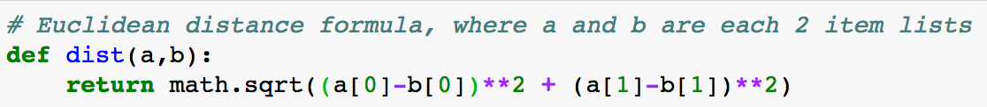
Activity 2: Implementing K-Means – Step 1
Step 1:
Using NumPy and the previous Euclidean distance formula, write a function that calculates the distance between two coordinates.
The above is just an example implementation of Euclidean distance. You are welcome to use available distance packages from SciPy or NumPy to complete this task.

Slide 30
Discussion
Why does the barebones Euclidean distance method perform poorly compared to pre-packaged ones?
Notes:
The barebones implementation is great for showing the underlying mechanisms, however it loops through each point one by one and is very computationally inefficient. Packaged implementations do pairwise distances across the entire matrices all at once.

Slide 31
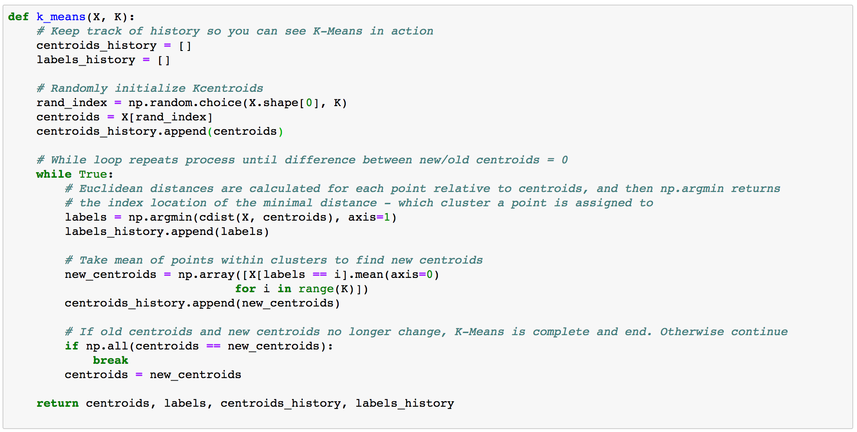
Activity 2: Implementing K-Means – Step2
Step 2:
Write a K-Means function that takes in a dataset and number of clusters (K) and returns final cluster centroids, as well as the data points that make up that cluster’s membership.

Slide 32
Summary
In this lesson, we:
Explained how unsupervised learning fits into the larger machine learning landscape
Provided a real world use case where unsupervised learning is valuable
Explained the importance of clustering
Explained the theory behind K-Means clustering
Implemented K-Means clustering algorithms from scratch in Python

Slide 33
Practice Questions
How are supervised and unsupervised learning different?
What is a cluster?
Are clusters always valuable in a dataset?
How are dimensions expressed in a dataset?
How many dimensions can be easily visualized by humans?
Notes:
Answers:
How are supervised and unsupervised learning different?
Supervised is labeled, Unsupervised is not.
What is a cluster?
A cluster is a grouping of similar data that exists within your larger dataset.
Are clusters always valuable in a dataset?
Not necessarily. Just because you find a pocket of data that is similar to each other does not mean that it is correlated with anything you’re interested in.
How are dimensions expressed in a dataset?
Dimensions are expressed as features in a dataset, or simply the number of columns available per row. For example a 2-dimensional dataset will have 2 columns.
How many dimensions can be easily visualized by humans?
3 dimensions

Slide 34
Practice Questions
6. What does the “K” represent in K-Means clustering?
7. T/F – The starting points for K-Means are determined by taking the mean of all the points in the space.
8. What is the formula that underpins K-Means clustering?
9. When does a K-Means clustering algorithm finish running?
10. T/F – K-Means will still find clusters in a dataset even if all of the data is fairly similar.
Notes:
Answers:
What does the “K” represent in K-Means clustering?
K represents the expected number of distinct clusters
T/F – The starting points for K-Means are determined by taking the mean of all the points in the space.
False – the starting points for K-Means are randomly initialized
What is the formula that underpins K-Means clustering?
Euclidean distance formula
When does a K-Means clustering algorithm finish running?
K-Means finishes when it converges, and there is no difference between the newest calculated centroid and old one in the training loop.
T/F – K-Means will still find clusters in a dataset even if all of the data is fairly similar.
True. K-Means does it’s best to find the K number of clusters you tell it to. That means even if you have one large cluster of data but tell it to find K clusters within it, it will break it into those K number of groups the best it can.

