Slide 1
1
Applied Unsupervised Learning with Python

Slide 2
2
Lesson 1: Introduction to Clustering
Lesson Time: [not sure]

Slide 3
3
Lesson Objectives
By the end of this chapter you will learn:
Distinguish between supervised learning and unsupervised learning
Explain the concept of clustering
Implement k-means clustering algorithm using built-in Python packages

Slide 4
4
Introduction
Not all data comes packaged nicely for machine learning optimization.
Many times you will be tasked with finding meaning that exists in a large, unknown dataset.
There are frameworks that exist, such as unsupervised learning, that will help with this goal.
This course will cover clustering (hinted at above) first, and then teach concepts of dimensionality reduction, which will help lower the amount of data you need to understand.
Notes:
Instructor Note: Have a discussion in class around the innovative uses of clustering students can come up with.
Start with a concise self-introduction. Provide your educational qualifications, your experience in teaching and working with the technology, as a user in a professional setting and as teacher.
Give a short synopsis of how this class will be conducted. Mention any attendance or pertinent policies.
11/25/2018
4

Slide 5
5
Discuss
If you were asked to understand a dataset, how would you do it? How many people in this class are familiar with supervised learning? What would you do if you got a dataset without labels, or targets, to train on?
Notes:
Possible answers:
Look at descriptive statistics for each feature in the data set (mean, median, mode, std deviation, etc). Understand how the data was collected and put together. Run Pearson correlation on features to see which can potentially interact.
If no examples are shared, a simple example of supervised learning can be a linear regression that uses features of a home (number of bedrooms, bathrooms, etc) to predict its price. In advance you will have a training set with features and target outcomes.
Ask what this dataset was originally collected for, if there was an original purpose. Fully understand what your superior is asking for as a result of analysis. See whether or not it is a truly unsupervised learning-type problem.

Slide 6
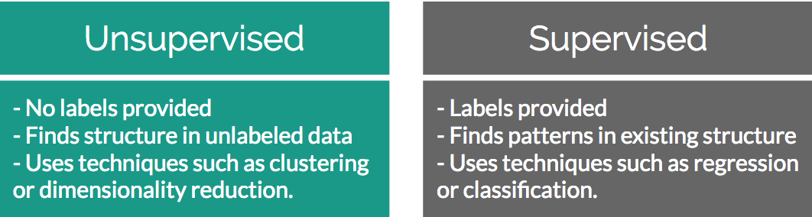
6
Unsupervised Learning versus Supervised Learning
Unsupervised learning solves problems where a label is unavailable
Supervised learning solves problems where a label is available

Slide 7
7
Discuss
Name the fields where supervised or unsupervised learning is used.
Notes:
Instructor Notes:
The responses here will be dependent on the backgrounds of your students.
Overall the responses to this discussion should drive home that supervised learning is used in places where we know the predicted outcomes and want to find a function mapping features to that outcome, and unsupervised learning is where we don’t know the outcomes and are trying to find a structure in the data.

Slide 8
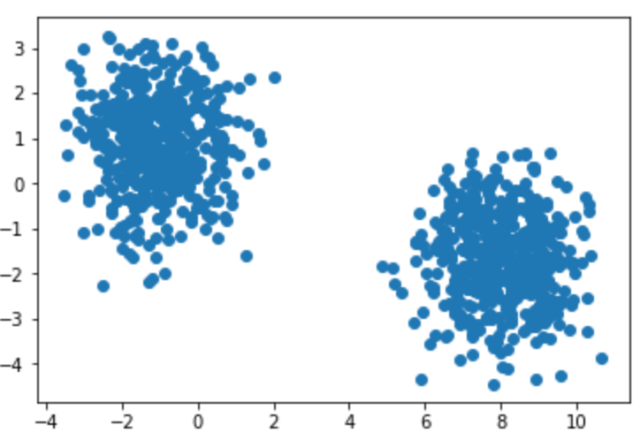
6
Clustering
Clustering is all about finding groups of similar data points in your larger data set.
Knowing which groups are similar can be extremely valuable in many use cases:
A very common one is segmentation in marketing. Your customers are all quite different yet still have similarities among them. By finding similar customers you can offer more personalized marketing offers.

Slide 9
9
Discuss
Can you give examples from past work experience where clustering has proven valuable? If you haven’t used it before, can you provide some examples of why knowing what records are similar in your data set may be valuable?
Notes:
Potential answers:
1) If no examples are given, a classic example of clustering is finding groups of similar customers in a CRM/invoice database.
2) Refer to above potential answer above if no examples are given. Additional example – finding servers in a datacenter that have similar workloads so you can group them and find potential optimizations
3) If you were to find groups in a large amount of invoice data set you can create more targeted marketing campaigns. Clustering is extremely helpful when you have a very large data set that is impossible to sort by hand.

Slide 10
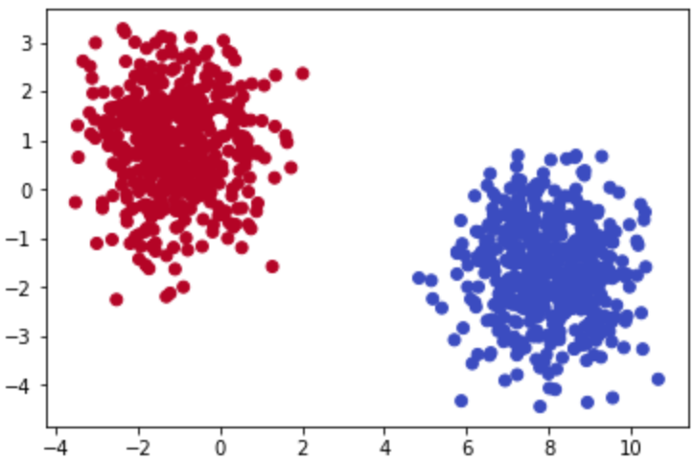
6
Identifying Clusters
In a two-dimensional space it is quite easy to identify what data points belong to which group
In the real world your datasets will probably have many more than 2 features. This is where unsupervised learning becomes valuable.

Slide 11
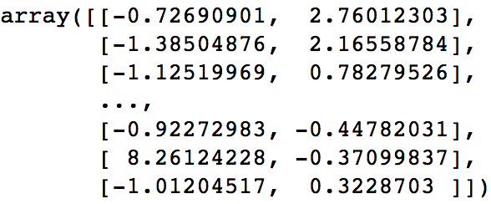
6
Two-Dimensional Data
A dimension in a dataset is another way of simply explaining how many columns it has.

Slide 12
6
Activity 1: Identifying the Cluster in Data
Scenario: You are given two-dimensional plots. Please look at the provided two-dimensional graphs and identify the clusters, to drive the point home that machine learning is important
Aim: Without using any algorithmic approaches, identify where the clusters exist in the data.
Outcome: This exercise will help start to build the intuition around how we identify clusters using our own eyes and thought processes. As you complete the exercises think of the rationale why a group of data points should be considered a cluster versus not.

Slide 13
13
Discuss
How did you derive clusters in the previous activity?
Notes:
Possible answers
It is only in 2D space and the clusters are quite well defined.

Slide 14
6
Introduction to K-Means Clustering
One of the simplest yet most popular clustering algorithms available.
Works by finding arithmetic mean center points among the data and assigning surrounding data points to their group.
The “K” in K-Means corresponds to the number of clusters you expect are in the data, and is the number of unique center points plotted in your feature space.

Slide 15
6
No-Math K-Means Walkthrough
Here are the high-level steps behind K-Means:
Pick K centroids (K = expected distinct # of clusters)
Randomly place K centroids anywhere amongst your existing training data
Calculate the Euclidean distance from each centroid to all the points in your training data
Training data points get grouped in with their nearest centroid
Amongst data points grouped into each centroid, calculate the mean data point and move your centroid to that location.
Repeat the above process until convergence, or when membership in each group no longer changes.

Slide 16
16
Discuss
What is a centroid?
Notes:
(A centroid is basically just a fancy way to say the geometric center of a figure. This is the mean of all points in the plane. When randomly set at first they are simply random points in the space

Slide 17
6
K-Means Clustering In-Depth Walkthrough
Imagine you had a dataset that was mapped to a feature space and you initialized a set of random centroids:
[ (2,5) , (8,3) , (4, 5) ]
You want to find which centroid an arbitrary point (0, 8) is assigned to.
Use Euclidean distance to compare arbitrary point to each centroid:
Distance from point to each centroid: [ 3.61, 9.43, 5.00 ]
Given the smallest distance is seen relative to Centroid 1, your arbitrary point is assigned to Cluster 1.

Slide 18
6
Exercise 1: Calculating Euclidean Distance in Python
Scenario: In this exercise we will create an example point along with 3 sample centroids to help illustrate how Euclidean distance works. Understanding this distance formula is foundational to the rest of our work in clustering.
Outcome: Be able to implement Euclidean distance from scratch and fully understand what it does to points in a feature space.
In this exercise we will be using the standard Python built-in math package. There are no prerequisites for using the math package and it is included in all standard installations of Python. As the name hints at, this package is very useful allowing to use a variety of basic math building blocks off the shelf such as exponentials, square roots, and more.

Slide 19
6
Activity 2: Implementing K-Means Clustering
Scenario: You are asked in an interview to implement a K-Means clustering algorithm from scratch to prove you understand how it works.
Aim: To truly understand how something works you need to build it from scratch. Take what you have learned in the above sections and implement K-Means from scratch in Python.

Slide 20
Discuss
20
Why does the barebones Euclidean distance method perform poorly compared to pre-packaged ones?
Notes:
The barebones implementation is great for showing the underlying mechanisms, however it loops through each point one by one and is very computationally inefficient. Packaged implementations do pairwise distances across the entire matrices all at once.
11/25/2018
20

Slide 21
21
Summary
In this lesson, we:
Explained how unsupervised learning fits into the larger machine learning landscape
Provided a real world use case where unsupervised learning is valuable
Explained the importance of clustering
Explained the theory behind K-Means clustering
Implemented K-Means clustering algorithms from scratch in Python

