Slide 1
Unsupervised Learning with Python

Slide 2
Lesson 1: Introduction to Unsupervised Learning
Notes:
Lesson Time: 2 hrs

Slide 3
Lesson Objectives
By the end of this lesson, you will be able to:
Explain how unsupervised learning fits into the larger machine learning landscape
Prove a real world use case where unsupervised learning is valuable
Explain the importance of clustering
Understand the theory behind K-Means clustering
Implement K-Means clustering algorithms from scratch in Python
Apply pre-packaged K-Means clustering algorithms to your own data

Slide 4
Introduction
Supervised learning solves problems where a label is available
Unsupervised learning solves problems where a label is unavailable
Notes:
Instructor Note (optional)
Fun Fact, Python’s creator, Guido Van Rossum, named Python after the British comedy series "Monty Python’s Flying Circus" and not after the animal.
Fun Fact, the Python interpreter is written in C.

Slide 5
Supervised versus Unsupervised Learning
Supervised learning solves problems where a label is available
Unsupervised learning solves problems where a label is unavailable
Notes:
Instructor Note (optional)
Fun Fact, Python’s creator, Guido Van Rossum, named Python after the British comedy series "Monty Python’s Flying Circus" and not after the animal.
Fun Fact, the Python interpreter is written in C.

Slide 6
Python 2 Versus Python 3
Generally, a lot of the code written for Python 3 will run on Python 2 and vice versa, but this should not be practiced as there are a few syntactic differences that can bring about issues. However, the majority of the differences between the two are under the bonnet.
Currently, support still runs for Python 2, but Python 3 is the only one in active development, meaning any new features brought to the language are only developed for Python 3. Additionally, the majority of commonly used third-party libraries have now ported to Python 3 and are withdrawing development for their Python 2 versions.

Slide 7
Working with The Python Interactive Shell

Slide 8
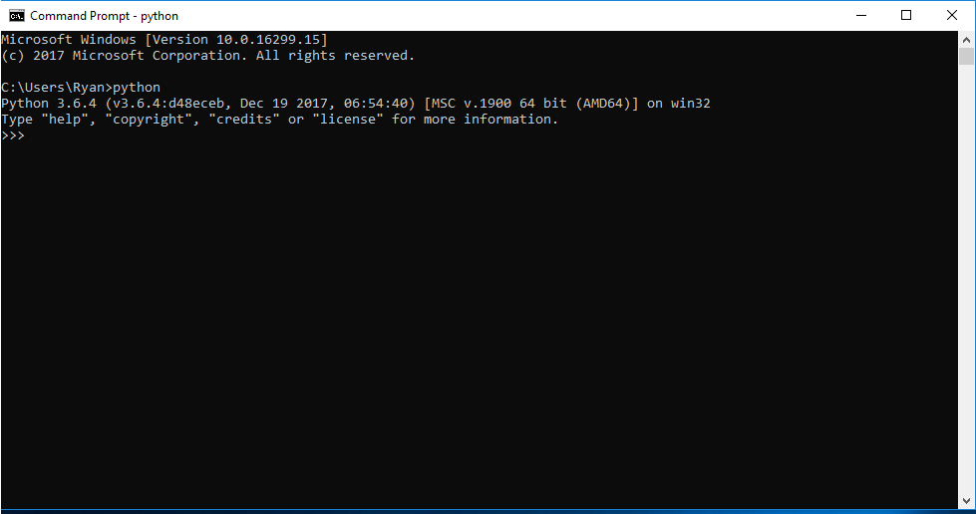
Exercise 1: Checking our Python Installation
In this exercise, we will check if Python is installed properly:

Slide 9
Discussion
Which shells for which operating systems are you familiar with?
Notes:
Possible answers
Bourne-again shell (Bash), Z shell, and Korn shell for Unix based systems such as Linux and the Windows CMD and Windows PowerShell.

Slide 10
Exercise 2: Working with the Python Interpreter
In this exercise, we will learn how to work with the Python interpreter.

Slide 11
Discussion
What are the benefits of the Python interactive shell?
Notes:
Answer
It allows you to quickly execute Python commands without having to compile anything and do quick tests.

Slide 12
Activity 1: Working with the Python Shell
In this activity, we will perform some basic operations using the Python interactive shell.
Notes:
Instructors Note
If the students have trouble doing this you can give them the hint that print() can be called with multiple arguments.

Slide 13
Writing and Running Simple Scripts

Slide 14
Writing and Running Simple Scripts
Python allows you to run your instructions from a saved file. A file containing Python instructions is called a module. A script is a module that can be run. Anything you can run on the interactive shell can be written and ran as a Python script.
By convention, Python scripts should have the file extension .py. The filename should be a valid filename, as defined by your operating system.

Slide 15
Exercise 3: Creating a Script
In this exercise, we will create a script that displays Hello five times in a single line.

Slide 16
Running a File Containing Invalid Commands
As with the interactive shell, putting in invalid instructions also causes an error. Make the following changes to your file and run it:
print("---------------------------------")
print(invalid instruction)
print("---------------------------------")
You should see an error. This output is called a stack trace. It tells us useful things such as where the error happened, what kind of error it was, and what other calls were triggered along the way when we ran our command. Stack traces should be read from bottom to top. Another name for stack trace is traceback
Notes:
Instructor Note: Have the students make suggestions on how to fix the error we’re getting. The correct answer should be adding quotes around invalid instruction on line 2, that is, print(“invalid instruction”). The error should disappear after that.

Slide 17
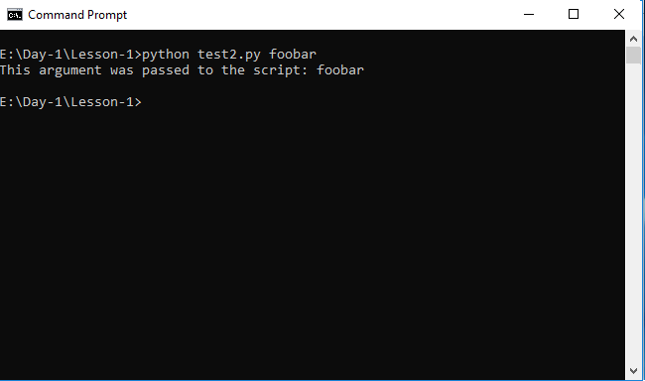
Exercise 4: Passing User Arguments to Scripts
To make a script more dynamic, you can have the user provide arguments to it when calling it:
Output:

Slide 18
Discussion
What are the advantages of the two different methods of running Python programs?
Notes:
Possible answer:
Pros of the interactive shell:
Running Python programs via the interactive shell has the benefit of being able to run quick tests/experiments as opposed to running a saved module which has the overheads of creating a file and having to change and save it if you want to run those changes.
You can run quick calculations using the Python interactive shell.
Pros of running a saved script:
You can reuse code by either running the same script or importing it into your module.
You can automate different tasks and have them run on your system on a schedule.

Slide 19
Activity 2: Running Simple Python Scripts
In this activity, we will create a name card generator script that, when called with a first name and last name, will generate a name card with the names.

Slide 20
Python Syntax

Slide 21
Python Syntax

Slide 22
Variables
Variables in Python can reference values of different data types such as strings, integers, floating point values, Booleans, and different data types and data structures. Python, in contrast to statically typed languages such as Java or C++, doesn’t require you to pre-declare a variable’s data type. It determines the type during runtime.
Additionally, a variable's value and type can change during runtime. Any variable can be used to store any data type and can be used as long as it has already been defined.

Slide 23
Numeric Values – Integers
Mathematically, integers are whole numbers that are either positive or negative. The same definition is applicable for Python integers.
>>> 7
7
We also saw the different symbols, such as +, *, and - that can be used to perform different arithmetic operations on the integer values:
>>> 5 + 4 + 6 + 9
24
>>> 5 * 5
25
Notes:
Instructor Note: Ask the students if they think the number 2.7 is an integer.
Answer: No. It is not a whole number.

Slide 24
Exercise 5: Checking the Type of a Value
We can also check the type of a value by using the type function that’s built into Python.
Notes:
Instructor Note: Explain to the students why we get str as the output in step 4.

Slide 25
Type Conversion
Python allows you to convert string type values to integer type values and vice versa.
Using the built-in str function, you can convert an integer to a string:
>>> str(7)
'7'
>>>

Slide 26
Type Conversion
Strings can also be converted to integers, as long as they hold a valid integer value within. This is done by use of the built-in int function:
>>> int("100")
100
>>>
An error occurs if we try converting a string that doesn’t contain an integer:
>>> int("Foobar")
Traceback (most recent call last):
File "<stdin>", line 1, in <module>
ValueError: invalid literal for int() with base 10: 'Foobar'
Notes:
Instructor Note: Inform the students we will go into further depth on Python data types in the next lesson. For now, we’ll take a look at assigning these values to variables.

Slide 27
Exercise 6: Assigning Variables
In this exercise, we will learn how to assign a value to a variable.

Slide 28
Exercise 7: Using Variables
We use variables when we have a value in our code that we want to use multiple times. They prevent us from having to repeat that value each time we want to use it as variables store the values in memory.
When we store values in memory, we can reuse them as many times as we’d like.
Notes:
Instructor Note
You can have an exercise where you ask the students for their name, give each student a number. Tell them that when you call their name, they should respond with the number you gave them. Using the numbers they give you, you can write out a simple arithmetic operation on the board, calling each student’s name for when you want to use that number.

Slide 29
Python Variables
An interesting phenomenon with Python variables is that they are not deeply linked:
>>> x = 1
>>> y = x
>>> x = 2
>>> print(x)
2
>>> print(y)
1
>>>

Slide 30
Python Variables
A behavior you’d expect would be that y being assigned to x would change upon changing x, but it doesn’t and stays the same.
Since Python variables point to values in memory, when y is assigned to x, it does not make an alias for x but instead points the variable y to where the value of x, 1, is. Changing x changes its pointer from 1 to 2, but y remains pointing to its initial value.

Slide 31
Multiple Assignment
In Python, you can also assign multiple variables in one statement, like so:
>>> a, b, c = 1, 2, 3
>>> print(a)
1
>>> print(b)
2
>>> print(c)
3
>>>

Slide 32
Multiple Assignment
What happens if we try to assign more variables than we pass values?
>>> a, b, c = 1, 2
Traceback (most recent call last):
File "<stdin>", line 1, in <module>
ValueError: not enough values to unpack (expected 3, got 2)
>>>
A similar error is raised when we try and assign more values than there are variables:
>>> a, b = 1, 2, 3
Traceback (most recent call last):
File "<stdin>", line 1, in <module>
ValueError: too many values to unpack (expected 2)
>>>

Slide 33
Activity 3: Using Variables and Assign Statements
Write a script that will use distance in kilometers and time in hours to calculate and print out speed in kilometers per hour, miles per hour, and meters per second.
Hints:
The formula for calculating speed is distance/time = speed
To convert kilometers to miles, divide the kilometers by 1.6
To convert kilometers to meters, multiply the kilometers by 1,000
To convert hours to seconds, multiply hours by 3,600

Slide 34
Naming Identifiers and Reserved Words
An identifier can consist of upper and lowercase letters of the alphabet, underscores, unicode identifiers, and digits 0 to 9.
An identifier cannot begin with a digit, for example, 7x is an invalid variable name.
No other characters can be in identifiers. This means spaces or any other symbols. Spaces most notably occur in module names as some operating systems will permit filenames with spaces. This should be avoided.
A Python keyword cannot be used in an identifier name, for example, import, if, for, and lambda.

Slide 35
Exercise 8: Python Keywords
Certain names in Python cannot be used as they are parts of the language syntax. Such words are known as reserved words or keywords. An example of a reserved word is import, which is a statement used for when you want to import a module into your code.

Slide 36
Discussion
Why do we get a syntax error when we try to assign reserved words?
Notes:
Answer
The Python interpreter tries to parse the keyword’s syntactical meaning which doesn’t fit into the context of a variable assignment. For example, when you try assigning keyword if, Python looks for a condition next but instead finds an equal sign which is invalid.

Slide 37
Python Naming Conventions
Python has several guidelines for naming identifiers that aren’t enforced by the interpreter. These guidelines are meant for consistent code and making it more readable. Please note that these are simply guidelines and the programmer is at liberty to ignore them.
Advantages:
Makes the code easier to read and understand for other programmers since they’d find consistent and instantly recognizable patterns
Enhances clarity and reduce ambiguity
Makes automated refactoring easier as the automation tools would have consistent patterns to look for
Provides additional information about the identifiers, for example, when you see a variable name in all caps, you immediately know that it is a constant

Slide 38
Python Naming Conventions
Compound variable names should be written in snake_case notation.
Prefer this:
>>> first_letter = "a"
Over this:
>>> firstLetter = "a" # camelCase
>>> FirstLetter = "a" # PascalCase

Slide 39
Python Naming Conventions
Naming for constants should be written in capital letters to denote that their values are not meant to change.
>>> NUMBER_OF_PLANETS = 8
>>> RADIUS_OF_THE_EARTH_IN_KM = 6371
Avoid lower case l or uppercase O as single character variable names as in some fonts, these letters can be mistaken for 1 and 0, respectively, making the code harder to read.

Slide 40
Discussion
Mark the following variable names as valid or invalid:
TestTOKEN
new-list
__
TOTAL
if
array2
2_nd
void
five%
n123456789
LastLetter
maximum width
$HOME
Notes:
Answer:
Valid variable names: 1, 3, 4, 6, 8, 10, 11
Invalid variable names: 2, 5, 7, 9, 12, 13

Slide 41
Activity 4: Variable Assignment and Variable Naming Conventions
Write a script that will calculate the area and circumference of a circle with a radius of 7. In this activity, we'll get better acquainted with variable assignment as well as variable naming conventions.
Hints:
The formula for calculating area is π * r², r being the radius
The formula for calculating circumference is 2 * π * r
π can be approximated to 3.14159

Slide 42
User Input, Comments, and Indentations

Slide 43
User Input from the Keyboard
Python has a very handy function for obtaining user keyboard input from the CLI called input(). When called, this function allows the user to type input into your program using their keyboard. The execution of your program pauses until the user presses the Enter key after completing the input. The user’s input is then passed to your program as a string that you can use.
>>> message = input()
Peter Piper picked a peck of pickled peppers
>>> print(message)
Peter Piper picked a peck of pickled peppers

Slide 44
Passing in a Prompt to the input Function
You may have noted that there is no cue that lets us know when to type or what to type. You can pass a prompt to the input function to do this. The prompt is written to standard output without a trailing newline and serves as a cue for the user to pass in their input.
>>> tongue_twister = input("Enter a tongue twister: ")
Enter a tongue twister: She sells seashells by the seashore
>>> print(tongue_twister)
She sells seashells by the seashore
>>>

Slide 45
Using Different Input Data Types in your Program
The values returned by the input function are always strings. Sometimes, a string may not be the data type you’re expecting in your program. You can convert strings to integers using the built-in int function. To retrieve integer values from user input, all your program needs to do is cast the string that is returned as a value by the input function.
>>> number = int(input("Find the square root of: "))
Find the square root of: 49
>>> print("The square root of", number, "is", number ** 0.5 )
The square root of 49 is 7.0

Slide 46
Exercise 9: Fetching and Using User Input
In this exercise, we will aim to get better acquainted with fetching and using user input as well as practice multiple assignment.

Slide 47
Comments
Comments can be thought of as notes on the code that give us more contextual information about it. They can tell us why certain decisions were made, some improvements that can be made in future, and also explain the business logic. In short, they make the code easier to understand for humans.
There are three different ways to write Python comments, documentation strings (docstrings for short), inline comments, and block comments.
Notes:
Instructor Note
Ask the students if they have used comments in other programming languages? How do they write comments in those languages?

Slide 48
Block and Inline Comments
A block comment comes in the line before the statement it annotates and is placed at the same indentation level:
# increment counter
counter = counter + 1
Inline comments are placed on the same line as the statement it annotates:
>>> print(foobar) # this will raise an error since foobar isn't defined

Slide 49
Documentation Strings
A documentation string, or docstring for short, is a literal string used as a Python comment. They are written and wrapped within triple quotation marks; """ or '''. Docstrings are often used to document modules, functions, and class definitions.
"""
This script can be called with two integer arguments to return their sum
"""
import sys
num_1 = int(sys.argv[1])
num_2 = int(sys.argv[2])
print(num_1, "+", num_2, "=", num_1 + num_2)

Slide 50
Indentation
A block is a group of statements that are meant to be executed together. Blocks are a fundamental aspect of modern programming languages since flow of control structures (structures that determine the flow of execution of code) are formed from blocks.
if (true) {
// execute this block of statements
} else {
// execute other block of statements
}
Notes:
Instructors note
Students may not understand the code snippets in this section as we are yet to introduce control flow structures and other parts of syntax that utilize blocks. Remind them to focus on the use of blocks.

Slide 51
Python Indentation
The Python equivalent of the previous code snippet:
if True:
# execute this block of statements
print("Block 1")
else:
# execute other block of statements
print("Block 2")

Slide 52
Exercise 10: The Importance of Proper Indentation
If we try running a piece of code without proper indentation, Python will raise an error. In this exercise, we'll see this.

Slide 53
Activity 5: Fixing Indentations in a Code Block
Fix the code snippet in the incorrect_indentation.py file from the code bundle to have the appropriate indentation in each block. Once you fix it, run the script in the terminal and verify that you get the output. Don’t worry if you don’t understand what the code is doing; the goal is to get comfortable with indentations. The incorrect code is also shown here:
>>> if 5 > 2:
... print("Greater than")
... x = 5
... print(x * 2)
... else:
... print("Less than")
... print(2)
Hint: Indentation for statements in a block is dictated by the first statement’s indentation level.

Slide 54
Activity 6: Implementing User Input and Comments in a Script
Write a script that takes a number from a user’s input and prints out its multiplication table from 1 to 10.

Slide 55
Summary
In this lesson, we:
Used the Python interactive shell to write simple programs
Ran simple Python scripts
Ran dynamic scripts that take arguments from the command line
Used variables and worked with the different types of values that variables can be assigned
Obtained user input from the keyboard for your Python programs
Understood the importance of comments, whitespace, and indentation in Python

Slide 56
Practice Questions
What are the two ways of running a Python program?
What do you call a saved file containing Python instructions?
What is the name for the output you get when an error occurs in your program?
What is the output of running the following script? print(5 * 4)
Notes:
Answers:
Through the Python interactive shell or running a saved program
A module
Stack trace or Traceback
20

Slide 57
Practice Questions
True or False: Python requires you to declare the type of a variable when defining it.
What function would you use to convert strings to integers?
What is the syntax for assigning a variable x to the value 8?
What type of value is returned by the input function to our program?
What are the three different kinds of comments in Python?
Notes:
Answers:
5. False
6. int()
7. x = 8
8. String
9. Block comments, inline comments and documentation strings

