Slide 1
Applied Unsupervised Learning with Python

Slide 2
Lesson 1: Introduction to Clustering
Notes:
Lesson Time: 2 hrs

Slide 3
Lesson Objectives
By the end of this lesson, you will be able to:
Distinguish between supervised learning and unsupervised learning
Explain the concept of clustering
Implement k-means clustering algorithm using built-in Python packages

Slide 4
Introduction
Not all data comes packaged nicely for machine learning optimization.
Many times you will be tasked with finding meaning that exists in a large, unknown dataset.
There are frameworks that exist, such as unsupervised learning, that will help with this goal.
This course will cover clustering (hinted at above) first, and then teach concepts of dimensionality reduction, which will help lower the amount of data you need to understand.

Slide 5
Discussion
If you were asked to understand a dataset, how would you do it?
How many people in this class are familiar with supervised learning? Please share examples.
What would you do if you got a dataset without labels, or targets, to train on?
Notes:
Possible answers:
Look at descriptive statistics for each feature in the data set (mean, median, mode, std deviation, etc). Understand how the data was collected and put together. Run Pearson correlation on features to see which can potentially interact.
If no examples are shared, a simple example of supervised learning can be a linear regression that uses features of a home (number of bedrooms, bathrooms, etc) to predict its price. In advance you will have a training set with features and target outcomes.
Ask what this dataset was originally collected for, if there was an original purpose. Fully understand what your superior is asking for as a result of analysis. See whether or not it is a truly unsupervised learning-type problem.

Slide 6
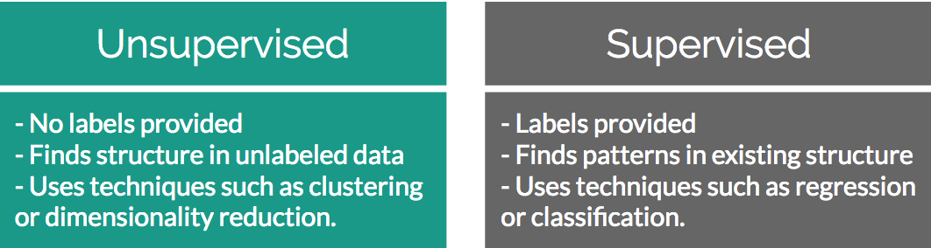
Supervised Learning versus Unsupervised Learning
Unsupervised learning solves problems where a label is unavailable
Supervised learning solves problems where a label is available
Notes:
Instructor Note
A label in this case is whether or not there is a “target” outcome in your dataset. If you want to find the connection in how A impacts B, you will need a label. If you just have A then a label is not available.

Slide 7
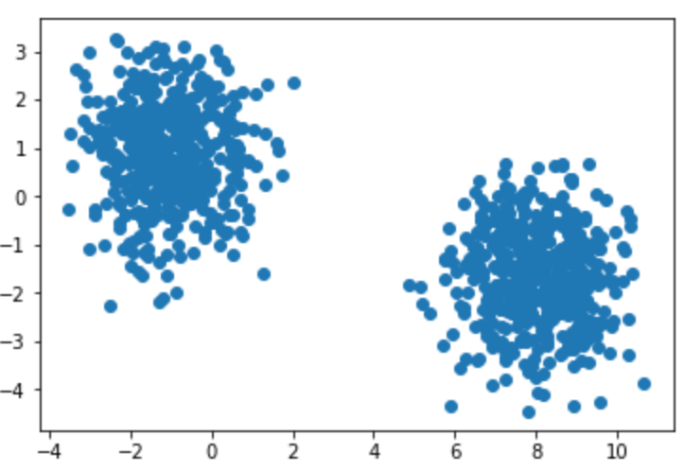
Unsupervised Learning - Clustering
Clustering is all about finding groups of similar data points in your larger data set.
Knowing which groups are similar can be extremely valuable in many use cases:
A very common one is segmentation in marketing. Your customers are all quite different yet still have similarities among them. By finding similar customers you can offer more personalized marketing offers.

Slide 8
Discussion
Who here is familiar with clustering? Please share examples
Can you give examples from past work experience where clustering has proven valuable?
If you haven’t used it before, can you provide some examples of why knowing what records are similar in your data set may be valuable?
Notes:
Potential answers:
1) If no examples are given, a classic example of clustering is finding groups of similar customers in a CRM/invoice database.
2) Refer to above potential answer above if no examples are given. Additional example – finding servers in a datacenter that have similar workloads so you can group them and find potential optimizations
3) If you were to find groups in a large amount of invoice data set you can create more targeted marketing campaigns. Clustering is extremely helpful when you have a very large data set that is impossible to sort by hand.

Slide 9
Identifying Clusters

Slide 10
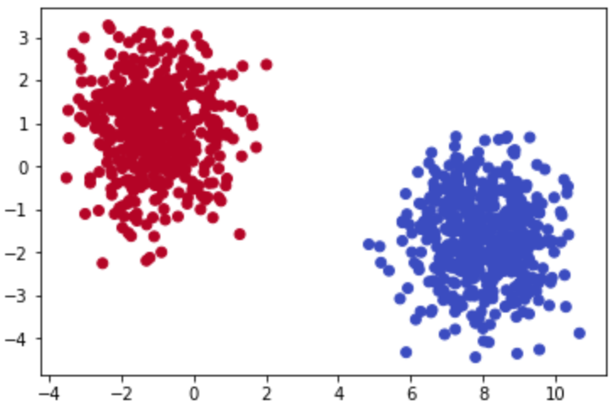
Identifying Clusters
In a two-dimensional space it is quite easy to identify what data points belong to which group
In the real world your datasets will probably have many more than 2 features. This is where unsupervised learning becomes valuable.

Slide 11
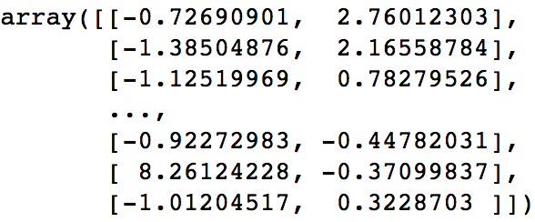
What is “Two-Dimensional” Data?
A dimension in a dataset is another way of simply explaining how many columns it has.

Slide 12
Activity 1: Identifying Clusters in Data
In this activity, please pair up with someone else in the class and see if you can identify the number of clusters and where they exist in the data.

Slide 13
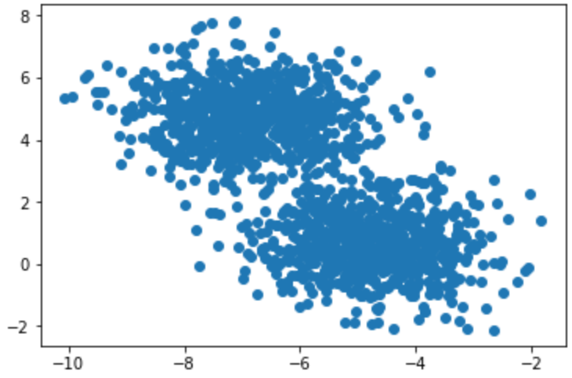
Activity 1: Identify Clusters in Data
1
Notes:
Answer – two clusters. Top Left, Bottom Right coordinates for Cluster 1: (-10,8), (-4, 2) and Cluster 2: (-8,2), (-2,2)

Slide 14
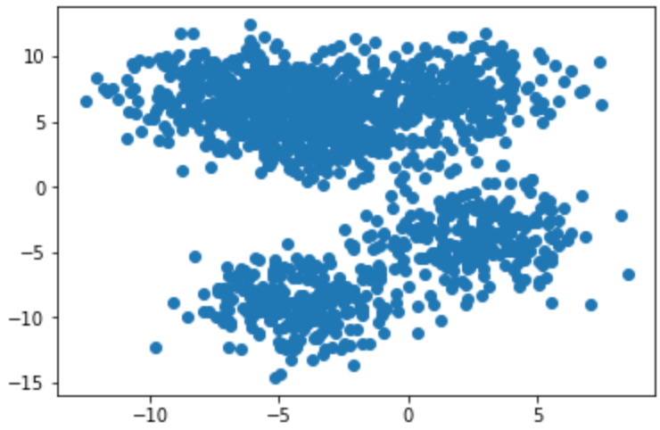
Activity 1: Identify Clusters in Data
2
Notes:
Answer – two clusters. Top Left, Bottom Right coordinates for Cluster 1: (-13,11), (8,0) and Cluster 2: (-10,0), (8,-15)

Slide 15
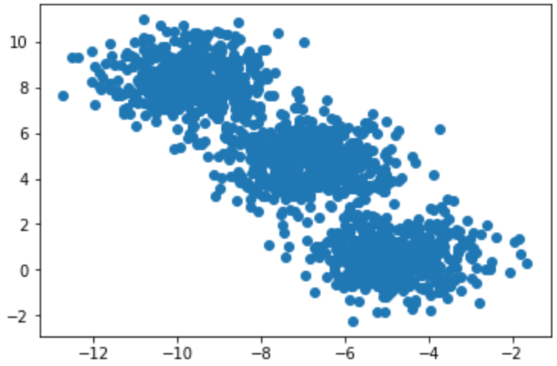
Activity 1: Identify Clusters in Data
3
Notes:
Answer – three clusters. Top Left, Bottom Right coordinates for Cluster 1: (-12,10), (-8,6) and Cluster 2: (-9,6), (-4,2) and Cluster 3: (-7,2), (-2,-2)

Slide 16
Discussion
If you felt that activity was easy, can you please explain why you think so?
Notes:
Possible answers
It is only in 2D space and the clusters are quite well defined.

Slide 17
K-Means Clustering

Slide 18
K-Means Clustering
One of the simplest yet most popular clustering algorithms available.
Works by finding arithmetic mean center points among the data and assigning surrounding data points to their group.
The “K” in K-Means corresponds to the number of clusters you expect are in the data, and is the number of unique center points plotted in your feature space.

Slide 19
K-Means Clustering: No Math Intro
Here are the high-level steps behind K-Means:
Pick K centroids (K = expected distinct # of clusters)
Randomly place K centroids anywhere amongst your existing training data
Calculate the Euclidean distance from each centroid to all the points in your training data
Training data points get grouped in with their nearest centroid
Amongst data points grouped into each centroid, calculate the mean data point and move your centroid to that location.
Repeat the above process until convergence, or when membership in each group no longer changes.

Slide 20
Discussion
What is a centroid?
Notes:
(A centroid is basically just a fancy way to say the geometric center of a figure. This is the mean of all points in the plane. When randomly set at first they are simply random points in the space

Slide 21
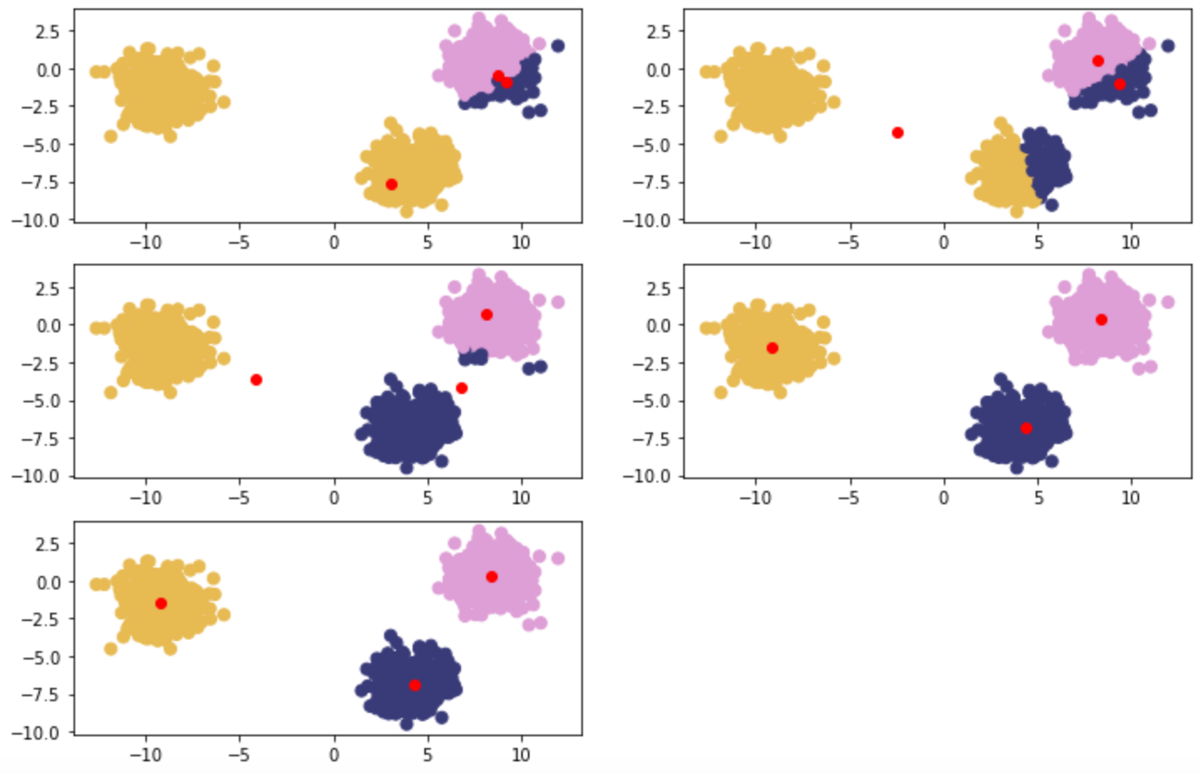
K-Means Clustering: No Math Intro
Notes:
Clockwise from top left – Red points are randomly initialized centroids, and closest data points are assigned to groupings of each centroid (denoted by distinct color).

Slide 22
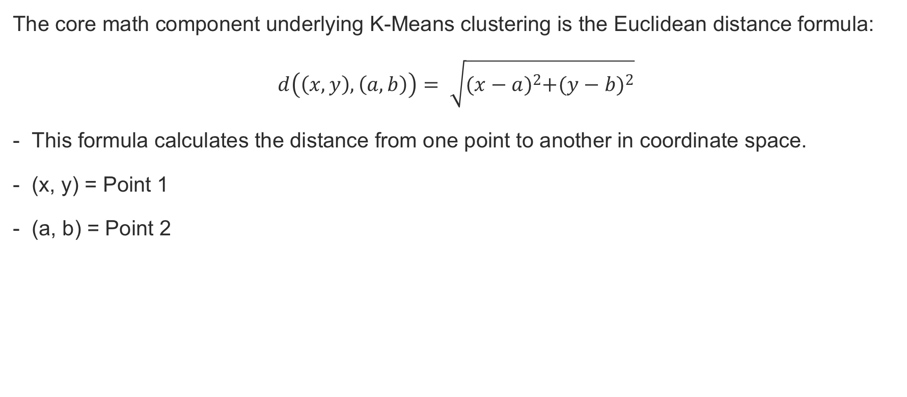
Euclidean Distance
The core math component underlying K-Means clustering is the Euclidean distance formula:
$$d\left(\left(x,y\right),\left(a,b\right)\right)= \sqrt{{(x−a)}^{2}+{(y−b)}^{2}}$$
This formula calculates the distance from one point to another in coordinate space.
(x, y) = Point 1
(a, b) = Point 2

Slide 23

Discussion
The core math component underlying K-Means clustering is the Euclidean distance formula:
$$d\left(\left(x,y\right),\left(a,b\right)\right)= \sqrt{{(x−a)}^{2}+{(y−b)}^{2}}$$
- Why are the points squared after subtraction?
Notes:
Instructor Notes
- To deal with potentially negative values after subtraction.

Slide 24
Example for a Random Point
Imagine you had a dataset that was mapped to a feature space and you initialized a set of random centroids:
[ (2,5) , (8,3) , (4, 5) ]
You want to find which centroid an arbitrary point (0, 8) is assigned to.
Use Euclidean distance to compare arbitrary point to each centroid:
Distance from point to each centroid: [ 3.61, 9.43, 5.00 ]
Given the smallest distance is seen relative to Centroid 1, your arbitrary point is assigned to Cluster 1.

Slide 25
Example for Cluster 1
Old Centroid for Cluster 1: (2,5)
With your arbitrary point assigned to Cluster 1, imagine that it now contains the following:
[ (0,8), (3,8), (3,4) ]
Calculate the mean point among Cluster 1 members:
Mean point calculation: [ (0+3+3)/3 , (8+8+4)/3 ] = (2, 6.67)
New Centroid for Cluster 1 now becomes (2, 6.67)
Repeat this process until the difference between Old Centroid and New Centroid = 0

Slide 26
Activity 2: Implementing K-Means
Scenario: You are asked in an interview to implement a K-Means clustering algorithm from scratch to prove you understand how it works.
Aim: To truly understand how something works you need to build it from scratch. Take what you have learned in the above sections and implement K-Means from scratch in Python.

Slide 27
Activity 2: Implementing K-Means
Step 1:
Using NumPy and the previous Euclidean distance formula, write a function that calculates the distance between two coordinates.
Step 2:
Write a K-Means function that takes in a dataset and number of clusters (K) and returns final cluster centroids, as well as the data points that make up that cluster’s membership.

Slide 28
Discussion
Why does the barebones Euclidean distance method perform poorly compared to pre-packaged ones?
Notes:
The barebones implementation is great for showing the underlying mechanisms, however it loops through each point one by one and is very computationally inefficient. Packaged implementations do pairwise distances across the entire matrices all at once.

Slide 29
Summary
In this lesson, we:
Explained how unsupervised learning fits into the larger machine learning landscape
Provided a real world use case where unsupervised learning is valuable
Explained the importance of clustering
Explained the theory behind K-Means clustering
Implemented K-Means clustering algorithms from scratch in Python

Slide 30
Practice Questions
1) How are supervised and unsupervised learning different?
Supervised has labels, Unsupervised does not
Supervised means you have to monitor the process the whole time, Unsupervised does not
Supervised only works on smaller datasets, and you need to use Unsupervised with larger datasets
2) What is a cluster?
A group of models used to train on data
A collection of features that are important to your model
A grouping of similar data
3) Finding clusters in your data is always valuable
True
False
Notes:
Answers:
1) How are supervised and unsupervised learning different?
Supervised has labels, Unsupervised does not
Supervised means you have to monitor the process the whole time, Unsupervised does not
Supervised only works on smaller datasets, and you need to use Unsupervised with larger datasets
2) What is a cluster?
A group of models used to train on data
A collection of features that are important to your model
A grouping of similar data
3) Finding clusters in your data is always valuable
True
False

Slide 31
Practice Questions
4) How are dimensions expressed in a dataset?
As features, typically the number of columns in your data
As features, typically the number of rows in your data
As features, typically the number of tables in your database
5) How many dimensions can be calculated by computers?
Less than 3
3
Greater than 3
6) What does the “K” represent in K-Means clustering?
How many models will be fit to your data, with performance results averaged
How many clusters you expect to be in your data
How many dimensions your data set has
Notes:
Answers:
4) How are dimensions expressed in a dataset?
As features, typically the number of columns in your data
As features, typically the number of rows in your data
As features, typically the number of tables in your database
5) How many dimensions can be calculated by computers?
Less than 3
3
Greater than 3
6) What does the “K” represent in K-Means clustering?
How many models will be fit to your data, with performance results averaged
How many clusters you expect to be in your data
How many dimensions your data set has

Slide 32
Practice Questions
7) The starting points for K-Means are determined by taking the mean of all the points in the space.
True
False
8) What is the formula that underpins K-Means clustering?
Euclidean Distance
Manhattan Distance
Cosine Distance
9) When does a K-Means clustering algorithm finish running?
After specified number of iterations
After K/2 iterations
After convergence, when there is no longer a difference in calculated cluster centers
10) K-Means will still find clusters in a dataset even if all of the data is fairly similar.
True
False
Notes:
Answers
7) The starting points for K-Means are determined by taking the mean of all the points in the space.
True
False
8) What is the formula that underpins K-Means clustering?
Euclidean Distance
Manhattan Distance
Cosine Distance
9) When does a K-Means clustering algorithm finish running?
After specified number of iterations
After K/2 iterations
After convergence, when there is no longer a difference in calculated cluster centers
10) K-Means will still find clusters in a dataset even if all of the data is fairly similar.
True
False

