Slide 1
Applied Unsupervised Learning with Python

Slide 2
Lesson 2: Hierarchical Clustering
Notes:
Lesson Time: 2 hrs

Slide 3
Lesson Objectives
Lesson Objectives
By the end of this lesson, you will be able to:
Explain the intuition behind the different types of Hierarchical Clustering
Implement the Hierarchical Clustering algorithm from scratch and using packages
Understand the differences between K-Means and Hierarchical Clustering

Slide 4
Introduction
Clustering has proven to be extremely helpful but there are many nuances that influence performance
K-Means was one option of understanding clusters in your data – it may not always be the best option
Hierarchical Clustering is an additional clustering approach that may improve performance

Slide 5
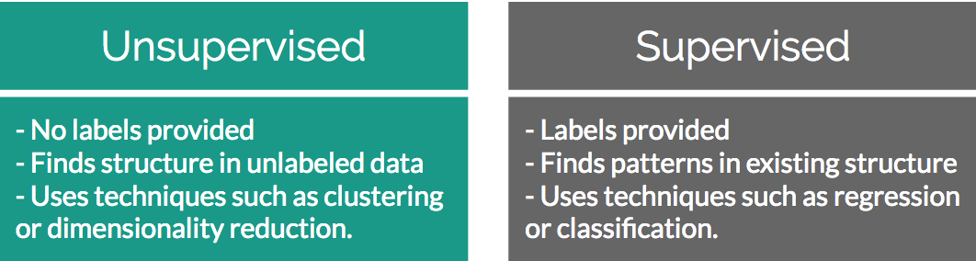
Refresh: Supervised Learning versus Unsupervised Learning
Unsupervised learning solves problems where a label is unavailable
Supervised learning solves problems where a label is available
Notes:
Instructor Note
A label in this case is whether or not there is a “target” outcome in your dataset. If you want to find the connection in how A impacts B, you will need a label. If you just have A then a label is not available.

Slide 6
Discussion
Can anyone explain from a high level how K-Means works?
Stemming from the exercises and activities from the last lesson, please share any unique findings from your work.
Notes:
Possible answers:
K-Means works by initializing K random points in the data space and calculating the distance from each of those points to the rest of the data points. Closest points to the random K points get assigned to that K cluster. Among cluster membership calculate mean point that serves as the new centroid. Repeat process above until change to centroid = 0
Dependent on student examples here. Try and engage the students by having them talk about their experiences with the first chapter. Worst case if there are no volunteers, quickly run through the exercises from Chapter 1 to reiterate fundamentals.

Slide 7
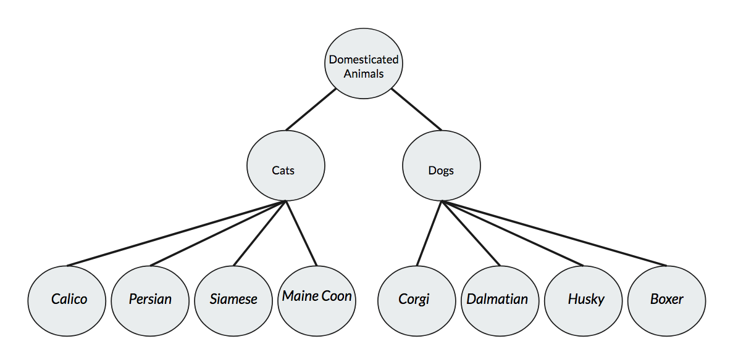
Organization of Hierarchy
Hierarchies have been used throughout history to understand the world around us.
There is a parent node (”root” if it has no parents) that has children nodes. This structure repeats into a tree-like structure.
By organizing information into a hierarchy you can see data relationships in groupings.

Slide 8
Organization of Hierarchy
In the realm of nature, these relationship diagrams are usually built to show classification schemes of animals and are called “taxonomies”
They are extremely information-dense ways to describe your data as they show how one data class interacts with all subsequent higher/lower level classes.

Slide 9
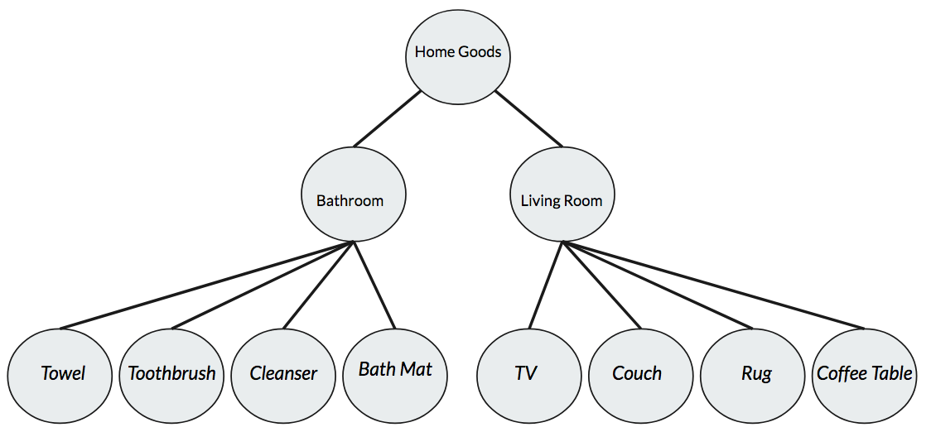
Organization of Hierarchy
These nature taxonomies can be mapped to real world business scenarios by thinking of navigating an e-commerce website.
Imagine visiting an online store and across the navigation bar you had every single product category at once. It would be extremely cluttered.
Instead, we can have categories -> subcategories -> product categories.

Slide 10
Discussion
Why are hierarchies so efficient at conveying information?
Beyond natural organisms and store navigation, can anyone provide additional examples of where hierarchical structures are beneficial?
Notes:
Possible answers:
Within one diagram you are able to understand the relationships between each data class, both as peers or as child/parents of other classes.
Open to student answers. One situation that might spark an interesting debate is whether a organizational hierarchy within a company is beneficial (CEO -> new associates) vs a flat structure. Considering both from a work quality of life perspective and from a ”trying to get things done with approval” perspective

Slide 11
Hierarchical Clustering

Slide 12
Hierarchical Clustering
Consider our evaluation of hierarchies as a way of conveying information.
Implicit to this conversation is that tree-like structures are a great way of understanding potential clusters.

Slide 13
Discussion
How might we organize data to build these tree structures?
Notes:
Potential Answer:
1) Evaluate what makes each of the data points you have different, separate them into different clusters that account for the highest amount of variance. Whatever makes each data point the most different from another is justification for branching off into a new cluster.

Slide 14
Hierarchical Clustering: Animal Example
Imagine you were given a dataset that had the height and weight of many different animals.
One hypothesis that you could test is that the height and weight of different animal species is enough information to tell which animals belong to different species classes.

Slide 15
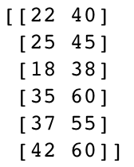
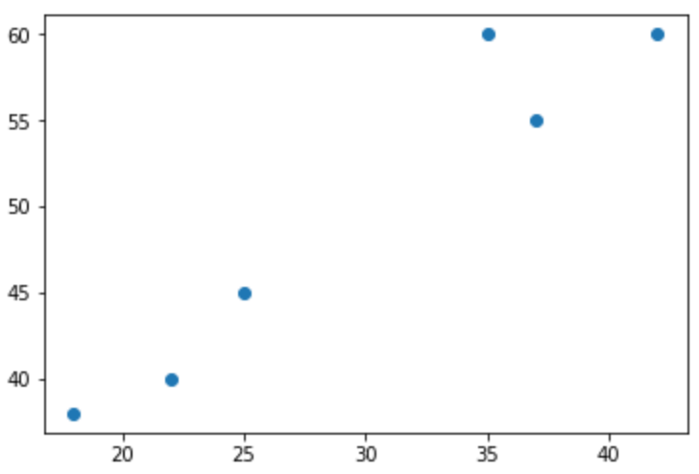
Hierarchical Clustering: Animal Example
Height, Weight

Slide 16
Hierarchical Clustering: Animal Example
One greedy approach to classify these two different animal clusters is called Agglomerative Clustering.
From a high level it works by considering each data point its own “cluster” and then recursively moving through the data to find its neighbor clusters, adding each point to a group cluster until just 1 is left.

Slide 17
Hierarchical Clustering: In Depth
To see how agglomerative hierarchical clustering works, we can trace the path of a simple toy example as it merges together to form a hierarchy:
Given n sample data points, view each point as an individual “cluster” with just that one point as a member.
Calculate pairwise Euclidean distance between the centroids of all the clusters in your data.
Group the closest point pairs together.
Repeat steps 2 and 3 until you reach a single cluster containing all data in your set.
Plot a dendrogram to show how your data has come together in a hierarchical structure.
Decide at which level you want to create clusters at.

Slide 18
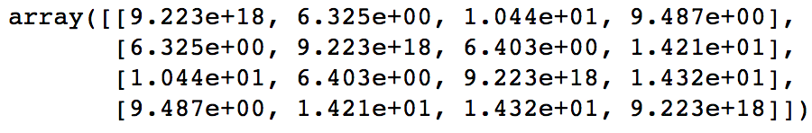
Hierarchical Clustering: In Depth - 1
Given 4 sample data points, view each point as its own cluster.
[ (1,7) ], [ (-5,9) ], [ (-9,4) ] , [ (4, -2) ]
Calculate pairwise Euclidean distance between the centroids of all clusters.

Slide 19
Hierarchical Clustering: In Depth - 2
Group the closest point pairs together.
In this case, Points [1,7] and [-5,9] join into a cluster with the remaining 2 points left as single-member clusters.
Repeat steps 2 and 3 until you reach a single cluster containing all data in your set.
Clusters (3 total now): [ [ [1,7], [-5,9] ], [-9,4], [4,-2] ]
Calculate the centroid of the 2-member cluster:
mean([ [1,7], [-5,9] ]) = [-2,8]

Slide 20
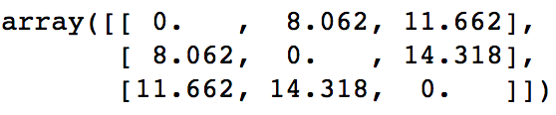
Hierarchical Clustering: In Depth - 3
Add centroid to 2 single-member clusters and re-calculate distances:
[ [-2,8], [-9,4], [4,-2] ]
Point [-9,4] is added to Cluster 1:
[ [ [1,7], [-5,9], [-9,4] ], [4,-2] ]
Repeat centroid calculation and group closest pairs together. Since there is only one point left, you can just add it to Cluster 1.

Slide 21
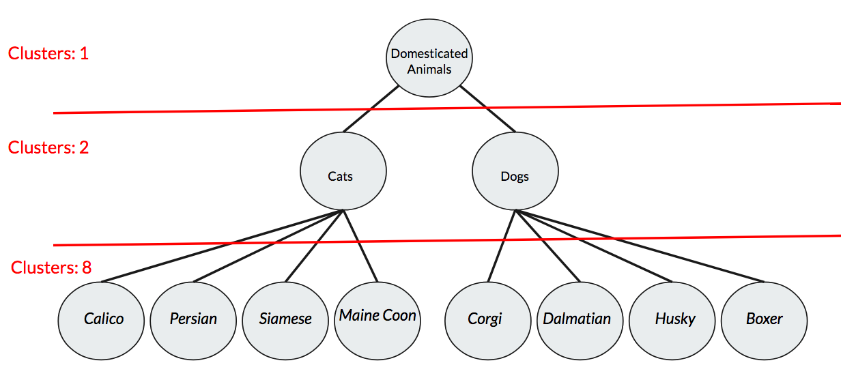
Hierarchical Clustering: In Depth - 4
Once you have established clustering histories, you can evaluate the final hierarchy to view parent/child relationships. Using this information you can decide after the fact how many cluster you want your algorithm to look for:

Slide 22
Discussion
- Why is this approach for clustering potentially better than K-Means?
Notes:
Potential Answers:
1) In K-Means, you must give the algorithm the number of clusters K to look for a priori. If you do not have background information on your problem this may be impossible. Hierarchical Clustering allows you to form your clusters first and then subjectively decide what number of clusters best serves your problem.

Slide 23
Hierarchical Clustering: Linkage Criteria
One key parameter to understand when building hierarchical clusters is linkage criteria.
This parameter captures the notion of how you determine distance between clusters.
Once you have multiple points in a cluster, how do you compare one cluster to any remaining un-clustered points?
You have seen this concept before in K-Means with “centroid” linkage, where you calculate the mean point in cluster membership.

Slide 24
Exercise 1
Please refer to exercise 1 in your coursework to explore different linkage methods.
Notes:
Lesson Time: 2 hrs

Slide 25
Hierarchical Clustering: Linkage Criteria
Two popular alternatives to the centroid linkage method found in K-Means are Single and Complete:
Single Linkage
Single Linkage works by finding the minimal distance between a pair of points between two clusters as its criteria for linkage.
dist(a,b) = min( dist( a[i]), b[j] ) )
Complete Linkage
Complete Linkage can be seen as opposite of Single Linkage and works by finding the maximal distance between a pair of points between two clusters as its criteria for linkage.
dist(a,b) = max( dist( a[i]), b[j] ) )

Slide 26
Discussion
- Why does choosing the right linkage method matter?
Notes:
Potential Answers:
1) The way you calculate distances between clusters can drastically influence membership. If your data are simply blobs there is less of an issue with something like centroid clustering, however if your data is very complex and intertwined, something that looks at the furthest distance point in a cluster may be better equipped to handle the data.

Slide 27
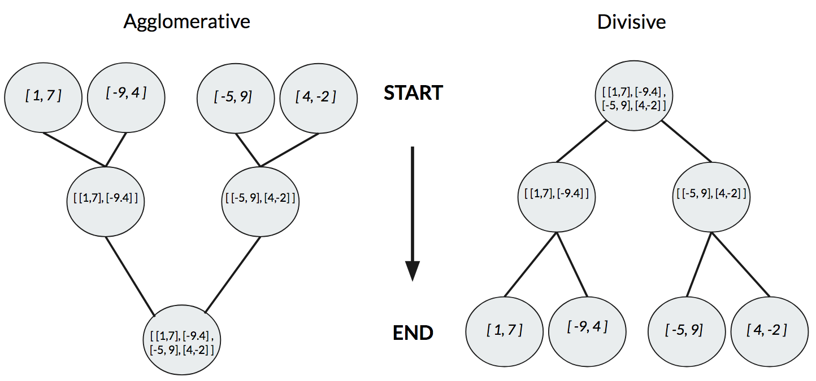
Hierarchical Clustering: Agglomerative vs Divisive
Another key parameter that could impact the performance of your hierarchical clustering is the choice between Agglomerative vs Divisive.
Agglomerative works bottoms-up and groups together single points at each step, while Divisive works top-down and recursively splits one large cluster into individual points.

Slide 28
Discussion
Why do the differences between agglomerative and divisive approaches account for changes in hierarchical clustering performance?
Notes:
Agglomerative clustering is more straightforward and similar to what we already know from K-Means. Divisive clustering is more complex, however if you start with all the data together in one large cluster you have a full view of the data distribution from the beginning. This knowledge allows you to gain a global view of data break downs that you do not get with a greedy approach as seen in agglomerative clustering.

Slide 29
Exercise 2
Please refer to exercise 2 in your coursework to implement agglomerative clustering.
Notes:
Lesson Time: 2 hrs

Slide 30
K-Means vs Hierarchical Clustering
Hierarchical clustering benefits from not needing to pass in an explicit “K” number of clusters a priori. You can find all potential clusters and decide where clusters are after the fact.
K-Means clustering benefits from a simplicity perspective – often times in business use cases there is a challenge to find methods that can be explained to non-technical audiences but still be accurate enough to generate quality results. K-Means can easily fill this niche.
Hierarchical clustering has more parameters to tweak than K-Means when it comes to dealing with abnormally shaped data. While K-Means is great at finding discrete clusters, it can falter when it comes to mixed clusters. By tweaking the parameters in Hierarchical clustering, you may find better results.
Vanilla K-Means works by instantiating random centroids and finding closest points to those centroids. If they are randomly instantiated in areas of the feature space that are quite far away from your data then it can end up taking quite some time to converge, or it may never even get to that point.

Slide 31
Summary
In this lesson, we:
Refreshed K-Means and Clustering concepts
Explored how hierarchies are efficient forms of communication
Used Agglomerative Clustering to walk through a sample problem
Understood how Linkage Methods affect clustering performance
Understood how Agglomerative vs Divisive affect clustering performance
Compared K-Means with Hierarchical Clustering

Slide 32
Practice Questions
The two approaches to Hierarchical Clustering are Agglomerative and Degenerative
True
False
Which of these linkage criteria can be used to determine distances between clusters?
Complete
Single
Centroid
All of the above
Hierarchies are always the most efficient way to convey information about a data set
True
False
Notes:
The two approaches to Hierarchical Clustering are Agglomerative and Degenerative
True
False
Which of these linkage criteria can be used to determine distances between clusters?
Complete
Single
Centroid
All of the above
Hierarchies are always the most efficient way to convey information about a data set
True
False

Slide 33
Practice Questions
How is Hierarchical Clustering a better approach to clustering than K-Means?
It is faster than K-Means
You don’t need to determine number of clusters a priori
It handles simple data sets in a more efficient manner
All of the above
How is K-Means a better approach to clustering than Hierarchical Clustering?
It is faster than Hierarchical Clustering
It is slower but more accurate
You don’t need to determine what K is a priori
K-Means is much more complex but more accurate
A hierarchy shows the relationships from parent nodes to their children nodes
True
False
Notes:
Answers:
How is Hierarchical Clustering a better approach to clustering than K-Means?
It is faster than K-Means
You don’t need to determine number of clusters a priori
It handles simple data sets in a more efficient manner
All of the above
How is K-Means a better approach to clustering than Hierarchical Clustering?
It is faster than Hierarchical Clustering
It is slower but more accurate
You don’t need to determine what K is a priori
K-Means is much more complex but more accurate
A hierarchy shows the relationships from parent nodes to their children nodes
True
False

Slide 34
Practice Questions
In a hierarchy, children nodes can also themselves be parents to other children nodes
True
False
Why are dendrograms helpful in determining clusters?
It shows how correlated features in the data set are
They give an idea how clusters could be formed with which members
If they fail, it’s a sign that the data is too complex for hierarchical clustering
They aren’t helpful
Agglomerative clustering adopts the tops-down approach, while Divisive adopts the bottoms-up approach.
True
False
Hierarchical Clustering in sci-kit learn is more modular and should always be preferred over scipy implementations.
True
False
Notes:
Answers
In a hierarchy, children nodes can also themselves be parents to other children nodes
True
False
Why are dendrograms helpful in determining clusters?
It shows how correlated features in the data set are
They give an idea how clusters could be formed with which members
If they fail, it’s a sign that the data is too complex for hierarchical clustering
They aren’t helpful
Agglomerative clustering adopts the tops-down approach, while Divisive adopts the bottoms-up approach.
True
False
Hierarchical Clustering in sci-kit learn is more modular and should always be preferred over scipy implementations.
True
False

