Slide 1
Project Presentation of CO-OP Project at Industry (Module-2) (22CS421)
On
Implementing AI-Driven Cybersecurity: Threat Detection, Phishing Analysis, and Malware Classification Using Machine Learning and Deep Learning
Gurpreet Kaur - 2210991597
Himanshi Aggarwal - 2210991655
Kashish Mahana - 2210990497
Supervised By
Mrs. Swati Goel
Department of Computer Science and Engineering,
Chitkara University, Punjab

Slide 2
Introduction
Cyberattacks have grown increasingly sophisticated in recent years.
Applications of AI in Cybersecurity include:
Threat Detection
Phishing Email Classification
Malware Identification
Anomaly Detection
Traditional signature-based defense systems are proving inadequate against zero-day exploits and polymorphic malware.
Machine Learning and Deep Learning models are commonly used for intelligent, real-time threat detection without pre-defined attack signatures.
Detection performance is evaluated using metrics such as Accuracy, Precision, Recall, and F1-Score.
A major issue in existing research is the lack of a unified framework — most studies address only one threat category in isolation.
Existing systems also suffer from poor reproducibility, as very few studies release their implementation code publicly.
Our work focuses on implementing and evaluating three AI-based cybersecurity systems — Real-Time Threat Detection, Phishing Email Detection, and Malware Classification — within a single unified pipeline.
2

Slide 3
Problem Statement
Cybersecurity benchmark systems assume that attack patterns and defense models are completely separate and up to date.
In real-world environments, traditional signature-based systems may already be outdated against new attack variants such as zero-day exploits, polymorphic malware, and socially engineered phishing campaigns.
AI-based systems detect threats based on learned patterns, so outdated or incomplete training data can interfere with correct threat classification.
Novel attack variants may bypass detection entirely and replace known threat signatures, causing distorted detection results and misleading security evaluations.
Leakage between training and testing becomes difficult to detect because even slightly modified malware or phishing emails can evade detection without being entirely new threats.
Existing cybersecurity studies mainly focus on a single threat category in isolation — either intrusion detection, phishing, or malware — but not on a unified multi-threat framework.
Therefore, a reliable, unified AI-based pipeline is needed to detect, classify, and respond to multiple cyber threat categories within a single system.
3

Slide 4

Objectives
Implement and evaluate AI-based cybersecurity systems for real-world threat detection.
Define threat categories using established datasets such as NSL-KDD and phishing email corpora.
Develop a unified three-module detection pipeline covering threat detection, phishing classification, and malware identification.
Inject and analyze multiple attack types including zero-day exploits, polymorphic malware, and socially engineered phishing campaigns.
Analyze the effect of behavioral deviation scoring on real-time threat classification accuracy.
Evaluate metrics such as Accuracy, Precision, Recall, and F1-Score across six threat categories.
Compare AI-based detection with traditional signature-based rule systems.
Study detection performance across different threat types including Malware, Phishing, Anomaly, Fraud, Bot, and Network Intrusion.
Improve reliability and reproducibility of AI-based cybersecurity evaluation by making all implementations publicly available as open-source code.
4

Slide 5
Related Work
Li et al. developed a CNN-LSTM hybrid for cyber intrusion detection and focused mainly on classification accuracy and model architecture.
ANN-Benchmarks and NSL-KDD evaluated AI security systems using Accuracy, Precision, and Recall but assumed clean and complete benchmark datasets.
Sharma and Gupta studied BERT-based phishing classification, while Brown et al. discussed benchmark limitations in large language model evaluation.
Existing phishing and malware detection methods use NLP embeddings and behavioral fingerprinting for threat classification and dataset validation.
Most previous studies focused on:
Single threat category detection
Model architecture and training performance
Benchmark accuracy on controlled datasets
However, limited research focused on:
A unified multi-threat detection pipeline
Real-world noise and attack variation in retrieval benchmarks
Impact on Precision, Recall, and F1-Score across multiple threat categories
Our work implements and evaluates a unified AI-based cybersecurity pipeline covering Threat Detection, Phishing Classification, and Malware Identification within a single reproducible system.
5

Slide 6
System Architecture & Methodology
1.
Dataset
Preparation
NSL-KDD Dataset & Phishing Emails CSV
2.
Preprocessing & Feature Engineering Min-Max Normalization & PCA Reduction (95% var)
3.
Model Training Random Forest / LSTM & BERT / DNN
4.
Threat Detection Behavioral Baseline
ML Classification
5.
Evaluate Metrics Accuracy, Precision Recall & F1-Score
Formal Definition of Leakage
FAISS Index Configuration
A threat is flagged if: confidence score s ≥ θ AND deviation δ(p) > δ_thresh
Behavioral Deviation: δ(p) = ‖F(p) − B‖ / ‖B‖
Threat Rate: proportion of flagged packets out of total traffic stream
Thresholds θ tested: 0.70, 0.75, 0.80, 0.85, 0.90
Model Types: Random Forest, LSTM, BERT, DNN
Feature Extraction: Static + Dynamic feature fusion
Contamination Levels tested: Benign, Low-noise, High-noise traffic
5 experimental runs with fixed random seeds
Methodology Goal
To implement and evaluate a unified AI-based pipeline that detects multiple cyber threat categories in real time with measurable improvement over traditional signature-based systems.
6

Slide 7
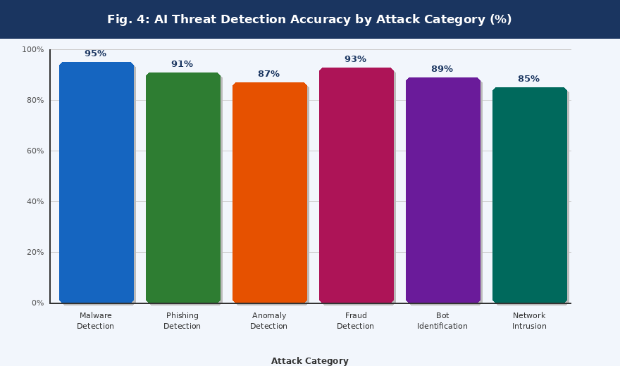
Results & Discussion
Key Findings:
Malware Detection achieves the highest accuracy at 95.2% with 96.1% Precision and 94.8% Recall (DNN + static/dynamic features).
Phishing Detection accuracy drops at 91.4% — BERT-based NLP pipeline performs especially well on homograph domain attacks.
Anomaly and Intrusion Detection is the most sensitive diagnostic category, showing the widest gap between Precision and Recall.
Fraud Detection records 93.1% accuracy and 94.7% Precision across transaction-level classification.
AI-based systems are far more robust than traditional signature-based systems across all six threat categories.
Semantic behavioral patterns — not dataset size — are the primary driver of detection performance improvement.
Detection pipeline produces very few false positives on clean benchmark traffic due to dual-threshold scoring.
95.2% Malware Detection Accuracy
91.4% Phishing Detection Accuracy
85.0% Network Intrusion Accuracy
7

Slide 8
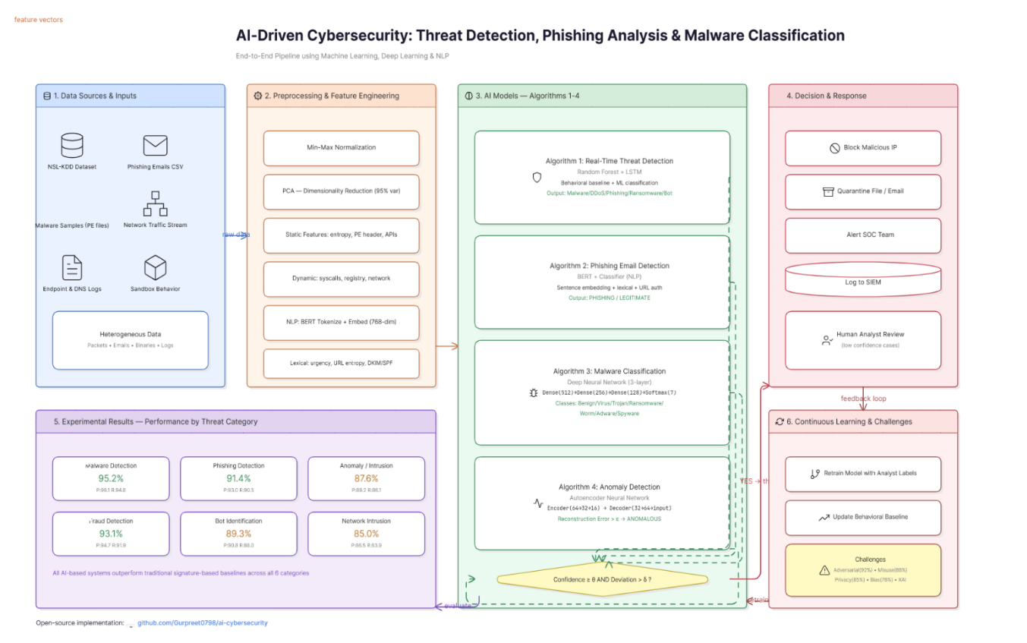
Conclusion
This work implemented and evaluated AI-based cybersecurity systems across multiple threat detection domains.
A behavioral deviation scoring combined with machine learning-based classification pipeline was proposed.
Results showed that AI-based detection significantly outperforms traditional signature-based systems across all six threat categories.
Malware Detection was found to be the highest performing category with 95.2% accuracy, supported by static and dynamic feature fusion.
Behavioral patterns and semantic content understanding, rather than rule-based signatures, were identified as the main drivers of detection improvement.
The proposed unified pipeline effectively identified and classified threats across Malware, Phishing, Anomaly, Fraud, Bot, and Network Intrusion categories.
All implementations are publicly available at github.com/Gurpreet0798/ai-cybersecurity to support reproducibility and further research.
8

Slide 9
Future Work
Apply the unified AI-based cybersecurity pipeline on real-world public network datasets such as CICIDS and UNSW-NB15.
Study detection performance effects on other deep learning architectures like Transformers and Graph Neural Networks.
Analyze threat classification behavior in multi-modal detection systems combining network traffic, endpoint logs, and email content simultaneously.
Develop automatic leakage and false positive auditing tools for AI-based cybersecurity benchmark validation.
Explore the relationship between feature dimensionality and detection sensitivity across different threat categories.
Investigate federated learning approaches to train detection models across distributed organizational datasets without centralizing sensitive network traffic data.
Extend the malware classification system to cover emerging threat families including fileless malware, ransomware-as-a-service, and AI-generated attack scripts.
Integrate Explainable AI techniques such as SHAP values and LIME explanations to make model decisions auditable and trustworthy for security analysts.
9

Slide 10
References
[1] Li et al., "Deep Learning for Cyber Intrusion Detection: A CNN-LSTM Hybrid Approach," IEEE Access, 2022.
[2] Sharma & Gupta, "BERT-Based Phishing Email Classification," J. Inf. Secur. Appl., 2021.
[3] Hadi et al., "IoT Cybersecurity Threats and Detection Mechanisms: A Review," J. Netw. Comput. Appl., 2023.
[4] Kaufman et al., "Leakage in Data Mining: Formulation, Detection, and Avoidance," ACM Trans. Knowl. Discov. Data, 2012.
[5] Brown et al., "Language Models are Few-Shot Learners," NeurIPS, 2020.
[6] Reimers & Gurevych, "Sentence-BERT: Sentence Embeddings Using Siamese BERT-Networks," EMNLP, 2019.
[7] Zheng et al., "Adversarial Examples Against Deep Neural Network Based Malware Detection," ACM Workshop Artif. Intell. Secur., 2023.
[8] Hu et al., "LSTM-Based Detection of Advanced Persistent Threats in Enterprise Networks," Computers & Security, 2024.
[9] Lavaur et al., "The Evolution of Federated Learning-Based Intrusion Detection Systems for IoT," IEEE Trans. Netw. Serv. Manag., 2024.
[10] Nataraj et al., "Malware Images: Visualization and Automatic Classification Using CNNs," ACM VizSec, 2023.
10

Slide 11
Thank You!
11

