Slide 1
Software Architecture of Web Browsers
Gurpreet Singh Matharu
M.Tech (IT), Amity University
A2351213017

Slide 2
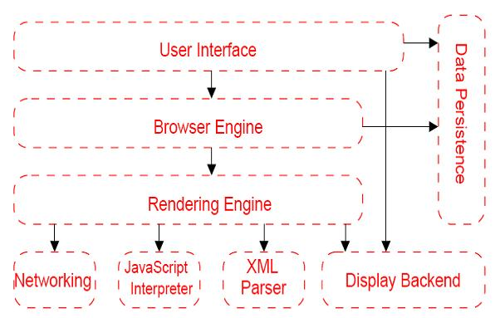
General Architecture of Web Browser

Slide 3
General Architecture of Web Browser
The User Interface subsystem is the layer between the user and the Browser Engine. It provides features such as toolbars, visual page-load progress, smart download handling, preferences, and printing. It may be integrated with the desktop environment to provide browser session management or communication with other desktop applications.
(2) The Browser Engine subsystem is an embeddable component that provides a high-level interface to
the Rendering Engine. It loads a given URI and supports primitive browsing actions such as forward,
back, and reload. It provides hooks for viewing various aspects of the browsing session such as
current page load progress and JavaScript alerts. It also allows the querying and manipulation of
Rendering Engine settings.
(3) The Rendering Engine subsystem produces a visual representation for a given URI. It is capable of
displaying HTML and Extensible Markup Language (XML) (Bray et al., 2004) documents, optionally
styled with CSS, as well as embedded content such as images. It calculates the exact page layout
and may use “reflow” algorithms to incrementally adjust the position of elements on the page. This
subsystem also includes the HTML parser.

Slide 4
General Architecture of Web Browser
(4) The Networking subsystem implements file transfer protocols such as HTTP and FTP. It translates between different character sets, and resolves MIME media types for files. It may implement a cache of recently retrieved resources.
(5) The JavaScript Interpreter evaluates JavaScript (also known as ECMAScript) code, which may be embedded in web pages. JavaScript is an object-oriented scripting language developed by Netscape. Certain Java-Script functionality, such as the opening of pop-up windows, may be disabled by the Browser Engine or Rendering Engine for security purposes.
(6) The XML Parser subsystem parses XML documents into a Document Object Model (DOM) tree. This is one of the most reusable subsystems in the architecture. In fact, almost all browser implementations leverage an existing XML Parser rather than creating their own from scratch.

Slide 5
General Architecture of Web Browser
(7) The Display Backend subsystem provides drawing and windowing primitives, a set of user interface widgets, and a set of fonts. It may be tied closely with the operating system.
(8) The Data Persistence subsystem stores various data associated with the browsing session on disk. This may be high-level data such as bookmarks or toolbar settings, or it may be low-level data such as cookies, security certificates, or cache.

Slide 6
Google Chrome’s Architecture
Google has a browser named Chrome and claims that it will make browsing the web faster, safer, and easier. How that has to work will be explained in the following section. Chrome uses a multi-process approach, by which each process has its own memory and copy of global data structures. Each browser tab or window has its own process. Because of this approach if a tab crashes the rest of the tabs are not affected, whereas a crash on other single-process browsers would mean a total crash of the application. A tab does not only has its own separate process but is also sandboxed. This sandboxing makes it possible to restrict access to the file system and network. Not only tab's have their own process but plug-ins also run on its own separate process while isolating them form the rest of the browser.

Slide 7
Google Chrome’s Architecture
Each process has multiple threads which will now be explained. The main browser thread manages the rendering process for each tab. This managing is done with inter process communication (IPC). The Browser object displays a top-level browser window. RenderProcessHost represents the browser side of a browser window. There is one RenderProcessHost in the main browser thread for each render process. RenderViewHost communicates with RenderView in a separate process. So each new tab or window forks its own process. That process is then instructed by the main thread to create a RenderView. It is, in special cases, possible for a render process to share a tab or window. A special case is when the total number of processes exceeds a threshold. The main browser thread can detect of render processes are crashed or misbehave. If that happens the user is notified on screen, the old process is cleared and a new one is created. WebKit is an open source web browser engine made by Apple and is also used in the browser Safari.

Slide 8
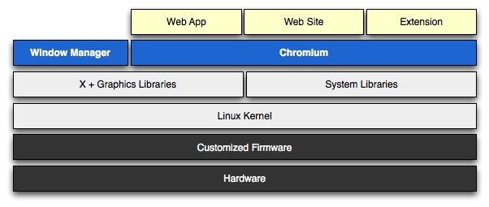
Google Chrome’s Architecture

Slide 9
Google Chrome’s Architecture
Chrome OS’s architecture has three distinct components, all of which have been tuned to make the OS fast: 1. The firmware: The firmware provides the quick boot time and incorporates system recovery, if and when it's needed. The firmware also contributes to security by verifying each step in the boot process. 2. The System-level/user-land software: Chrome OS's system-level software includes a Linux kernel that has been patched to increase the speed and performance of the system. User land software has been trimmed to essentials, with management by Upstart, which can launch services in parallel, re-spawn crashed jobs, and defer services in the interest of faster booting. 3. The Window Manager: Window manager cum browser handles the user interaction and is also used to log on and use the internet services and various Google apps.

Slide 10
Features
• 100GB Google Drive. • Based on Linux: supports multiple workspaces. • Auto updating and translation. • Printing with Google Cloud Print. Cloud Print does now come with access to FedEx stores in the United States, which is a nice improvement for remote printing. • Cookies, image management, JavaScript, plug-ins, pop-ups, location information, and notifications can be adjusted. • A new feature: "verified boot." Chrome OS will check its own integrity when booting, and if it detects any changes, it will allow user to restore a last-known good configuration. • Explores external devices in Chrome Browser itself. • A media player is integrated enabling users to play back MP3s, view JPEGs, and handle other multimedia files while offline. Embedded Video Player is provided as a feature of HTML 5. • V8 JavaScript engine is used to increase browser speed. • Developer mode is included with a switch mode button. It allows developer to install their own builds of Chrome OS • File sharing is easier.

Slide 11
Internet Explorer
Internet Explorer uses a componentized architecture built around the Component Object Model (COM) technology. The Component Object Model governs the interaction of all of its components and enables reuse and extensibility. Internet Explorer is made up of five major components, each of which are contained in a separate .dll and expose a set of COM interface that enables them to be hosted by the Internet Explorer main executable, iexplore.exe.
IExplore.exe is at the top level, and is the Internet Explorer executable. It is a small application that relies on the other main components of Internet Explorer to do the work of rendering, navigation, protocol implementation, and so on.
Browsui.dll provides the user interface to Internet Explorer. Often referred to as the "chrome". This DLL includes the Internet Explorer address bar, status bar, menus, and so on.
Shdocvw.dll provides functionality such as navigation and history, and is commonly referred to as the WebBrowser control.

Slide 12
Internet Explorer
Mshtml.dll is at the heart of Internet Explorer and takes care of its HTML and Cascading Style Sheets (CSS) parsing and rendering functionality. Mshtml.dll houses the Trident rendering engine (introduced in IE 4) which is responsible for displaying the pages on-screen and handling the Document Object Model of the web pages. MSHTML.dll parses the HTML/CSS file and creates the internal DOM tree representation of it. It also exposes a set of APIs for runtime inspection and modification of the DOM tree. The DOM tree is further processed by a layout engine which then renders the internal representation on screen.
Urlmon.dll offers functionality for MIME handling and code download.
WinInet.dll is the Windows Internet Protocol handler. It implements the HTTP and File Transfer Protocol (FTP) protocols along with cache management. It handles all network communication over these protocols.

Slide 13
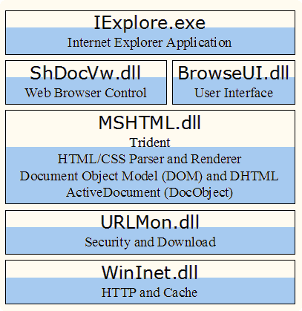

Slide 14
Description of Components
IExplore.exe is at the top level, and is the Internet Explorer executable. It is a small application that relies on the other main components of Internet Explorer to do the work of rendering, navigation, protocol implementation, and so on.
Browsui.dll provides the user interface to Internet Explorer. Often referred to as the "chrome," this DLL includes the Internet Explorer address bar, status bar, menus,.
Shdocvw.dll provides functionality such as navigation and history, and is commonly referred to as the Web Browser control. This DLL exposes ActiveX Control interfaces, enabling you to easily host the DLL in a Windows application using frameworks such as Microsoft Visual Basic, Microsoft Foundation Classes (MFC), Active Template Library (ATL), or Microsoft .NET Windows Forms. When your application hosts the WebBrowser control, it obtains all the functionality of Internet Explorer except for the user interface provided by Browseui.dll. This means that you will need to provide your own implementations of toolbars and menus.

Slide 15
Mozilla Firefox Architecture
Firefox is a variation of Mozilla, providing a streamlined interface and removing many of the integrated components such as clients for mail, news, and chat. Firefox does contain one notable feature not found in the reference architecture: a powerful extension facility. While standard browser plugins are used to display content that the browser is unable to display directly, extensions can “hook in” and alter the browser at various levels in the architecture. For example, extensions can modify user interface elements such as toolbars and menus, capture user interface events such as mouse clicks, alter the way web pages are rendered, and provide support for additional network protocols.
User Interface: The User Interface is split over two subsystems, allowing for parts of it to be reused in other applications.
Data Persistence: All data persistence is provided by Mozilla’s profile mechanism, which stores both high-level data such as bookmarks and low-level data such as a page cache.
Rendering Engine: Mozilla’s Rendering Engine is larger and more complex than that of other browsers. One reason for this is Mozilla’s excellent ability to parse and render malformed or broken HTML. Another reason is that the Rendering Engine also renders the application’s cross-platform user interface. The UI is specified in platform independent Extensible User Interface Language (XUL), which in turn is mapped onto platform-specific libraries using specially written adapter components. This architecture distinguishes Mozilla from other browsers in which the platform-specific display and widget libraries are used directly, and it minimizes the maintenance effort required to support multiple, diverse platforms.

Slide 16
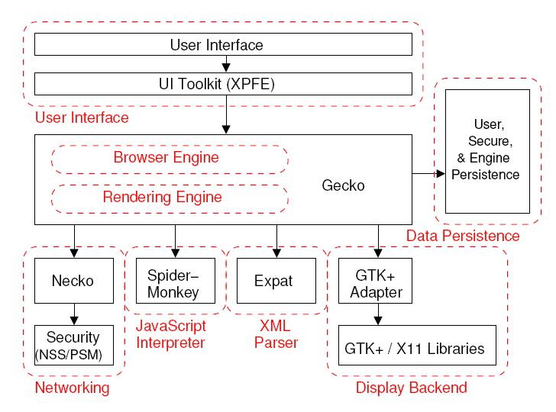

Slide 17
Comparison of Architectures
The comparison of the architectures between Google Chrome, Internet Explorer and Mozilla Firefox can be explained by partitioning between the browser and rendering engine.
Google Chrome: The Browser and Rendering Engine is separated and each tab that is opened has its own Rendering Engine. To avoid crashing of the whole browser due to one single crash tab isolation between tabs are used. The implication for the memory is that when a new tab or site is opened, each tab gets its own process. The advantage is that if that tab is closed the process is killed. In this way you know for certain that all memory that was used by this process is freed.
Internet Explorer: The Browser and Rendering Engine(Trident) are two separated units defined by dll files. They are then used by the IExplore.exe. Internet Explorer doesn't use different processes for different tabs. It can happen that not all memory is freed when a tab is closed.
Mozilla Firefox: The Browser and Rendering Engine are combined into one single layout Engine unit called Gecko. The same as for Internet Explorer holds; also Firefox runs all its tabs in one and the same process.

Slide 18
References
http://sufianalogy.blogspot.in/2012/12/chrome-os-and-system-architecture.html
http://msdn.microsoft.com/en-us/library/aa741312(v=vs.85).aspx
http://www.chromium.org/chromium-os/chromiumos-design-docs/software-architecture
http://www.diffen.com/difference/Firefox_vs_Google_Chrome
http://isea.nitk.ac.in/PMISprojects/reports/WebBrowsersReport.pdf

