Slide 1
Project Guide and Lecturer: Dion Nyugen
Developed by Team – 2 (Gurpreet Kaur, Gagandeep, Shashank)
CAR Mechanic Theme

Slide 2

INTRODUCTION
Car Mechanic Theme is customize theme which makes editing and managing content easy to build a website on WordPress. The features implemented in the theme makes it very user friendly.
A team of three is working on the development aspect of this theme and we have reached half way in completion of this theme
The main aim of this theme and the website which will be developed simultaneously is to reach maximum number of people to generate profit by providing high quality products and services at a very reasonable rates.

Slide 3
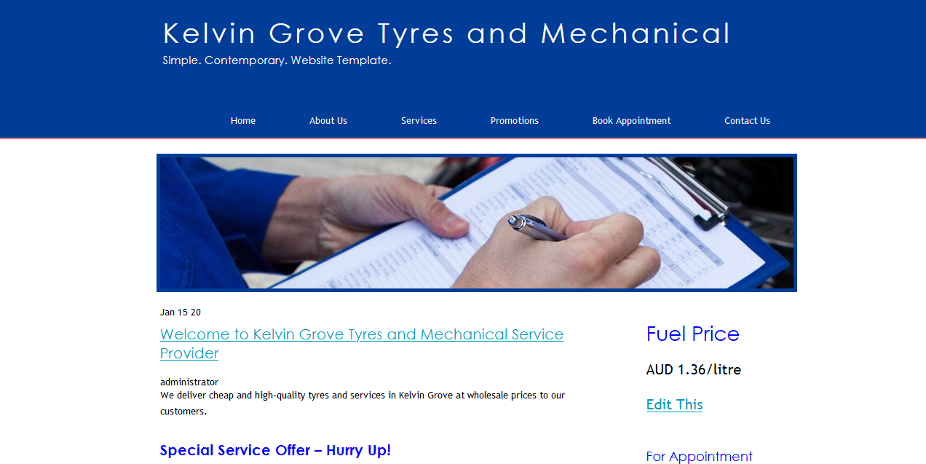

Slide 4
Customize Theme
Home Page
About Us Page
Services page
Promotions Page
Book Appointment Page
Contact Us page
Theme and associated website will include:

Slide 5
INDIVIDUAL CONTRIBUTION – GAGANDEEP
TASK INCLUDES:
Header and Footer Development for theme
Development of 2 basic pages for –
Book Appointment
Contact Us

Slide 6
INDIVIDUAL CONTRIBUTION – GURPREET KAUR
Task Includes:
Index file and Function file and connecting all the other files to main index files
Home Page
Services Page (Including Tyres)

Slide 7
INDIVIDUAL CONTRIBUTION - SHASHANK
Task Includes:
Sidebar development for theme
About Us Page
Promotions

Slide 8
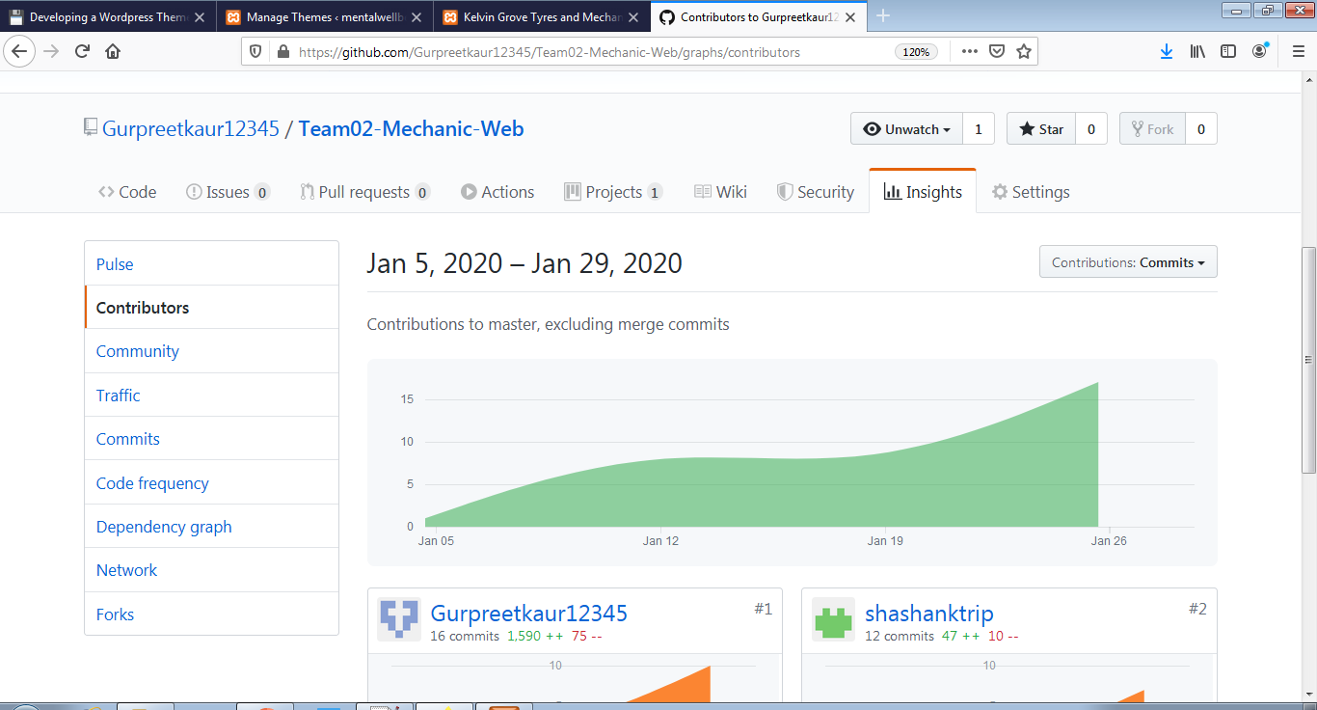
Github Usage for version control:

Slide 9
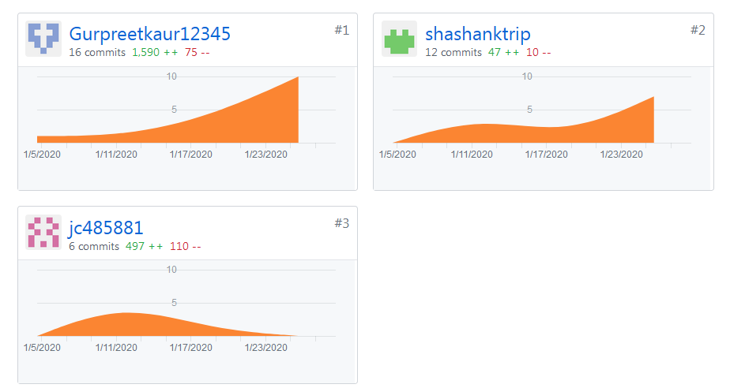
Individual Contribution Till Now:

Slide 10
THANK YOU

