Slide 1
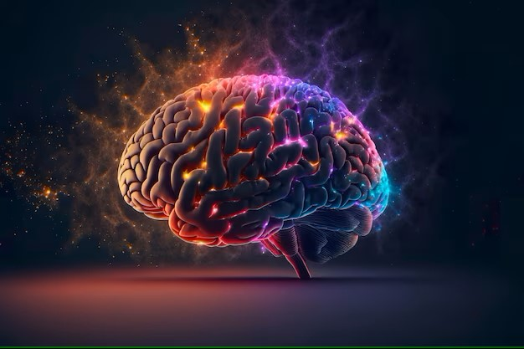
Brain Stock Detection
Name : Gurpreet Kaur
Student ID: 23185190
Date: 14-01-2024

Slide 2

Introduction
Brain stroke, either ischemic or hemorrhagic, results from irregularities in blood flow and pressure in brain nerves, manifesting in symptoms like dizziness and impaired movement and cognition.
These symptoms could indicate a full stroke or a transient ischemic attack, depending on their duration. Other health factors like diabetes and kidney disease can also increase the risk of a stroke, and diagnostics like MRI or CT scans help determine the cause.
Preventive measures include careful health monitoring, surgical intervention, medication, and using comprehensive datasets on stroke occurrences for research and pattern identification.

Slide 3
Problem Statement
Classification: Predicting stroke occurrence by examining the health condition using various health factors that help to identify the possible cause. Therefore, some classification models like GaussianNB model, decision tree, Naive Bayesian model and K-nearest Neighbor. However, I am using GaussianNB and confusion metrics for model accuracy and prediction.
Clustering: I will use K-means clustering on the dataset, making at least 2-3 clusters to check whether an individual has experienced strokes or not. Considering variables like age, hypertension, gender, work type, BMI, glucose level, and heart disease.
New Variable: In this, I will create a variable name Health_index, which merges the value of BMI, heart disease and glucose. It helps to identify the trends & patterns of weather a person living in certain places tends to have worse or better health.

Slide 4
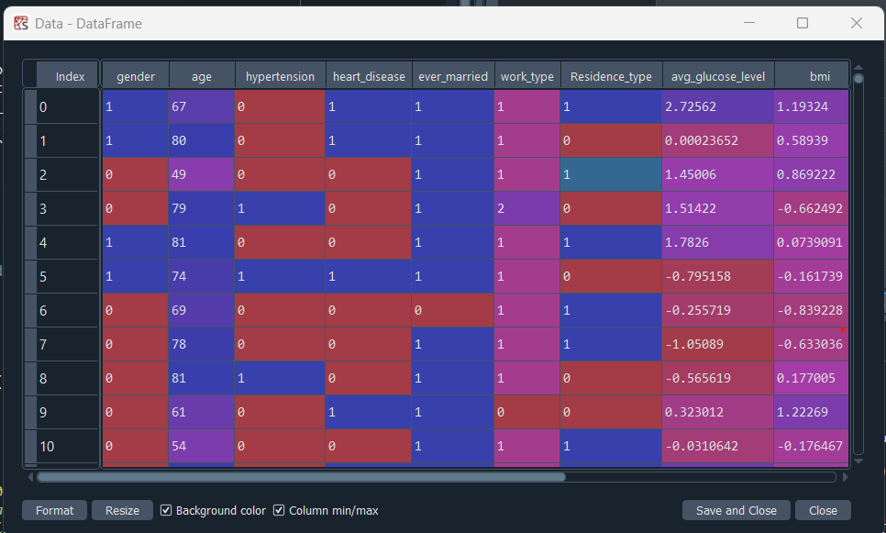
Dataset Description
I have obtained this dataset from Kaggle to recognize human health conditions using various health factors that help to identify real-world health problems. This dataset mainly focuses on brain stroke detection. It consists of 4981 rows and 11 columns. The dataset was loaded into Spyder and converted to a data frame for further analysis. Contains categorical columns such as "Type" and numeric columns such as "Smoking Status" and "BMI."
This dataset highlights Age, Hypertension, Gender, Job type, Residence type, BMI, blood sugar level, and heart disease. By analyzing these features, machine learning models are used to create a stroke detection system that can identify stroke patterns such as smoking status and high blood pressure along with age factors. This allows the system to detect stroke cases early in the process and recommend prevention at an early stage, significantly reducing the likelihood of occurrence.

Slide 5
Methodology
high degree of accuracy when predicting stroke occurrence, deliver predictions in real-time
Accuracy, Efficiency, Simplicity
Case 1
Classification Model
GaussianNB
Classification
Regression
Case 2
Clustering Model
K-means clustering
Grouping transactions to detect Brain Stock activity
effectively identifying patterns and similarities
Case 3
Regression Model
Linear regression
Detects if there is patterns in Brain stock effectively.

Slide 6
Data Preprocessing
Checking null values in row and columns
Checking If there is any outlier present in dataset, I my case I have outliers
Data is ready to used in machine learning model
If there is any null values present, In my case I have null values
Remove the outliers from dataset
No
Yes
Yes
Remove with mode function or if columns is not important then drop the columns

Slide 7
Model Development
Libraries
Train, Test and split
Take 60 % for Tain and 40 % for test
Apply the GaussianNB model
Fit and predict the model
Case 1
GaussianNB
Case 2
K-means clustering
Libraries
Train, Test and split
Take 60 % for Tain and 40 % for test
Calculate distance with Elbow method
Apply the K-Mean model
Fit and predict the k-mean model
Libraries
Train, Test and split
Take 60 % for Tain and 40 % for test
Apply the Linear regression model
Fit and predict the Linear regression model.
Case 3
Linear regression

Slide 8
Model Evaluation
Case 1
Case 2
Case 3
GaussianNB
K-means clustering
Linear regression
The accuracy GaussianNB about 86% and using confusion matrix to check the number of false and true valse.
Take 1 to 11 values of WCSS and found that onwards 4 model provide good accuracy about 56% and using confusion matrix to check the number of false and true valse.
silhouette_score Ise about 0.52
The accuracy of linear regression after creating new variable is about 94, which is very accurate.

Slide 9
Findings
Case 1: The statement discusses predicting stroke occurrence using various health factors and different classification models such as GaussianNB, decision tree, Naive Bayesian, and K-nearest Neighbor. The writer is specifically using the GaussianNB model and confusion metrics for assessing model accuracy and prediction.
Case 2: The speaker plans to apply K-means clustering to a dataset to detect patterns in stroke experiences, using factors such as age, hypertension, gender, work type, BMI, glucose level, and heart disease. The speaker will create a minimum of 2 to 3 clusters for this analysis.
Case 3: The statement refers to the creation of a new variable named 'Health_index', which combines the values of BMI, heart disease, and glucose.

Slide 10
Conclusions
To Conclude, the models utilized in this assessment is included GaussianNB, K-Mean Clustering and Linear Regression. However, the main focus will be on the GaussianNB model and confusion metrics for measuring model accuracy. K-means clustering will be employed on the dataset to differentiate individuals who have experienced strokes. The variables considered in this analysis include age, hypertension, gender, work type, BMI, glucose level, and heart disease. Furthermore, a new variable called 'Health index' is created that combines the values of BMI, heart disease and glucose level. This will provide insights into health trends and patterns of individuals in different regions.

Slide 11
Future Work
I am planning to develop a user-friendly graphical interface (GUI) for these three scenarios, enabling users to easily interact with and explore the various similarity behaviors.
Integration of Advanced Machine Learning Models.
Incorporating Real-time Data and Continuous Monitoring.

Slide 12

Thank you ..!

