Slide 1
ChefKart Assignment
By Gurpreet Singh
Email gurpreetsinghjio11@gmail.com
Phone- 88378-94064

Slide 2
Content
View off the Page
Mobile View of Page for responsiveness.
Extra Points added
Made Everything Dynamic
Notification Button
Dynamic Main content
FeedBack part
Used props
Used event handling
Dynamic Rendering
Use of Life Cycle Hooks
5. Used Routing

Slide 3
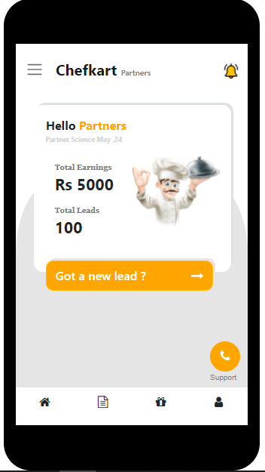
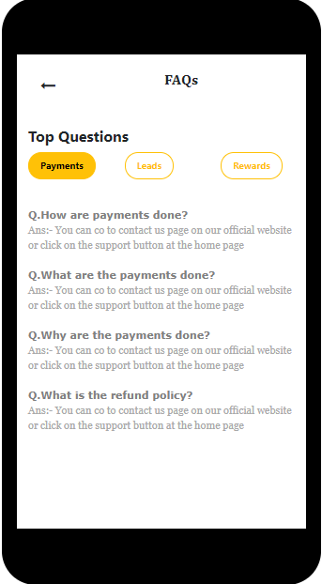
View of the main Page
Made the Page in a way that it shows the Mobile View.

Slide 4
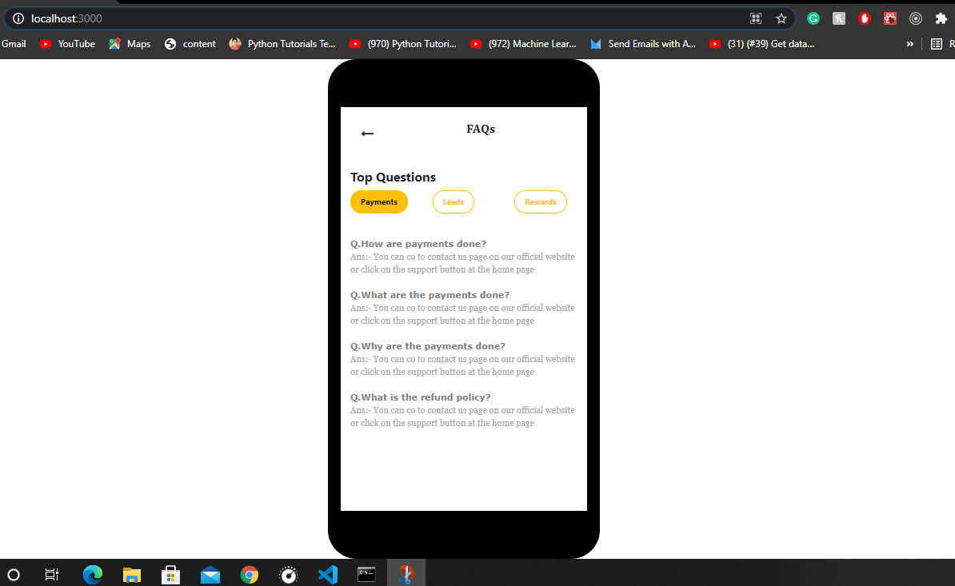
This is the look

Slide 5
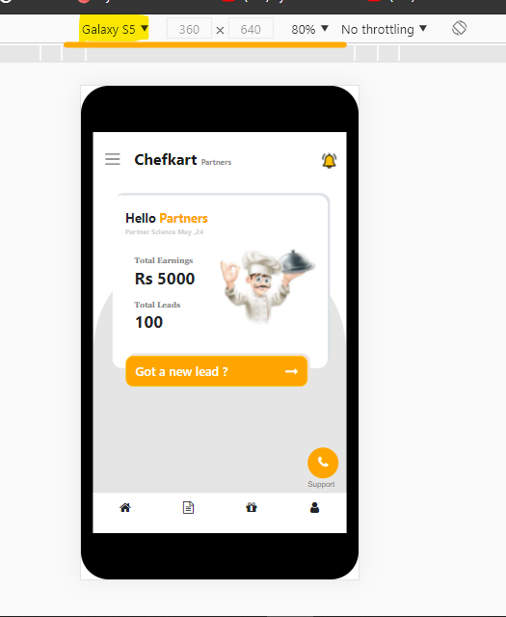
Responsive

Slide 6
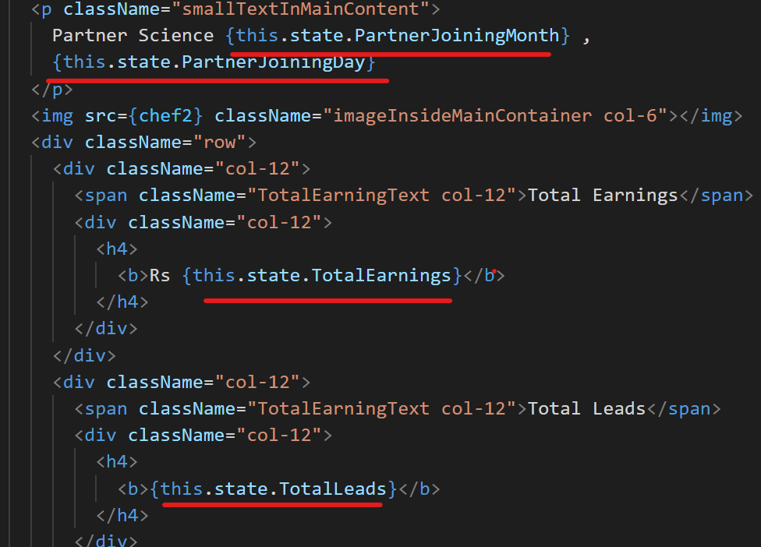
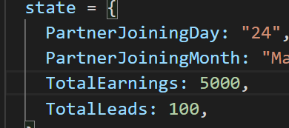
Dynamic Values
The Value of Date, Total Earnings and Total Leads are coming from states, where we can also get the data from backend.

Slide 7


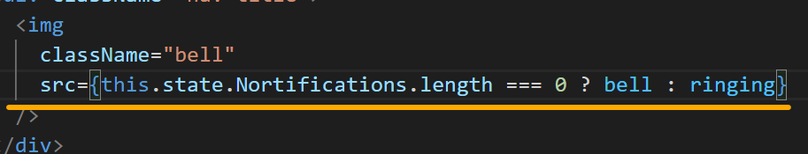
Notification
It Changes if it have some real Notifications
Condition Used

Slide 8
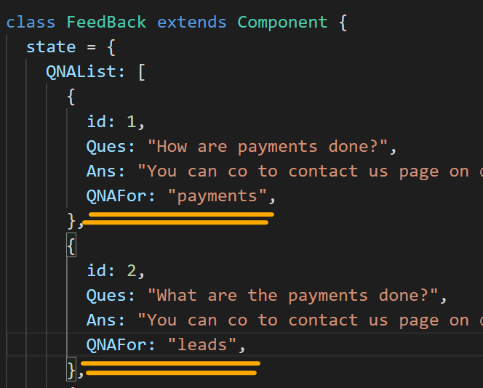
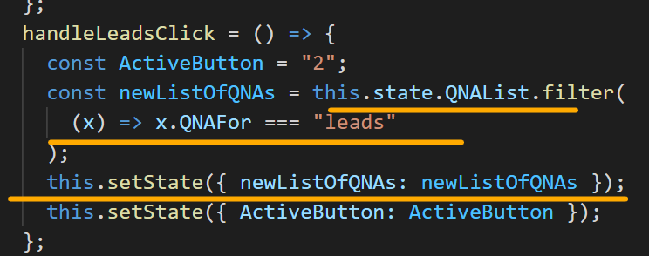
Feedback Page
Data hi coming from the states.
Then from these states data is filtered with the QNAFor property.

Slide 9
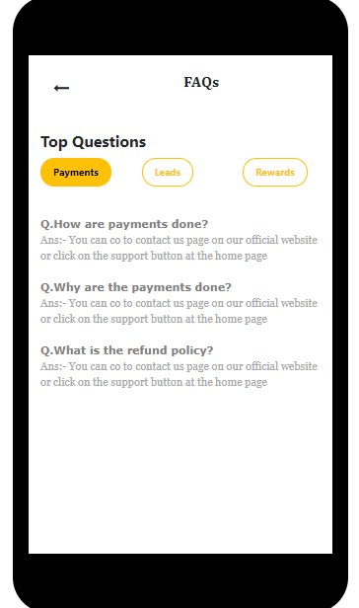
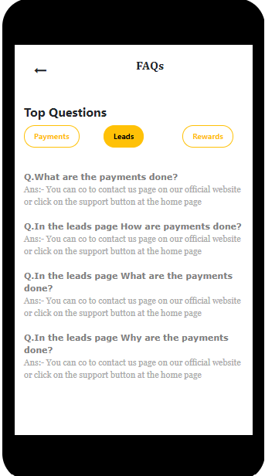
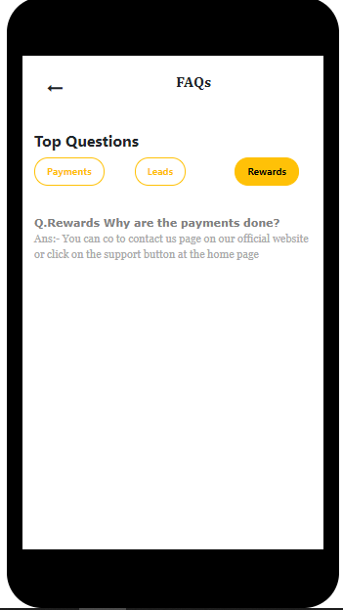

Slide 10
Props and Routes are used
I have Props used in the Feedback page to send the data from the parent components to child components, the list which is rendering the data is the child component and it also have one child component which is responsible to show the question and answer.
This data was sent by Props because it was depending upon the Parent component i.e component containing Payment, leads and rewards button.
So I Updated the state.

Slide 11
Thank you
I tried to cover few more topics of React to show the Functionality.
My main focus was to show the functionality ( React ) not the design (HTML,CSS ).

