Slide 1
SHAM lowers oxygen flux

Slide 2
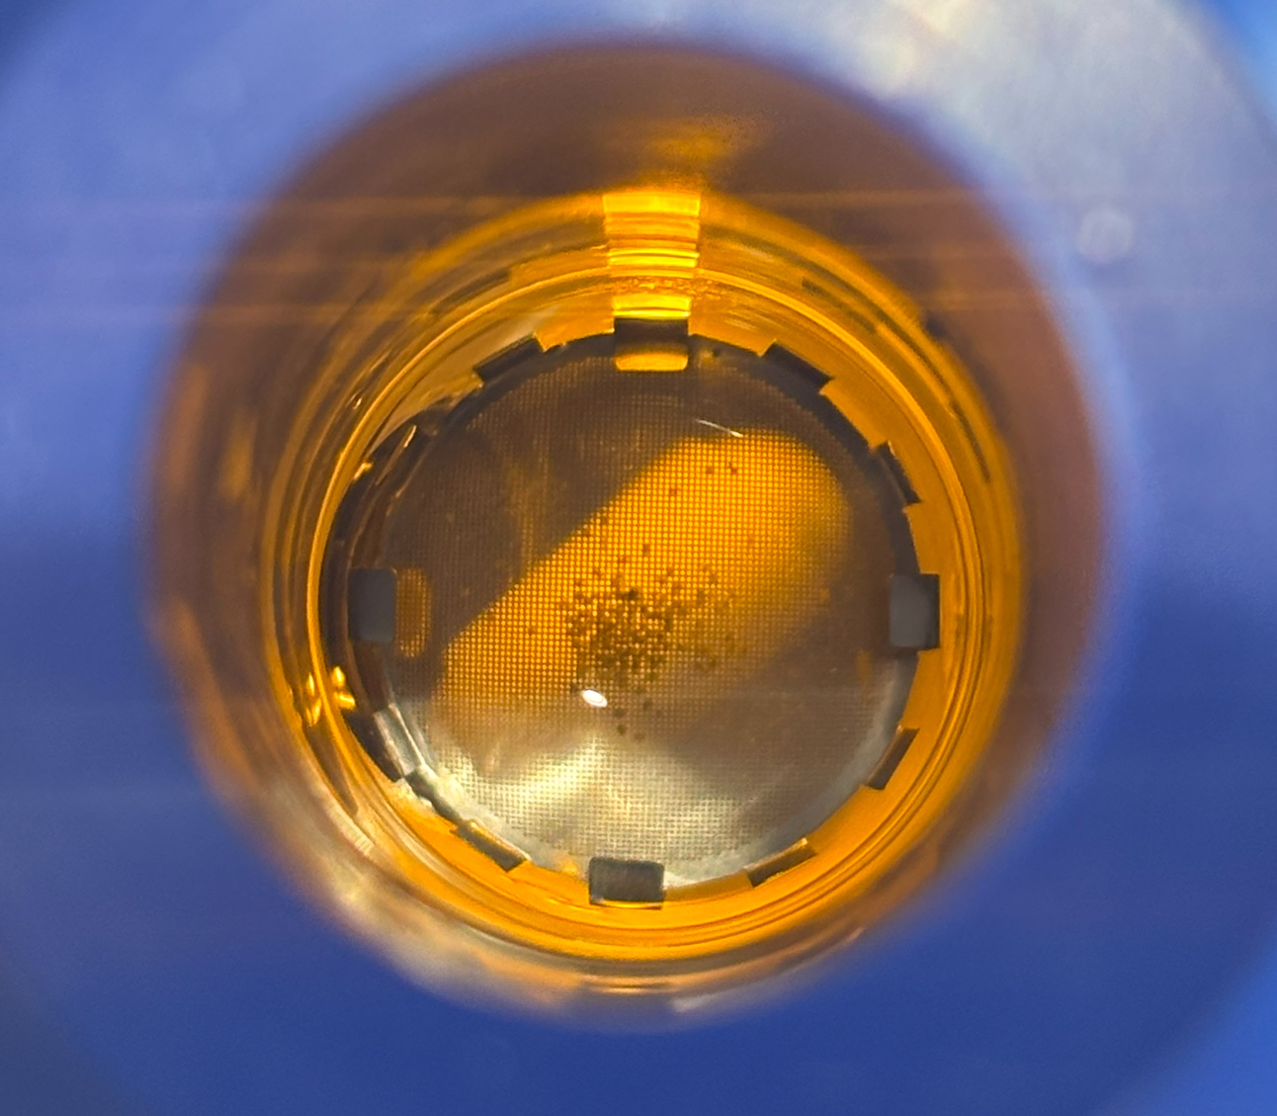
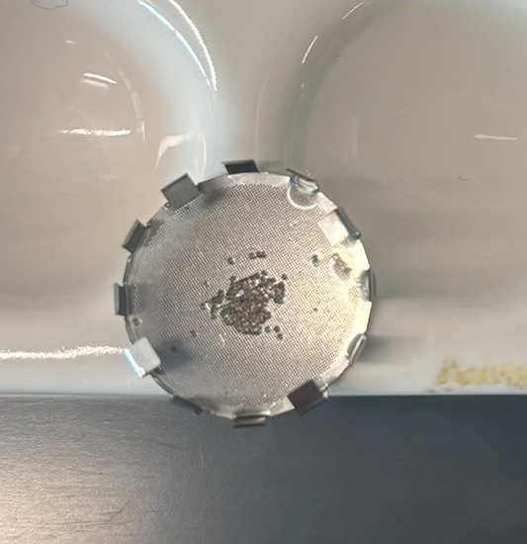
Oyster’s immediately after the DMSO experiment, a majority if not all, were on the holder, and had not moved

Slide 3
DMSO does not lower oxygen flux

Slide 4
Change relative to baseline
Baseline was very close between each experiment

Slide 5
Plotted together

