Slide 1
Restaurants Recommendation System
Team Members:
Eswar (Data Analytics)
Suleman (Data Collection & preprocessing)
Neha (Quality assurance and deployment)
Git - https://github.com/suleman804/RevatureProject_2.git

Slide 2
Description
In this project we have downloaded a dataset from Kaggle which consists of the restaurant details in Bangalore.
We have performed preprocessing on this dataset and used the sample data 1500 records.
We have processed this data in SparkSQL to extract some use cases from the user perspective.
We have added few more columns to the existing dataset from restaurant point of view.
We done this project using Jupyter Notebook and cloudera

Slide 3
Tools & TECHNOLOGY Used
Spark
Spark Sql
Hadoop 2.x
Hive
Jupyter Notebook
Kaggle
Cloudera 5

Slide 4
Concept used
Partitioning :- It was used to make our data more accessible and presentable.
Bucketing:- It was used mainly for price column ,So that we can bucket the high ranges of price into minimal number of buckets.
Data Pre-Processing:- We used Python for data processing to remove all the null values and to add new data.
Data Sets and Data Frames.

Slide 5
Features
Estimate cost for two people
Restaurants rating, votes and reviews are avilable
Online Order and Table booking facility
restaurants phone numbers and url are available
The acceptable payment modes of restaurants

Slide 6
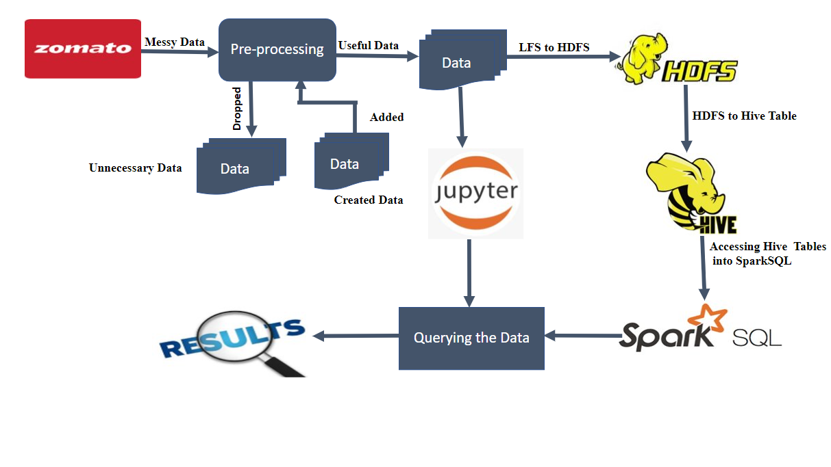
Work flow of project

Slide 7
Schema of the table
|-- cuisines: string (nullable = true)
|-- approx_cost_for_two_people: integer (nullable = true)
|-- reviews_list: string (nullable = true)
|-- menu_item: string (nullable = true)
|-- listed_in_type: string (nullable = true)
|-- listed_in_city: string (nullable = true)
|-- payMode: string (nullable = true)
|-- Discount: integer (nullable = true)
|-- Capacity: integer (nullable = true)
|-- Catering: string (nullable = true)
|-- url: string (nullable = true)
|-- address: string (nullable = true)
|-- name: string (nullable = true)
|-- online_order: string (nullable = true)
|-- book_table: string (nullable = true)
|-- rate: string (nullable = true)
|-- votes: int (nullable = true)
|-- phone: string (nullable = true)
|-- location: string (nullable = true)
|-- rest_type: string (nullable = true)
|-- cuisines: string (nullable = true)

Slide 8
Queries in sparksql
Restaurant names in Banashankari with online order and table booking availability
s.sql('select distinct name from restaurant2 where online_order="Yes" and book_table="Yes" and listed_in_city="Banashankari"').show()
Top rated restaurant with their type of service.
s.sql('select name,rest_type,rate from restaurant2 where rate>="4.0" group by name,rest_type,rate order by rate').show()
The costly restaurant (cost for 2 greater than 800) with restaurant type and location located in Bannerghatta Road
s.sql('select name,rest_type,location from restaurant2 where approx_cost_for_two_people>=800 and listed_in_city="Bannerghatta Road"').show()

Slide 9
Queries
Restaurants in Bannerghatta Road with cost for two people between 500 to 800 with its type, rating and location
s.sql('select name,listed_in_type,rate,location from restaurant2 where (approx_cost_for_two_people between 500 and 800) and listed_in_city="Bannerghatta Road"').show()
Top Voted Restaurant details
s.sql('select max(votes) from restaurant2').show()
s.sql('select * from restaurant2 where votes=4401').show()
Restaurants in Banashankari having votes greater than 500 and having the menu list with restaurant type
s.sql('select name,menu_items,rest_type,votes from restaurant2 where votes>500 and listed_in_city="Banashankari" and menu_items!="notAvailable"').show()

Slide 10
Queries
Top 5 Restaurant details based on votes and rating in both cities.
s.sql('select name,address,location,rate,votes,cuisines,rest_type from restaurant2 where listed_in_city="Banashankari” order by votes desc,rate desc').show(5)
s.sql('select name,address,location,rate,votes,cuisines,rest_type from restaurant2 where listed_in_city="Bannerghatta Road" order by votes desc,rate desc').show(5)
Top five restaurants based on rating and votes which has continental in their cuisines list
s.sql('select name,address,location,rate,votes,cuisines,rest_type,listed_in_city as city from restaurant2 where cuisines like "%Continental%" order by votes desc,rate desc').show(5)

Slide 11
Queries
Top 5 costly restaurants with restaurant name location,cuisines,rate,votes,approx_cost_2 and listed_in_type based on approx_cost_2,rate and votes.
s.sql('select distinct name,location,cuisines,rate,votes,approx_cost_2,listed_in_type from restaurant2 order by approx_cost_2 desc,votes desc,rate desc').show(5)
List of restaurants which are rated more than 3.5 in reviews list
s.sql('select name,location,rest_type from restaurant2 where substring(reviews_list,6,9)>"3.5"').show()
Top 5 restaurants based on rating and votes, having the rest_type as Casual Dining
s.sql('select distinct name,location,cuisines,rate,votes from restaurant2 where rest_type like "%Casual Dining%" order by rate desc,votes desc').show(5)

Slide 12
Queries
Restaurant name,loaction,rating and discount having discount>30 order by discount and rating in descending order
s.sql('select name,location,rate,Discount from restaurant2 where Discount>=30 order by Discount desc, rate desc').show(10)
Restaurant having catering facility in Banashankari area
s.sql('select name,location from restaurant2 where Catering="yes" and listed_in_city="Banashankari"').show(20)
Café Restaurant accepting credit card and Paytm mode of payment
s.sql('select name,location,votes from restaurant2 where listed_in_type="Cafes" and (payMode like "%DebitCard%" or payMode like "%Paytm%")').show()

Slide 13
Queries
Dessert type restaurant having capacity greater than 100 order by capacity, rating and votes
s.sql('select name,location,rate,votes,capacity from restaurant2 where listed_in_type="Desserts" and Capacity>=100 order by rate desc,votes desc,capacity desc').show
Restaurant details which have catering facility and accepting cash with high discounts with menu
s.sql('select name,location,menu_item,Discount,payMode from restaurant2 where Catering="yes" and payMode like "%Cash" and menu_item!="notAvailable" order by Discount desc').show()

Slide 14
Queries
find me list of restaurant where online orders are accepted, book table facility should be there and PhonePe is available.
data.select("url","name", "address", "phone", 'payMode').filter((data.online_order=='Yes') & (data.book_table=='Yes') & (data.payMode.contains('PhonePe'))).show()
Looking for good discount and restaurant type should be Drinks and Night Life.
data.select("url","name", "address","phone","Discount", "listed_in_type").filter((data.Discount>=40) & (data.listed_in_type=='Drinks & nightlife')).show()

Slide 15
Queries
Restaurant type should be dine out and dosa should be there in the menu item.
data.select("url", "name", "address","phone", "menu_item").filter((data.menu_item.contains('Dosa')) & (data.listed_in_type=='Dine-out')).show()
Veg food in banashankari, budget is 800 max, please provide url, address, name, mobile Number of the restaurant and one more thing I only have Paytm to pay the bills.
data.select("url", "name", "address", "phone").filter((data.menu_item.contains('Veg')) | (data.menu_item.contains('veg')) & (data.listed_in_city=='banashankari') & (data.payMode.contains('Paytm')) & (data.approx_cost_for_two_people<=800)).show()

Slide 16
Partitioning and bucketing
Partitioning the table based on Discounts of restaurant
rest=s.sql('select * from restaurant2')
rest.write.partitionBy('Discount').saveAsTable("restaurant_part")
We have performed bucketing on the type of restaurant with 20 buckets
rest=s.sql('select * from restaurant2')
rest.write.bucketBy(20, "rest_type").saveAsTable("restaurant_bucketed")

Slide 17
Thank you

