Slide 1
Smart Waste Management System Using Data Mining
Optimizing Waste Collection and Recycling through Technology

Slide 2
Table Of Content
Abstract
Background
System Overview
Technical
Workflow
Experimental Results
Future Work
Conclusion
Reference

Slide 3
Abstract
Problem: Urban waste management inefficiencies and environmental impact.
Solution: Using data mining to analyze waste patterns, optimize collection, and improve recycling rates.
Outcome: Increased efficiency and reduced costs.

Slide 4
Background/Motivation
Challenges in current waste management:
- Fixed schedules ignore variations.
- Poor recycling rates.
- Environmental degradation.
Proposed Integration: Data mining to predict and optimize waste handling.

Slide 5
System Overview
Components:
Data Collection: IoT sensors, mobile app, geo-tagging.
Data Mining Techniques: Clustering, Prediction, and Association Rules.
Actionable Insights: Dynamic schedules, recycling recommendations.

Slide 6
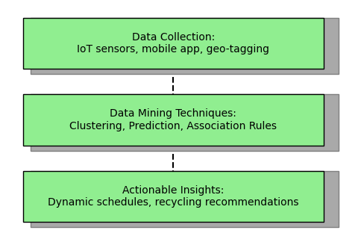

Slide 7
Technical Workflow
Steps:
1. Data preprocessing.
2. Clustering using K-Means.
3. Prediction with Decision Tree Regression.
4. Association rule mining for waste behavior analysis.

Slide 8
Data Processing
Clustering
Prediction
Association Rules

Slide 9
Clustering: K-Means
Objective: Group neighborhoods into waste zones.
Steps:
- Random initialization of centroids.
- Assign data points and recalculate centroids.

Slide 10
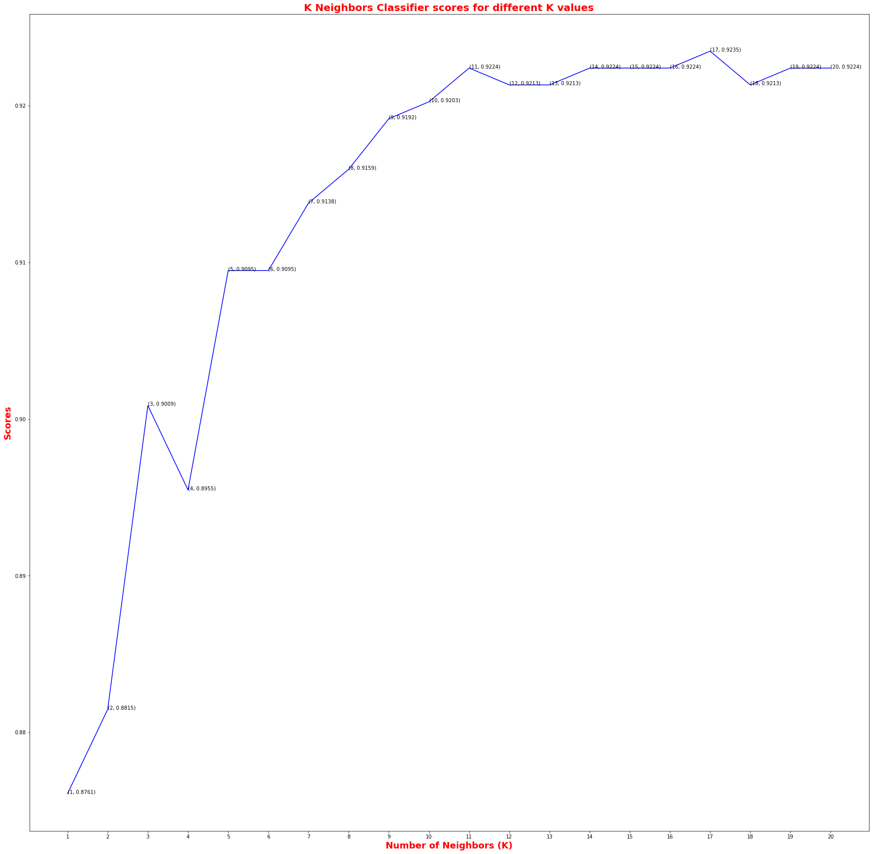
Before Clustering

Slide 11
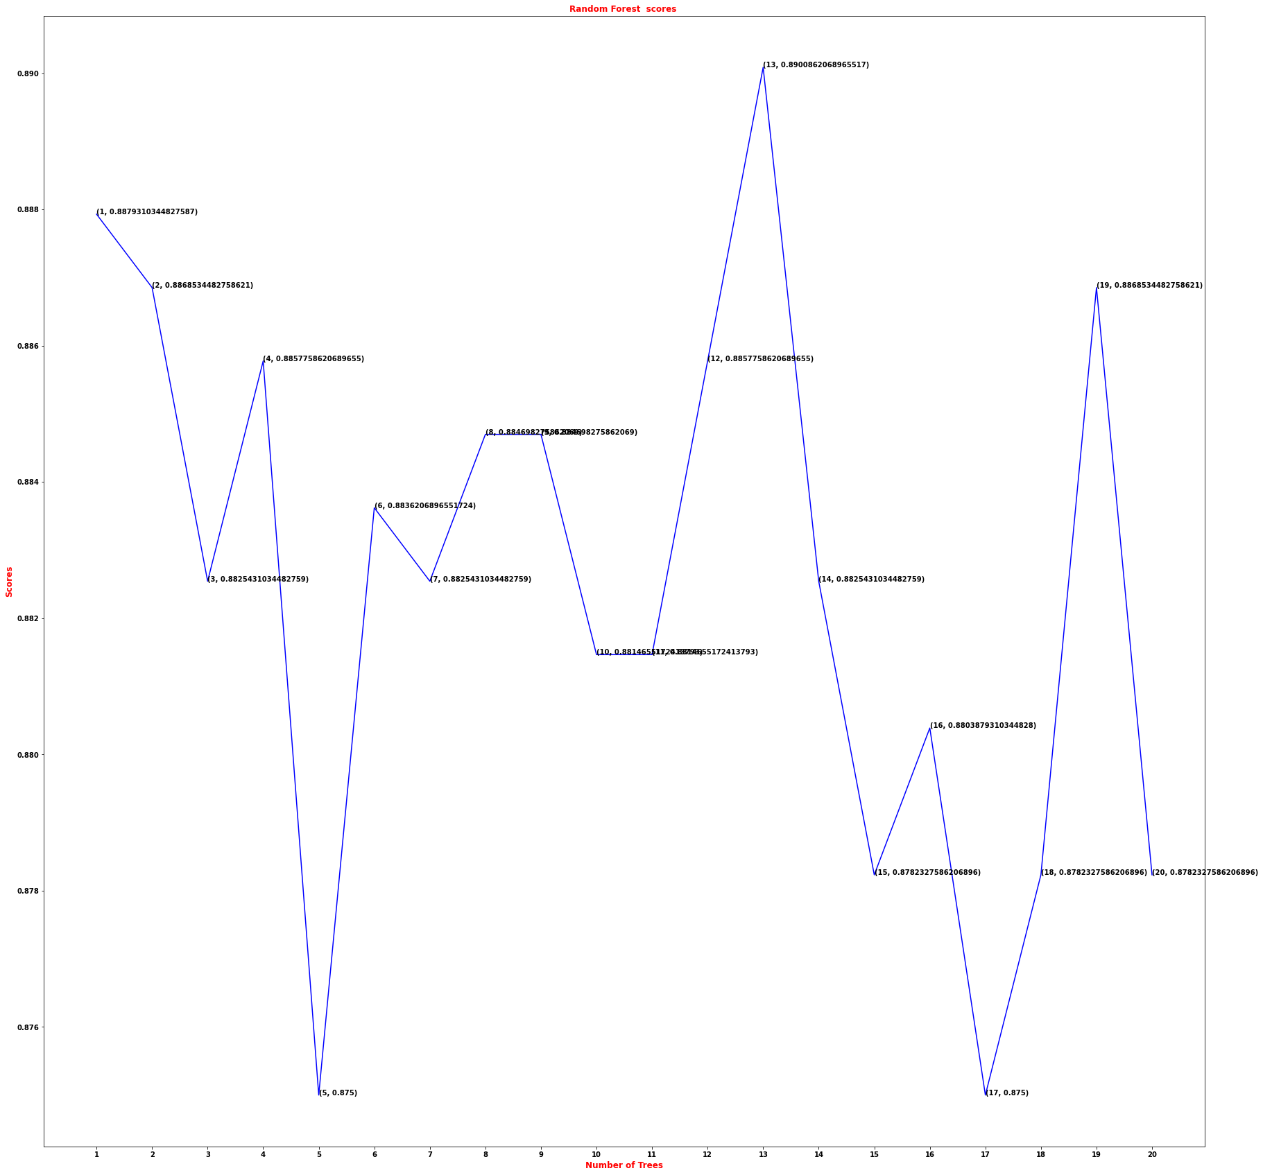
After Clustering
Results: High, moderate, and low-waste zones identified

Slide 12
Prediction: Decision Tree Regression
Purpose: Forecast bin fill levels.
Steps:
- Split data by minimizing errors.
- Recursively refine splits.
Outcome: 92% accuracy in predicting bin fill levels.

Slide 13
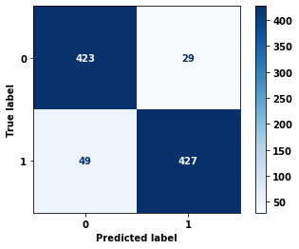
Actual Forecast

Slide 14
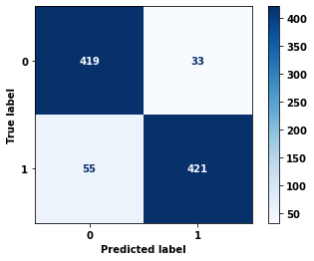
Predicted Forecast

Slide 15
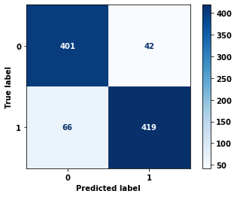
Result Forecast

Slide 16
Association Rule Mining
Goal: Discover waste disposal patterns.
Example Insight: Glass and paper are often disposed of together.
Recommendation: Install dual-compartment bins.

Slide 17
Experimental Results
Dataset:
- 4639 records, 100 locations.
- Attributes include bin ID, waste type, fill level, etc.
Outcomes:
- Heatmaps for waste zones.
- Improved schedule efficiency.

Slide 18
Results
Data Analysis
Data Collection
Optimization

Slide 19
Future Work
Integration with real-world municipal data.
Machine learning for route optimization.
Reward-based user incentives.
Expansion to industrial and medical waste management.

Slide 20
Integration with real-world municipal data
Machine Learning For Route Optimization
Reward-Based User Incentives
Expansion To Industrial & Medical Waste Management

Slide 21
Conclusion
Impact:
- Enhanced waste management efficiency.
- Reduced operational costs and environmental footprint.
Vision: A sustainable and data-driven waste management system.

Slide 22
References
Kotsiantis, S., Zaharakis, I., & Pintelas, P. (2007). Supervised Machine Learning: A Review of Classification Techniques.
Tan, P., Steinbach, M., & Kumar, V. (2006). Introduction to Data Mining.
Google Maps Api Documentation

