Slide 1
FedUSNet: Federated Learning for Privacy-Preserving Breast Cancer Classification
Sainath Vaddi (101179915)
Sony Reddy Gurram (101179182)
Sai Galipelli (101176490)
Course: Distributed Systems (CSC-721-U16)
Instructor: Dr. Rodrigue Rizk

Slide 2
Outline
Problem Statement
Introduction to FedUSNet
Understanding Federated Learning
Breast Cancer Classification: An Overview
FedUSNet Architecture
Implementation of FedUSNet
Results and Performance Evaluations
Key Advantages of FedUSNet
Challenges and Limitations
Future Work
Ethical Considerations
Conclusion
Q & A Session

Slide 3
Problem Statement
Massive Data Generation: Healthcare generates large volumes of sensitive data, including patient records, diagnostic images, and health data from health-monitoring studies, which are essential for improving care.
Privacy Concerns: This data contains personal information that must remain private and centralizing it for analysis could violate privacy laws like HIPAA.
Need for Privacy-Preserving Collaboration: There is a critical need for a method to collaborate on data analysis without compromising patient privacy or legal requirements.

Slide 4
Introduction to FedUSNet
Overview of Federated Learning: Federated Learning is a decentralized approach to machine learning that allows for model training across multiple servers with local data samples, without the need to share actual data. This method is valuable in healthcare, where patient privacy is highly important.
Important in Healthcare: In healthcare, utilizing federated learning can improve collaborations among institutions while protecting sensitive patient information, also improving diagnosis models like those used for breast cancer classification without comprising data integrity.
Breast Cancer Classification challenges: Classifying breast cancer accurately is complex due to factors such as varied imaging protocols, differences in patient demographics, and misdiagnosis. This makes it essential to explore innovative approaches like FedUSNet which not only maintain privacy standards but also improves classification accuracy.

Slide 5
Understanding Federated Learning
Federated learning relies on a system where models are trained on individual devices, and the updates are then sent to a central server to be combined. This approach helps protect privacy by keeping the data on the local devices instead of bringing it all together in one place.
Federated learning process involves multiple rounds of communication between clients and their central server. Each client trains a local model using its private data and shares only model updates, thus maintaining data privacy and minimizing the risk of data leakage.
This approach lower the risks of data breaches, reduces latency in training process, and enables continuous learning from different datasets across different institutions without the need for costly and time-consuming data agreements.

Slide 6
Breast Cancer Classification: Overview
Current Classification Methods: The classification of breast cancer mostly rely on methods like mammography, histopathology, and imaging techniques using machine learning algorithms. However, many of these methods are limited by small datasets and the difficulty of applying models effectively across different populations.
Challenges in Data Privacy: One of the main challenges in breast cancer classification is ensuring data privacy while assessing sensitive information across healthcare institutions, as sharing data can lead to ethical and legal issues.
Need for Improved Techniques: To enhance breast cancer classification, there is a main need for robust techniques that can operate within privacy-preserving frameworks, ultimately improving accuracy, efficiency, and outcomes for patients while adhering to privacy regulations.

Slide 7
FedUSNet Architecture
Components of FedUSNet: FedUSNet is designed with a custom Res-Net architecture, a central federated server, and 10 client nodes, each holding a local BUSI dataset and participating in model training.
Data Distribution: In real-world scenarios, data is typically stored across multiple institutions or hospitals to protect patient privacy. Similarly, our model mimics this approach by evenly distributing the data across all 10 clients, which represent medical facilities, to maintain privacy standards.
Model Training Process: The training process involves clients iteratively updating their local models on their unique datasets before sending aggregated updates to the central server, allowing continuous improvement while protecting individual data privacy.

Slide 8
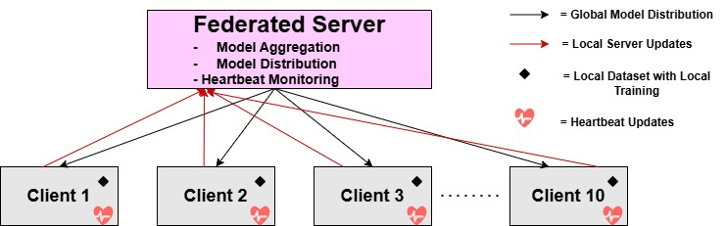
FedUSNet Architecture

Slide 9
Implementation of FedUSNet
Data Preparation: The BUSI dataset is split across 10 clients, with 80% used for training and 20% reserved for testing. Each client works with an equal portion of the training data, ensuring that the learning process is fair and balanced across all participants.
Training Parameters: We use a custom Res-Net architecture for the model, which is tailored for feature extraction and classification. The Adam optimizer is chosen with a learning rate of 0.001 to fine-tune the model, and we apply Cross-Entropy as the loss function. Each batch consists of 32 samples, and the model is trained over 10 rounds, with 5 epochs in each round to gradually improve its accuracy.
System Setup: To speed up the training process, we utilize GPUs for faster computations. Google Colab is used as the development platform, providing the necessary tools and computational power to build and test the model efficiently.

Slide 10
Performance Metrics
Model Performance: Our federated learning system achieved good accuracy on the test dataset, demonstrating excellent convergence and classification ability for breast cancer classification.
Efficiency and Latency: The average throughput was 0.20 updates per second, with an average training round latency of 49.83 seconds, indicating efficient processing and communication.
Communication Overhead and Stability: The system maintained a reasonable communication overhead of 10.97 MB per training session and ran stably for 0.14 hours without interruptions, highlighting its practicality for medical applications.

Slide 11
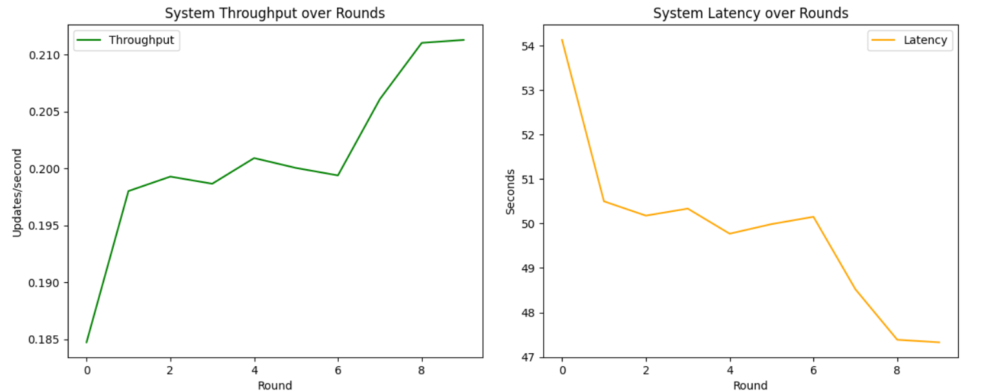

Slide 12
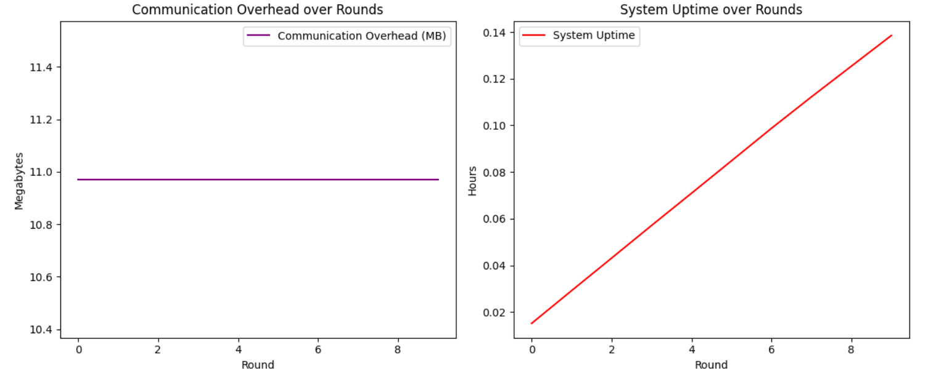

Slide 13
Key Advantages of FedUSNet
High Accuracy: Delivered exceptional results for breast cancer classification.
Efficient: Minimal communication costs and consistent system uptime.
Reliable: The implementation demonstrated exceptional reliability, with zero client failures throughout the training process.
Impactful: This demonstrates how privacy-preserving research can contribute to healthcare.

Slide 14
Challenges and Limitations
Data Heterogeneity: In general, the diverse nature of data across multiple institutions, varying in quality, structure, and volume, can introduce challenges in training models that generalize effectively while being trained on different datasets.
Communication Overhead: The decentralized nature of federated learning can lead to increased communication overhead between clients and the central server, ultimately affecting the training speed and efficiency, particularly when dealing with large amounts of data.
Scalability Issues: As the number of institutions involved increases, scaling the architecture to maintain performance without compromising security becomes a non-trivial challenge that requires careful planning and resource allocation.

Slide 15
Ethical Considerations
Patient Consent: Ensuring that patients are informed and provide consent for their data to be utilized in federated learning processes is crucial for ethical practice, highlighting transparency.
Data Ownership: Navigating data ownership rights is important, and is necessary to clearly mention who has access, control, and privileges associated with datasets being utilized within federated learning frameworks.
Regulatory Compliance: Complying with existing regulations such as HIPAA (in USA), GDPR (in Europe) demonstrates the commitment to ethical standards in using patient data, protecting rights while developing innovations in healthcare.

Slide 16
Conclusion
Summary of Key Findings: FedUSNet emerges as an interesting solution for privacy-preserving breast cancer classification, showing its efficiency through results.
Impact on Breast Cancer Diagnosis: FedUSNet is leading the way in transforming breast cancer diagnosis by combining privacy and performance. Its collaborative learning approach improves diagnostic accuracy across a diverse range of patients.
Future of Federated Learning in Healthcare: The promising capabilities of federated learning signal a shift towards more secure, collaborative healthcare technologies, suggesting a future where advanced diagnostics can thrive without compromising patient privacy.

Slide 17
Future Work
Broadening the Scope: Expanding this approach to cover other diseases and diverse healthcare datasets to enhance its applicability.
Exploring Advanced Models: Testing more advanced deep learning models to improve classification accuracy and model performance.
Real-World Deployment: Deploying the system in actual healthcare settings, ensuring it works efficiently in real-world environments.
Enhancing Privacy: Strengthening privacy protections by incorporating advanced techniques like differential privacy to further safeguard patient data.

Slide 18
Questions ?
Thank you.

