Slide 1


SAG-Droning’s
MS5611 Barometric Pressure Sensor

Slide 2
Introduction
Barometric Pressure Sensor (MS5611) is a high-resolution altimeter sensor with SPI ad I2C bus interface.
This Sensor has a resolution of 10cm. i.e. it can detect a difference of 10 cm in height of the object it was connected to

Slide 3
Proposal
The sensor that I am working, uses the height of the device attached and gives a next level of sense of security to the user, as mobile devices tend to get lost and a moderately priced product usually has a GPS built in to find it but if they live in a area with a lot trees, buildings . A barometric sensor enables the user to check what's the altitude of the device and when its paired to a GPS tracker it gives the user full access to its position and elevation.

Slide 4

Budget

Slide 5
Schedule
The project is on schedule,
Minor Set backs :-
PCB had to be redesigned.
Casing wasn’t fitting properly.
OS was getting corrupted.

Slide 6
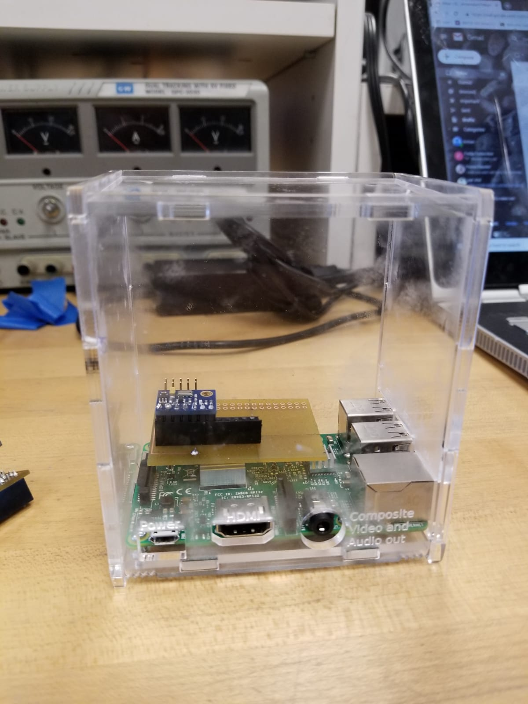
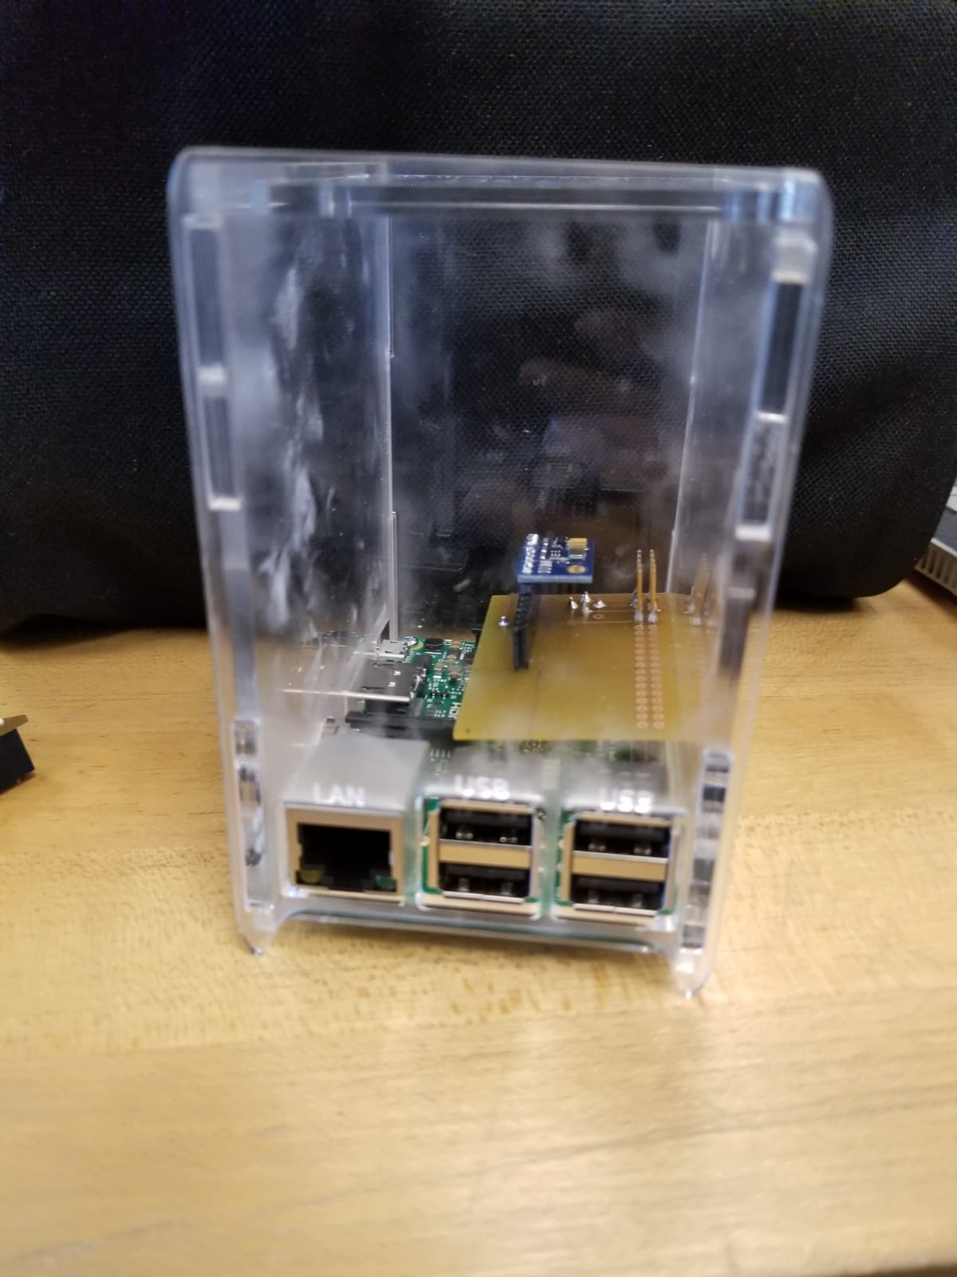
Hardware

Slide 7
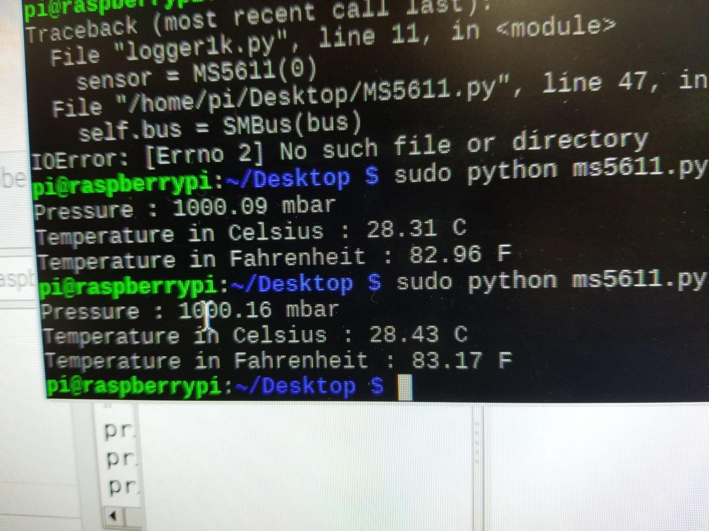
Readings From the Sensor

Slide 8
Course Knowledge
Electric circuit :- Understood the basic concepts and methods on how to work around electrical equipment.
Embedded System :- Understood how a sensor works and how it communicates with a sensor.

Slide 9
References
https://www.digikey.ca/en/product-highlight/t/te-connectivity-measurement-specialties/ms5611-01ba-barometric-pressure-sensor

