Slide 1




ENHANCING ENDPOINT DIFFERENTIATION IN CDMA THROUGH VARIABLE LENGTH SPREADING

Slide 2

Overview
Members
Abstract
Introduction
Objective
Proposed Idea
Results
References

Slide 3

Members
Mohamed Shoukat Ali 21BLC1497
Gurshaan Singh Bhasin 21BLC1424
Kevin Joshua T 21BLC1445

Slide 4
Abstract
Code Division Multiple Access (CDMA) is a wireless communication technique that utilizes unique spreading codes for each user to increase signal bandwidth. The original data signal is spread by multiplying it with the assigned code. At the receiver, the received signal is correlated with the specific code to extract the user's data and suppress interference, enabling efficient and robust communication with multiple users sharing the same frequency band simultaneously.

Slide 5


Introduction
Code Division Multiple Access (CDMA) employs unique Pseudonoise (PN) spreading codes for each user to expand signal bandwidth. The original data is multiplied by the assigned code for transmission, and at the receiver, the signal is correlated with the corresponding code to extract the desired user's data while suppressing interference. This correlation process involves multiplication and integration, separating the user's signal from others. Further processing removes noise, and the original data is efficiently recovered. CDMA's use of low cross-correlation spreading codes enables multiple users to share the same frequency band effectively.

Slide 6


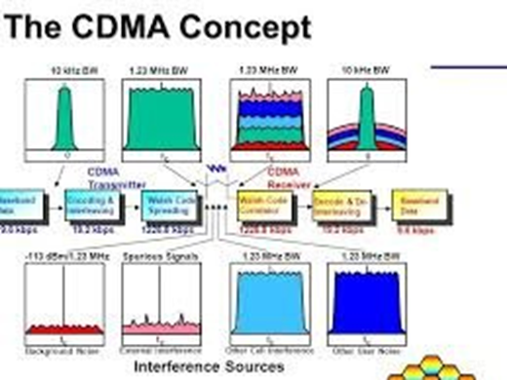
1.1:CDMA:
Code Division Multiple Access (CDMA) is a digital cellular technology that enables multiple users to share the same frequency spectrum simultaneously. Unlike other multiple access techniques like Time Division Multiple Access (TDMA) or Frequency Division Multiple Access (FDMA), CDMA employs a unique spreading code for each user, allowing for concurrent transmissions on the same frequency band. This spreading code, also known as a chip sequence or pseudo-random noise sequence, spreads the user’s signal over a wider bandwidth.

Slide 7
At the receiver side, correlation with the appropriate spreading code enables the extraction of the desired user’s signal while mitigating interference from other users. CDMA offers several advantages over alternative multiple access schemes. Firstly, it provides inherent interference rejection capabilities, as the use of unique spreading codes enables simultaneous transmissions without the need for strict time or frequency separation. Additionally, CDMA exhibits robustness against multipath fading and offers enhanced capacity by efficiently utilizing available spectrum resources

Slide 8
1.2 Pseudo Noise:
Pseudonoise sequences, also referred to as pseudo-random noise sequences, are deterministic sequences that exhibit statistical properties similar to random noise. These sequences possess two critical characteristics: a long period and good auto-correlation properties. The long period ensures that the sequence repeats itself after an extended period, allowing for a large number of unique codes to be generated. Good auto-correlation properties mean that the cross-correlation between two different pseudonoise sequences is low, reducing interference and improving the ability to distinguish between different users.
Pseudonoise sequences are typically generated using shift registers or feedback shift registers (FSRs). Shift registers are digital circuits capable of producing sequences based on the feedback of previous outputs.

Slide 9
By selecting appropriate feedback taps and initial states, shift registers can generate long-period pseudonoise sequences. Pseudonoise sequences serve as spreading codes. Each user is assigned a unique pseudonoise sequence, which is used to spread their signal over a wider frequency band. This spreading process increases the resistance of the signal to interference and improves the overall capacity of the system by allowing multiple users to simultaneously transmit on the same frequency band. Furthermore, pseudonoise sequences are used in synchronization and timing recovery. In receiver systems, the received signal is correlated with the expected pseudonoise sequence to synchronize the receiver’s clock and determine the timing of the transmitted signal. This correlation process involves multiplying the received signal with the pseudonoise sequence and integrating the result over a specific time period.

Slide 10
OBJECTIVE
The project aims to explore the benefits and implications of using VLS for enhancing endpoint differentiation in CDMA, with the following specific objectives:
•Creata a basline implementation of VLS and its implementation in the general CDMA diaspora.
•Identify the limitations and challenges associated with PN spreading in CDMA systems, such as fixed spreading code lengths and their impact on spectral efficiency, data rates, and adaptability.
•Investigate the benefits of VLS in CDMA systems:
•Explore the potential advantages and benefits of employing Variable Length Spreading as an alternative to PN spreading, including improved adaptability, enhanced spectral efficiency, and optimized system performance.

Slide 11
•Assess the impact of VLS on endpoint differentiation in CDMA systems, considering factors such as signal conditions, interference levels, and varying user requirements.
•Quantitatively and qualitatively evaluate the performance of VLS compared to PN spreading in terms of data rates, spectral efficiency, system capacity, and resilience against noise and interference.
Analyze the practical implications and feasibility of implementing VLS in CDMA systems, considering factors such as complexity, hardware requirements, and compatibility with existing infrastructure

Slide 12

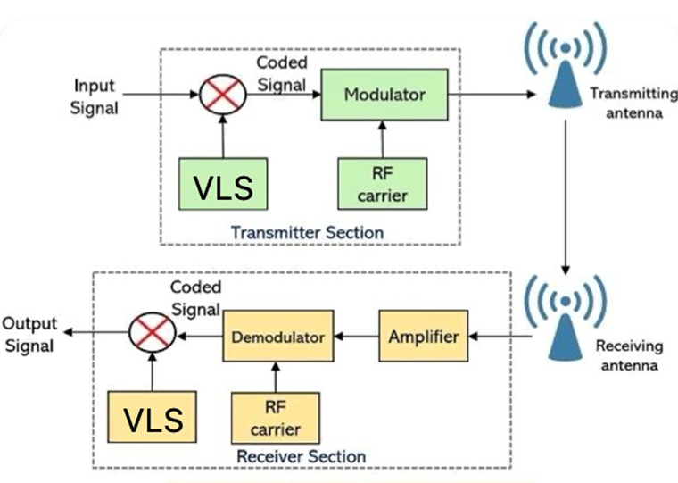
Proposed Idea
Traditional CDMA (Code Division Multiple Access) is a technique used in telecommunications to allow multiple users to share the same frequency spectrum simultaneously. In traditional CDMA, each user is assigned a unique code (known as a spreading code) that is used to spread their data across the entire available bandwidth. All users transmit their data simultaneously, and the receiver, knowing the spreading codes of the users it wants to listen to, can separate and extract the desired data from the received signals. The spreading codes act as a kind of signature that helps the receiver distinguish between different users' transmissions, allowing for concurrent communication over the same frequency band.

Slide 13
Variable Length Spreading (VLS) is an enhancement to the traditional CDMA system that allows for more efficient spectrum utilization and improved capacity. In traditional CDMA, the spreading code length is fixed, and all users spread their data using the same code length. In contrast, VLS allows different users to use spreading codes of varying lengths. Users with higher data rates or better signal conditions can use shorter spreading codes, while users with lower data rates or worse signal conditions can use longer spreading codes. This flexibility in spreading code length allows the system to adapt to different channel conditions and user requirements, optimizing the use of available resources. VLS can significantly increase the capacity of the CDMA system and improve overall
system performance, making it a valuable addition to traditional CDMA networks

Slide 14
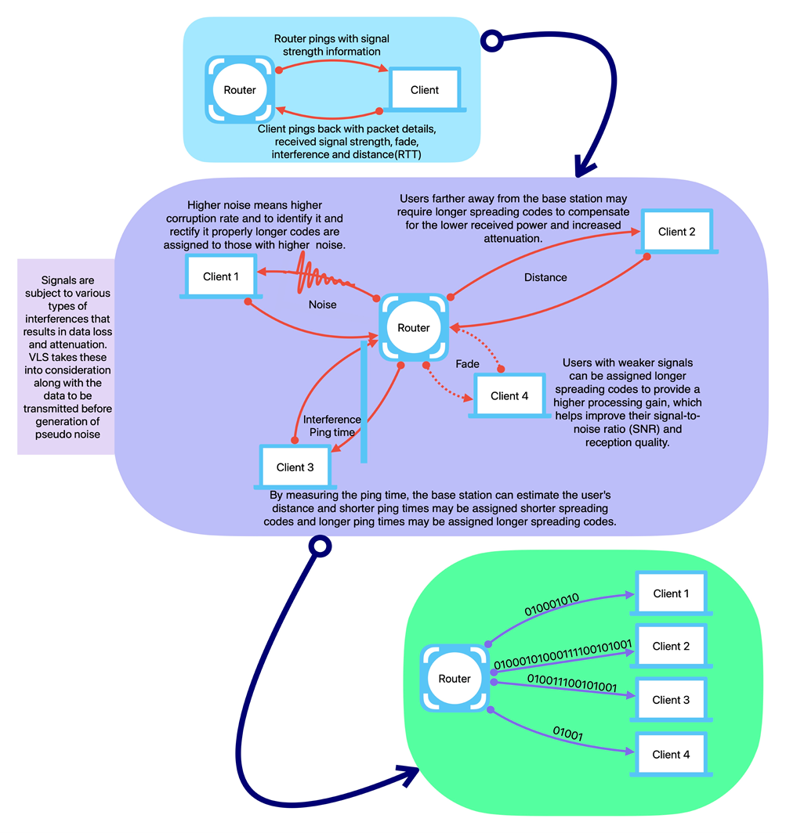
By incorporating Variable Length Spreading (VLS) into a CDMA system , as seen in Figure 2.
code assignment and data transmission are modified to accommodate spreading codes of different lengths. VLS allows users to be assigned spreading codes based on their data rates and channel conditions, with shorter codes for higher data rates and better signals, and longer codes for lower data rates and weaker signals. During data transmission, each user spreads their signal using their designated spreading code of variable length,
Your paragraph text

Slide 15

enabling faster transmission or better interference resilience. The receiver correlates the received signal with different spreading codes to extract the desired user's data. Adaptive resource allocation algorithms are employed to dynamically adjust code assignments and efficiently allocate the spectrum. VLS enhances the CDMA system's flexibility, spectral efficiency, capacity utilization, and performance in various scenarios.

Slide 16
Results Obtained
Python is a high-level, interpreted programming language known for its simplicity and readability. It emphasizes code readability and allows developers to express concepts in fewer lines of code compared to other languages. Python supports multiple programming paradigms, including procedural, object-oriented, and functional programming. Its extensive standard library and large community support make it a popular choice for various applications, from web development and data analysis to artificial intelligence and automation.
the following libraries are used:
NumPy (imported as np): NumPy is a powerful library for numerical computing in Python. It provides support for large, multi-dimensional arrays and matrices, along with a collection of mathematical functions to operate on these arrays efficiently.
Time: The time module is a standard Python library used for time-related functions. In this context, it might be used to measure the execution time of certain parts of the code.
Matplotlib.pyplot (imported as plt): Matplotlib is a widely used library for creating static, interactive, and animated visualizations in Python. The "pyplot" submodule provides a simple interface to create various types of plots, charts, and graphs.

Slide 17
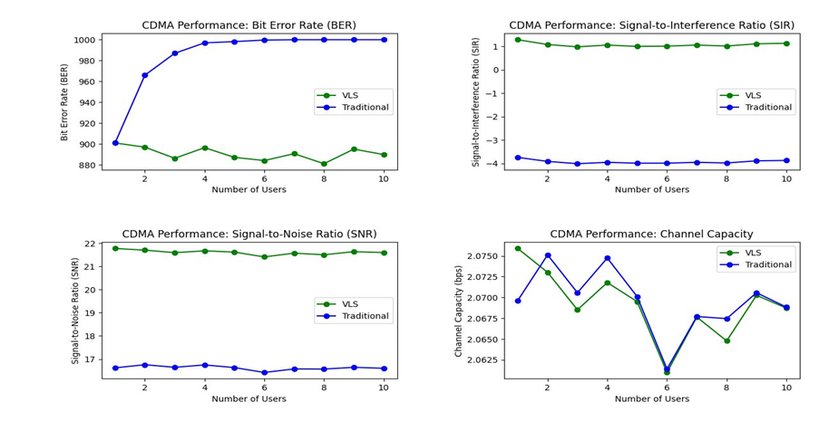
Simulation Parameters
As we can Decipher from
the graphs given the
overall performance of
VLS in CDMA is highly
effective when compared
to the traditional method
the bit error rate , Signal
to interference Ratio ,
SIgnal to Noise Ratio,
Channel Capacity has
seen quiet an
improvement

Slide 18
REFERENCES
[1] Ayse Kortun – Detection of Spreading Codes in CDMA
[2] Lie-Liang Yang and Lajos Hanzo - Adaptive Rate DS-CDMA Systems Using Variable Spreading Factors
[3] Xia Wenlong , Zhou Yuanping , Meng Qingdang - Run‐length method for determining the segmentation length based on the segmentation long‐code blind estimation
[4] Dong In Kim - Analysis of a Hybrid Multicode/Variable Spreading Factor DS-CDMA System With Two-Stage Group Detection
[5] YAMASAKI and Tomoko K. MATSUSHIMA - Complex Orthogonal Variable Spreading Factor Codes Based on Polyphase Sequences
[6] Wang Bisheng ,Yang Dongkai1, and Zhang Qishan - Efficient Identification UHF RFID system scheme based on combination of DFSA and OVSF-CDMA
[7] Ula¸s C. Kozat, Iordanis Koutsopoulos and Leandros Tassiulas - Dynamic code assignment and spreading gain adaptation in synchronous CDMA wireless networks
[8] Po-Wei Fu and Kwang-Cheng Chen - Multi-Rate Multi-Carrier CDMA with Multiuser Detection for Wireless Multimedia Communications
[9] Hirofumi Tsuda and Ken Umeno - Orthogonal basis spreading sequence for optimal CDMA
[10] Mouad Addad and Ali Djebbari - Suitable Spreading Sequences for Asynchronous MC-CDMA Systems

Slide 19
THANK YOU

