Slide 1
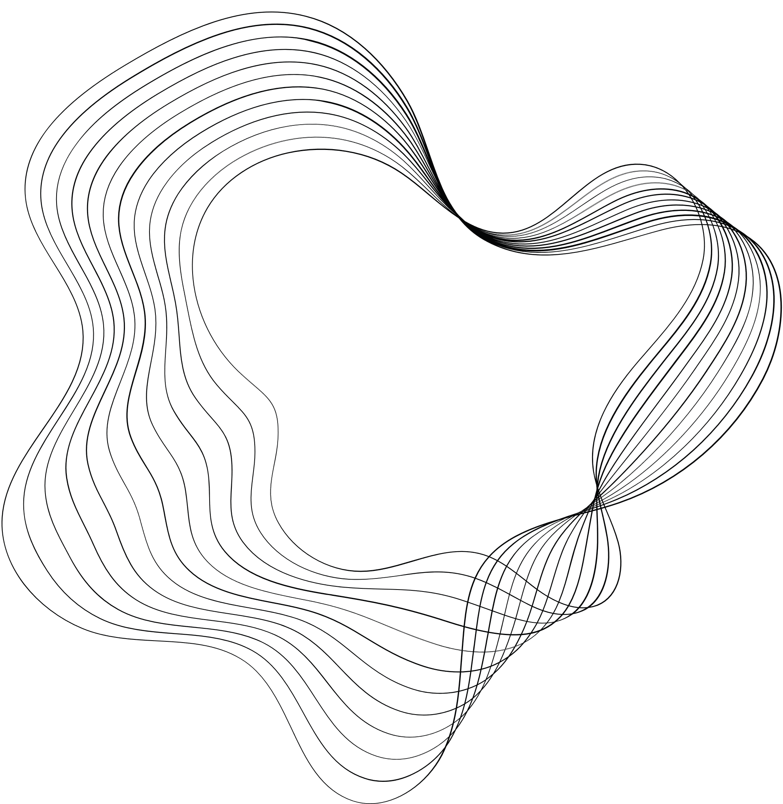

SIMPLE ALU

Slide 2

CONTENT
01
MEMBERS
02
OBJECTIVE
03
LITERATURE SURVEY
04
DESIGN METHODOLOGY, CODES AND COMPONENTS
05
DEMONSTRATION OF THE WORK COMPLETED
06
DISCUSSION OF RESULTS
07
REFERENCES

Slide 3
1. MEMBERS
Kevin Joshua T 21BLC1445
Kevin Joe Thomas 21BLC1190
Mohammed Shoukat Ali 21BLC1497
Gurshaan Singh 21BLC1424
Raghav Matta 21BLC1563
Sujay Ramesh 21BLC1605

Slide 4


2. OBJECTIVE
The ALU is a crucial component in computer architecture, responsible for executing core operations and enabling the processor to perform arithmetic, logical, and control operations efficiently. Its capabilities directly impact the speed, efficiency, and versatility of a computer system.
Our objective is to thus create a much faster and overall efficient ALU compared to those currently in use to help boost the capabilities of not only the processor but also consequently all its relevant functions

Slide 5
3. LITERATURE SURVEY
Arithmetic operations are one of the fundamental functions performed by an ALU. In addition to basic addition, subtraction, multiplication, and division operations, ALUs can also support additional arithmetic operations such as increment, decrement, shift, and rotate.
1. Increment: This operation adds 1 to the input value, effectively incrementing it by one.
2. Decrement: This operation subtracts 1 from the input value, effectively decrementing it by one.
3. Shift: Shifting involves moving the bits of a binary number to the left or right. ALUs can perform logical shifts (shifting in zeros) or arithmetic shifts (preserving the sign bit). Logical left shift multiplies the input value by 2 for each shift, while logical right shift divides the input value by 2 for each shift. Arithmetic left shift is similar to logical left shift, but it preserves the sign bit. Arithmetic right shift is similar to logical right shift, but it preserves the sign bit and replicates it.
4. Rotate: Rotation is similar to shifting, but the bits that are shifted out are brought back in at the other end. Circular left rotation shifts the bits to the left and brings the leftmost bit to the rightmost position, while circular right rotation shifts the bits to the right and brings the rightmost bit to the leftmost position.
These additional arithmetic operations are useful in various computational tasks, such as data manipulation, bit manipulation, and algorithmic optimizations. They provide flexibility and efficiency in performing calculations within the ALU.

Slide 6

(3.1)
WORKING PRINCIPLE
In recent times, FPGA circuitry has become increasingly complex with multiple layers of hardware aligning to perform simple calculations. As a result, the complexity of code has also increased, leading to more complex types and numbers of calculations. However, through experimentation, we have discovered that codes run much faster on simpler circuitry if they are designed accordingly. We compared our simple ALU with a traditional 64-bit ALU to determine the computation time and resources required to achieve the desired outcome.

Slide 7
(3.2.1)
ADVANTAGES OF ALU
It supports parallel architecture and applications with high performance.
It has the ability to get the desired output simultaneously and combine integer and floating-point variables.
It has the capability of performing instructions on a very large set and has a high range of accuracy.
In general, it is very fast; hence, it provides results quickly.
There are no sensitivity issues and no memory wastage with ALU.
They are less expensive and minimize the logic gate requirements.

Slide 8
(3.2.2)
DISADVANTAGES OF ALU
With the ALU, floating variables have more delay, and its designed controller is not easy to understand.
the concept of pipelining is complex to understand.
In ALU there is an irregularity in latencies
Bugs would occur in ALU result if memory space was definite.

Slide 9
4.
METHODOLOGY
The provided code implements an ALU (Arithmetic Logic Unit) module that performs arithmetic and logical operations on two 32-bit operands.
It includes internal registers to store the result and zero flag.
The module supports operations like addition, subtraction, bitwise AND, bitwise OR, and bitwise XOR.
The result and zero flag are determined using case statements based on the operation input.
The module assigns the result and zero flag to the output wires. This ALU can be integrated into a larger design for efficient computation.

Slide 10

(5.1.1)VERILOG CODE
module Statistics (
input [N-1:0] data,
output [N-1:0] mean,
output [N-1:0] median,
output [N-1:0] mode,
output [N-1:0] iqr,
output [N-1:0] range,
output [N-1:0] quantile1,
output [N-1:0] quantile3,
output [N-1:0] skewness,
output [N-1:0] kurtosis,
output [N-1:0] correlation,
output [N-1:0] regression
);
parameter N = 8; // Number of bits for data
// Internal variables
reg [N-1:0] sorted_data[N];
reg [N-1:0] sorted_data_temp;
reg [N-1:0] sorted_data_mode;
reg [N-1:0] temp;
reg [N-1:0] sum;
reg [N-1:0] count;
reg [N-1:0] q1;
reg [N-1:0] q3;
reg [N-1:0] x_mean;
reg [N-1:0] x_median;
reg [N-1:0] x_mode;
reg [N-1:0] x_iqr;
reg [N-1:0] x_range;
reg [N-1:0] x_quantile1;
reg [N-1:0] x_quantile3;
x_mean = sum / count;
end
// Calculate the median
always @*
begin
if (N % 2 == 0)
x_median = (sorted_data[N/2-1] + sorted_data[N/2]) / 2;
else
x_median = sorted_data[N/2];
end
// Calculate the mode
always @*
begin
sorted_data_mode = sorted_data[0];
temp = sorted_data[0];
count = 1;
int max_count = 1;
for (int i = 1; i < N; i = i + 1)
begin
if (sorted_data[i] == temp)
count = count + 1;
else
begin
if (count > max_count)
begin
max_count = count;
sorted_data_mode = temp;
end
reg [N-1:0] x_skewness;
reg [N-1:0] x_kurtosis;
reg [N-1:0] x_correlation;
reg [N-1:0] x_regression;
// Sort the data
always @*
begin
for (int i = 0; i < N; i = i + 1)
sorted_data[i] = data[i];
for (int i = 0; i < N-1; i = i + 1)
for (int j = 0; j < N-i-1; j = j + 1)
if (sorted_data[j] > sorted_data[j+1])
begin
sorted_data_temp = sorted_data[j];
sorted_data[j] = sorted_data[j+1];
sorted_data[j+1] = sorted_data_temp;
end
end
// Calculate the mean
always @*
begin
sum = 0;
count = 0;
for (int i = 0; i < N; i = i + 1)
begin
sum = sum + sorted_data[i];
count = count + 1;
end

Slide 11
(5.1.2)VERILOG TESTBENCH CODE
temp = sorted_data[i];
count = 1;
end
end
x_mode = sorted_data_mode;
end
// Calculate the interquartile range (IQR)
always @*
begin
q1 = sorted_data[(N+1)/4-1];
q3 = sorted_data[3*(N+1)/4-1];
x_iqr = q3 - q1;
end
// Calculate the range
always @*
begin
x_range = sorted_data[N-1] - sorted_data[0];
end
// Calculate the 1st quantile
always @*
begin
x_quantile1 = q1;
end
// Calculate the 3rd quantile
always @*
begin
x_quantile3 = q3;
end
x_correlation = 0; // Implement your correlation calculation logic here
end
// Calculate the regression (placeholder)
always @*
begin
x_regression = 0; // Implement your regression calculation logic here
end
// Assign output values
assign mean = x_mean;
assign median = x_median;
assign mode = x_mode;
assign iqr = x_iqr;
assign range = x_range;
assign quantile1 = x_quantile1;
assign quantile3 = x_quantile3;
assign skewness = x_skewness;
assign kurtosis = x_kurtosis;
assign correlation = x_correlation;
assign regression = x_regression;
endmodule
// Calculate the skewness
always @*
begin
reg [N-1:0] sum_dev_cubed = 0;
for (int i = 0; i < N; i = i + 1)
sum_dev_cubed = sum_dev_cubed + (sorted_data[i] - x_mean) * (sorted_data[i] - x_mean) * (sorted_data[i] - x_mean);
x_skewness = sum_dev_cubed / (count * x_iqr * x_iqr * x_iqr);
end
// Calculate the kurtosis
always @*
begin
reg [N-1:0] sum_dev_fourth = 0;
for (int i = 0; i < N; i = i + 1)
sum_dev_fourth = sum_dev_fourth + (sorted_data[i] - x_mean) * (sorted_data[i] - x_mean) * (sorted_data[i] - x_mean) * (sorted_data[i] - x_mean);
x_kurtosis = sum_dev_fourth / (count * x_iqr * x_iqr * x_iqr * x_iqr);
end
// Calculate the correlation (placeholder)
always @*
begin

Slide 12
(5.1.2)VERILOG TESTBENCH CODE
module ALU (
input wire [31:0] operandA,
input wire [31:0] operandB,
input wire [2:0] operation,
output wire [31:0] result,
output wire zero
);
// Declare internal wires and registers
reg [31:0] result_reg;
reg zero_reg;
// ALU operations
parameter ADD = 3'b000;
parameter SUB = 3'b001;
parameter AND = 3'b010;
parameter OR = 3'b011;
parameter XOR = 3'b100;
// Add more operations as needed
always @*
case (operation)
ADD: result_reg = operandA + operandB;
SUB: result_reg = operandA - operandB;
AND: result_reg = operandA & operandB;
OR: result_reg = operandA | operandB;
XOR: result_reg = operandA ^ operandB;
// Add more cases for additional operations
default: result_reg = 32'hxxxxxxxx; // Undefined value
endcase
always @*
zero_reg = (result_reg == 32'b0);
// Assign outputs
assign result = result_reg;
assign zero = zero_reg;
endmodule

Slide 13
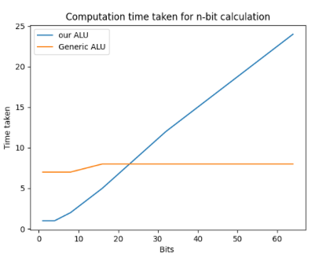
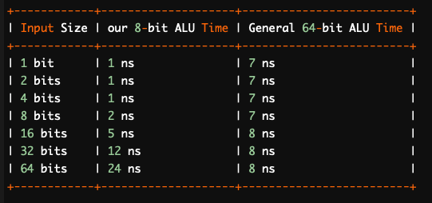
5.1.3 DEMONSTRATION

Slide 14
6.
DISCUSSION OF RESULTS
Thus from the previous slide , after running a time analysis of our Verilog code , we have clearly by statistical means proved how our simpe ALU works more efficiently when transferring bits of data.
Our case study considered data of bits from 1 - 64 and the graph alongside evidently visualizes what our project aimed to do in the first place , which is to create a better ALU than the ones currently in use.
By this same logic, we can also say that while transferring other complex polynomial functions and when performing further logical operations , our ALU design and code will most definitely come out victorious and will prove to be of help in a universal other applications which will benefit from a faster processing unit.
So to conclude , the sky is the limit in the applications to follow when implemented and with the evergrowing scope of technology , we have no doubt that our implemented code will be further advanced with time still.

Slide 15
7. REFERENCES
https://www.gimtec.io/p/simplest-alu-ever
http://www.csc.villanova.edu/~mdamian/Past/csc2400fa13/assign/ALU.html
https://study.com/learn/lesson/arithmetic-logic-unit-alu.html#:~:text=The%20function%20of%20an%20ALU,calculations%20within%20a%20computer%27s%20CPU
The guidance of our professor , Prof. Sindhuja M.

Slide 16

THANK YOU

