Slide 1

MCA Major Project Mid Term Evaluation
CineChoice:-Movie recommendation system
Under the guidance of
Faculty Guide Name:- Pramod Soni
Department of Computer Applications
Faculty of Science, Technology and Architecture
Manipal University Jaipur
By
Gursharan Singh
23FS20MCA00028
2023-25

Slide 2
Outline
Introduction
Motivation
Process Model
Software Requirement Specification (SRS)
Data Flow Diagram (DFD)
Output
Conclusion
Future Scope

Slide 3
1. Introduction
CineChoice is a personalized movie recommendation system that helps users find movies based on their preferences, viewing history, and movie attributes. With the vast number of films available on streaming platforms, it can be overwhelming to choose the right one. CineChoice uses machine learning algorithms to suggest movies that align with user interests, making the decision-making process easier and more enjoyable.

Slide 4
2. Motivation
The entertainment industry is experiencing a massive boom with the rise of streaming platforms, making it difficult for users to decide what to watch. Traditional search methods often result in user fatigue, leading to decreased engagement. CineChoice addresses this issue by leveraging data-driven insights and AI-powered recommendations.
Key motivations for this project include:
Growing demand for personalized recommendations: Users prefer content that aligns with their tastes rather than browsing through countless options.
Challenges in manual movie selection: With thousands of movies available, users often struggle to find something that suits their mood and preferences.
Utilizing data analytics for smarter decision-making: Analyzing audience behavior and trends helps refine movie suggestions, enhancing user satisfaction.
Enhancing content discovery and engagement: A well-structured recommendation system increases user retention and platform engagement by delivering accurate and appealing suggestions.

Slide 5
3. Process Model
The project follows the Waterfall Model, which includes:
Requirement Analysis – Identifying user preferences and system needs.
Design – Developing the recommendation algorithm and data structures.
Implementation – Integrating machine learning models for recommendations.
Testing – Ensuring recommendation accuracy and system efficiency.
Deployment – Making the system available for real-world use.

Slide 6
4. Software Requirement Specification (SRS)
Functional Requirements:
Collect and process movie data.
Provide personalized movie recommendations.
Utilize collaborative filtering, content-based filtering, and hybrid models.
Allow users to rate and review movies for better recommendations.
Hardware Requirements:
Minimum 4GB RAM, i5 processor, 100GB storage.
Non-Functional Requirements:
High accuracy in recommendations.
Fast and responsive processing.
User-friendly interface for seamless navigation.
Scalability for handling large datasets.
Software Requirements :
Python, Pandas, Scikit-learn, Flask, Jupyter Notebook.
Data visualization tools for analytics.

Slide 7
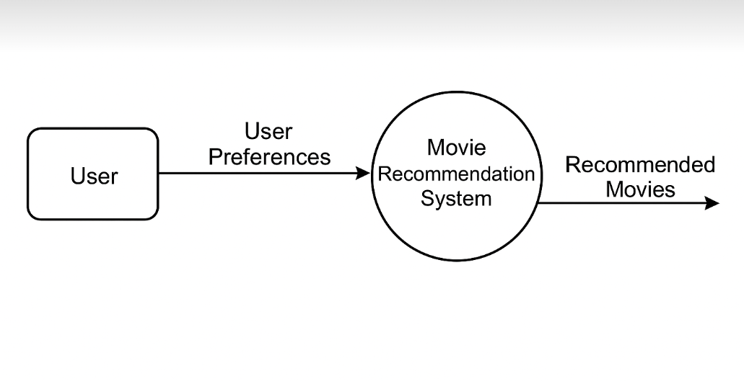
5.DFD

Slide 8
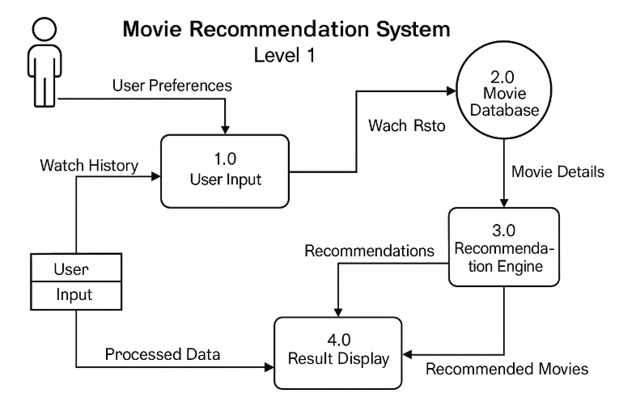

Slide 9
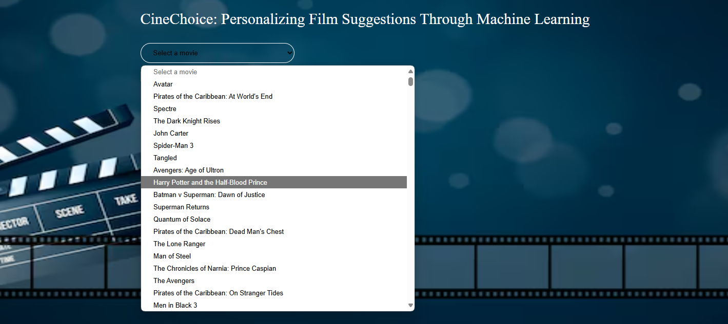
6. Output

Slide 10
7. Conclusion
CineChoice is an AI-powered movie recommendation system that helps users navigate the overwhelming number of movies available today. By using advanced machine learning algorithms, it personalizes movie suggestions, improving user experience and engagement.
This system has great potential for the entertainment industry, offering a data-driven approach to content discovery. With future enhancements like AI-based sentiment analysis, real-time recommendations, and web-based dashboards, CineChoice aims to revolutionize how users find and enjoy movies.

Slide 11
8. Future Scope
Integration with AI for sentiment-based recommendations.
Expansion to TV shows and web series recommendations.
Real-time movie trend analysis.
Development of a web-based interface for better accessibility.

