Slide 1

MCA Major Project Mid Term Evaluation
Fake News Detection using Machine learning
Under the guidance of
Faculty Guide Name:- Pramod Soni
Department of Computer Applications
Faculty of Science, Technology and Architecture
Manipal University Jaipur
By
Gursharan Singh
23FS20MCA00028
2023-25

Slide 2
Outline
Introduction
Motivation
Process Model
Software Requirement Specification (SRS)
Data Flow Diagram (DFD)
Output
Conclusion
Future Scope

Slide 3
1. Introduction
Fake news is false or misleading information presented as news. It spreads rapidly due to social media. Detecting fake news is crucial to prevent misinformation and its negative effects on society.

Slide 4
2. Motivation
• Fake news influences public opinion and causes misinformation.
• Manual fact-checking is slow and inefficient.
• Machine learning provides an automated, scalable solution for fake news detection.

Slide 5
3. Process Model
1. Data Collection: Gathering news articles from multiple sources.
2. Data Preprocessing: Cleaning and tokenizing text.
3. Feature Extraction: NLP techniques (TF-IDF, Word Embeddings, BERT).
4. Model Training: ML models (Logistic Regression, Random Forest, LSTMs, BERT).
5. Evaluation: Accuracy, precision, recall, F1-score.
6. Deployment: Real-time fake news detection system.

Slide 6
4. Software Requirement Specification (SRS)
Functional Requirements:
• The system should classify news as Fake or Real.
• It should support multiple sources and languages.
• Allow users to input news for credibility checking.
Non-functional Requirements:
• Scalable system to handle large datasets.
• High accuracy and low latency.
• Secure and user-friendly interface.

Slide 7
5.DFD
• Input: User submits a news article.
• Processing: The system analyzes the article using NLP and ML models.
• Output: Classification result (Fake/Real) with confidence score.

Slide 8
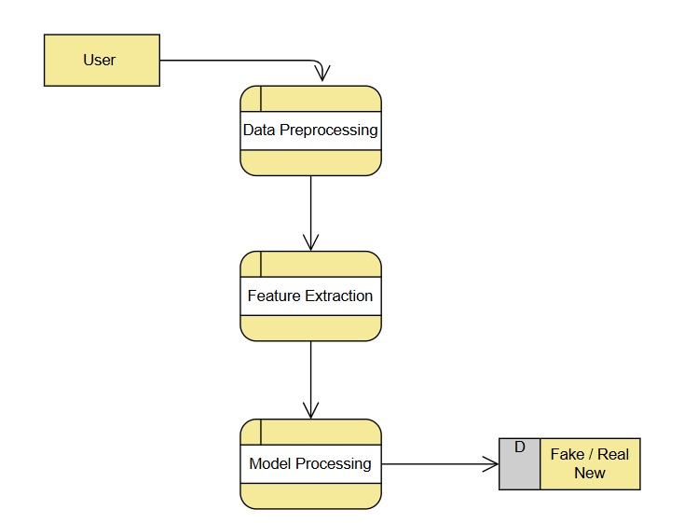

Slide 9
6. Output
• Model achieves XX% accuracy on the test dataset.
• Example:
- 'Breaking news about a celebrity scandal' → FAKE
- 'Government announces new policies' → REAL
• Performance Metrics: Precision, Recall, F1-score.

Slide 10
7. Conclusion & Future Scope
• Machine learning is a powerful tool for fake news detection.
• Feature engineering and NLP techniques play a crucial role.
• Future improvements:
- Implementing BERT and GPT models for better accuracy.
- Real-time fake news detection APIs.
- Multilingual support for global applicability.

