Slide 1

MCA Major Project Mid Term Evaluation
Fake News Detection using Machine learning
Faculty Guide Name:- Pramod Soni
Department of Computer Applications
Faculty of Science, Technology and Architecture
Manipal University Jaipur
By
Gursharan Singh
23FS20MCA00028
2023-25

Slide 2
Outline
Introduction
Motivation
Process Model
Software Requirement Specification (SRS)
Data Flow Diagram (DFD)
Output
Conclusion
Future Scope

Slide 3
1. Introduction
As digital banking becomes more common, people expect fast and accurate help with their financial questions—especially when it comes to credit cards. But traditional customer support channels often get flooded with the same routine questions, leading to long wait times and frustrated users.
To solve this, our project "AI-Powered Conversational Assistant for Credit Card FAQs“ aims to build a smart, conversational system that can answer these frequently asked questions instantly. Using the power of Google’s Gemini language model, combined with LangChain and FAISS, we’ve created an assistant that understands natural language and gives helpful, real-time responses based on a carefully curated knowledge base. The goal is to make customer support faster, smarter, and more accessible.

Slide 4
2. Motivation
We were inspired to build this project after noticing how frustrating it can be to get quick answers from traditional customer support—especially when you're dealing with something as important as your credit card. Static FAQ pages are often hard to navigate, and getting help from a human agent can take time.
With recent breakthroughs in AI, especially with powerful language models and smarter search tools, we saw an opportunity to change that. We wanted to create a system that feels more like chatting with a helpful assistant—one that understands what you're asking and gives clear, accurate answers instantly. This project is our way of showing how conversational AI can make customer support in the banking world faster, more reliable, and way less stressful.

Slide 5
3. Process Model
Requirement Analysis: We started by figuring out what kinds of questions users are likely to ask about credit cards and how the assistant should respond.
Design: Once we had that figured out, we designed the system’s architecture. This included planning how the Flask backend, Google Gemini API, and FAISS retriever would all work together.
Implementation: Then came the actual coding. We built a web app using Python and Flask, with LangChain handling the conversation logic and AI flow.
Testing: After building it, we tested the system by asking it different kinds of questions to see how well it understood and responded.
Deployment: Finally, we set everything up to run locally, using Google Cloud Platform (GCP) for AI services and SQLite to store conversation history.

Slide 6
4. Software Requirement Specification (SRS)
Functional Requirements:
Understands natural language questions about credit cards.
Provides accurate, context-aware answers.
Saves user conversations with timestamps.
Non-functional Requirements:
Fast responses (under 2 seconds).
Secure handling of API keys and credentials.
Easy to scale and update as needed.

Slide 7
Software Requirement Specification (SRS)
Technologies We Used
Frontend: We used HTML and Flask templates to create a simple, user-friendly interface.
Backend: The logic was written in Python using Flask, with LangChain to manage conversations.
LLM Provider: We integrated Google's Gemini model through Vertex AI to handle the actual language understanding.
Vector Store: To store and retrieve information efficiently, we used FAISS along with HuggingFace Embeddings.
Storage: SQLite (chat history), GCS (knowledge base).
Config Management: we used .env file to manage configuration.

Slide 8
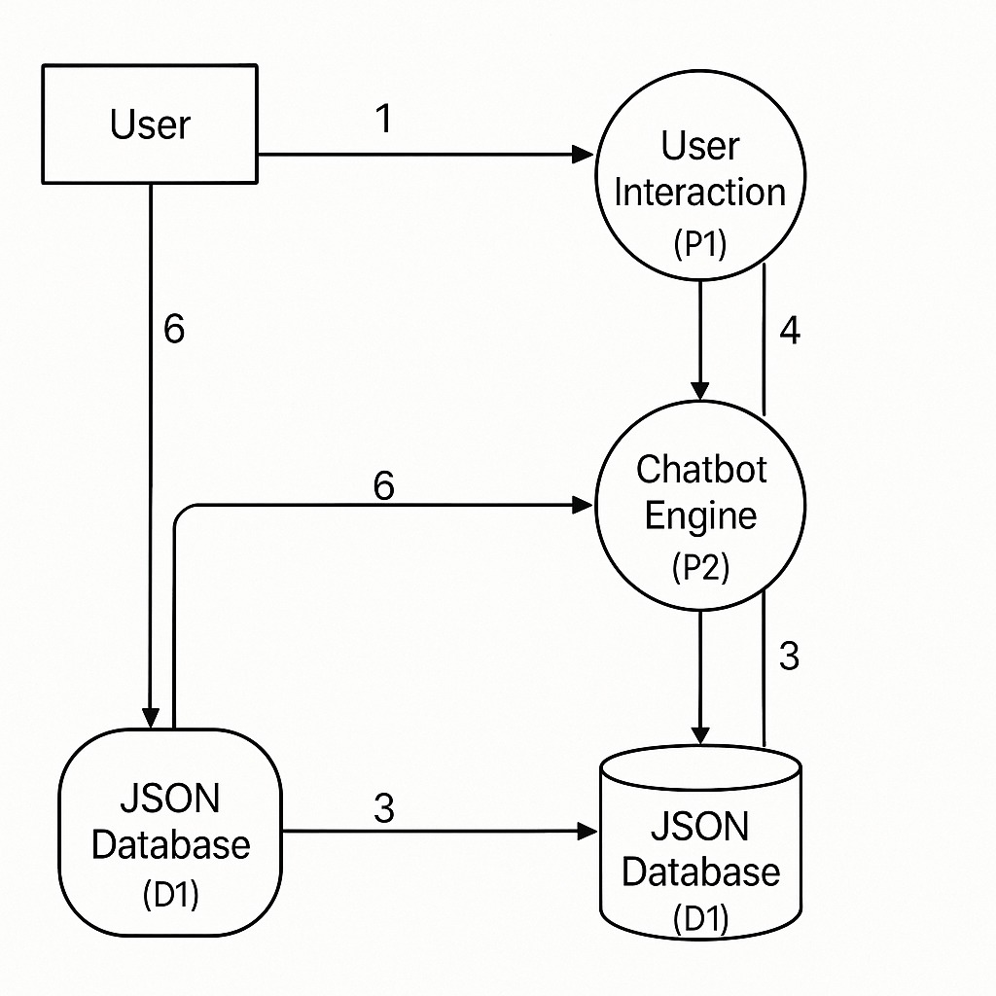
5.DFD
Level 0:

Slide 9
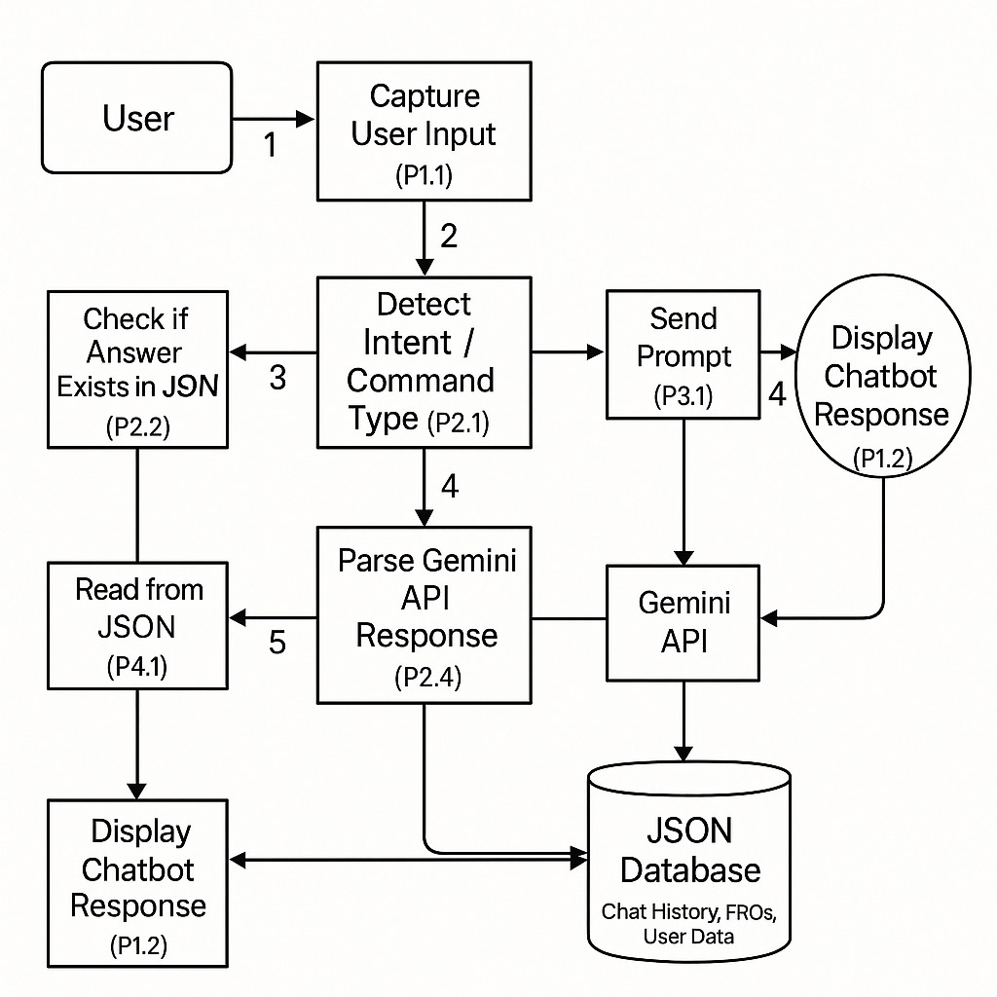
Level 1:

Slide 10
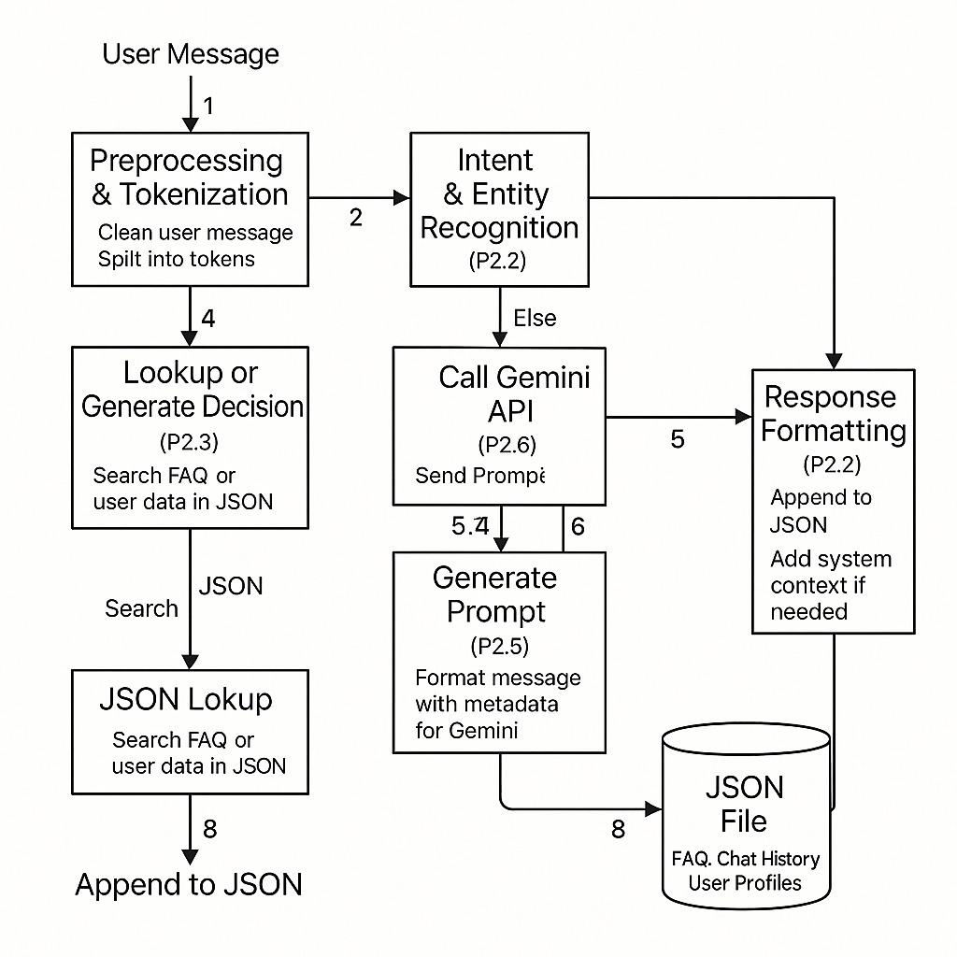
Level 2:

Slide 11
6. Output
The system returns:
A conversational response addressing the user’s specific credit card query.
A UI-rendered chat interface replicating natural conversation.
Logged interactions stored in a local SQLite database.
Example Output:
User: "How can I increase my credit limit?"
Bot: " If you're the primary account holder, you can request a credit limit increase or decrease online: 1. Select your credit card account. 2. Choose "Credit Limit Change" and follow the prompts. For assistance, call 1-800-123-1234 and provide necessary details on income, assets, or credit obligations."

Slide 12
7. Conclusion
The project successfully demonstrates how LLMs can be leveraged to build domain-specific conversational assistants. By integrating Gemini with LangChain and FAISS, the system efficiently handles real-world queries related to credit cards. The modular design ensures adaptability to other domains with minimal changes.

Slide 13
8. Future Scope
Voice Input Integration using Speech-to-Text.
Multilingual Support to expand accessibility.
Dashboard Analytics for admin to monitor FAQs trends.
Real-time Deployment on cloud (e.g., GCP App Engine).
User Authentication for personalized support.

