Slide 1

Linear Feature Engineering
Presentation by Hong Yang and Gursimran Singh
September 14
2021

Slide 2

Goals
To estimate dependent variable values from a given test data series by training on the data using feature engineering and making the least square error minimal.
We also need to take care of overfitting problems using cross validation methodology.

Slide 3

Steps taken
We used the k-fold cross validation methodology to compute the mean square error for different models over varied degrees.
3 aspects K, degree, and model(feature function).
We used degree of polynomials from 0 to 10 as most of the positive results lied in the range.
We used a standard value of K=10 as it gave the least mean square error for tried models without taking much computation power.
We used the average test error generated using each model for a particular degree of polynomial during cross-validation to estimate the test error for the given model.

Slide 4

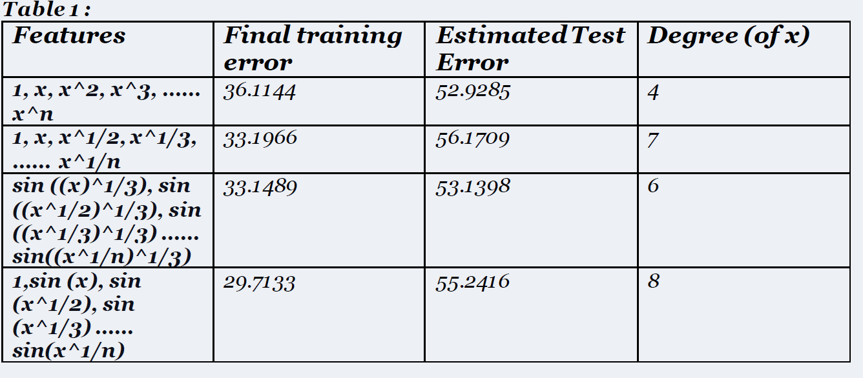
Methods used

Slide 5

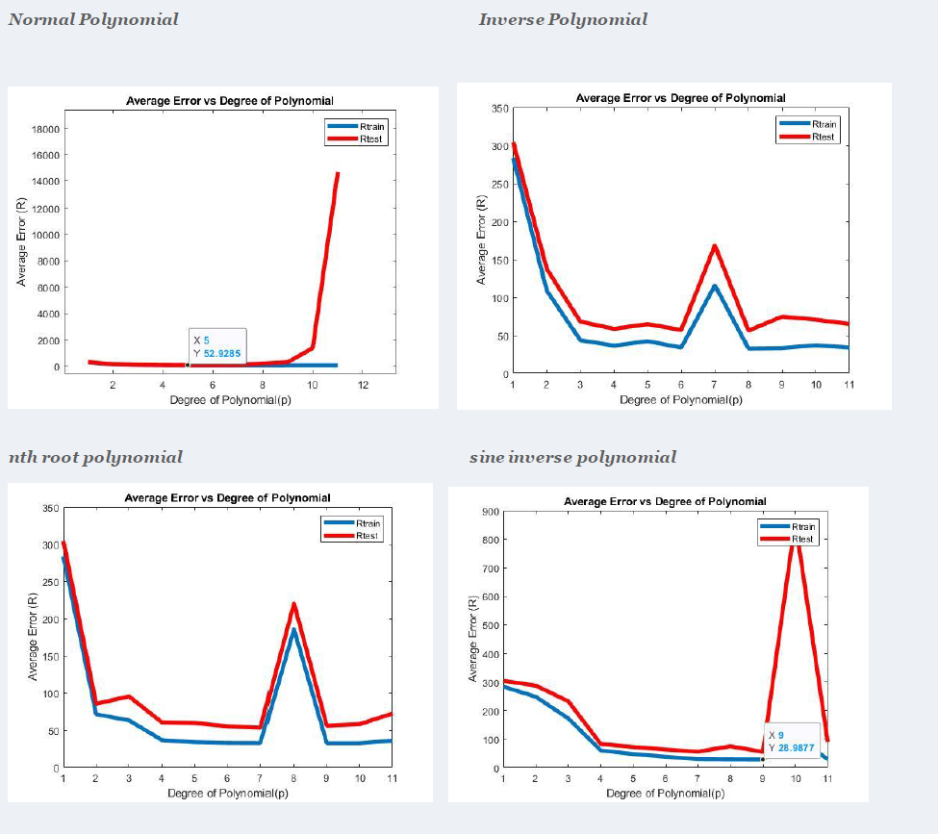
CV Errors

Slide 6

THANK YOU!

