Slide 1
2 b A C A D E M Y
Python Bootcamp
Week 2 — Data Structures · Strings · Files & Error Handling · OOP
Jul 6 – Jul 10, 2026 | Days 4–8 | 15 Hours
Data Structures
Strings & Files
OOP Basics

Slide 2





Week 2 At-a-Glance — What We Cover
4
Mon Jul 6
Data Structures
Lists · Tuples · Dicts · Student Marks Program
5
Tue Jul 7
String Handling
Methods · Palindrome · Patterns
6
Wed Jul 8
Files + Errors + Capstone
File I/O · try/except · Module 1 Capstone
7
Thu Jul 9
OOP Part 1
Classes · Objects · Constructors
8
Fri Jul 10
OOP Part 2 + Project
Inheritance · Encapsulation · Graded Project

Slide 3





Week 1 Quick Recap — What You Already Know
Python Setup
Variables & Types
Input / Output
Control Flow
Functions
Python 3.x + VS Code · First program ran!
int · float · str · bool · None · type()
print() · input() · f-strings · type conversion
if/elif/else · for loops · while loops · break/continue
def · parameters · return · default args · built-ins
Today we go deeper — data structures, files, errors, and object-oriented programming!

Slide 4
2 b A C A D E M Y
DAY 4 / WEEK 2
Day 4 — Mon, Jul 6
Data Structures: Lists · Tuples · Dictionaries + Student Marks Program

Slide 5
Introduction to Lists in Python
Creating Lists
📋 Python Lists
A list is an ordered and mutable collection used to store multiple items in a single variable.
Features of Lists
✅ Ordered
✅ Mutable (can be changed)
✅ Allows duplicate values
✅ Can store different data types
✅ Indexed collection
# list of integers
numbers = [10, 20, 30]
# list of strings
fruits = ["Apple", "Mango", "Banana"]
# mixed data types
mixed = [10, "Python", True, 3.14]

Slide 6
Accessing and Slicing Lists
Indexing
Output
fruits = ["Apple", "Mango",
"Banana"]
print(fruits[0]) # Apple
print(fruits[-1]) # Banana
[20, 30, 40]
[10, 20, 30]
[30, 40, 50]
[50, 40, 30, 20, 10]
Slicing
numbers = [10, 20, 30, 40, 50]
print(numbers[1:4])
print(numbers[:3])
print(numbers[2:])
print(numbers[::-1])

Slide 7
Adding and Removing Elements
Adding Elements
List Methods
fruits.append("Orange")
fruits.insert(1, "Kiwi")
fruits.extend(["Grapes",
"Cherry"])
Method
Purpose
append()
Add one item
insert()
Add at index
Removing Elements
extend()
Add multiple items
fruits.remove("Mango")
fruits.pop()
del fruits[0]
fruits.clear()
remove()
Remove by value
pop()
Remove by index
clear()
Remove all items

Slide 8
Useful List Methods
Example
Useful Methods
numbers = [30, 10, 50, 20]
numbers.sort()
numbers.reverse()
print(numbers.count(10))
print(numbers.index(50))
Method
Purpose
sort()
Sort list
reverse()
Reverse list
count()
Count occurrences
index()
Find position
copy()
Create copy

Slide 9
Looping and List Operations
Traversing a List
Output
fruits = ["Apple", "Mango",
"Banana"]
for fruit in fruits:
print(fruit)
[1, 2, 3, 4]
[1, 2, 1, 2]
True
List Operations
a = [1, 2]
b = [3, 4]
print(a + b)
print(a * 2)
print(2 in a)

Slide 10
List Comprehension
List Comprehension
squares = [x*x for x in range(5)]
print(squares)
Output
[0, 1, 4, 9, 16]
Lists are the most used data structure in Python for storing and manipulating collections of data.

Slide 11
Introduction to Tuples
Creating Tuples
📦 Tuples in Python
A tuple is an ordered and immutable collection used to store multiple items in a single variable.
Features of Tuples
✅ Ordered
✅ Immutable (cannot be changed)
✅ Allows duplicate values
✅ Supports indexing and slicing
✅ Faster than lists
✅ Can store different data types
# integers
numbers = (10, 20, 30)
# strings
fruits = ("Apple", "Mango",
"Banana")
# mixed data types
mixed = (10, "Python",
True, 3.14)
Single Element Tuple
# note the trailing comma
single = (10,)

Slide 12
Accessing Elements and Slicing
Tuples support indexing and slicing just like lists.
Indexing
Output
fruits = ("Apple", "Mango",
"Banana")
print(fruits[0])
print(fruits[-1])
Apple
Banana
(20, 30, 40)
(10, 20, 30)
(50, 40, 30, 20, 10)
Slicing
numbers = (10, 20, 30, 40, 50)
print(numbers[1:4])
print(numbers[:3])
print(numbers[::-1])

Slide 13
Immutability and Tuple Operations
Tuples cannot be modified after creation.
❌ Invalid Operation
Tuple Operators
fruits[1] = "Orange"
a = (1, 2)
b = (3, 4)
print(a + b)
print(a * 2)
print(2 in a)
Output
TypeError: 'tuple' object
does not support assignment
Output
(1, 2, 3, 4)
(1, 2, 1, 2)
True

Slide 14
Tuple Methods and Built-in Functions
Tuples provide only two methods, but work with many built-in functions.
Tuple Methods
Functions
numbers = (10, 20, 10, 30, 10)
print(numbers.count(10))
print(numbers.index(30))
count()
index()
len()
max()
min()
sum()
Built-in Functions
values = (10, 20, 30, 40)
print(len(values))
print(max(values))
print(min(values))
print(sum(values))

Slide 15
Packing, Unpacking, and Nested Tuples
Tuple Packing
Tuple Unpacking
student = ("John", 20, 85)
name, age, marks = student
print(name)
print(age)
print(marks)
Variable Swapping
Nested Tuples
a = 10
b = 20
a, b = b, a
matrix = ((1, 2, 3),
(4, 5, 6))
print(matrix[1][2]) # 6
Tuples are best used when data should remain constant throughout the program.

Slide 16
Introduction to Dictionaries
Creating Dictionaries
📘 Dictionaries in Python
A dictionary is a collection of data stored as key-value pairs.
Features of Dictionaries
✅ Ordered (Python 3.7+)
✅ Mutable (can be changed)
✅ Keys must be unique
✅ Values can be duplicated
✅ Fast data lookup using keys
student = {
"name": "John",
"age": 20,
"marks": 85
}
print(student)
Dictionary Structure
Key Value
name → John
age → 20
marks → 85

Slide 17
Accessing and Modifying Elements
Accessing Values
Adding New Elements
student = {
"name": "John",
"age": 20
}
print(student["name"])
print(student.get("age"))
student["city"] = "Delhi"
Removing Elements
# remove by key
student.pop("age")
# delete an entry
del student["city"]
Modifying Values
student["age"] = 21

Slide 18
Dictionary Methods
Methods in Action
Method Reference
student = {
"name": "John",
"age": 20
}
student.keys()
student.values()
student.items()
student.get("name")
student.update({"age": 21})
student.pop("age")
student.popitem()
student.clear()
copy_student = student.copy()
Method
Purpose
keys()
Returns all keys
values()
Returns all values
items()
Returns key-value pairs
get()
Access safely
update()
Update dictionary
pop()
Remove by key
popitem()
Remove last item
clear()
Remove all items
copy()
Create copy

Slide 19
Looping and Built-in Functions
Loop Through Keys
Loop Through Key-Value Pairs
for key in student:
print(key)
for key, value in student.items():
print(key, value)
Loop Through Values
Built-in Functions
for value in student.values():
print(value)
len(student)
max(student)
min(student)
Looping lets you iterate over keys, values, or both — while built-in functions report size and key extremes.

Slide 20
Nested Dictionaries and Membership Operators
Nested Dictionary
Membership Operators
students = {
"student1": {
"name": "John",
"age": 20
},
"student2": {
"name": "Alice",
"age": 22
}
}
print(students["student1"]["name"])
Output:
John
print("name" in student)
print("city" not in student)
Dictionary Comprehension
squares = {
x: x * x
for x in range(5)
}
print(squares)
Output:
{0: 0, 1: 1, 2: 4, 3: 9, 4: 16}

Slide 21
Special Concepts of Dictionaries
Duplicate Keys
Key Points
data = {
"a": 10,
"a": 20
}
print(data) # {'a': 20}
• Keys must be unique.
• Keys must be immutable.
• Values can be any data type.
• Dictionaries provide very fast searching.
Immutable Keys
# valid keys
name = "John"
age = 20
# invalid key (list not allowed)
my_dict = {[1, 2]: "value"}
Dictionaries are one of the most powerful Python data structures for storing and retrieving data efficiently using keys.

Slide 22
Sorting in Python — sort() and sorted()
Using sorted()
Two Ways to Sort
sort() → list method (sorts in place)
sorted() → built-in (returns a new list)
numbers = [40, 10, 30, 20]
result = sorted(numbers)
print(result)
Using sort()
Output
numbers = [40, 10, 30, 20]
numbers.sort()
print(numbers)
[10, 20, 30, 40]
sort() changes the original list, while sorted() leaves it untouched and returns a new sorted list.
Output
[10, 20, 30, 40]

Slide 23
sort() vs sorted()
sort() vs sorted()
sort() — modifies
Feature
sort() / sorted()
numbers = [40, 20, 10]
numbers.sort()
print(numbers)
Works on Lists
Yes / Yes
Works on Tuples
No / Yes
sorted() — preserves
Works on Dictionaries
No / Yes
numbers = [40, 20, 10]
new_list = sorted(numbers)
print(numbers)
print(new_list)
Modifies Original
Yes / No
Returns New Object
No / Yes

Slide 24
Sorting Lists, Tuples, and Dictionaries
Lists
Dictionaries (sorts keys)
numbers = [40, 10, 30]
print(sorted(numbers))
student = {
"name": "John",
"age": 20,
"city": "Delhi"
}
print(sorted(student))
Tuples
numbers = (40, 10, 30)
print(sorted(numbers))
Output
['age', 'city', 'name']

Slide 25
Advanced Sorting with key and reverse
Reverse Sorting
Sorting Dictionaries by Value
numbers = [10, 50, 20]
numbers.sort(reverse=True)
students = {
"John": 85,
"Alice": 92,
"Bob": 78
}
print(sorted(students.items(),
key=lambda x: x[1]))
Sorting by String Length
names = ["Python", "C", "Java"]
print(sorted(names, key=len))
key= sets the sort criterion; reverse=True flips the order.

Slide 26
The map() Function
Example
map()
Applies a function to every element of an iterable.
numbers = [1, 2, 3, 4]
squares = list(
map(lambda x: x*x, numbers)
)
print(squares)
Syntax
map(function, iterable)
Output
Tuple Example
[1, 4, 9, 16]
numbers = (1, 2, 3)
result = list(map(str, numbers))

Slide 27
The filter() Function
Example
filter()
Selects elements that satisfy a condition.
numbers = [1, 2, 3, 4, 5, 6]
even = list(
filter(
lambda x: x % 2 == 0,
numbers
)
)
print(even)
Syntax
filter(function, iterable)
Tuple Example
numbers = (10, 15, 20, 25)
result = list(filter(
lambda x: x > 15, numbers))
Output
[2, 4, 6]

Slide 28
map() vs filter()
map() vs filter()
Example
Feature
map() / filter()
numbers = [1, 2, 3, 4]
squares = list(map(
lambda x: x*x, numbers))
even = list(filter(
lambda x: x%2==0, numbers))
Purpose
Transform / Select
Returns
Modified / Matching
Requires
Function / Condition
Output
Output Size
Same / May shrink
Squares: [1, 4, 9, 16]
Even: [2, 4]
map() transforms every item; filter() keeps only items that pass the test.

Slide 29
Using map() and filter() with Dictionaries
Mapping Dictionary Values
Filtering Dictionary Items
marks = {
"John": 80,
"Alice": 90
}
result = list(
map(
lambda x: x * 2,
marks.values()
)
)
print(result)
marks = {
"John": 80,
"Alice": 95,
"Bob": 70
}
result = dict(
filter(
lambda x: x[1] > 80,
marks.items()
)
)
map() runs over marks.values(), doubling every score into a new list.
Output
{'Alice': 95}
sort() modifies lists, sorted() returns a new sequence, map() transforms data, and filter() selects by condition.

Slide 30
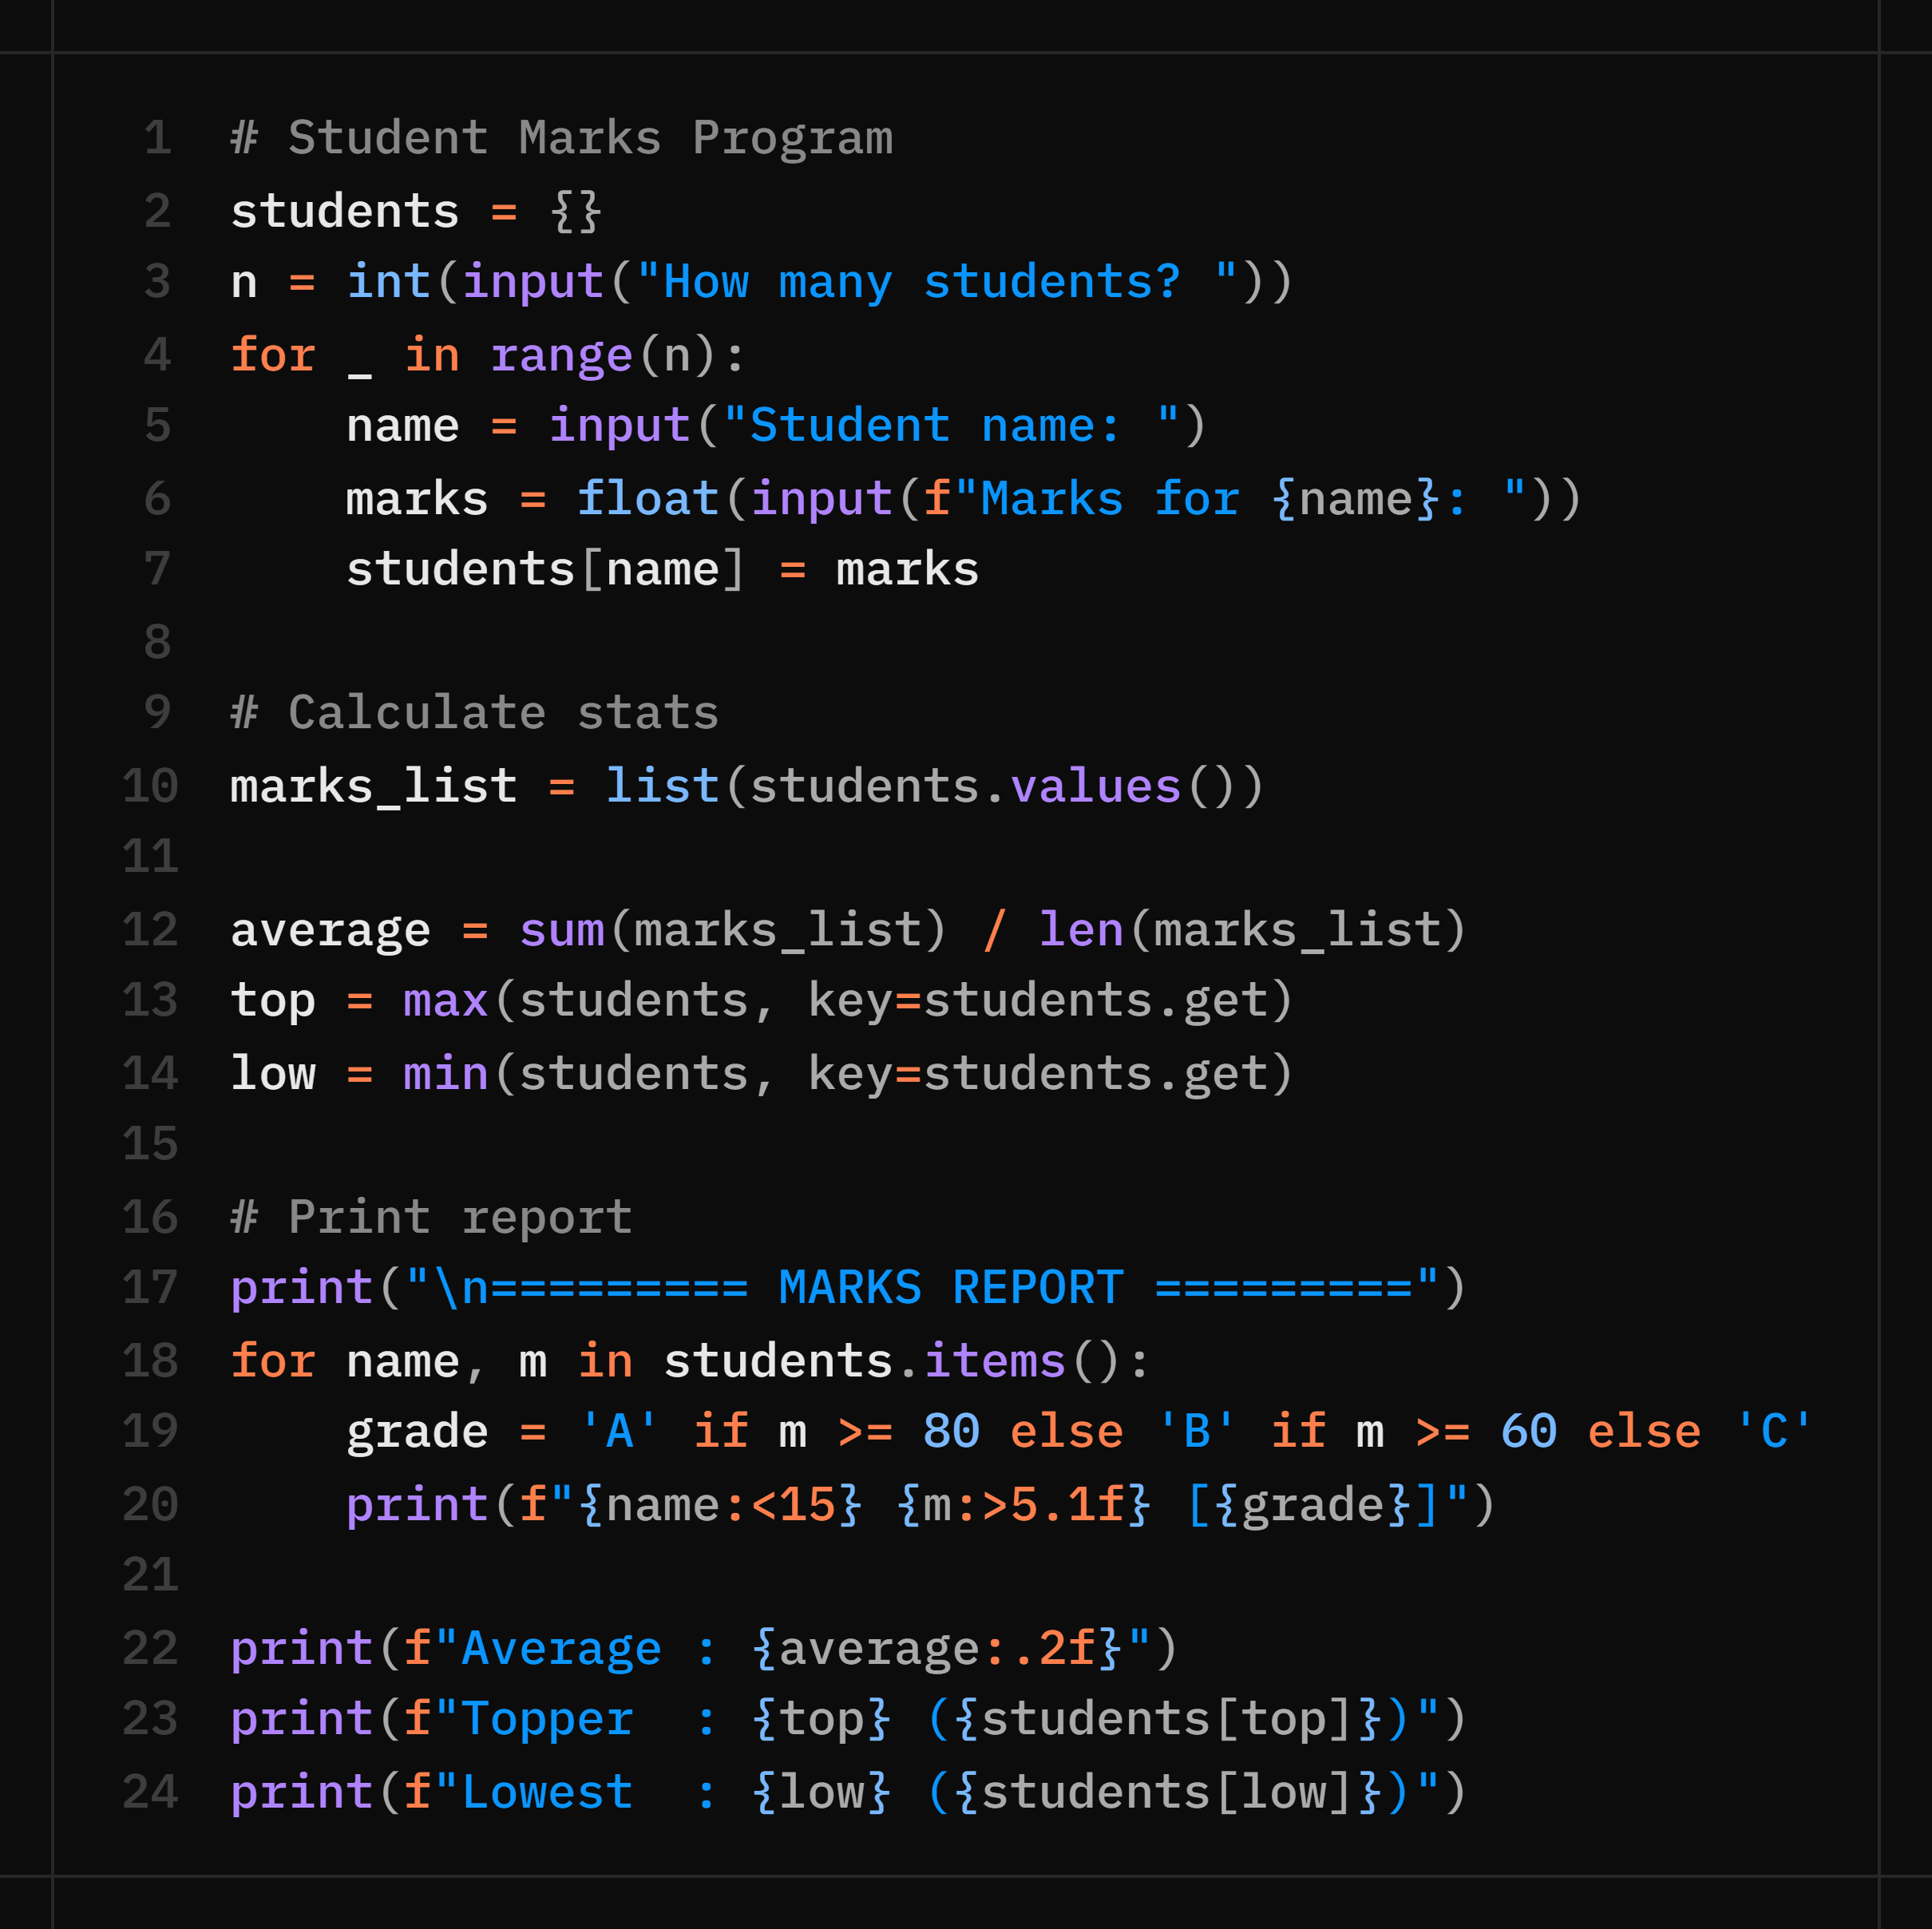
Day 4 Practical — Student Marks Program
Store student names and marks in a dictionary. Compute average, highest, lowest. Print a formatted report.
What You Practice
• Dictionary creation & iteration • Built-in functions: sum / max / min • f-string formatting (:<15, :>5.1f) • Conditional expression (grade logic)

Slide 31
🧠 Practice Questions — Day 4
Create a list of 5 numbers. Print the list reversed WITHOUT using .reverse() or reversed().
Given a dictionary of {country: capital}, write a function that takes a country name and returns its capital (or 'Not found').
Create a list of student marks. Remove all students who scored below 40 (use a loop — not list comprehension).
Convert a list of words into a dictionary where key = word, value = length of word. Example: ['hi', 'hello'] → {'hi':2, 'hello':5}
Write a program to count how many times each letter appears in a given string using a dictionary.

Slide 32
2 b A C A D E M Y
DAY 5 / WEEK 2
Day 5 — Tue, Jul 7
String Handling: Methods · Manipulation · Pattern Programs

Slide 33
Introduction to Strings
Creating Strings
Strings in Python
A string is a sequence of characters enclosed in single, double, or triple quotes.
Features of Strings
✅ Ordered
✅ Indexed
✅ Immutable
✅ Supports slicing
✅ Iterable
✅ Allows duplicate characters
name = "Python"
language = 'Programming'
text = """Multi-line
String"""
Quote Types
'single quotes'
"double quotes"
"""triple quotes"""

Slide 34
Indexing, Slicing, and String Operations
Indexing
Operations
text = "Python"
print(text[0])
print(text[-1])
print("Hello" + " World")
print("Hi " * 3)
print("Py" in text)
Slicing
print(text[0:3])
print(text[2:])
print(text[::-1])
Output
Hello World
Hi Hi Hi
True

Slide 35
Case Conversion Methods
Methods in Action
Method Reference
text = "python programming"
print(text.upper())
print(text.lower())
print(text.title())
print(text.capitalize())
print(text.swapcase())
Method
Purpose
upper()
Uppercase
lower()
Lowercase
title()
Title Case
capitalize()
First letter uppercase
swapcase()
Reverse case

Slide 36
Searching and Checking Methods
Searching Methods
Validation Methods
text = "Python Programming"
print(text.find("Pro"))
print(text.count("m"))
print(text.startswith("Py"))
print(text.endswith("ing"))
print("123".isdigit())
print("Python".isalpha())
print("abc123".isalnum())
print("HELLO".isupper())
print("hello".islower())
Searching methods locate or count text; validation methods (is...) return True or False.

Slide 37
String Manipulation and Formatting Methods
Replacing and Splitting
Removing Spaces
Methods Covered
text = "Python\nProgramming"
print(text.replace(
"Python", "Java"
))
words = text.split()
print("-".join(words))
text = " Python "
print(text.strip())
print(text.lstrip())
print(text.rstrip())
Output:
Python
Python (trailing kept)
Python (leading kept)
Method | Purpose
replace() | Replace text
split() | Split string
join() | Join strings
strip() | Remove spaces both sides
lstrip() | Remove left spaces
rstrip() | Remove right spaces
center() | Center align text
ljust() | Left align text
rjust() | Right align text
String Alignment Methods
Padding Characters
text = "Python"
print(text.center(20))
print(text.ljust(20))
print(text.rjust(20))
Output:
Python
Python
Python
print(text.center(20,"*"))
print(text.ljust(20,"-"))
print(text.rjust(20,"-"))
Output:
*******Python*******
Python--------------
--------------Python

Slide 38
String Formatting and Escape Characters
f-Strings
Escape Characters
name = "John"
age = 20
print(f"My name is {name}")
print("Hello\nWorld")
print("Name:\tJohn")
Escape Reference
format()
Escape
Meaning
print("Age: {}".format(age))
\n
New Line
\t
Tab
\\
Backslash

Slide 39
Looping, Comprehension, and Built-in Functions
Looping
Built-in Functions
for ch in "Python":
print(ch)
print(len(text))
print(max(text))
print(min(text))
print(sorted(text))
String Comprehension
text = "python"
result = "".join(
ch.upper()
for ch in text
)
print(result)
max() and min() compare characters by Unicode order; sorted() returns a list of characters.

Slide 40
String Immutability
Invalid Operation
Correct Approach
text = "Python"
text[0] = "J"
text = "Python"
text = "J" + text[1:]
print(text)
Output
Output
TypeError: 'str' object does
not support item assignment
Jython
Strings are immutable sequences of characters used to store and manipulate text data efficiently in Python.

Slide 41
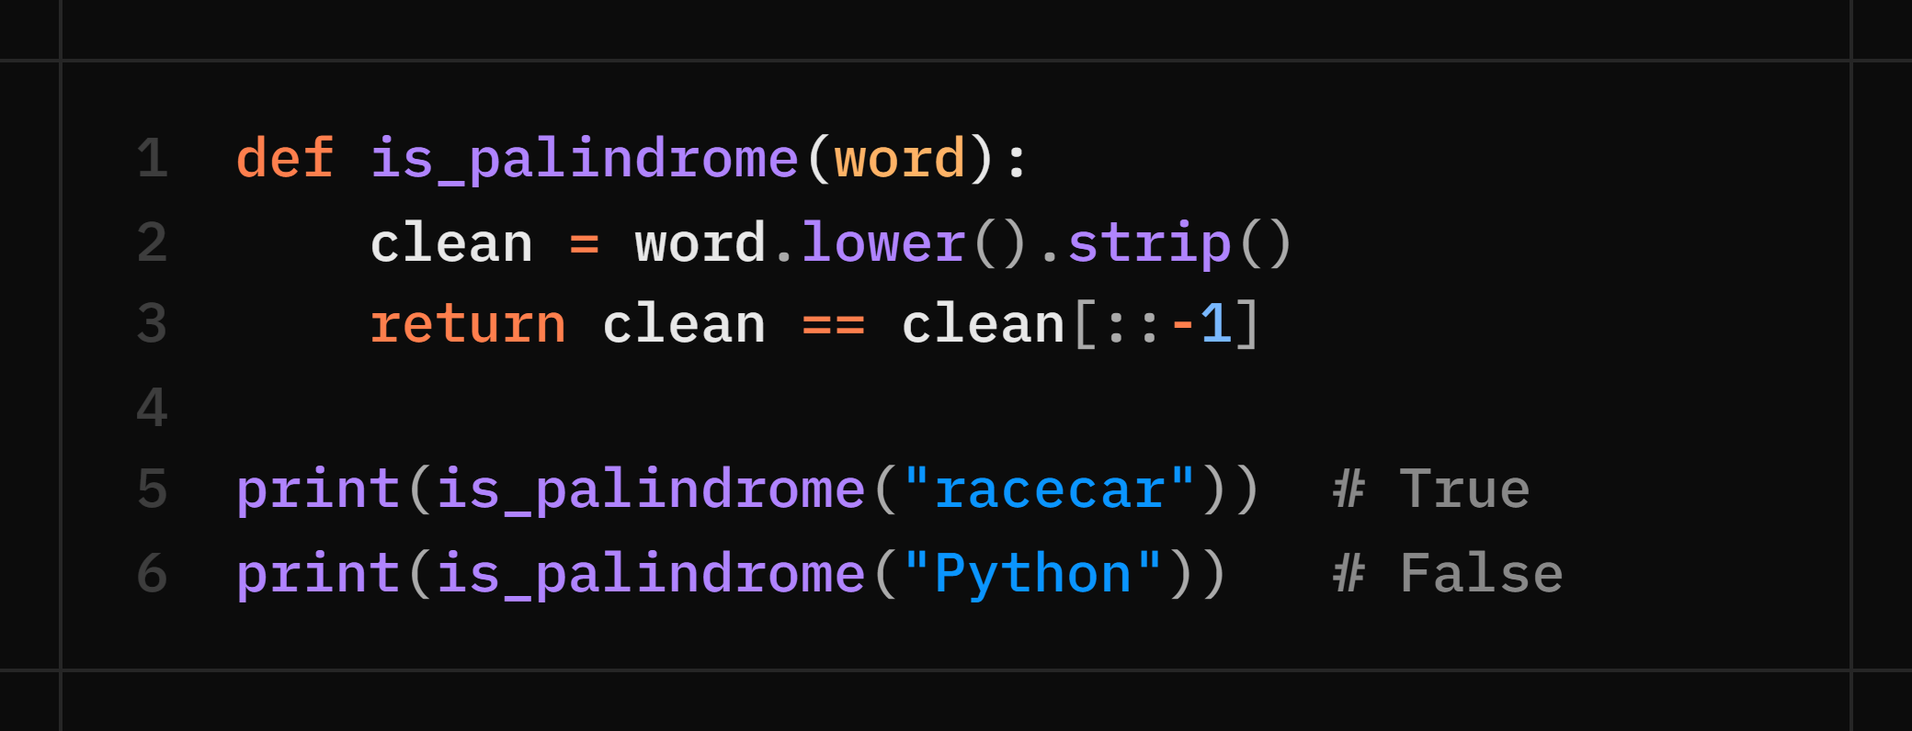
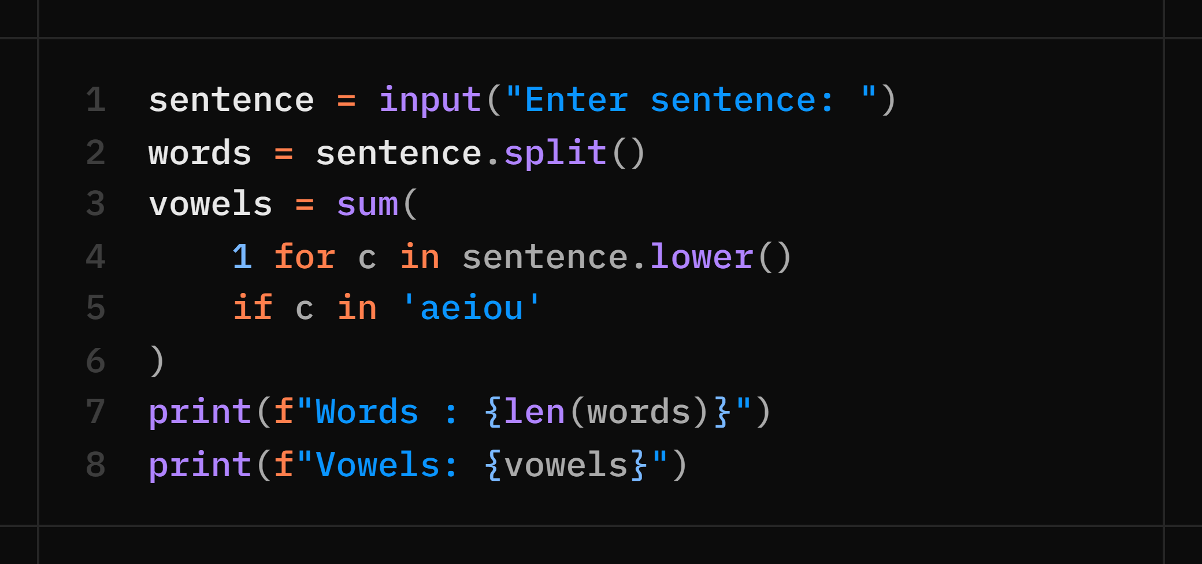
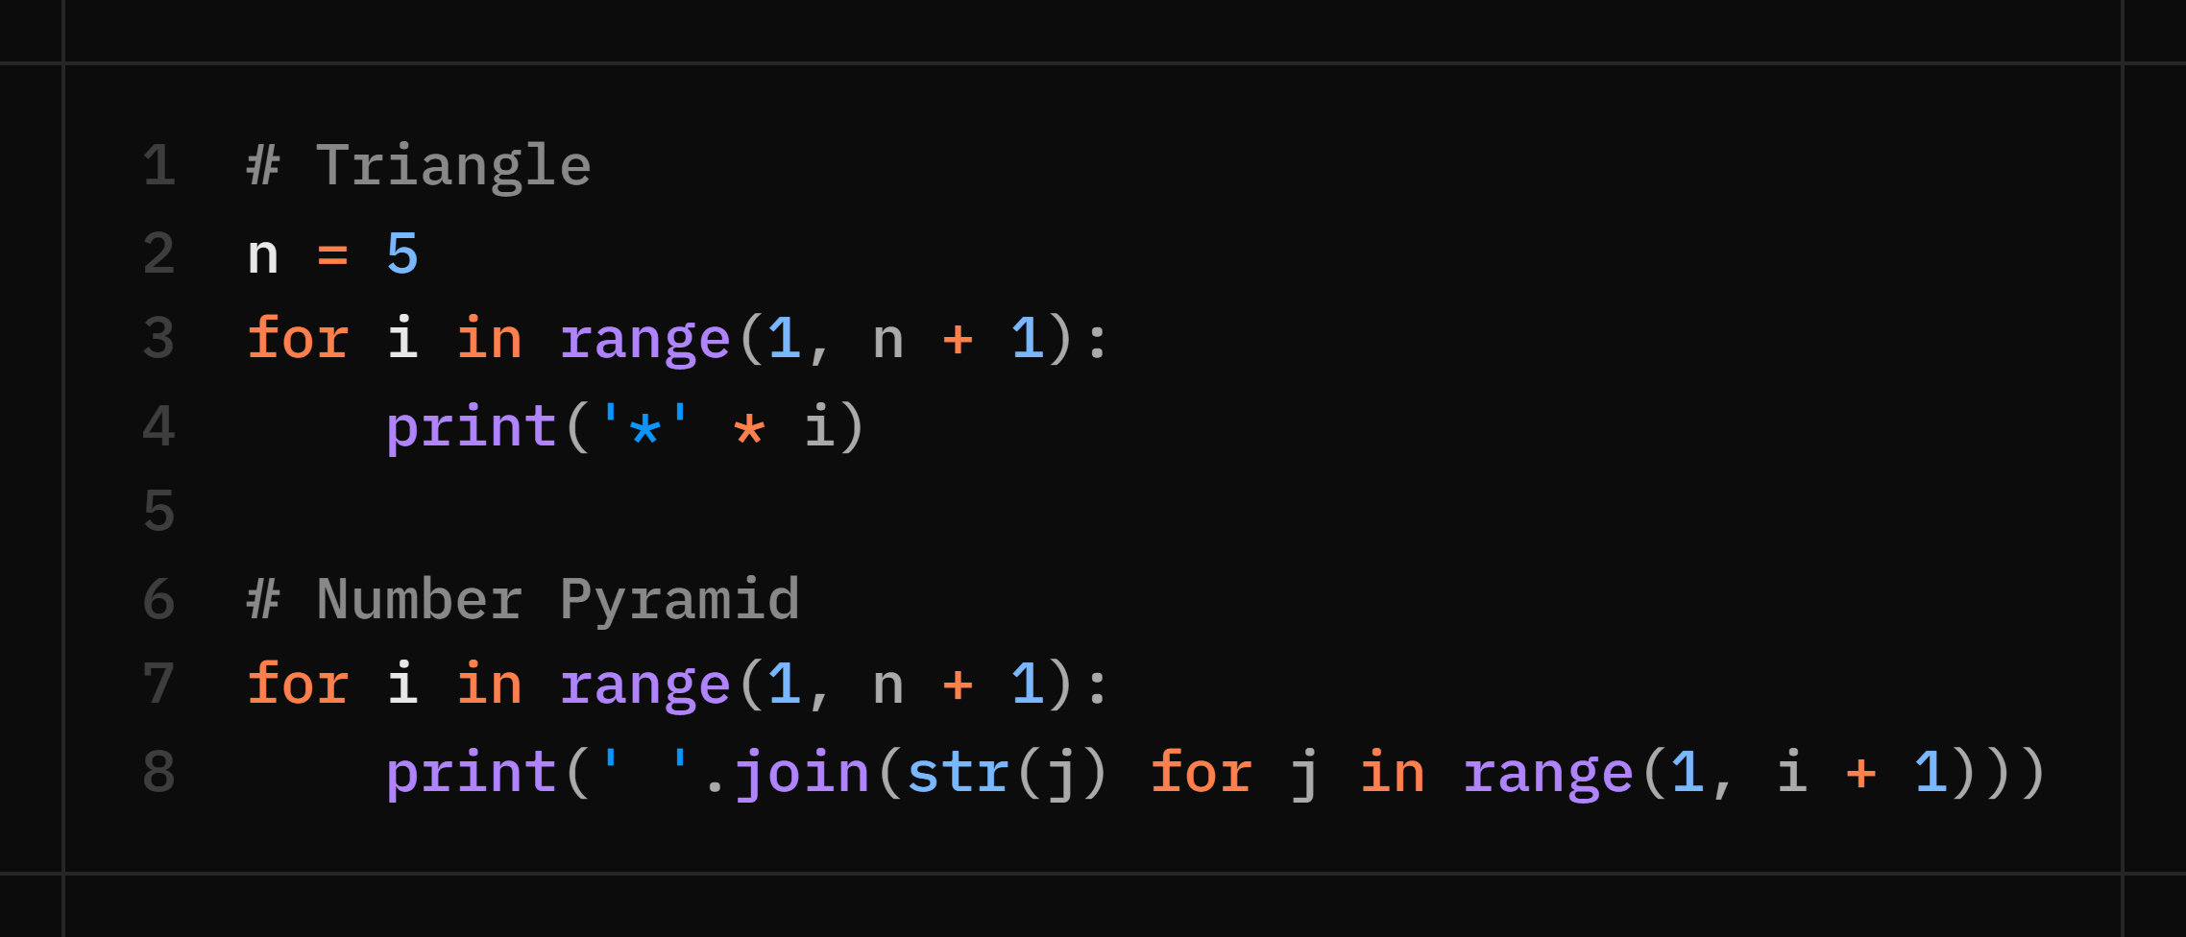
Day 5 Lab — String Manipulation + Pattern Programs
Palindrome Checker
Word & Vowel Counter
Pattern Programs (Practical)
*
**
***
****
*****
1
1 2
1 2 3
1 2 3 4
1 2 3 4 5

Slide 42
🧠 Practice Questions — Day 5
Write a function that takes a sentence and returns it with every word capitalized (without using .title()).
Write a program that checks whether a given string is an anagram of another string. E.g. 'listen' and 'silent'.
Count the frequency of each character in a string. Print only characters that appear more than once.
Write a program to print a right-angled triangle of numbers. Row 1 = '1', Row 2 = '1 2', Row 3 = '1 2 3'…
Remove all vowels from a given string. E.g. 'Python is fun' → 'Pythn s fn'.

Slide 43
🧩 Day 5 Question — Doormat Pattern
Given the number of rows R and columns C, print a doormat pattern where C = 3 × R. The word “2BAcademy” is printed in the center, and the mat’s width equals the number of columns.
Since “2BAcademy” has 9 characters (odd), R must be odd to keep the mat symmetric.
Approach
Split the pattern into three parts — a top triangle, the centered word, and an inverted bottom triangle — using string alignment methods:
ljust — left-aligns text to length l
center — center-aligns text to length l
rjust — right-aligns text to length l
Valid Conditions
R must be odd (R % 2 != 0)
C must be equal to 3 × R
Examples:
R = 7, C = 21 ✓ Valid R = 9, C = 27 ✓ Valid R = 10, C = 30 ✗ Invalid (R is even) R = 7, C = 20 ✗ Invalid (C ≠ 3 × R)
Input: R = 11, C = 33
---------------|*|---------------
------------|*||*||*|------------
---------|*||*||*||*||*|---------
------|*||*||*||*||*||*||*|------
---|*||*||*||*||*||*||*||*||*|---
------------2BAcademy------------
---|*||*||*||*||*||*||*||*||*|---
------|*||*||*||*||*||*||*|------
---------|*||*||*||*||*|---------
------------|*||*||*|------------
---------------|*|---------------
Input: R = 9, C = 27
------------|*|------------
---------|*||*||*|---------
------|*||*||*||*||*|------
---|*||*||*||*||*||*||*|---
---------2BAcademy---------
---|*||*||*||*||*||*||*|---
------|*||*||*||*||*|------
---------|*||*||*|---------
------------|*|------------

Slide 44
2 b A C A D E M Y
DAY 6 / WEEK 2
Day 6 — Wed, Jul 8
File Handling · Error Handling · Module 1 Capstone

Slide 45
Introduction to File Handling
File handling lets programs store and retrieve data permanently from files.
Why Use Files?
Basic Steps
✅ Store data permanently
✅ Read existing data
✅ Write new data
✅ Process large amounts of data
✅ Share data between programs
Open the file
Perform operations
Close the file
file = open("data.txt", "r")
print(file.read())
file.close()

Slide 46
Opening Files and File Modes
Syntax
File Modes
file = open("filename", "mode")
Mode | Description
r | Read
w | Write (overwrite)
a | Append
x | Create new file
r+ | Read and Write
w+ | Write and Read
a+ | Append and Read
rb | Read Binary
wb | Write Binary
Examples
open("data.txt", "r")
open("data.txt", "w")
open("image.jpg", "rb")

Slide 47
Reading Files
Python provides several methods to read data from a file depending on the requirement.
read() Reads the entire file content as a single string.
file = open("data.txt", "r")
print(file.read())
Method Reference
Method | Description
read() | Reads the entire file
read(size) | Reads a specific number of characters
readline() | Reads a single line
readlines() | Reads all lines into a list
read(size) Reads a specified number of characters.
print(file.read(10))
readline() Reads one line at a time from the file.
print(file.readline())
readlines() Reads all lines and returns them as a list.
print(file.readlines())
Different reading methods let us efficiently process small files, large files, or line-by-line data depending on the application's requirements.

Slide 48
Writing and Appending Files
Writing
Appending
file = open("data.txt", "w")
file.write("Hello Python")
file.close()
file = open("data.txt", "a")
file.write("\nNew Line")
Writing Multiple Lines
file.writelines([
"Python\n",
"Java\n"
])
w replaces contents, while a adds to existing data.

Slide 49
The with Statement and File Methods
The with Statement
File Methods
Automatically closes the file after the block finishes execution, even if an error occurs.
tell() Returns the current pointer position.
print(file.tell())
with open("data.txt", "r") as file:
print(file.read())
seek(position) Moves the pointer to a position.
file.seek(0)
flush() Writes buffered data immediately.
file.flush()
Using with makes file handling safer and cleaner, and removes the need to explicitly call close().
close() Closes the file and frees resources.
file.close()
Method Reference
File methods help control the file pointer, manage data buffering, and ensure files are handled safely and efficiently.
Method | Description
tell() | Returns current cursor position
seek() | Moves the file pointer
flush() | Writes buffered data to the file
close() | Closes the file

Slide 50
File Properties and Exception Handling
File Properties
Exception Handling
print(file.name)
print(file.mode)
print(file.closed)
try:
file = open("abc.txt", "r")
except FileNotFoundError:
print("File not found")
Common Errors
FileNotFoundError
PermissionError
IOError

Slide 51
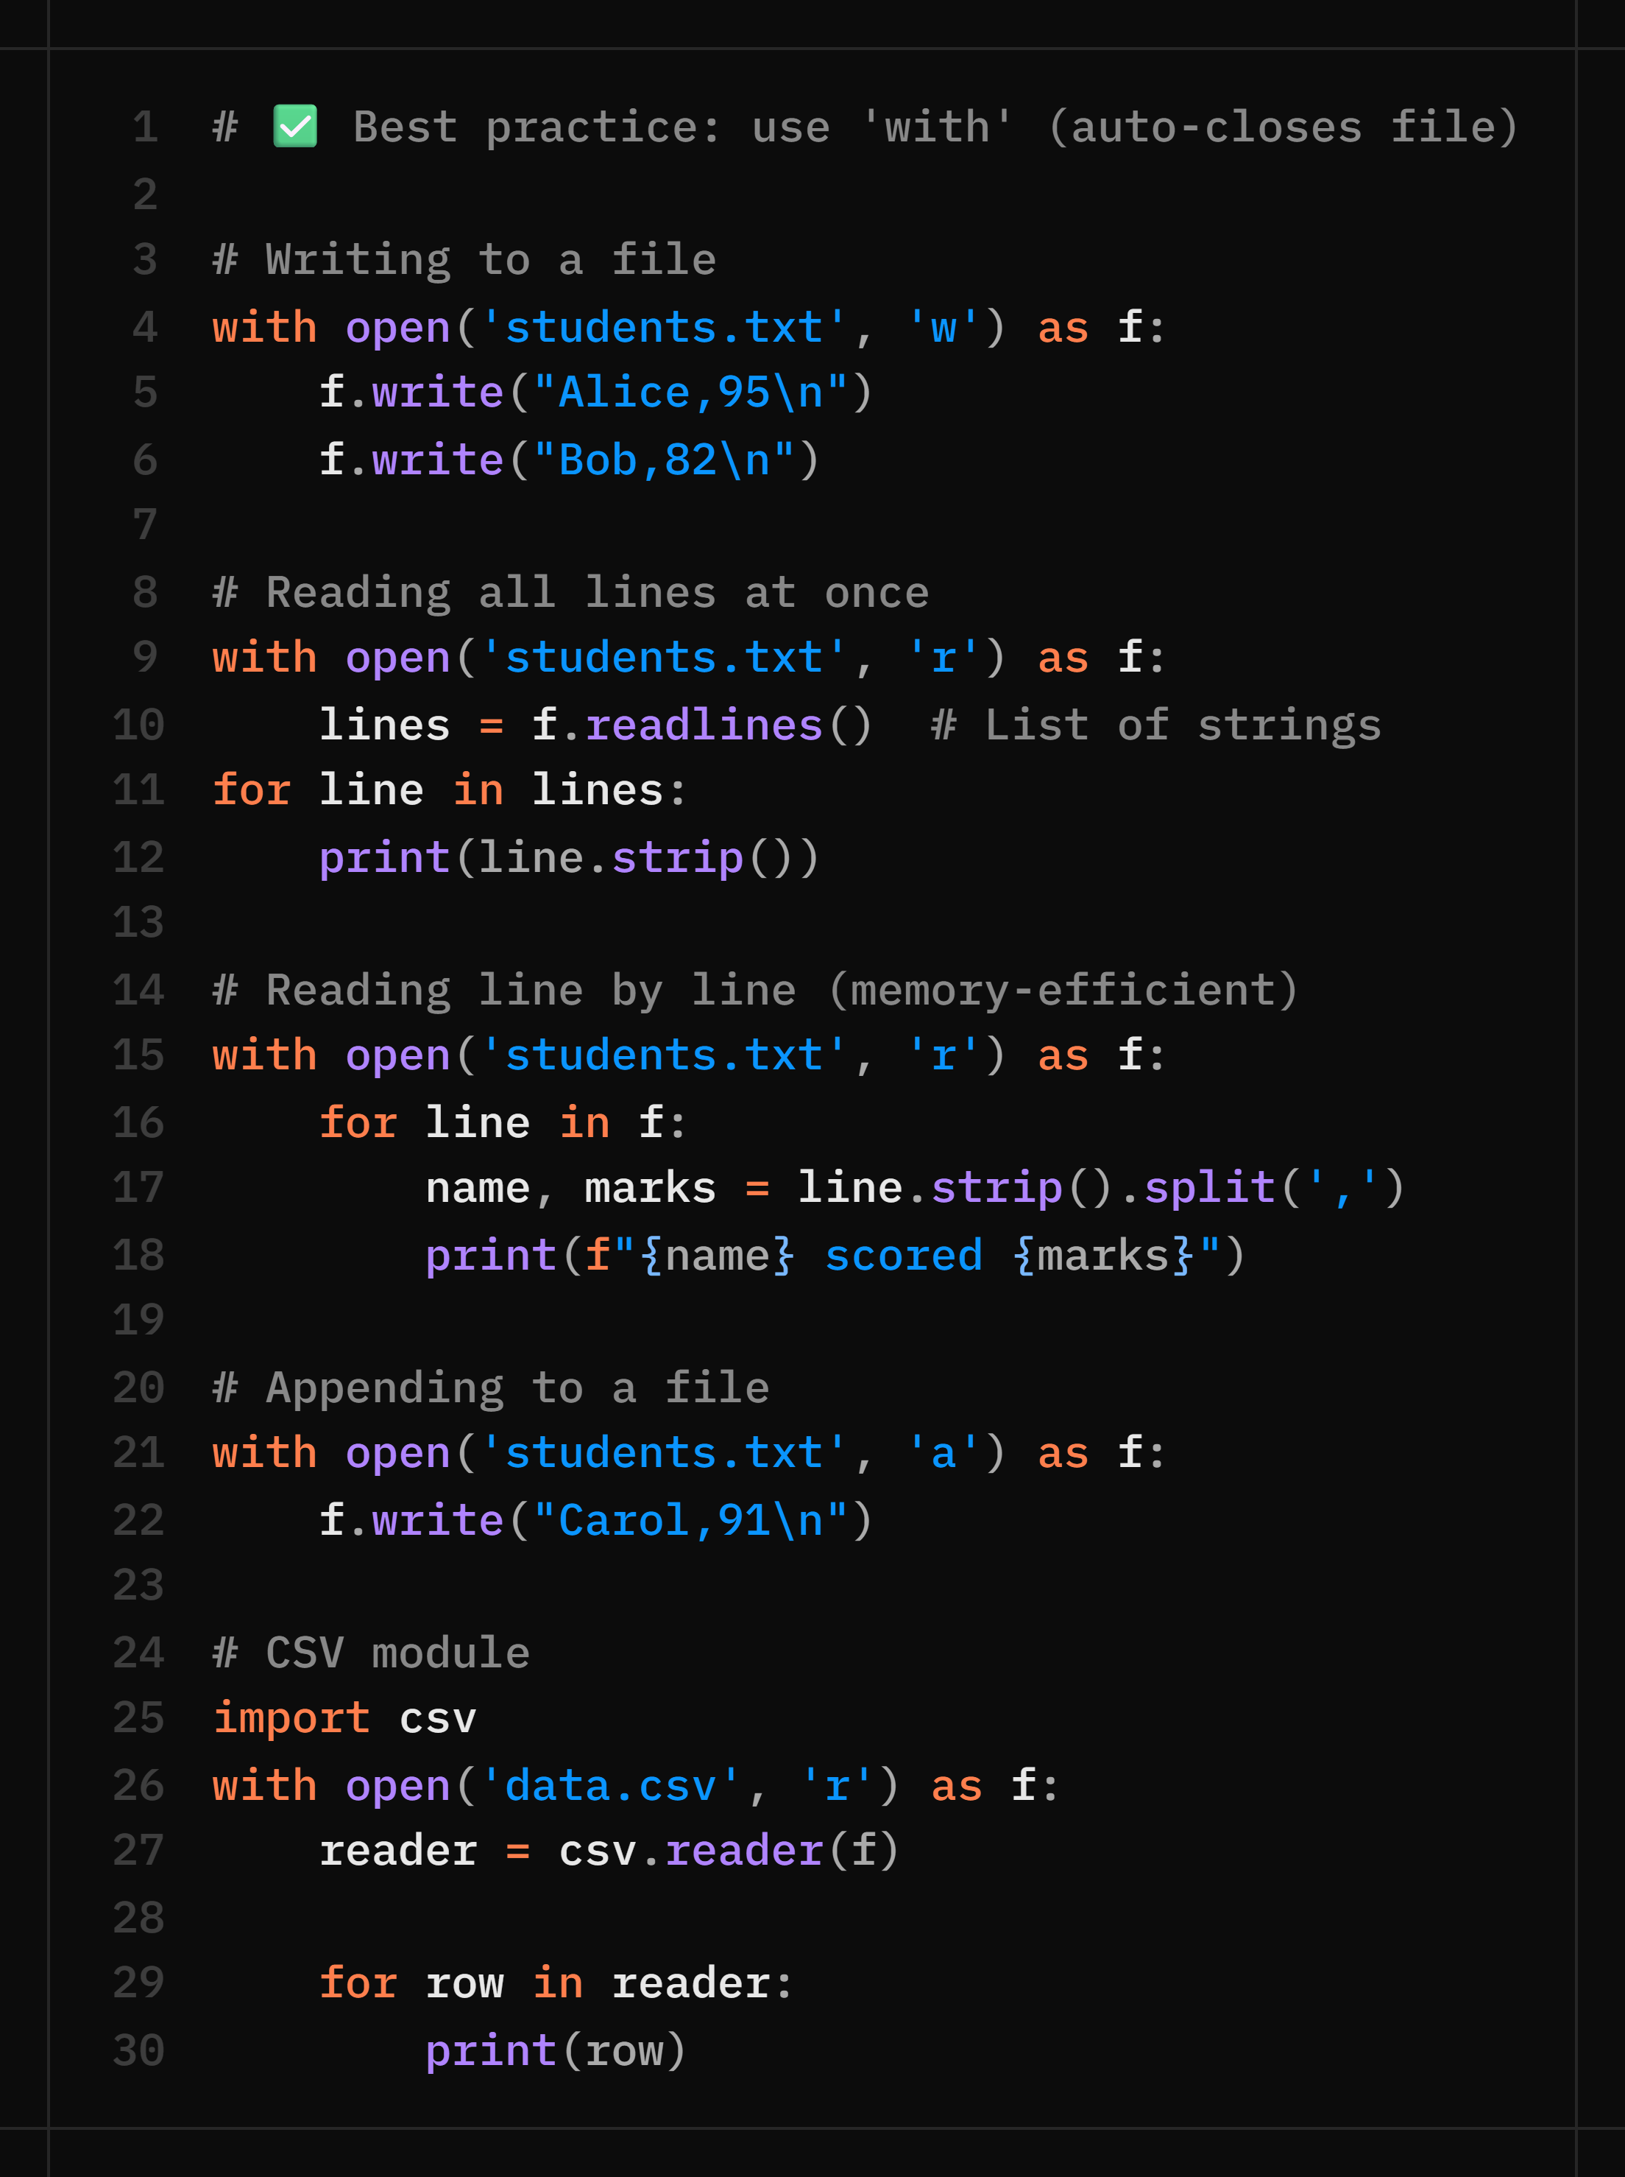

File Handling — Reading & Writing Files
File Modes
'r'
Read (default)
File must exist
'w'
Write
Creates/overwrites
'a'
Append
Adds to end
'r+'
Read + Write
File must exist
Key Points
Always use 'with' block
'w' mode deletes existing content
Close file after opening (with does it auto)

Slide 52
Introduction to Exception Handling
An exception is a runtime error that interrupts the normal flow of a program.
Why Exception Handling?
Example Without Exception Handling
✅ Prevents program crashes
✅ Handles errors gracefully
✅ Improves program reliability
✅ Provides meaningful error messages
num = int(input("Enter a number: "))
result = 10 / num
print(result)
If the user enters 0, the program crashes.

Slide 53
The try and except Block
Syntax
Example
try:
# Risky code
except:
# Error handling code
try:
num = int(input("Enter a number: "))
print(10 / num)
except:
print("An error occurred.")
The try block contains code that may generate an exception, while the except block handles the error.

Slide 54
Handling Specific Exceptions
Example
Common Exceptions
try:
num = int(input("Enter number: "))
result = 10 / num
except ZeroDivisionError:
print("Cannot divide by zero.")
except ValueError:
print("Invalid input.")
• ZeroDivisionError
• ValueError
• TypeError
• IndexError
• KeyError
• FileNotFoundError

Slide 55
Multiple Exceptions and Exception Objects
Multiple Exceptions
Exception Object
try:
value = int(input())
except (ValueError, TypeError):
print("Invalid value.")
try:
print(10 / 0)
except Exception as e:
print("Error:", e)
e contains the actual error message.

Slide 56
The else and finally Blocks
else
Executes if no exception occurs.
try:
num = int(input())
except ValueError:
print("Invalid input")
else:
print("Input accepted")
finally:
print("Program finished")
finally
Executes whether an exception occurs or not.

Slide 57
Raising Exceptions
The raise keyword generates exceptions manually.
Example
Custom Error Message
age = -5
if age < 0:
raise ValueError(
"Age cannot be negative."
)
raise Exception("Something went wrong")

Slide 58
Best Practices
Best Practices
Exception Flow
✅ Catch specific exceptions
✅ Use finally for cleanup
✅ Avoid empty except blocks
✅ Use meaningful messages
✅ Use with for file handling
✅ Raise exceptions when necessary
Try ↓ Exception? ↓ Yes → except ↓ No → else ↓ finally
Exception handling makes programs more reliable, user-friendly, and capable of recovering from unexpected errors.

Slide 59
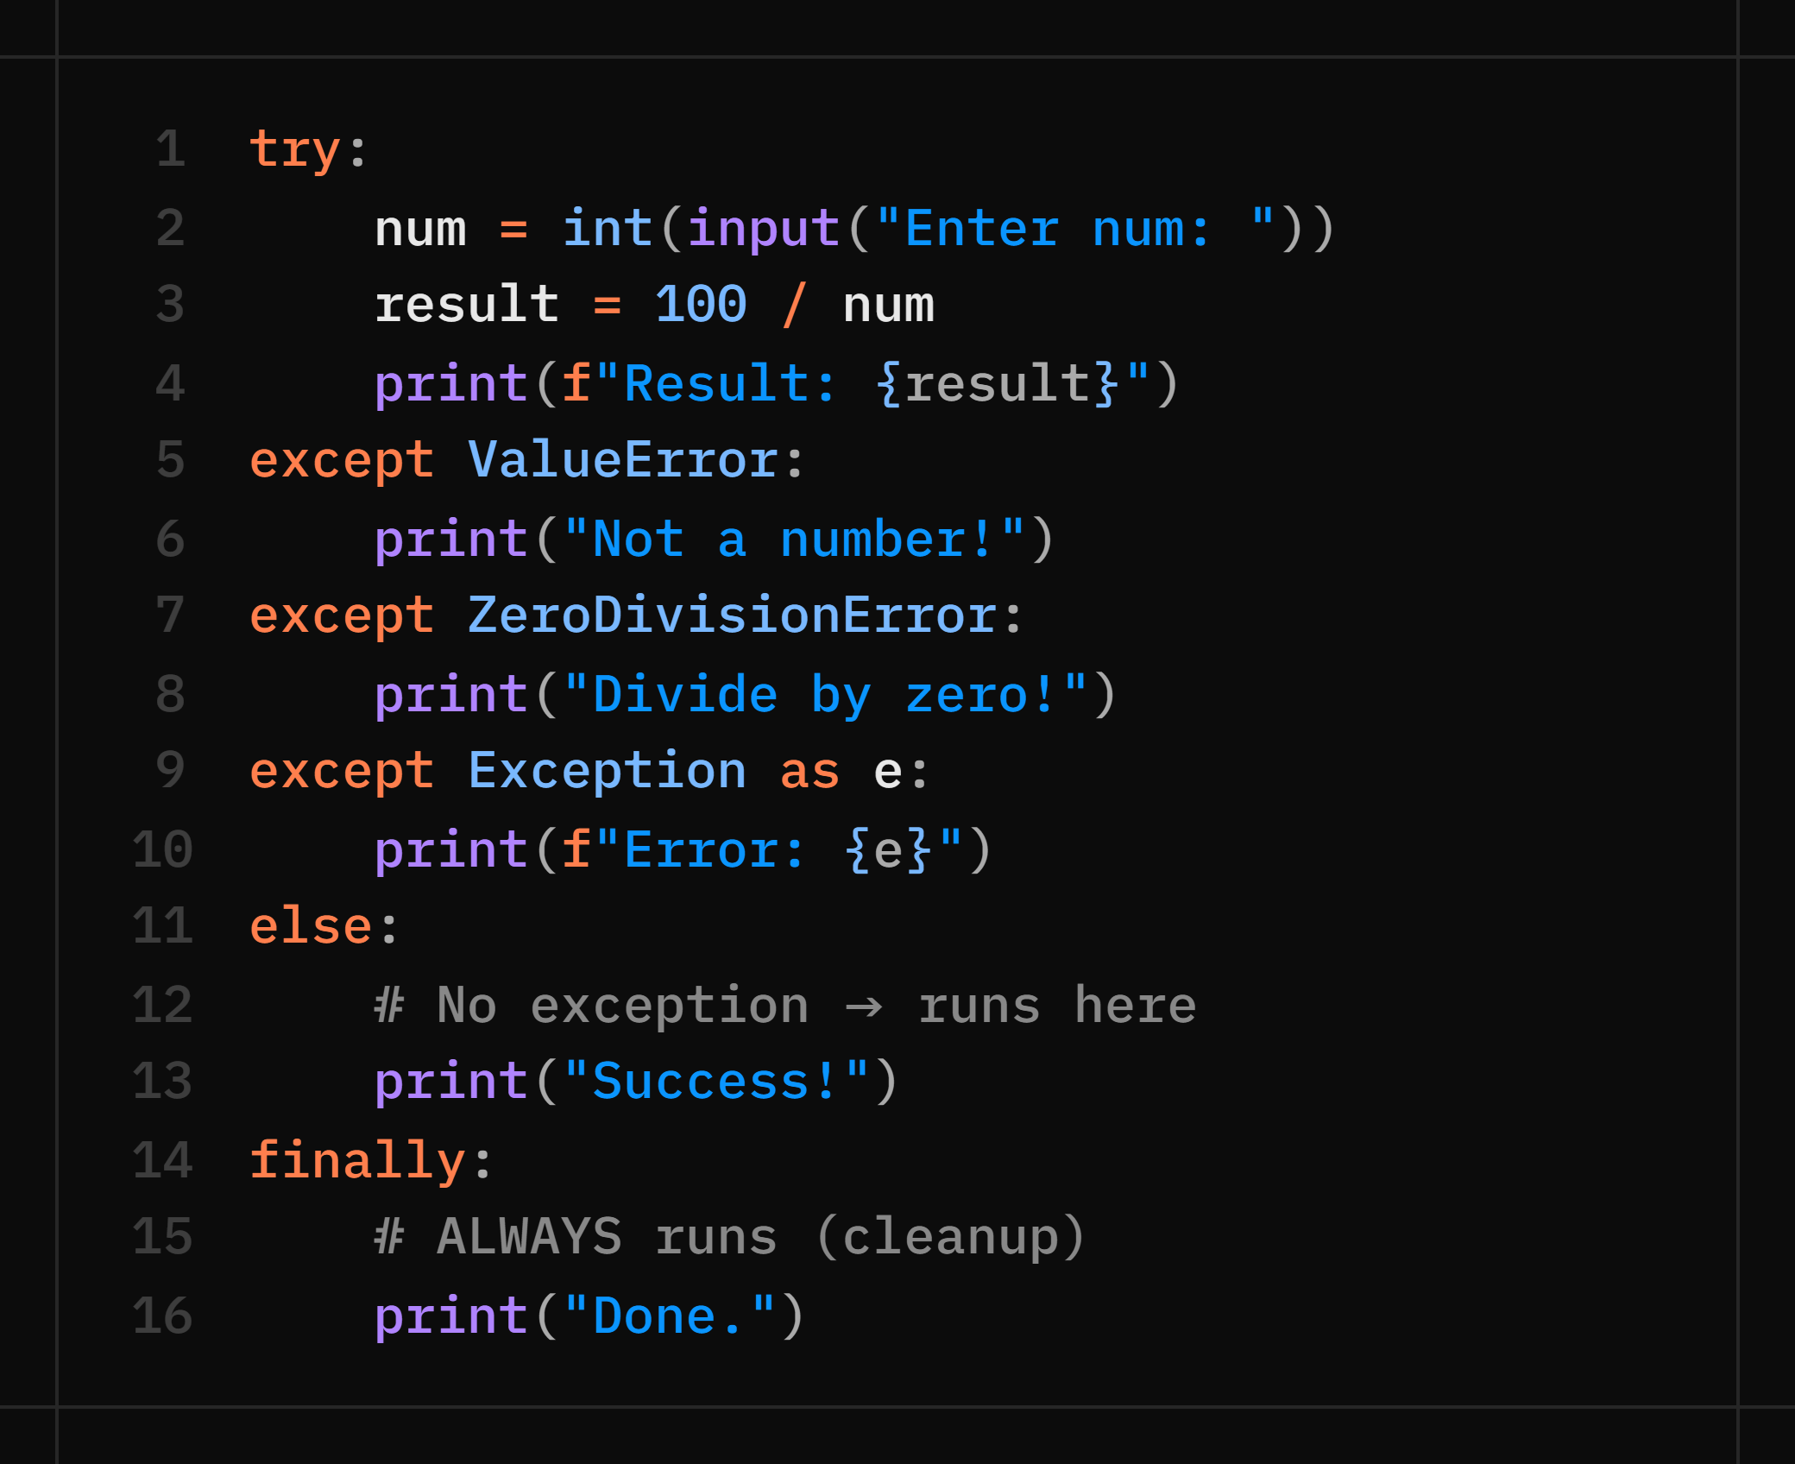
Error Handling — try · except · finally
🛡️ try / except Syntax
⚡ Common Python Exceptions
ValueError
Wrong value type: int('abc')
ZeroDivisionError
Dividing by zero: 10 / 0
TypeError
Wrong type: '5' + 5
IndexError
List out of bounds: lst[99]
KeyError
Missing dict key: d['x']
FileNotFoundError
open('ghost.txt', 'r')
NameError
Variable not defined
💡 Catch specific exceptions first (ValueError), generic (Exception) last!

Slide 60
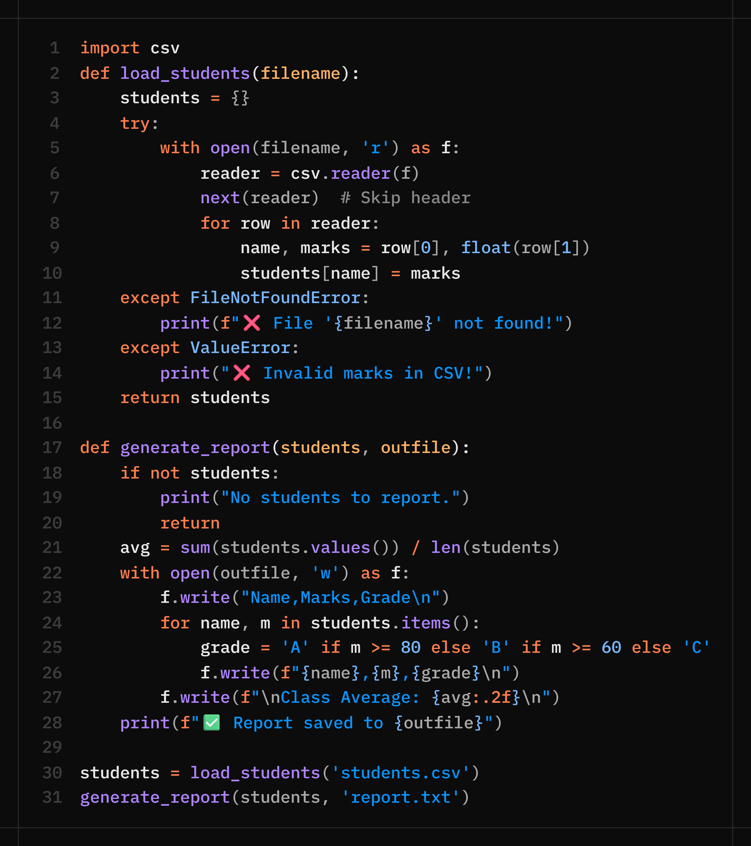


Module 1 Capstone — File-Based Student Records System
Combine everything from Module 1: read CSV → process → compute stats → write report → handle errors.
Skills Used
✅ Functions (DRY)
✅ Dictionaries
✅ File Handling (csv module)
✅ Error Handling (try/except)
✅ f-strings & formatting
✅ Loops & conditionals
Extension Ideas
• Add a search function: find student by name
• Sort and print top 3 students
• Let user add new students via input()
• Validate: marks must be 0–100

Slide 61
2 b A C A D E M Y
DAY 7 / WEEK 2
Day 7 — Thu, Jul 9
OOP Part 1 — Classes · Objects · Constructors

Slide 62
Introduction to Object-Oriented Programming
Object-Oriented Programming (OOP) is a programming paradigm that organizes code using objects and classes.
Why OOP?
Real-World Examples
✅ Better code organization
✅ Code reusability
✅ Easier maintenance
✅ Real-world modeling
✅ Reduced code duplication
Car → Object
Student → Object
Employee → Object
Mobile Phone → Object
OOP Concepts: Classes, Objects, Constructors, Inheritance, Encapsulation. Today we focus on Classes, Objects, and Constructors.

Slide 63
Classes and Objects
Class & Object
Examples
class Student:
pass
s1 = Student()
s2 = Student()
Class → Student
Objects → John, Alice, Bob
Class → Car
Objects → BMW, Audi, Tesla
A class is a blueprint used to create objects. An object is an instance of a class.

Slide 64
Creating a Class
Syntax
Creating an Object
class Student:
def display(self):
print("Hello Student")
s1 = Student()
s1.display()
Output: Hello Student. The keyword self refers to the current object calling the method.

Slide 65
Instance Variables and Methods
Class Definition
Using the Object
class Student:
def set_data(self, name, age):
self.name = name
self.age = age
def display(self):
print(self.name)
print(self.age)
s1 = Student()
s1.set_data("John", 20)
s1.display()
Instance variables store data that belongs to each individual object.

Slide 66
Constructors (__init__)
Syntax
Creating an Object
class Student:
def __init__(self):
print("Constructor Called")
s1 = Student()
# Output:
Constructor Called
A constructor automatically executes when an object is created.

Slide 67
Parameterized Constructors
Class Definition
Creating an Object
class Student:
def __init__(self, name, age):
self.name = name
self.age = age
def display(self):
print(self.name)
print(self.age)
s1 = Student("John", 20)
s1.display()
Parameterized constructors let you pass values into an object at the moment it is created.

Slide 68
Multiple Objects
Code
Output
s1 = Student("John", 20)
s2 = Student("Alice", 22)
s1.display()
s2.display()
John 20
Alice 22
Each object has its own data. Although objects are created from the same class, each object maintains its own independent state.

Slide 69
The self Keyword
Example
Behind the Scenes
class Student:
def __init__(self, name):
self.name = name
def show(self):
print(self.name)
s1 = Student("John")
s1.show()
# Python internally does:
Student.show(s1)
self represents the current object. It lets each object access its own variables and methods.

Slide 70
Real-World Example
Example
This Demonstrates
class Car:
def __init__(self, brand, price):
self.brand = brand
self.price = price
def details(self):
print(self.brand)
print(self.price)
c1 = Car("BMW", 5000000)
c1.details()
✅ Class
✅ Object
✅ Constructor
✅ Instance Variables
✅ Methods

Slide 71
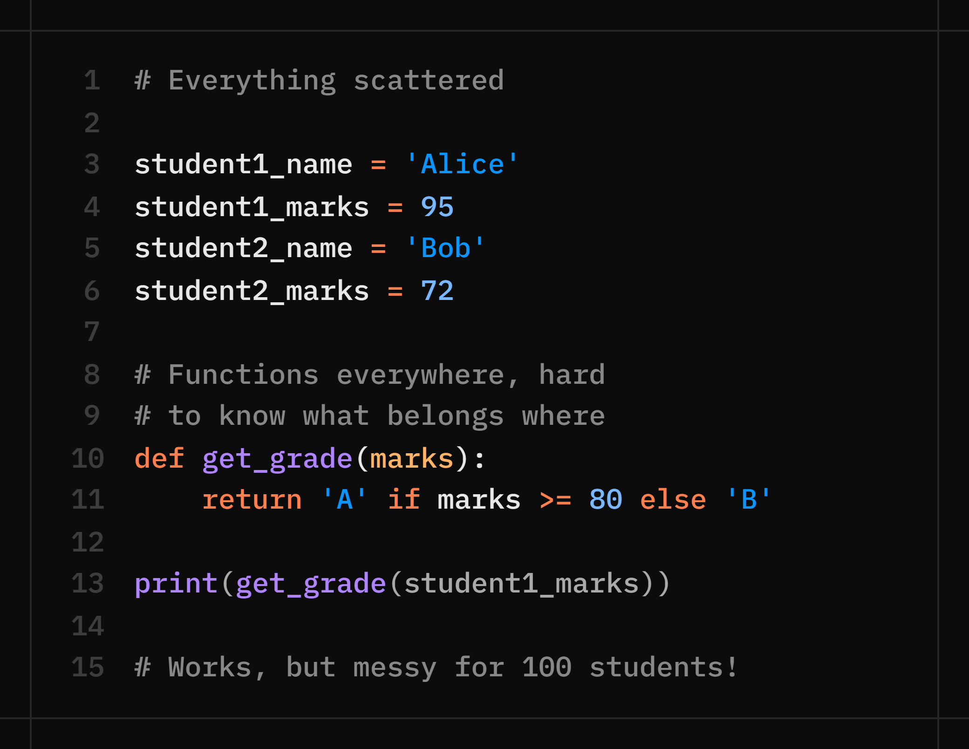
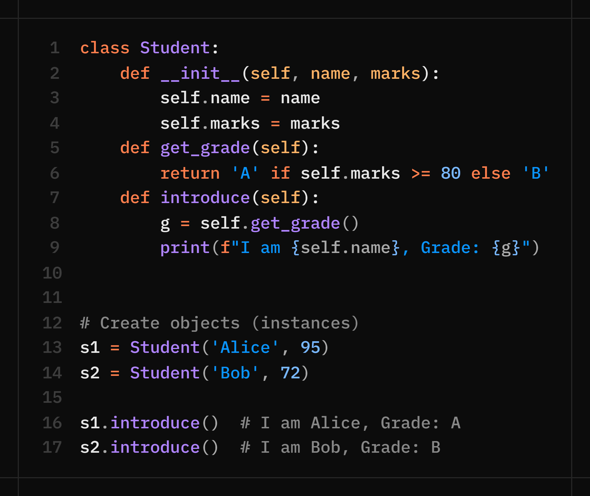
Why Object-Oriented Programming?
OOP bundles data (attributes) + behaviour (methods) into one unit called a Class.
❌ Without OOP (Day 4 approach)
✅ With OOP (today's approach)
Hard to scale · prone to mistakes · no structure
Clean · scalable · reusable · industry standard!

Slide 72
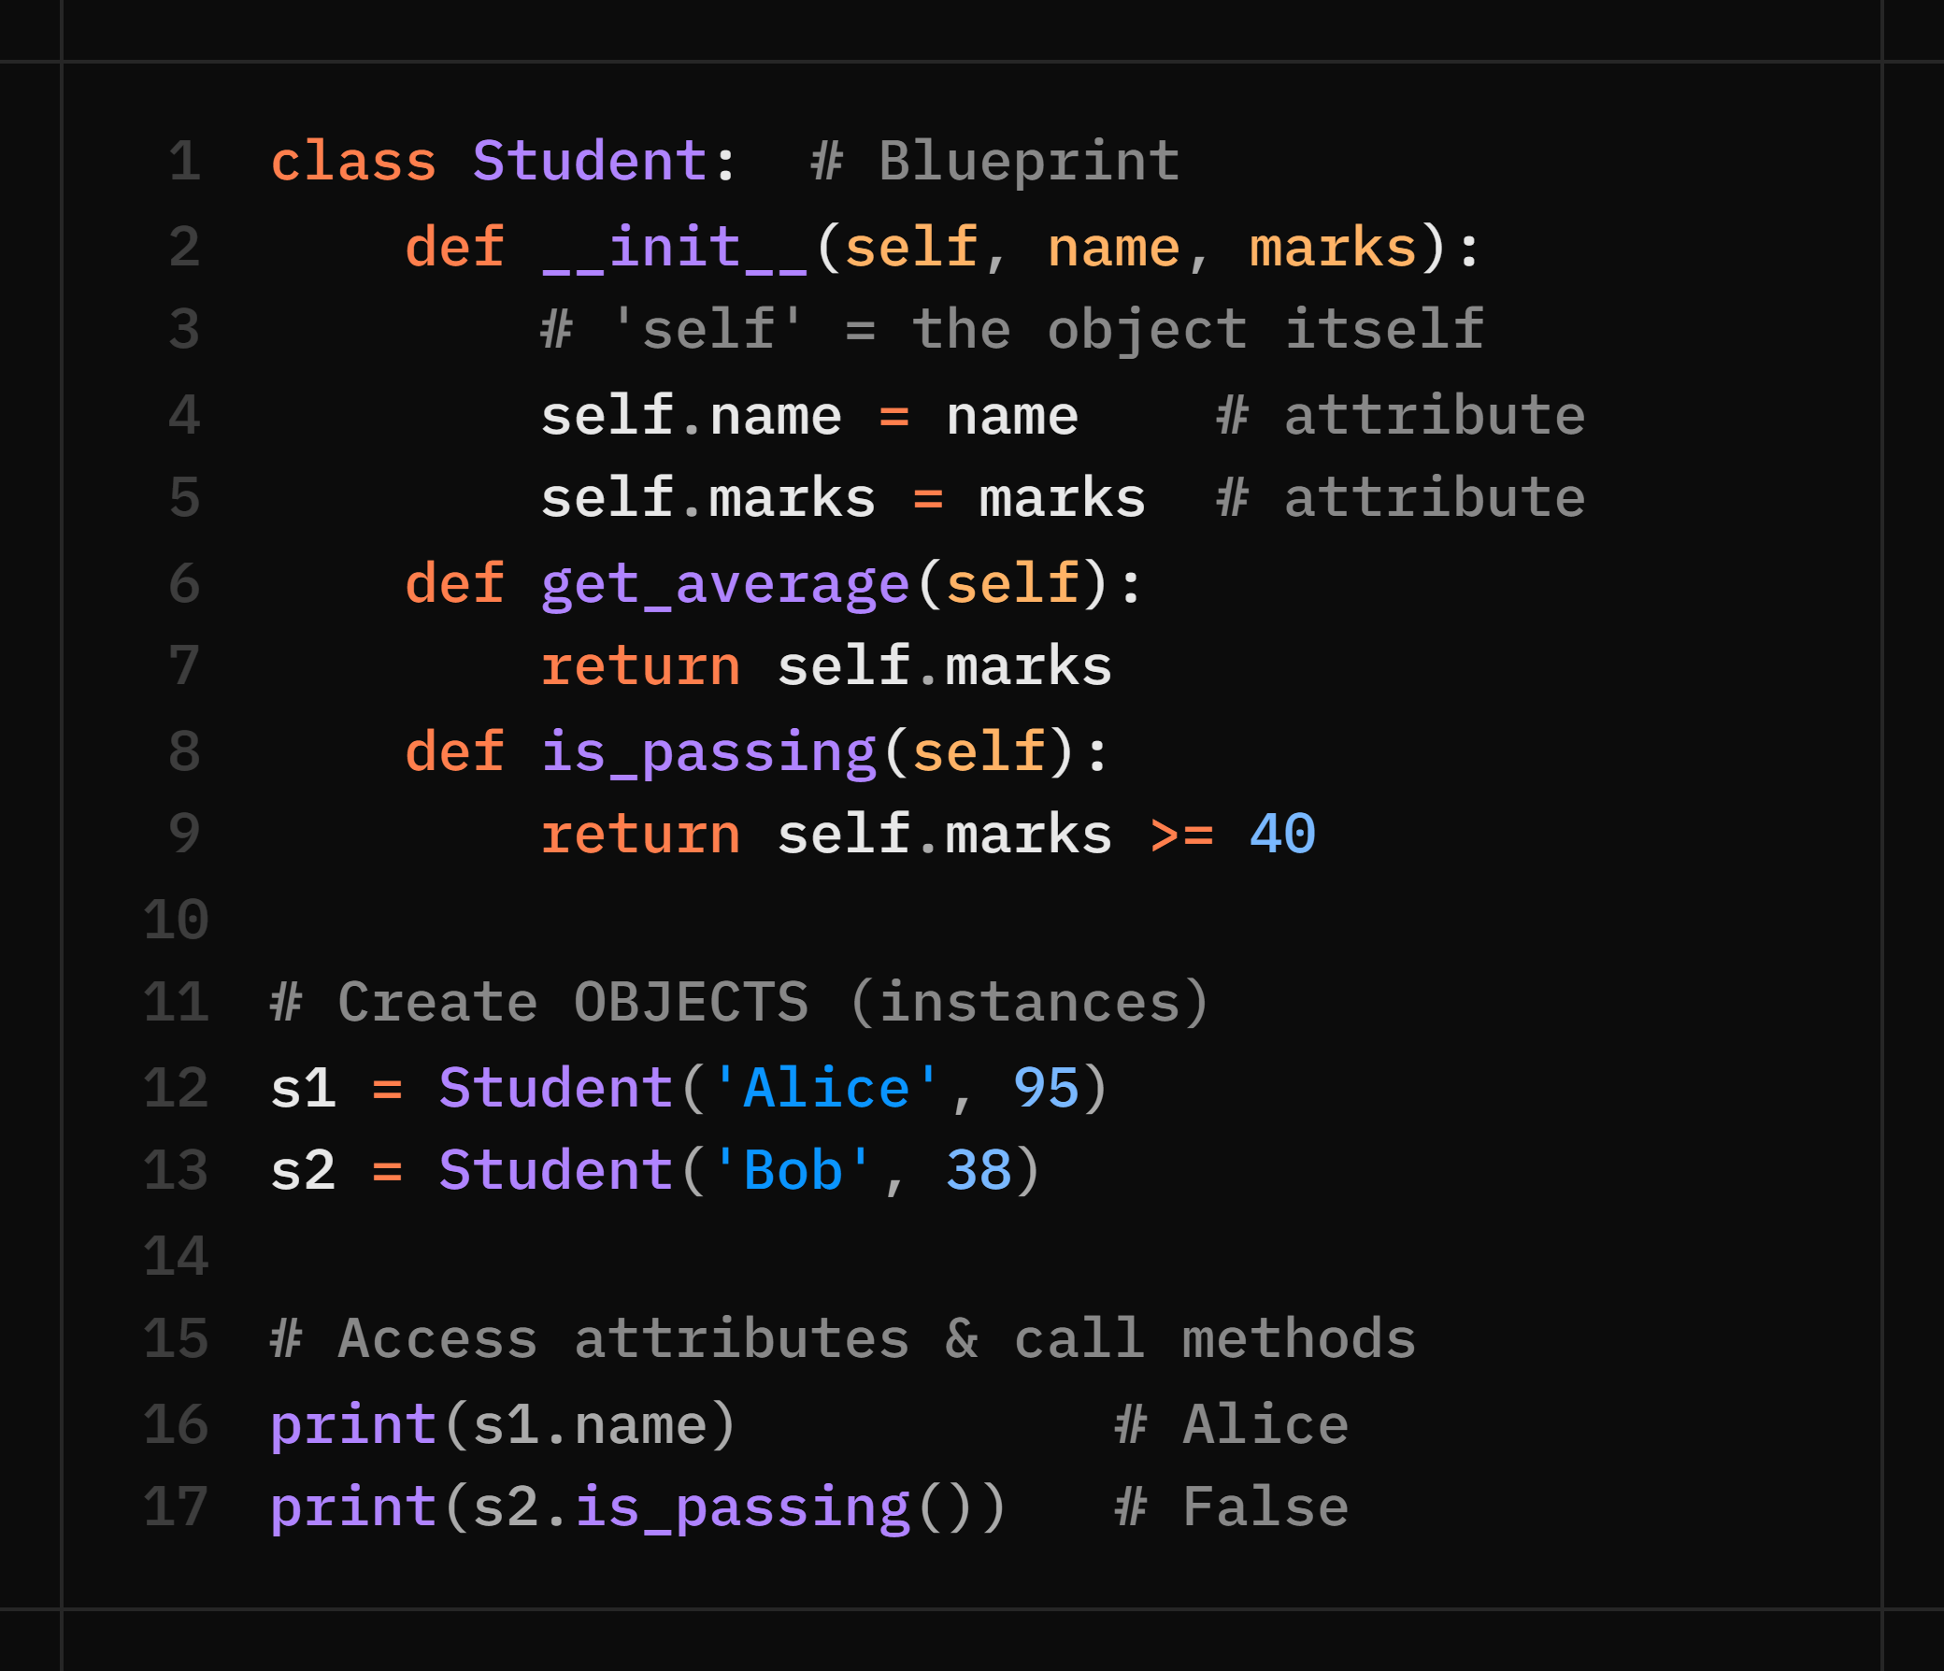
Classes · Objects · __init__ Constructor
🏛️ Anatomy of a Class
🔑 Key Concepts
class
Blueprint — defines the structure
object
Instance — a real thing made from class
__init__
Constructor — sets up object on creation
self
Reference to the current object (always 1st param)
attribute
Variable belonging to an object (self.name)
method
Function belonging to a class (def greet(self):)
💡 A class = cookie cutter. An object = the actual cookie!

Slide 73
🧠 Practice Questions — Day 7 (OOP Part 1)
Create a class Book with attributes: title, author, pages. Add a method summary() that prints all details neatly.
What happens if you forget the 'self' keyword in a method parameter? Show the error and explain why it occurs.
Create a class Car with attributes: brand, speed. Add a method accelerate(amount) that increases speed and a brake(amount)that decreases it (min speed = 0).
Create a class Employee with: name, salary. Add a method give_raise(percent) that increases salary by the given percentage and prints the old and new salary.
What is the difference between a class and an object? Give a real-life analogy and show it in code.

Slide 74
2 b A C A D E M Y
DAY 8 / WEEK 2
Day 8 — Fri, Jul 10
OOP Part 2 — Inheritance · Encapsulation · Graded Project

Slide 75
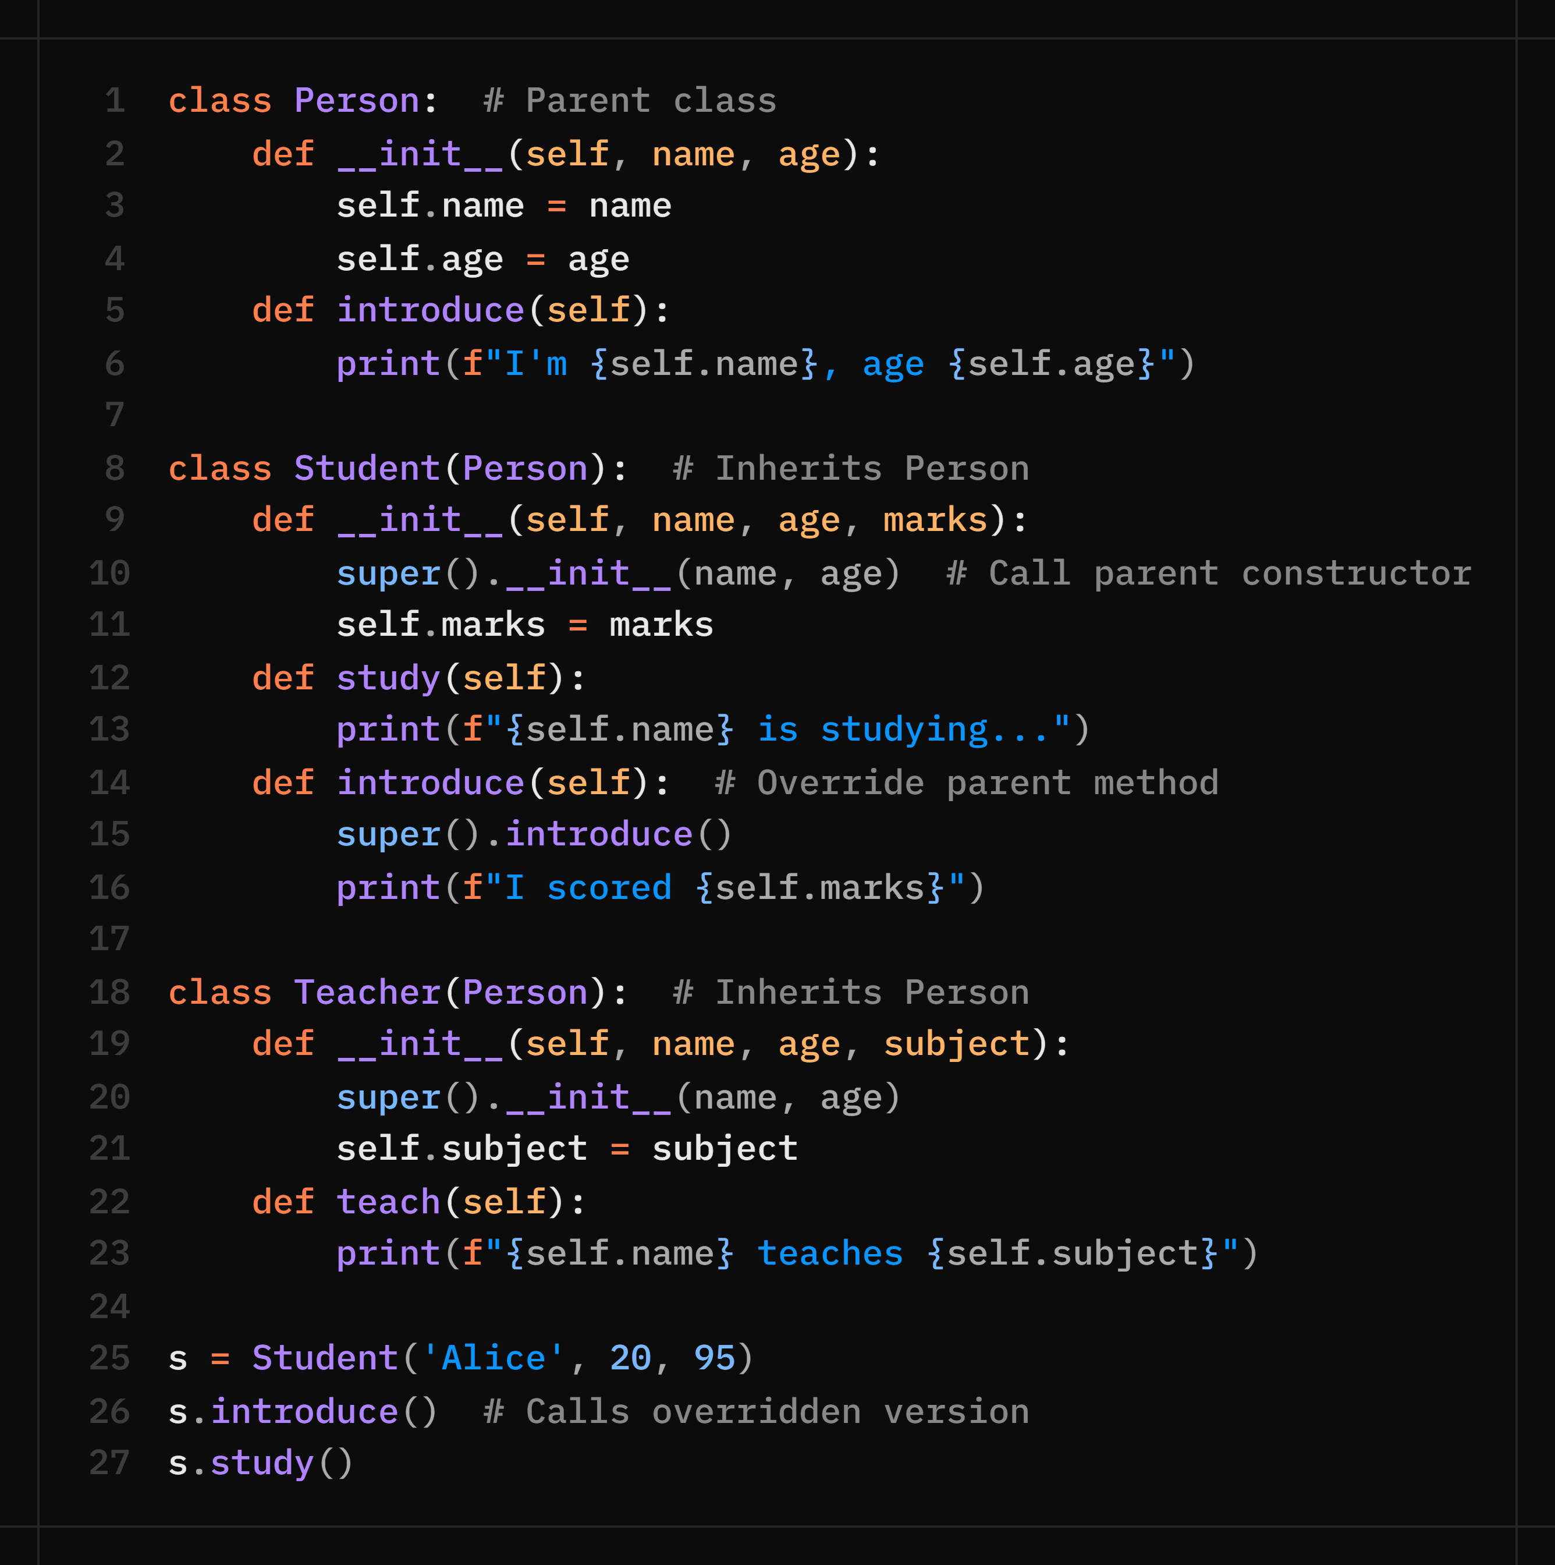
Inheritance — Parent & Child Classes
Inheritance lets a child class reuse and extend a parent class — promoting code reuse.
👨‍👩‍👧 Person → Student / Teacher
📌 Key Terms
Inheritance
Child gets all parent attributes & methods
super()
Calls parent class method/constructor
Method Override
Child redefines a parent method
isinstance()
isinstance(s, Person) → True
issubclass()
issubclass(Student, Person) → True
DRY: write Person once, reuse in Student & Teacher!

Slide 76
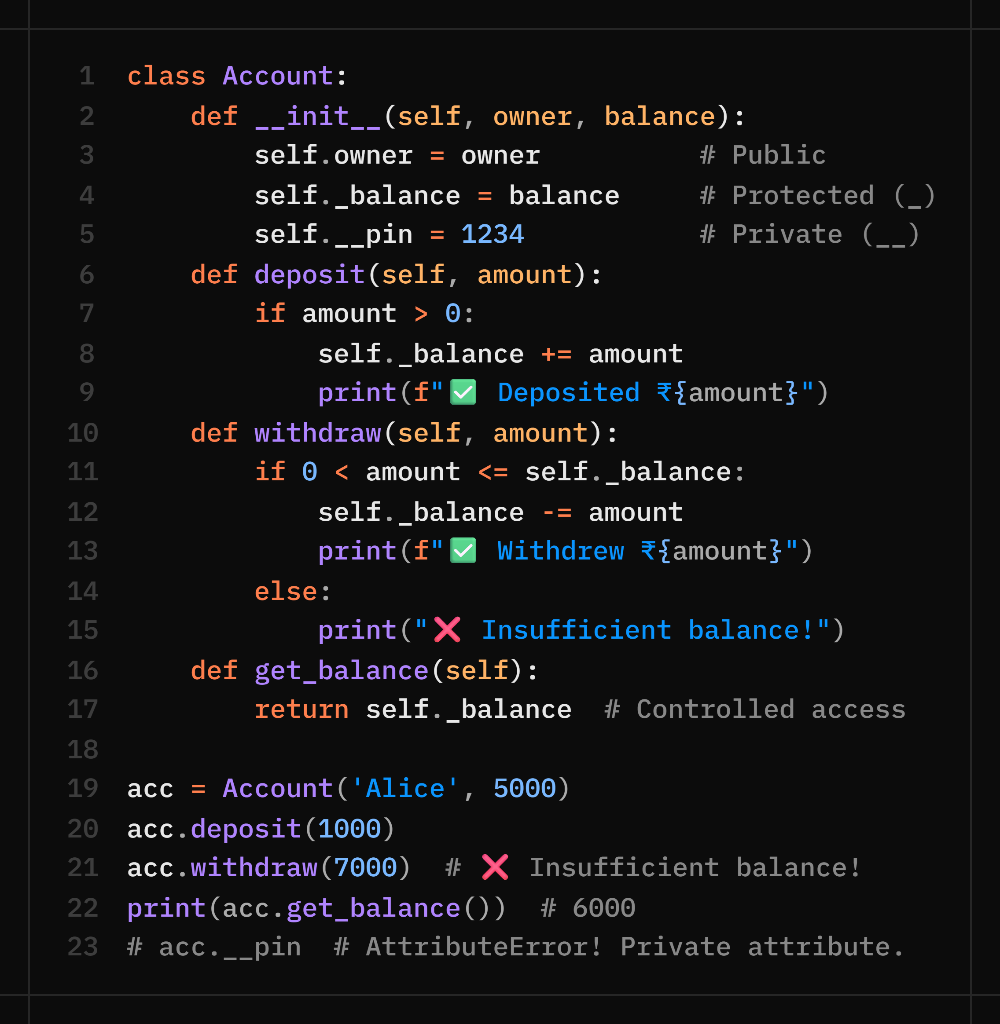
Encapsulation — Protecting Data
Encapsulation = hiding internal details and exposing only what's necessary. Prevents accidental modification.
🔒 Bank Account Example
🛡️ Access Levels
Public
self.name
Accessible from anywhere
Protected
self._balance
Convention: 'don't touch'
from outside the class
Private
self.__pin
Name-mangled. Raises
AttributeError if accessed

Slide 77
Day 8 — Graded Project (Choose ONE)
A
Student Management Program
B
Simple Banking System
Build an OOP-based student records system:
Build an Account class with full banking ops:
class StudentManager:
students = [] # class variable
def add(self, name, marks):...
def search(self, name):...
def update(self, name, marks):...
def get_top(self):...
def print_report(self):...
# Must include:
# ✅ Encapsulation (_marks)
# ✅ At least 5 methods
# ✅ Error handling
# ✅ File save/load
class Account:
def __init__(self, owner, bal):...
def deposit(self, amount):...
def withdraw(self, amount):...
def transfer(self, acc, amount):...
def get_statement(self):...
# Must include:
# ✅ Private __balance attribute
# ✅ Input validation (negative $)
# ✅ Transaction history (list)
# ✅ Transfer between accounts
⚡ Fast finisher: attempt BOTH. The other one is your portfolio bonus! | 🏆 Top 2 projects will be featured on Demo Day.

Slide 78
🧠 Practice Questions — Day 8 (OOP Part 2)
Create a class Animal with a method speak(). Create subclasses Dog and Cat that override speak() with their own sounds. Create a list of mixed animals and call speak() on each.
Explain the difference between public, protected, and private attributes with a code example. Why would you use each one?
Create a class Shape with area() returning 0. Inherit Circle and Square from it, each with their own area() calculation. Test polymorphism by calling area() on a list of shapes.
Create a class Rectangle with private attributes __width and __height. Add getter/setter methods. Prevent negative values with validation.
What is method overriding? Show an example where a child class method produces different output than the parent's same-named method.

Slide 79

Week 2 Recap — What You've Mastered!
Data Structures
Strings
File Handling
Lists · Tuples · Dictionaries
Slicing · Methods · Marks Program
Methods · Slicing · Palindrome
Word Counter · Patterns
open/read/write · with block
CSV module · Modes
Error Handling
OOP Part 1
OOP Part 2
try/except/finally
Common exceptions
class · __init__ · self
Attributes & Methods
Inheritance · super()
Encapsulation · Graded Project

Slide 80
Coming Up Next ⚡
Week 3 — Frontend Basics (HTML · CSS · JavaScript)
Day 9 — Mon Jul 13
🌐
Page structure · headings · links · images · forms → Portfolio Page start
HTML Basics
Day 10 — Tue Jul 14
🎨
Selectors · box model · flexbox · responsive design → Portfolio styling
CSS Basics
Day 11 — Wed Jul 15
⚡
Variables · functions · DOM manipulation · events → Interactive Portfolio
JavaScript Basics
🏠 Weekend Homework: Revisit all 5 days · Attempt bonus questions · Try extending the graded project!

Slide 81
Great Work This Week!
You've gone from Python basics to Object-Oriented Programming in one week 🚀
Exit Ticket — Before you leave, write:
"Today I learned ___ and my one remaining doubt is ___"
See you Monday for Week 3 — the web awaits! 🌐
2b Academy · Python Bootcamp · July 2026

