Slide 1

Python Bootcamp
Week 1 — Python Fundamentals
Jul 1 – Jul 3, 2026 | Days 1-3 | 9 Hours
🐍 Python 3.x
💻 VS Code
🚀 Beginner Friendly
Notes:
Welcome everyone! Introduce yourself and the bootcamp. This is Day 1 of a 22-day journey. The energy you set today defines the whole batch.

Slide 2
Week 1 At-a-Glance — What We Cover
1
Day 1 (Wed Jul 1) — Python Setup, Variables, Data Types, Operators, I/O
2
Day 2 (Thu Jul 2) — Control Statements: if-else, Loops + Number Guessing Game
3
Day 3 (Fri Jul 3) — Functions, DRY Principle, Built-ins + Quiz Scorer Project
4
Weekend — Practice! Revisit all 3 days' code, attempt bonus exercises
5
Coming up Week 2 → Data Structures, Strings, File Handling, OOP Basics

Slide 3
DAY 1 / WEEK 1
Day 1 — Wed, Jul 1
Orientation + Python Basics: Setup · Variables · I/O · Operators

Slide 4
What is Python?
Python is an interpreted, high-level, beginner-friendly programming language — readable, powerful, and used everywhere.
🌐
🤖
📊
⚙️
🎮
Web Dev
AI / ML
Data Science
Automation
Game Dev
Django · Flask
Powerful backends
TensorFlow · scikit
What we'll build!
Pandas · NumPy
Analyse anything
Scripts · bots
Save hours of work
PyGame · Arcade
For fun projects
Notes:
Ask: Who has heard of Python? Who has tried coding before? Use Netflix, Instagram, YouTube as examples of Python-powered products.

Slide 5





Python in the Real World
From Instagram to NASA — Python powers products used by billions of people every day.
Instagram
Netflix
Spotify
NASA
Dropbox
Backend built on Django, serving 2B+ users
Recommendation engine & workflow automation
Data pipelines that power Discover Weekly
Scientific computing & mission data analysis
Desktop app & file sync engine in Python
Why Python is so powerful
Simple, readable syntax • 400,000+ ready-made libraries • Runs on every platform • Scales to billions of users

Slide 6
Environment Setup (Do This Together!)
1
Download Python 3.x — Go to python.org → Downloads → Install with 'Add to PATH' checked ✓
2
Verify Installation — Open terminal/cmd → type: python --version
You should see: Python 3.x.x
3
Install VS Code — Go to code.visualstudio.com → Download → Install
4
Python Extension — Open VS Code → Extensions (Ctrl+Shift+X) → Search 'Python' → Install
5
First Program! — Create hello.py → type print("Hello, World!") → Run ▶
Notes:
Walk through this live on the projector. Watch the room — help anyone who gets stuck. Don't move on until everyone has python --version working.

Slide 7
Introduction to Python Data Types
What is a Data Type?
A data type defines the kind of value a variable can store and the operations that can be performed on it.
Why Data Types Matter
Store different kinds of data.
Perform appropriate operations.
Improve code readability.
Help prevent programming errors.
Example
age = 25
name = "Alice"
is_student = True
print(type(age))
print(type(name))
print(type(is_student))

Slide 8
Basic Data Types
Data Type | Description | Example
int | Whole numbers | 10
float | Decimal numbers | 3.14
complex | Real and imaginary numbers | 2 + 3j
str | Text values | "Python"
bool | True or False | True
NoneType | Represents no value | None
Example
age = 25
price = 99.99
name = "Python"
is_pass = True
result = None

Slide 9
Collection Data Types
Data Type | Description | Example
list | Ordered and mutable collection | [1, 2, 3]
tuple | Ordered and immutable collection | (1, 2, 3)
set | Unordered collection of unique values | {1, 2, 3}
dict | Key-value pairs | {"name": "John"}
Example
fruits = ["Apple","Mango"]
point = (10, 20)
numbers = {1, 2, 3}
student =
{
"name": "John",
"age": 20
}

Slide 10
What is a Variable?
A variable is a name that refers to an object in memory.
This does NOT mean:
“Create a box called x and put 10 inside.”
Python actually does:
1. Create an integer object 10.
2. Create the name x.
3. Make x point to the object 10.
x = 10 x → 10

Slide 11
Everything in Python is an Object
In Python, these are all objects:
Numbers
Strings
Lists
Functions
Classes
a = 5
b = "hello"
c = [1, 2, 3]
Each value exists somewhere in memory as an object.

Slide 12
Variable Assignment
Binding
x = 10
This is called binding.
The name x becomes bound to the integer object 10.
Reassignment
x = 10
x = 20
x → 10 becomes x → 20
The old object may eventually be removed by garbage collection if nothing references it.

Slide 13
Names and Objects
Memory
a = 100
b = a
a → 100 ← b
Both variables point to the same object.
Checking Identity
a = 100
b = a
print(a is b)
Output: True
is checks whether two variables refer to the same object.

Slide 14
Object Identity & Dynamic Typing
id() Function
Every object has a unique identity.
x = 10
print(id(x))
Example:
140736811430216
Usually the object's memory address in CPython.
Dynamic Typing
Python is dynamically typed.
x = 10
x = "hello"
x = [1, 2]
The variable has no fixed type – the object carries the type.
type(x)

Slide 15
Typing, Naming & Assignment
Strong Typing
Python is strongly typed.
"5" + 5 produces TypeError
Python does not automatically convert incompatible types.
Variable Naming Rules
Valid:
name = "John"
age2 = 20
_student = "A"
Invalid:
2age = 20
my-name = 10
class = 5
Keywords Cannot Be Variables
if = 10 → Error
Keywords include:
if else while for class def return import
Multiple Assignment
a, b, c = 1, 2, 3
Python performs tuple packing and unpacking.
values = (1, 2, 3)
a = values[0]
b = values[1]
c = values[2]

Slide 16
Swapping, Aliasing & Mutability
Swapping Variables
a = 10
b = 20
a, b = b, a
Internally:
temp = (b, a)
a = temp[0] b = temp[1]
Aliasing
a = [1, 2]
b = a
b.append(3)
print(a) → [1, 2, 3]
Both variables point to the same list.
Immutable Objects – cannot change after creation.
Examples: int, float, bool, str, tuple
x = 10
x += 1 → new object
10 object destroyed (if unused), 11 object created.
Mutable Objects – can change after creation.
Examples: list, dict, set
numbers = [1, 2]
numbers.append(3)
The same list object changes.

Slide 17
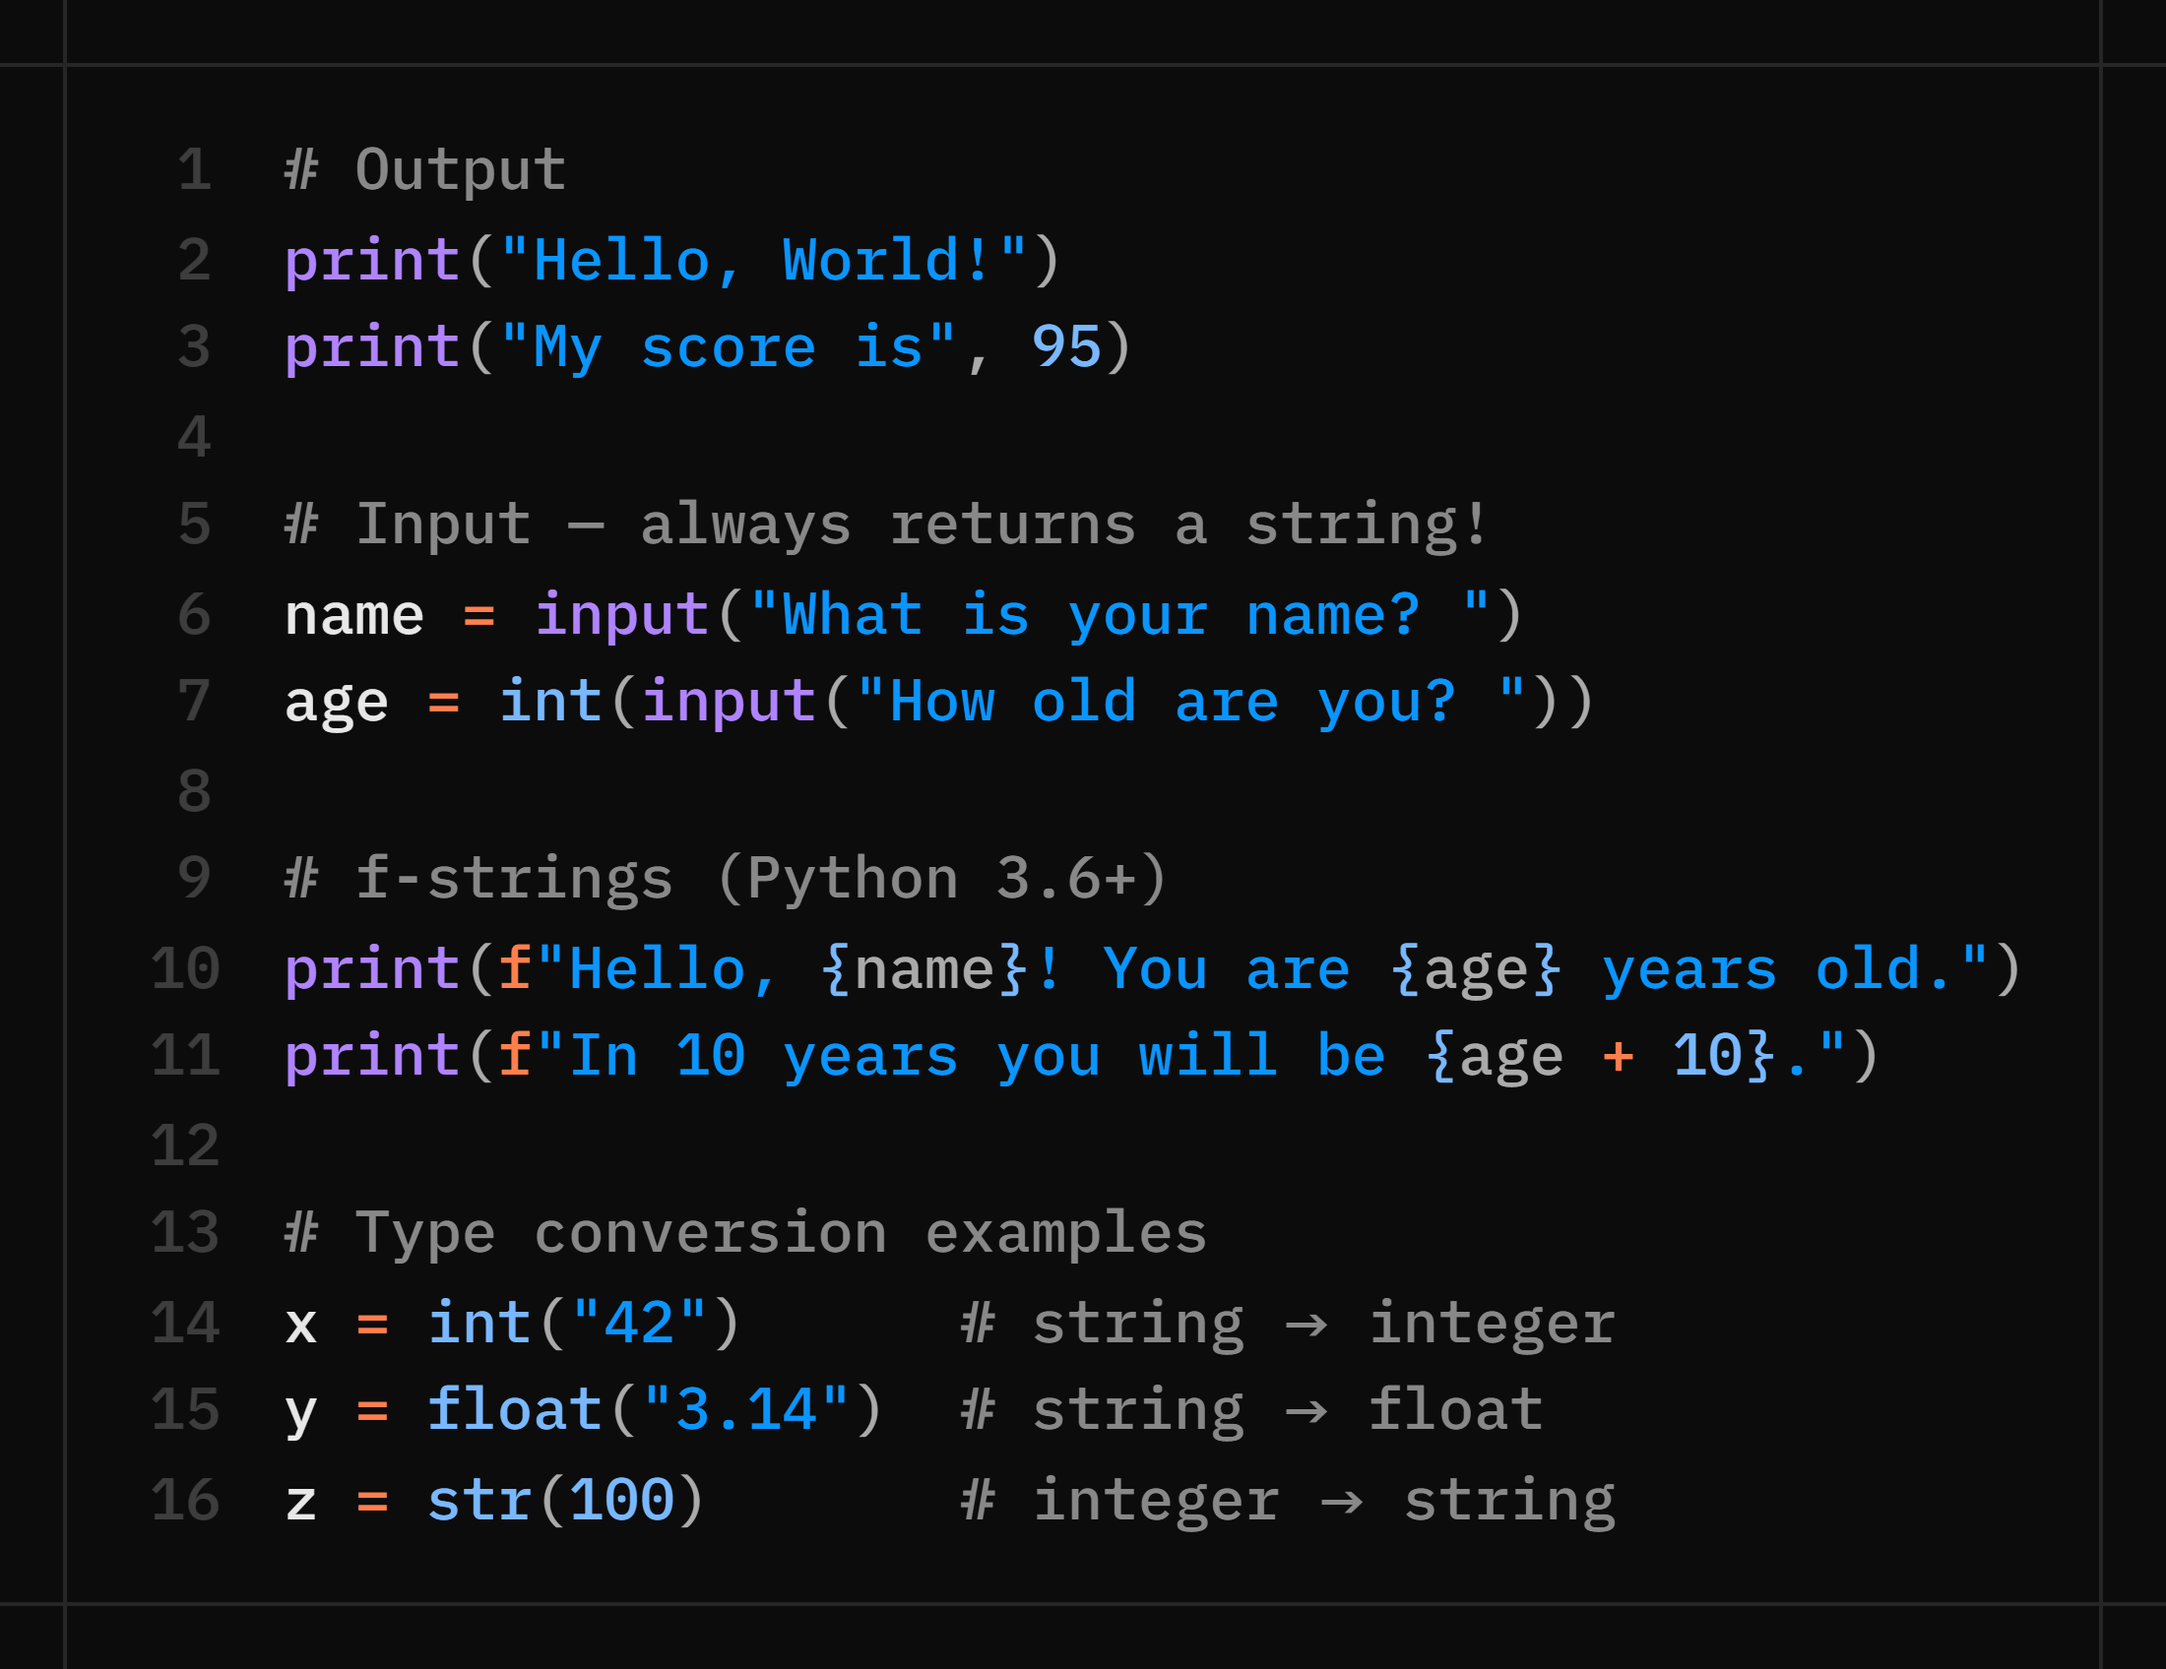
Input, Output & f-Strings
Python communicates with the user through print() for output and input() for input. f-strings make formatting easy.
💡 input() always gives a STRING — use int() or float() to convert numbers!

Slide 18
print() Function
1. What is print()?
print() is a built-in Python function used to display output on the screen.
print("Hello World")
Output:
Hello World
2. Syntax
print(*objects, sep=' ', end='\n')
Parameters:
Parameter | Purpose
*objects | Values to print
sep | Separator between values
end | What to print at the end

Slide 19
print() – Values, sep & end
Printing Strings
print("Python") → Python
Printing Numbers
print(100) → 100
print(3.14) → 3.14
Printing Multiple Values
name = "John"
age = 25
print(name, age) → John 25
Default: a space separates values.
The sep Parameter
print("A", "B", "C") → A B C
print("A", "B", "C", sep="-") → A-B-C
print(1, 2, 3, sep=", ") → 1, 2, 3
The end Parameter
print("Hello")
print("World") → Hello World
Default: end="\n" adds a newline.
print("Hello", end=" ")
print("World") → Hello World

Slide 20
f-Strings & Formatting
f-Strings (Modern printf)
name = "John"
age = 25
print(f"My name is {name}")
print(f"Age is {age}")
Output:
My name is John Age is 25
Expressions Inside f-Strings
a = 10 b = 20
print(f"Sum = {a+b}")
Output: Sum = 30
Decimal Formatting
pi = 3.14159265
print(f"{pi:.2f}") → 3.14
.2f keeps two decimal places.
Width Formatting
text = "cat"
num = 42
print(f"|{text:10}|") # Output: |cat | print(f"|{num:10}|") # Output: | 42|

Slide 21
Operators in Python
Arithmetic Operators
+ Addition 5+3 = 8 - Subtraction 5-3 = 2 * Multiplication 5*3 = 15 / Division 7/2 = 3.5 // Floor Div 7//2 = 3 % Modulo 7%2 = 1 ** Power 2**3 = 8
Comparison Operators
== != > < >= <=
Logical Operators
and → both must be True or → at least one True not → flips True/False
Assignment Operators x = 5 x += 3 # x = x + 3 x -= 2 # x = x - 2 x *= 4 # x = x * 4
Type Conversion
int('5') · float('3.2') · str(10)

Slide 22
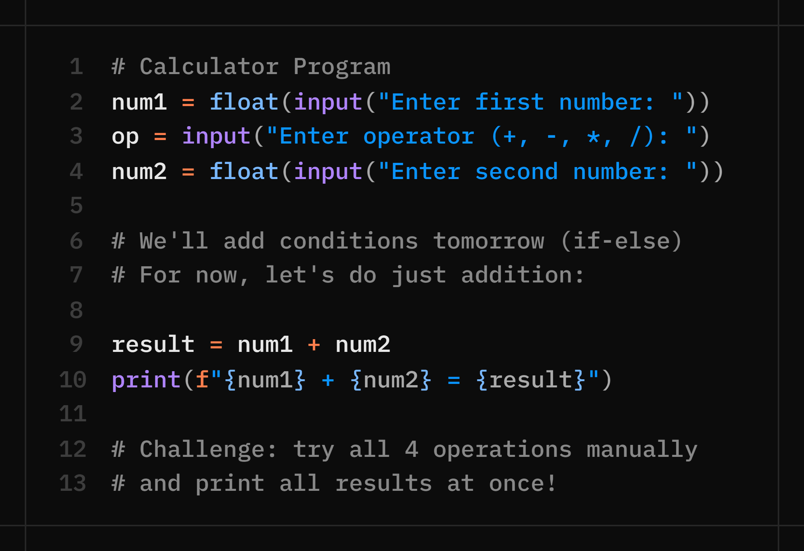
Day 1 Practical — Calculator Program
Mini project: Build a calculator that takes two numbers and an operator as input, performs the operation, and prints the result.
💡 Tomorrow we use if-else to make the calculator handle ALL operators automatically!

Slide 23
🧠 Practice Questions
Day 1 — Practice Questions
Q1. Write a program that asks for your name and age, then prints: 'Hello [name], you will turn [age+1] next year!'
Q2. What is the output of: print(type(3.14)) and print(type(True))?
Q3. Ask the user for their first name and last name, then print their full name using an f-string.
Q4. Convert the string '42' to an integer and multiply it by 3. Print the result.
Q5. Bug Hunt: name = input('name') / print('Hello + name) — Find and fix both errors.
Q6. Using one print() statement with sep and end, print 10, 20, 30 separated by " | " and ending with "!!!" instead of a newline.
Q7. price = 499.5. Print it with exactly two decimal places using an f-string.
Q8. Ask the user for their age and whether they have a valid ID (yes/no). Print "Entry allowed" only if age ≥ 18 and they have a valid ID — using and directly, no nested if.

Slide 24
DAY 2 / WEEK 1
Day 2 — Thu, Jul 2
Control Statements: if-else · Loops · Number Guessing Game

Slide 25
Decision Making in Python
Conditional Statements (if, elif, else)
Conditional statements allow a program to make decisions and execute different blocks of code based on conditions.
Why Use Conditions?
✅ Make decisions in programs
✅ Validate user input
✅ Compare values
✅ Control program flow
Syntax
if condition:
statements
The indented block runs only when the condition is True.

Slide 26
The if Statement
The if statement executes a block of code only when the condition is True.
age = 18
if age >= 18:
print("Eligible to vote")
Output
Eligible to vote
Flow
Condition is True → Execute code
Condition is False → Skip code

Slide 27
The if-else Statement
The else block executes when the condition is False.
num = 7
if num % 2 == 0:
print("Even")
else:
print("Odd")
Output
Odd
Flow
Condition True → if block
Condition False → else block

Slide 28
The if-elif-else Statement
Used when multiple conditions need to be checked.
marks = 85
if marks >= 90:
print("Grade A+")
elif marks >= 75:
print("Grade A")
elif marks >= 60:
print("Grade B")
else:
print("Fail")
Output
Grade A
marks = 85 fails the first test but passes marks >= 75, so the second branch runs.

Slide 29
Nested if Statement
An if statement inside another if statement.
age = 20
citizen = True
if age >= 18:
if citizen:
print("Eligible to vote")
Output
Eligible to vote
Uses
• Login systems
• Permission checks
• Multiple dependent conditions

Slide 30
Comparison & Logical Operators
Comparison Operators
== Equal to != Not equal to
> Greater than < Less than
>= Greater or equal
<= Less or equal
Logical Operators
and Both conditions True
or Any one True
not Reverses the condition
and
if age>=18 and citizen:
print("Eligible")
else:
print("No")
or
if vip or member:
print("Welcome")
else:
print("Guest")
not
if not blocked:
print("Allowed")
else:
print("Denied")

Slide 31
Introduction to Loops
Loops execute a block of code repeatedly until a condition becomes false or all elements in a sequence are processed.
Types of Loops
for loop
Used when the number of iterations is known.
while loop
Used when repetition depends on a condition.
Benefits of Loops
✓ Reduce code repetition
✓ Save time and effort
✓ Process collections of data
✓ Automate repetitive tasks

Slide 32
The for Loop & range()
Syntax
for variable in sequence:
statements
Example
for i in range(5):
print(i)
Output
0 1 2 3 4
range() Function
range(5) → 0 to 4
range(1,6) → 1 to 5
range(1,10,2)
→ 1, 3, 5, 7, 9

Slide 33
The while Loop
Syntax
while condition:
statements
Example
count = 1
while count <= 5:
print(count)
count += 1
Output
1 2 3 4 5
Be Careful
If the condition never becomes False, an infinite loop occurs.
Always update the variable used in the condition so the loop can end.

Slide 34
Loop Control Statements
break
Terminates the loop immediately.
for i in range(5):
if i == 3:
break
print(i)
Output: 0 1 2
continue
Skips the current iteration.
for i in range(5):
if i == 2:
continue
print(i)
Output: 0 1 3 4
pass
Acts as a placeholder and performs no action.
if True:
pass
Useful where code is required but you have nothing to run yet.

Slide 35
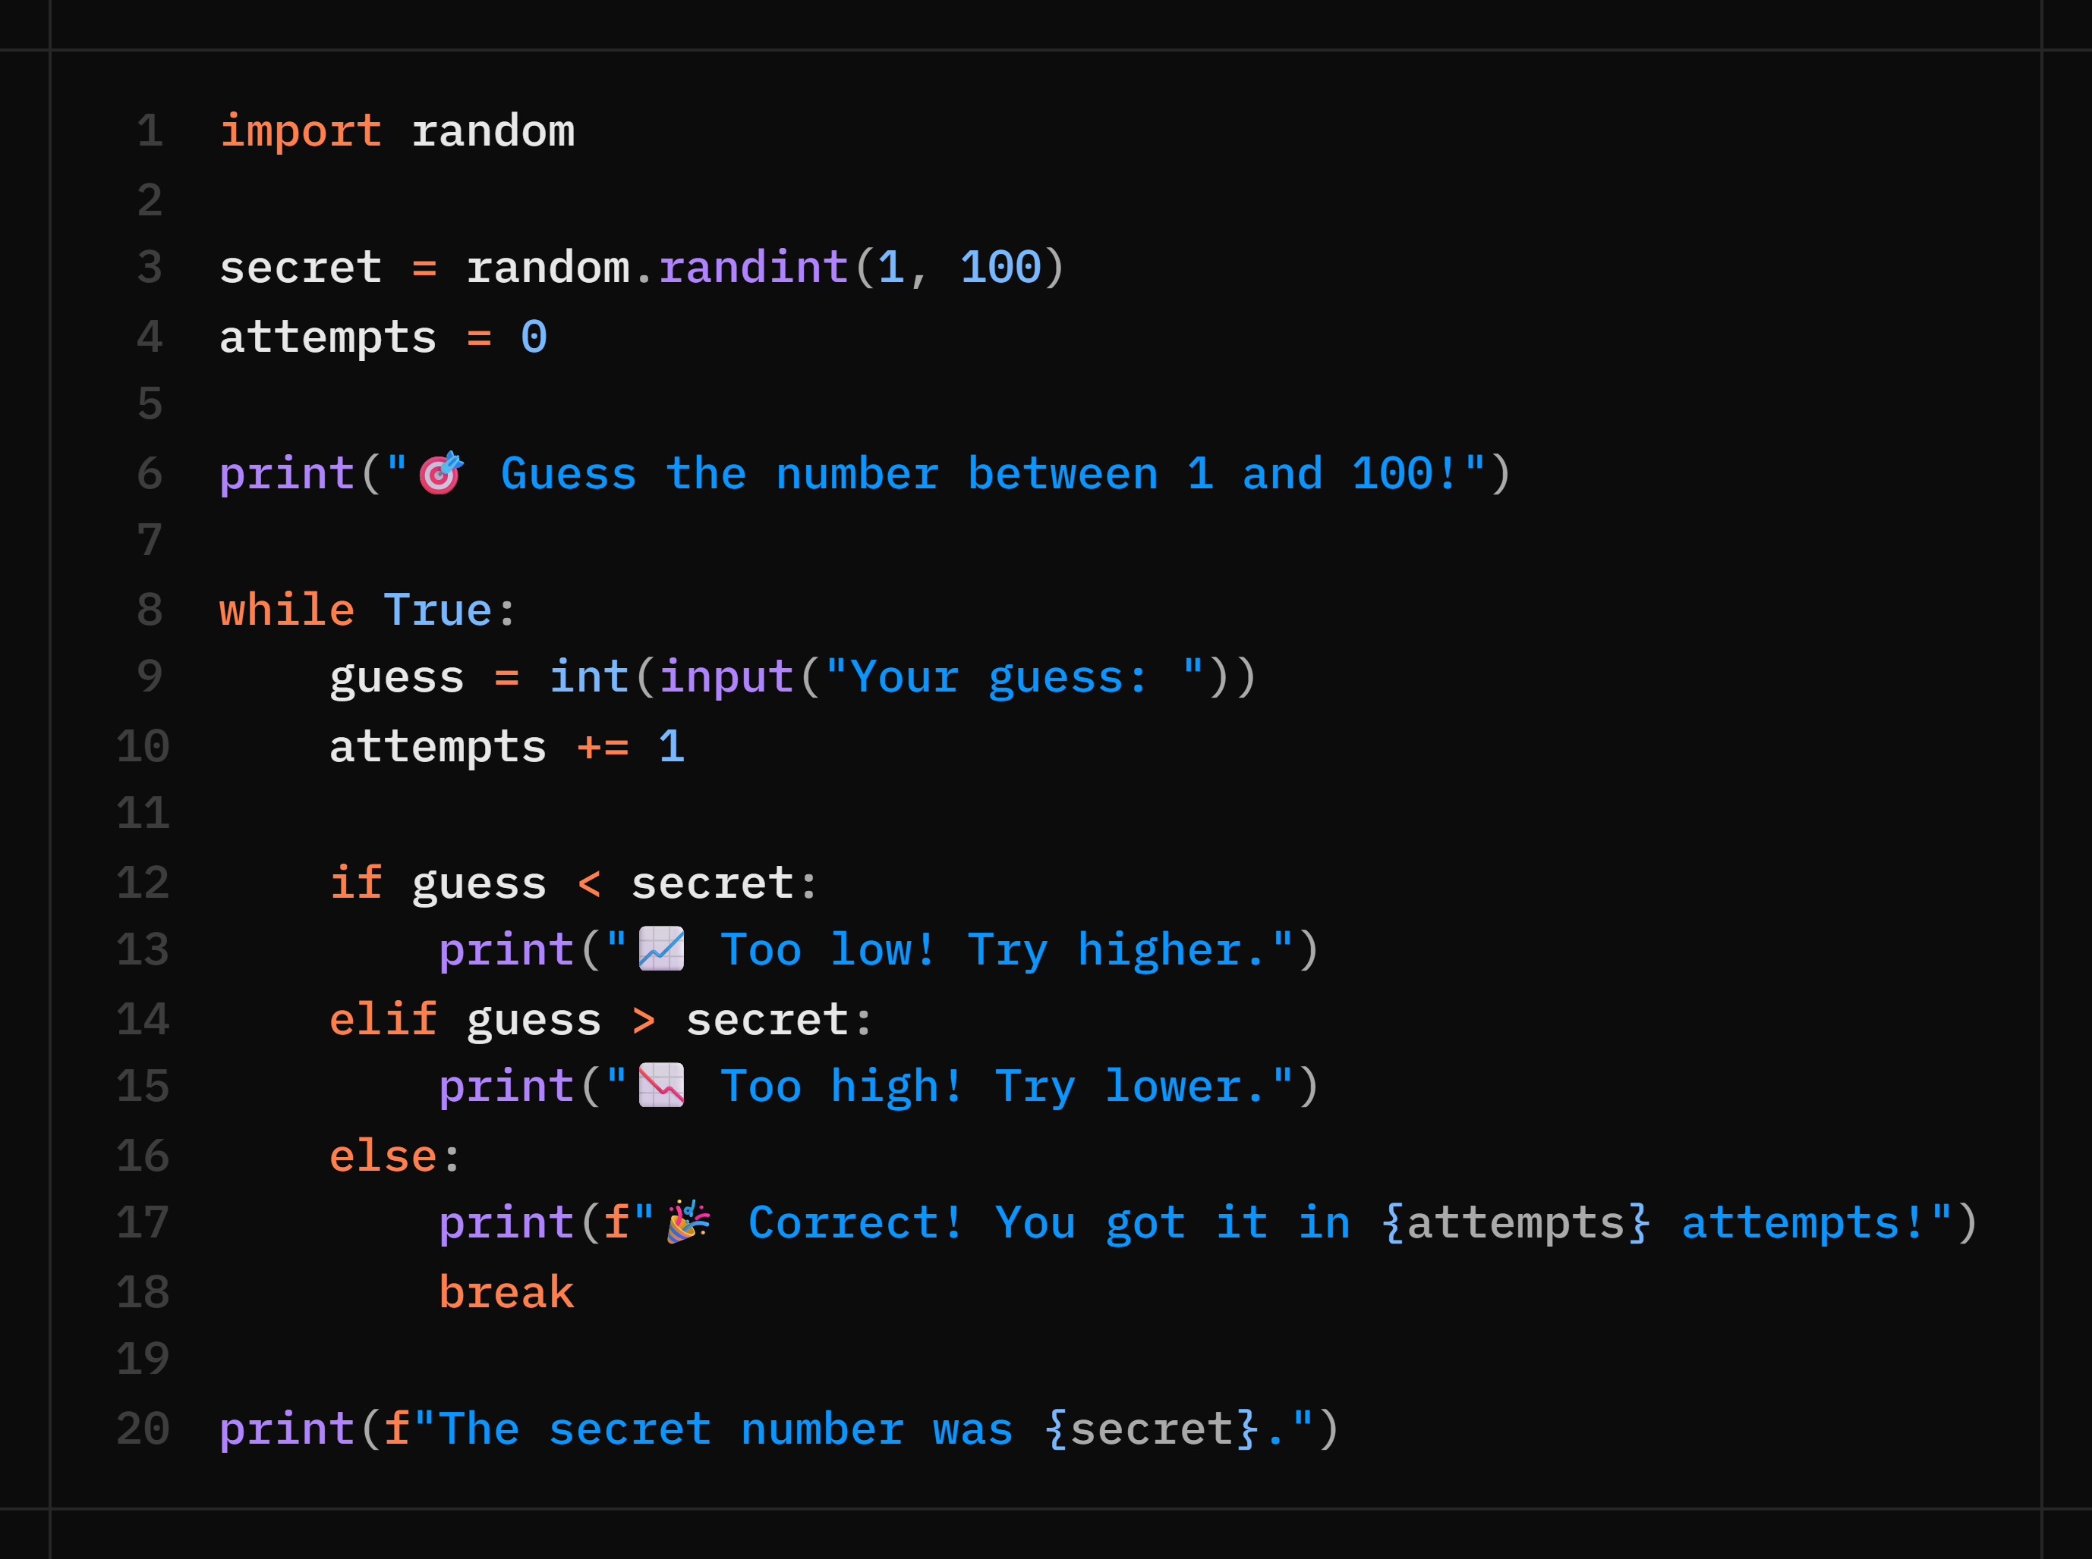
Day 2 Practical — Number Guessing Game
Combine random module + while loop + if-elif-else to build an interactive game!

Slide 36
🧠 Practice Questions
Day 2 — Practice Questions
Q1. Write an if-else program to check if a number entered by the user is positive, negative, or zero.
Q2. Print a multiplication table for any number entered by the user (using a for loop).
Q3. Using a while loop, keep asking the user for a number until they enter 0. Print the sum of all numbers entered.
Q4. Write a program that prints numbers 1–20 but skips multiples of 3 (use continue).
Q5. Modify the Number Guessing Game: add a maximum attempts limit of 7. If exceeded, print 'Game over!'
Q6. Take a student's marks as input and print their grade using an elif chain: 90+ → "A+", 75–89 → "A", 60–74 → "B", below 60 → "Fail".
Q7. Write a login check using nested if statements: first check if the username matches "admin", and only if it does, check if the password matches "1234". Print "Access granted", "Wrong password", or "Unknown user" accordingly.

Slide 37
DAY 3 / WEEK 1
Day 3 — Fri, Jul 3
Functions — DRY Principle · Parameters · Return Values · Built-ins

Slide 38
Introduction to Functions
A function is a reusable block of code that performs a specific task.
Why Use Functions?
✓ Code reusability
✓ Reduces code duplication
✓ Improves readability
✓ Easier testing and maintenance
Syntax
def function_name():
statements
Example
def greet():
print("Hello World")
greet()

Slide 39
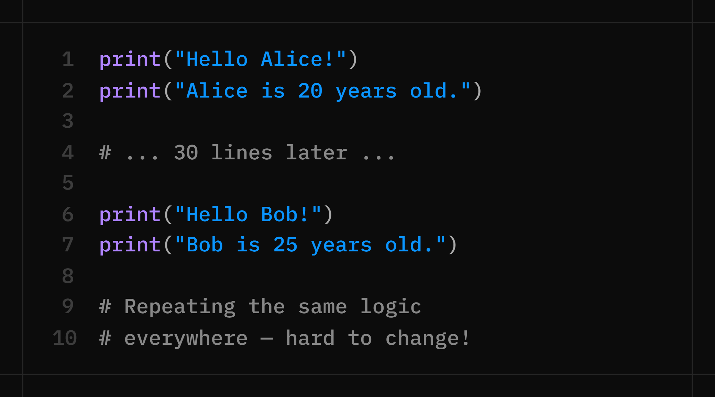
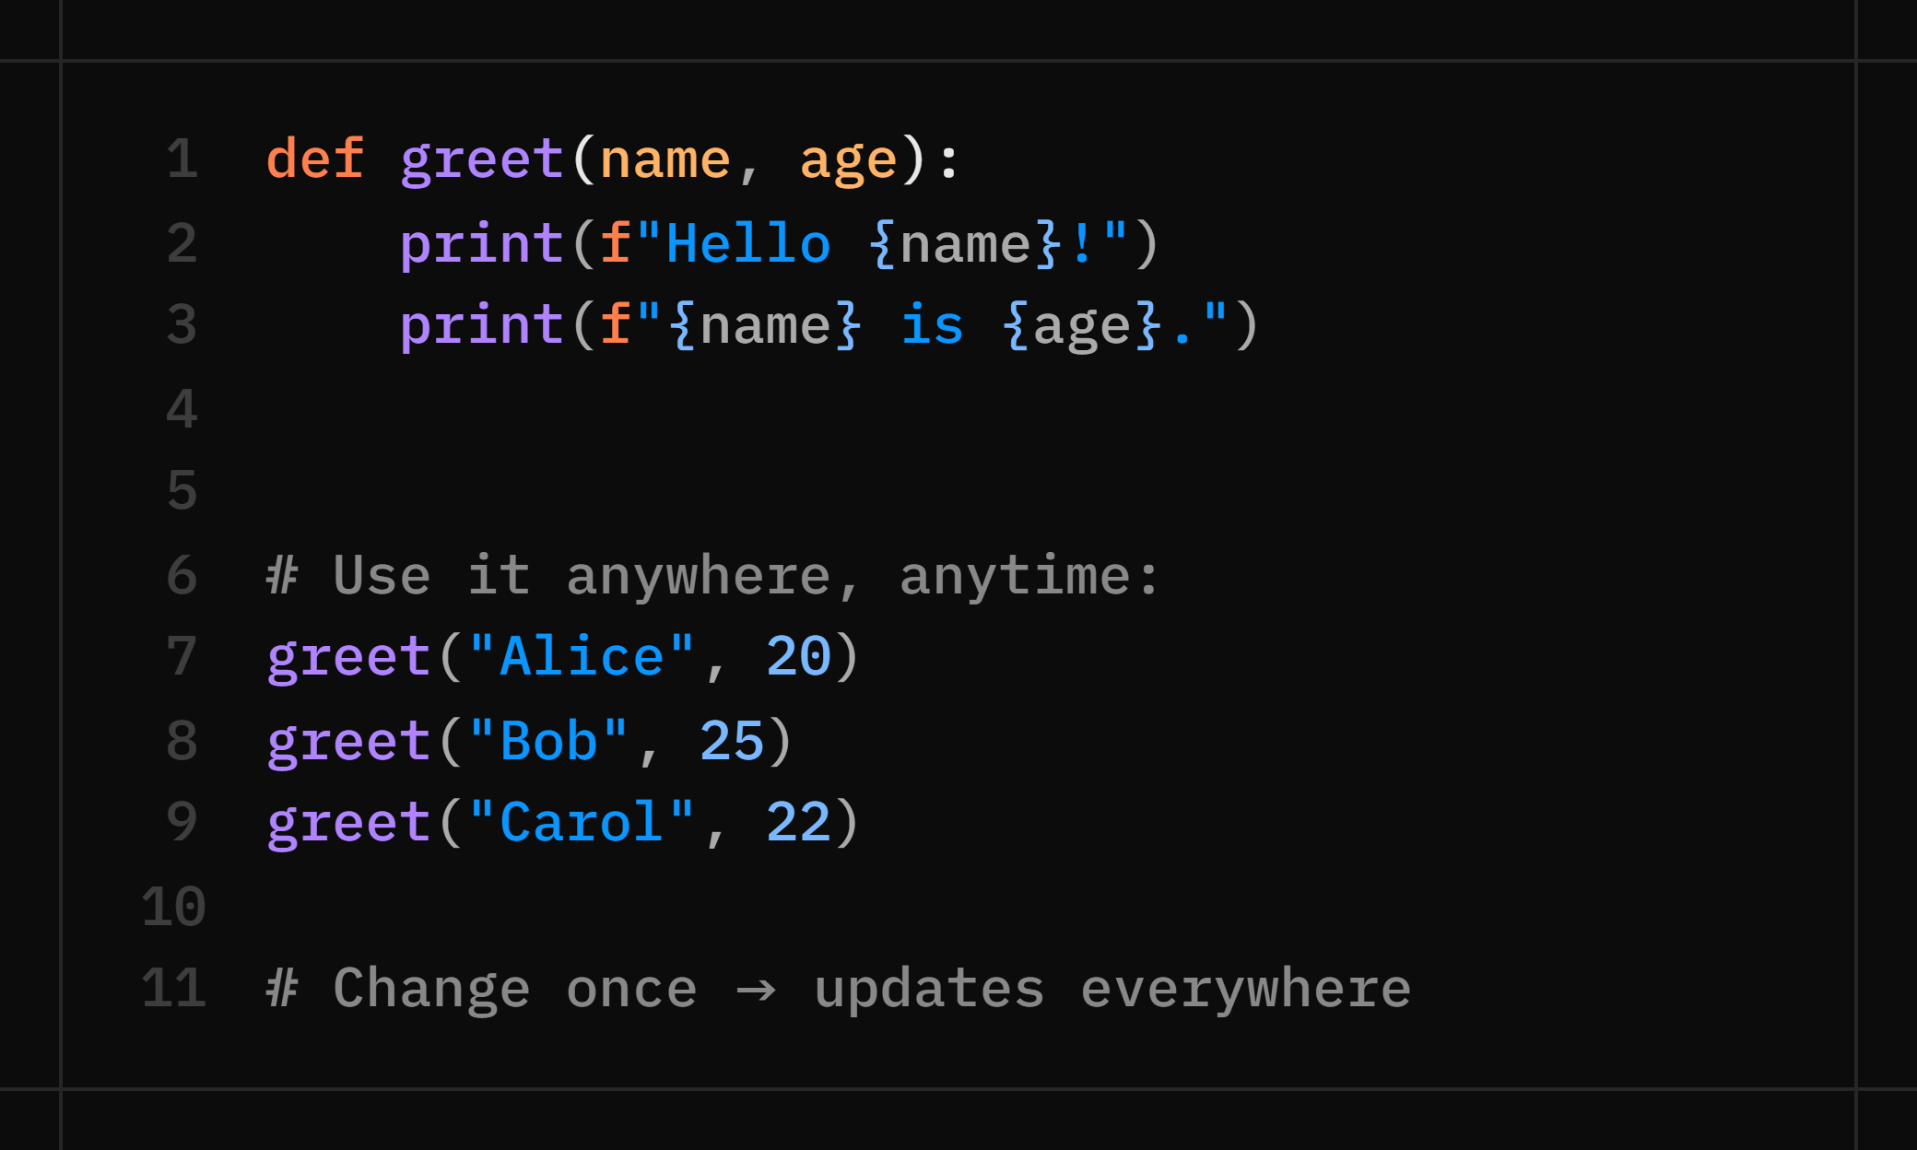
Why Functions? — The DRY Principle
DRY = Don't Repeat Yourself
Functions let you write code ONCE and use it ANYWHERE.
❌ Without Functions
✅ With Functions
Notes:
Analogy: A function is like a recipe. You write it once, then cook it (call it) whenever you want. You don't rewrite the recipe each time.

Slide 40
Parameters & Arguments
Parameters receive values when a function is called.
def greet(name):
print("Hello", name)
greet("John")
Default value example
def greet(name="Guest"):
print("Hello", name)
greet()
greet("John")
Types of Parameters
Positional
add(10, 20)
Keyword
add(a=10, b=20)
Default
greet(name="Guest")

Slide 41
Variable-Length Arguments
*args
Multiple positional arguments
def add(*numbers):
print(numbers)
add(10, 20, 30)
Output
(10, 20, 30)
**kwargs
Multiple keyword arguments
def student(**data):
print(data)
student(name="John", age=20)
Output
{'name': 'John', 'age': 20}

Slide 42
Return Statement & Scope
Return Statement
Sends a value back to the caller.
def add(a, b):
return a + b
result = add(10, 20)
Variable Scope
Local: Exists inside the function.
Global: Exists outside the function.
x = 100
def show():
y = 50
print(y)

Slide 43
Important Function Concepts
Lambda Function
Anonymous one-line function.
square = lambda x: x * x
print(square(5))
Output
25
Recursive Function
A function that calls itself.
def factorial(n):
if n == 1:
return 1
return n * factorial(n-1)
Each call reduces the problem until a base case stops it.
Built-in Functions
Ready-to-use Python functions.
print()
len()
input()
type()
sum()
max()
min()

Slide 44
Useful Built-in Functions
Math & Sequences len([1,2,3]) → 3 sum([1,2,3]) → 6 max([5,2,8]) → 8 min([5,2,8]) → 2 abs(-7) → 7 round(3.567, 2) → 3.57
Range range(5) → 0,1,2,3,4 range(1,6) → 1,2,3,4,5 range(0,10,2) → 0,2,4,6,8
Sorting & Type Checks sorted([3,1,2]) → [1,2,3] sorted([3,1,2], reverse=True) type(42) → <class 'int'> isinstance(42, int) → True
Common Lab Functions to Write def is_even(n):
return n % 2 == 0
def factorial(n):
result = 1
for i in range(1, n+1):
result *= i
return result
def reverse_string(s):
return s[::-1]

Slide 45
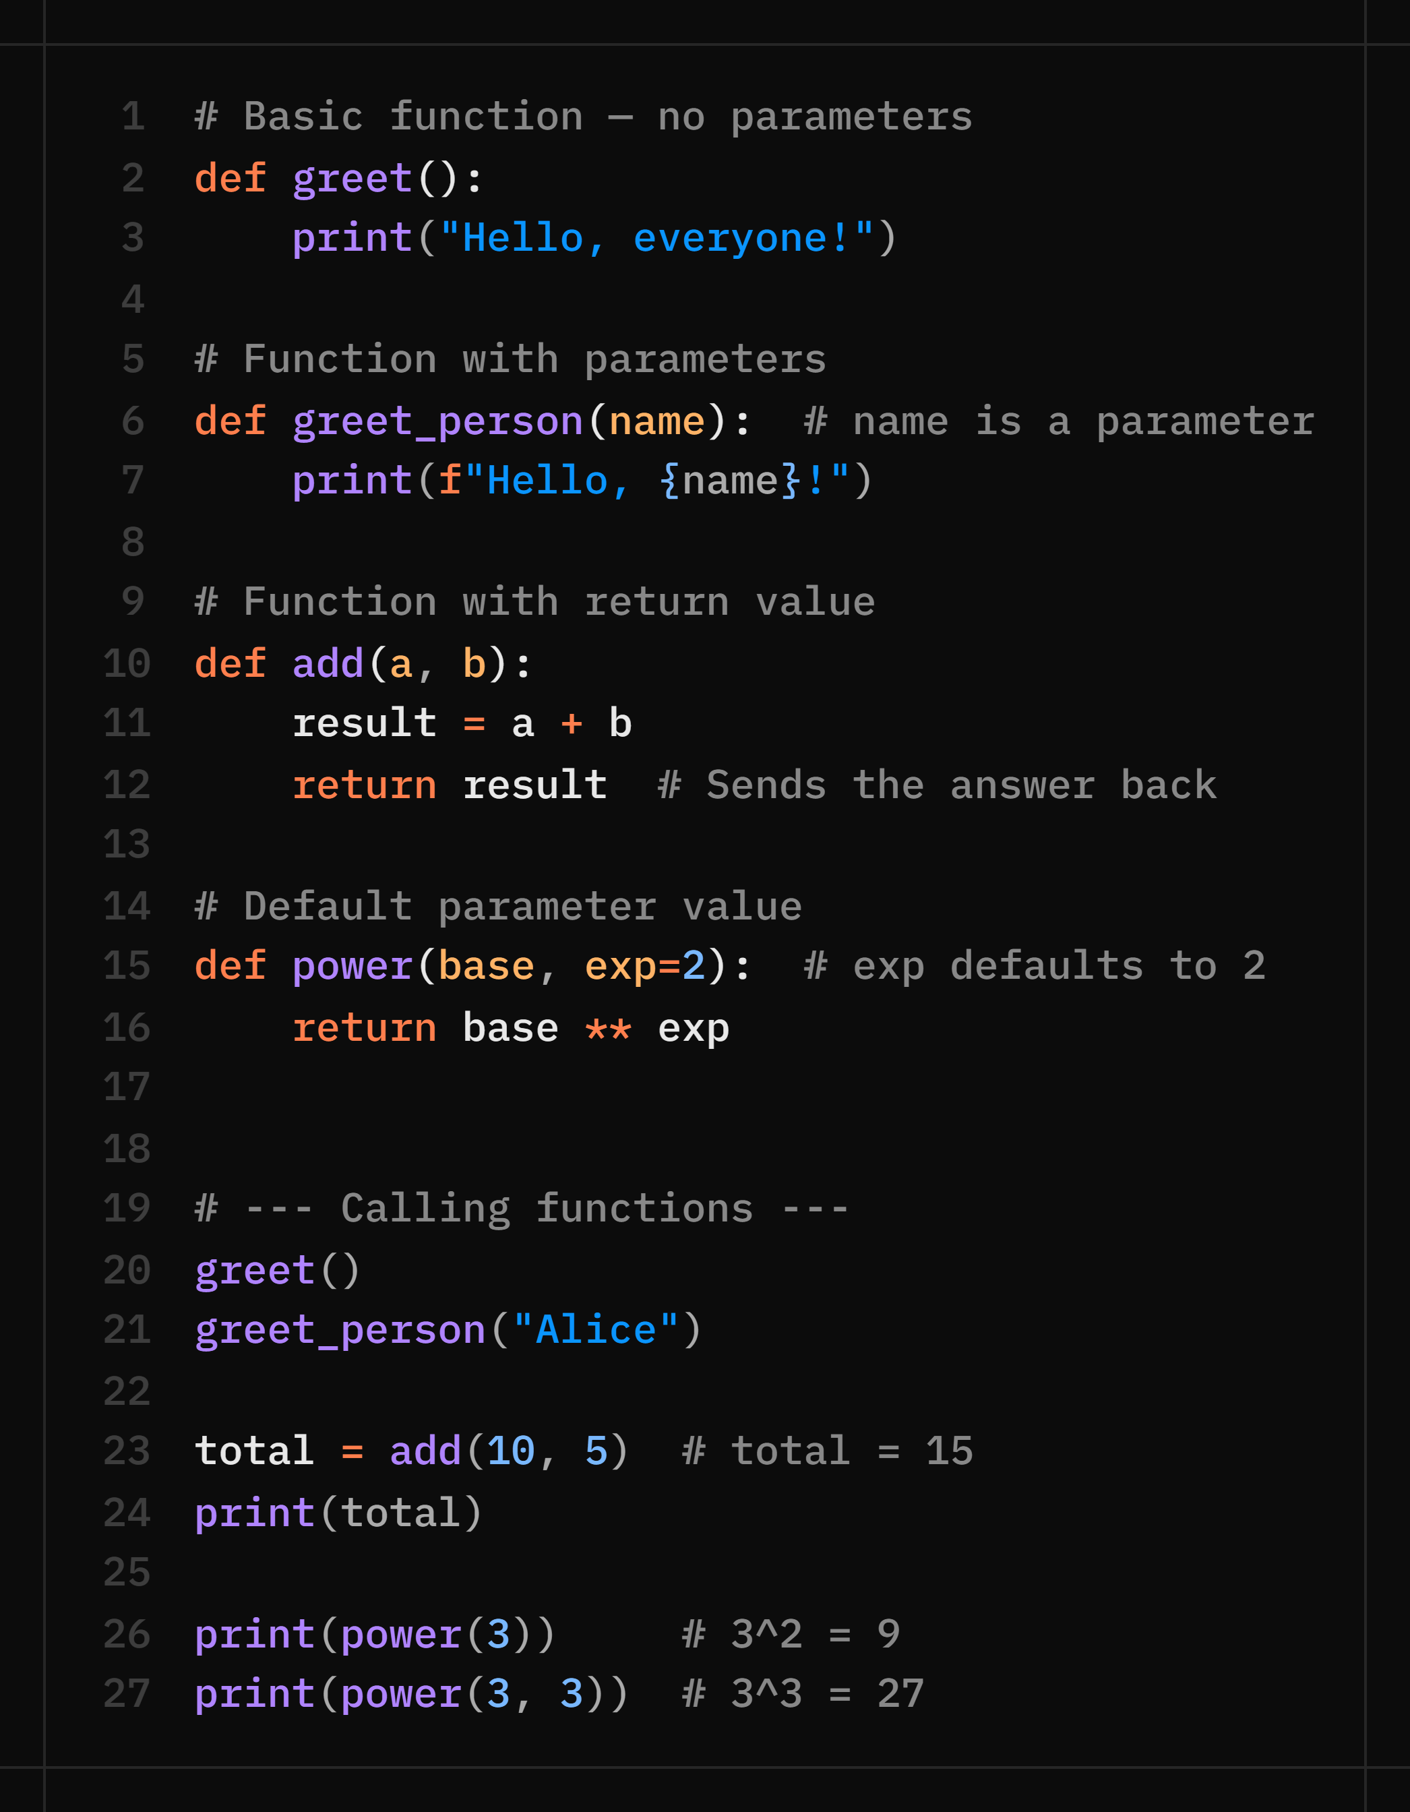
Function Syntax — def, Parameters, Return
Functions are defined with 'def', can accept parameters (inputs), and can return values (outputs).

Slide 46
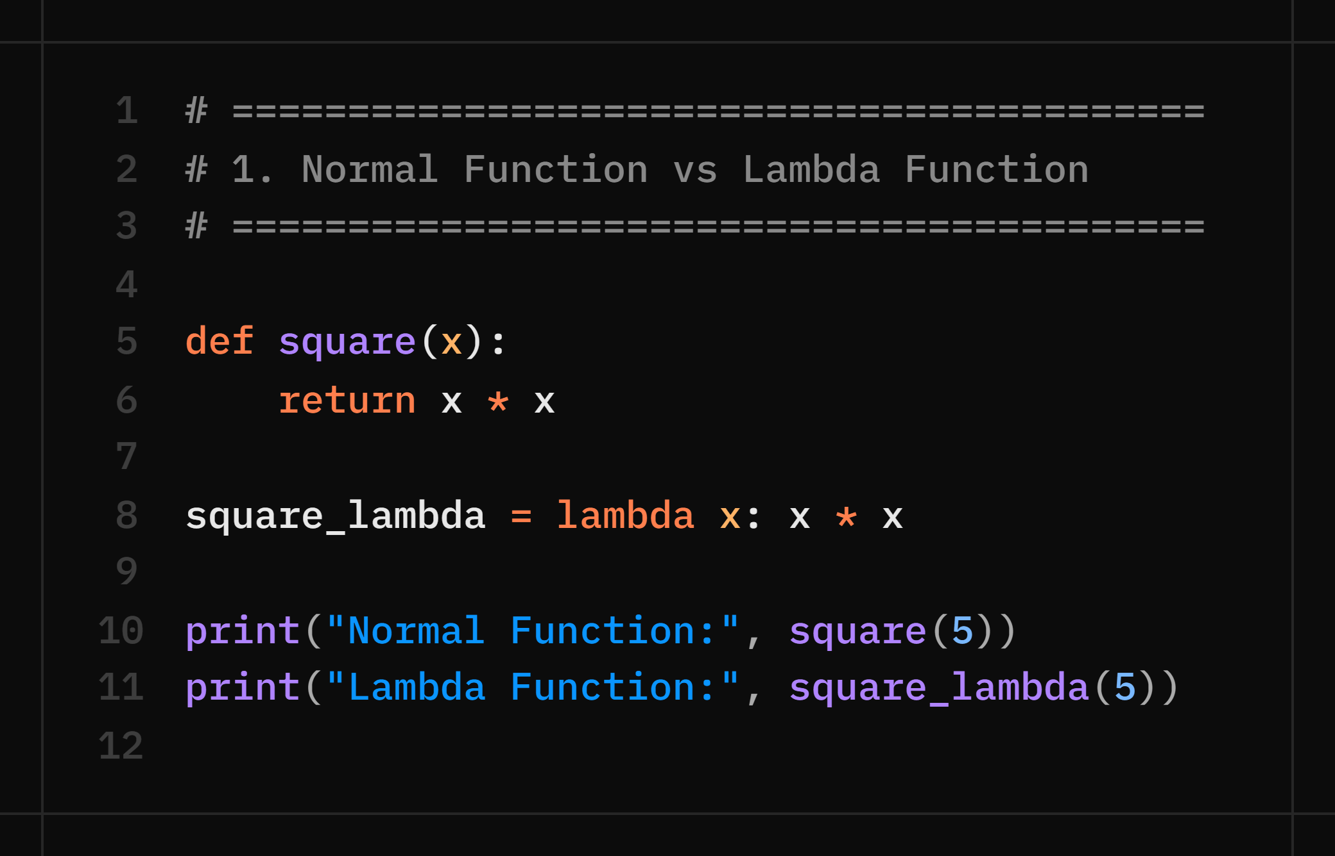
Lambda Function
A lambda function is a small, anonymous function in Python that can have any number of parameters but only one expression.
It is called anonymous because it does not require a function name.

Slide 47
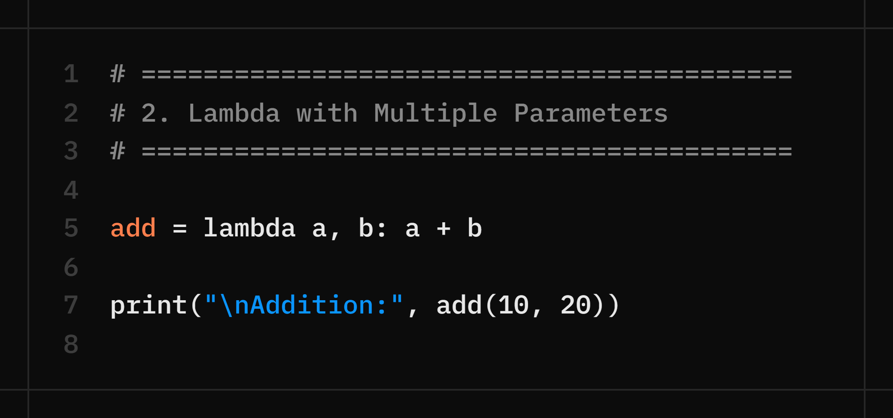
Lambda with Multiple Parameters

Slide 48
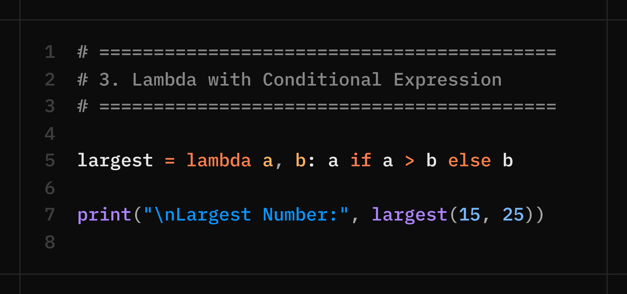
Lambda with Conditional Expression

Slide 49
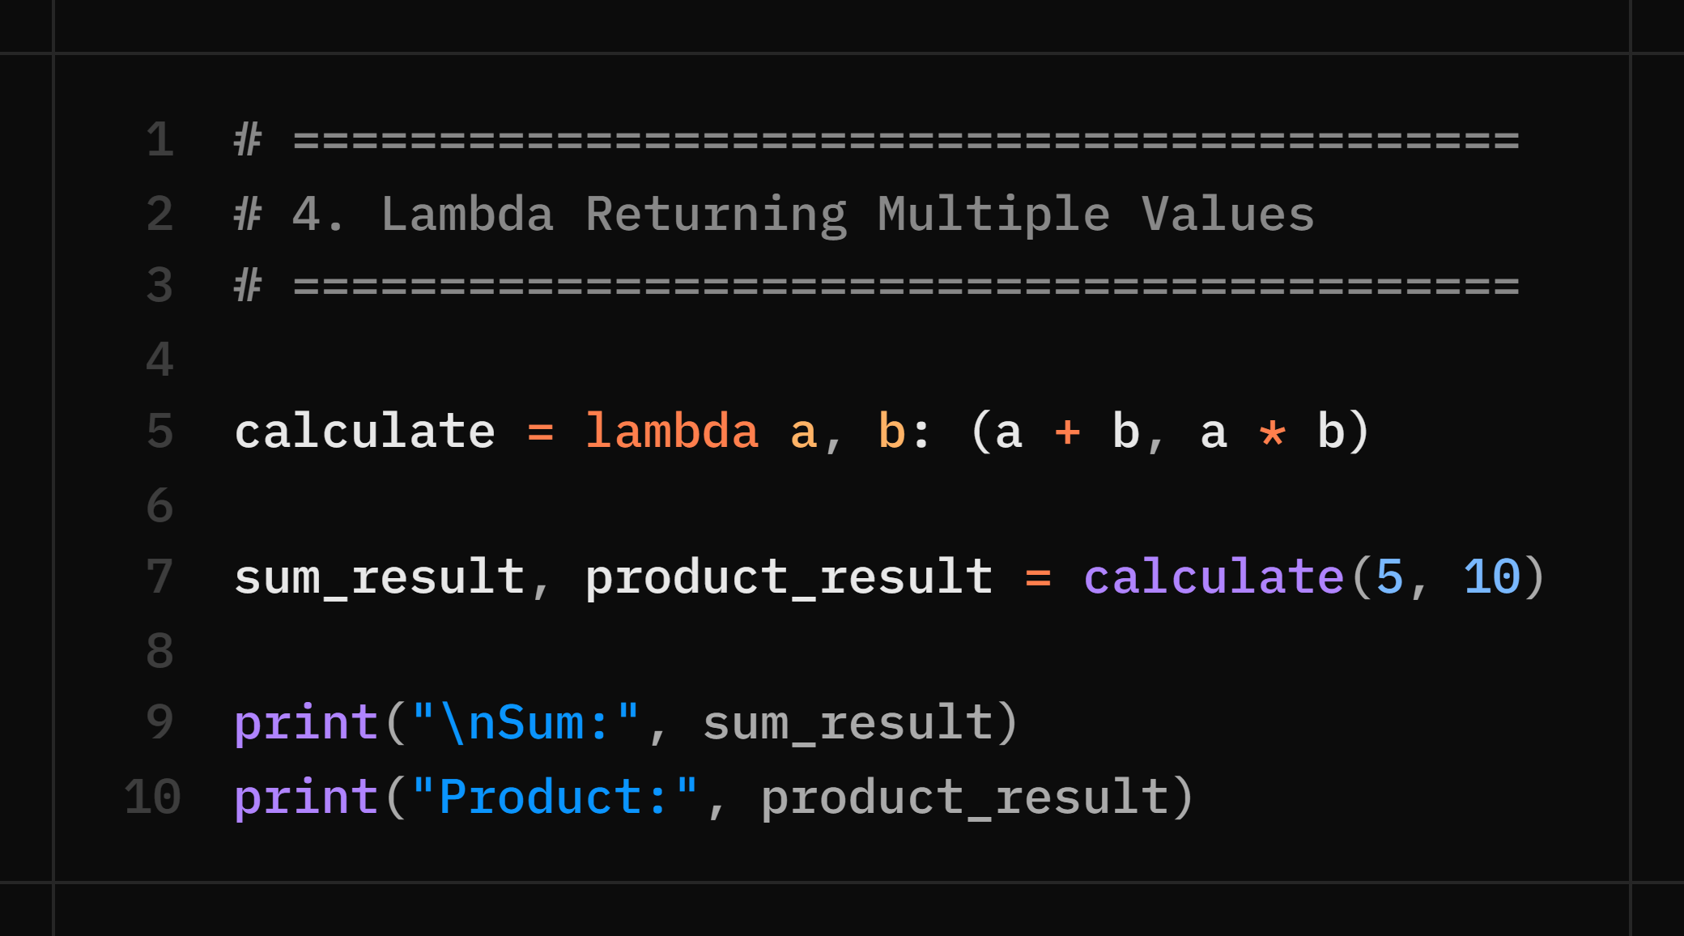
Lambda Returning Multiple Values

Slide 50
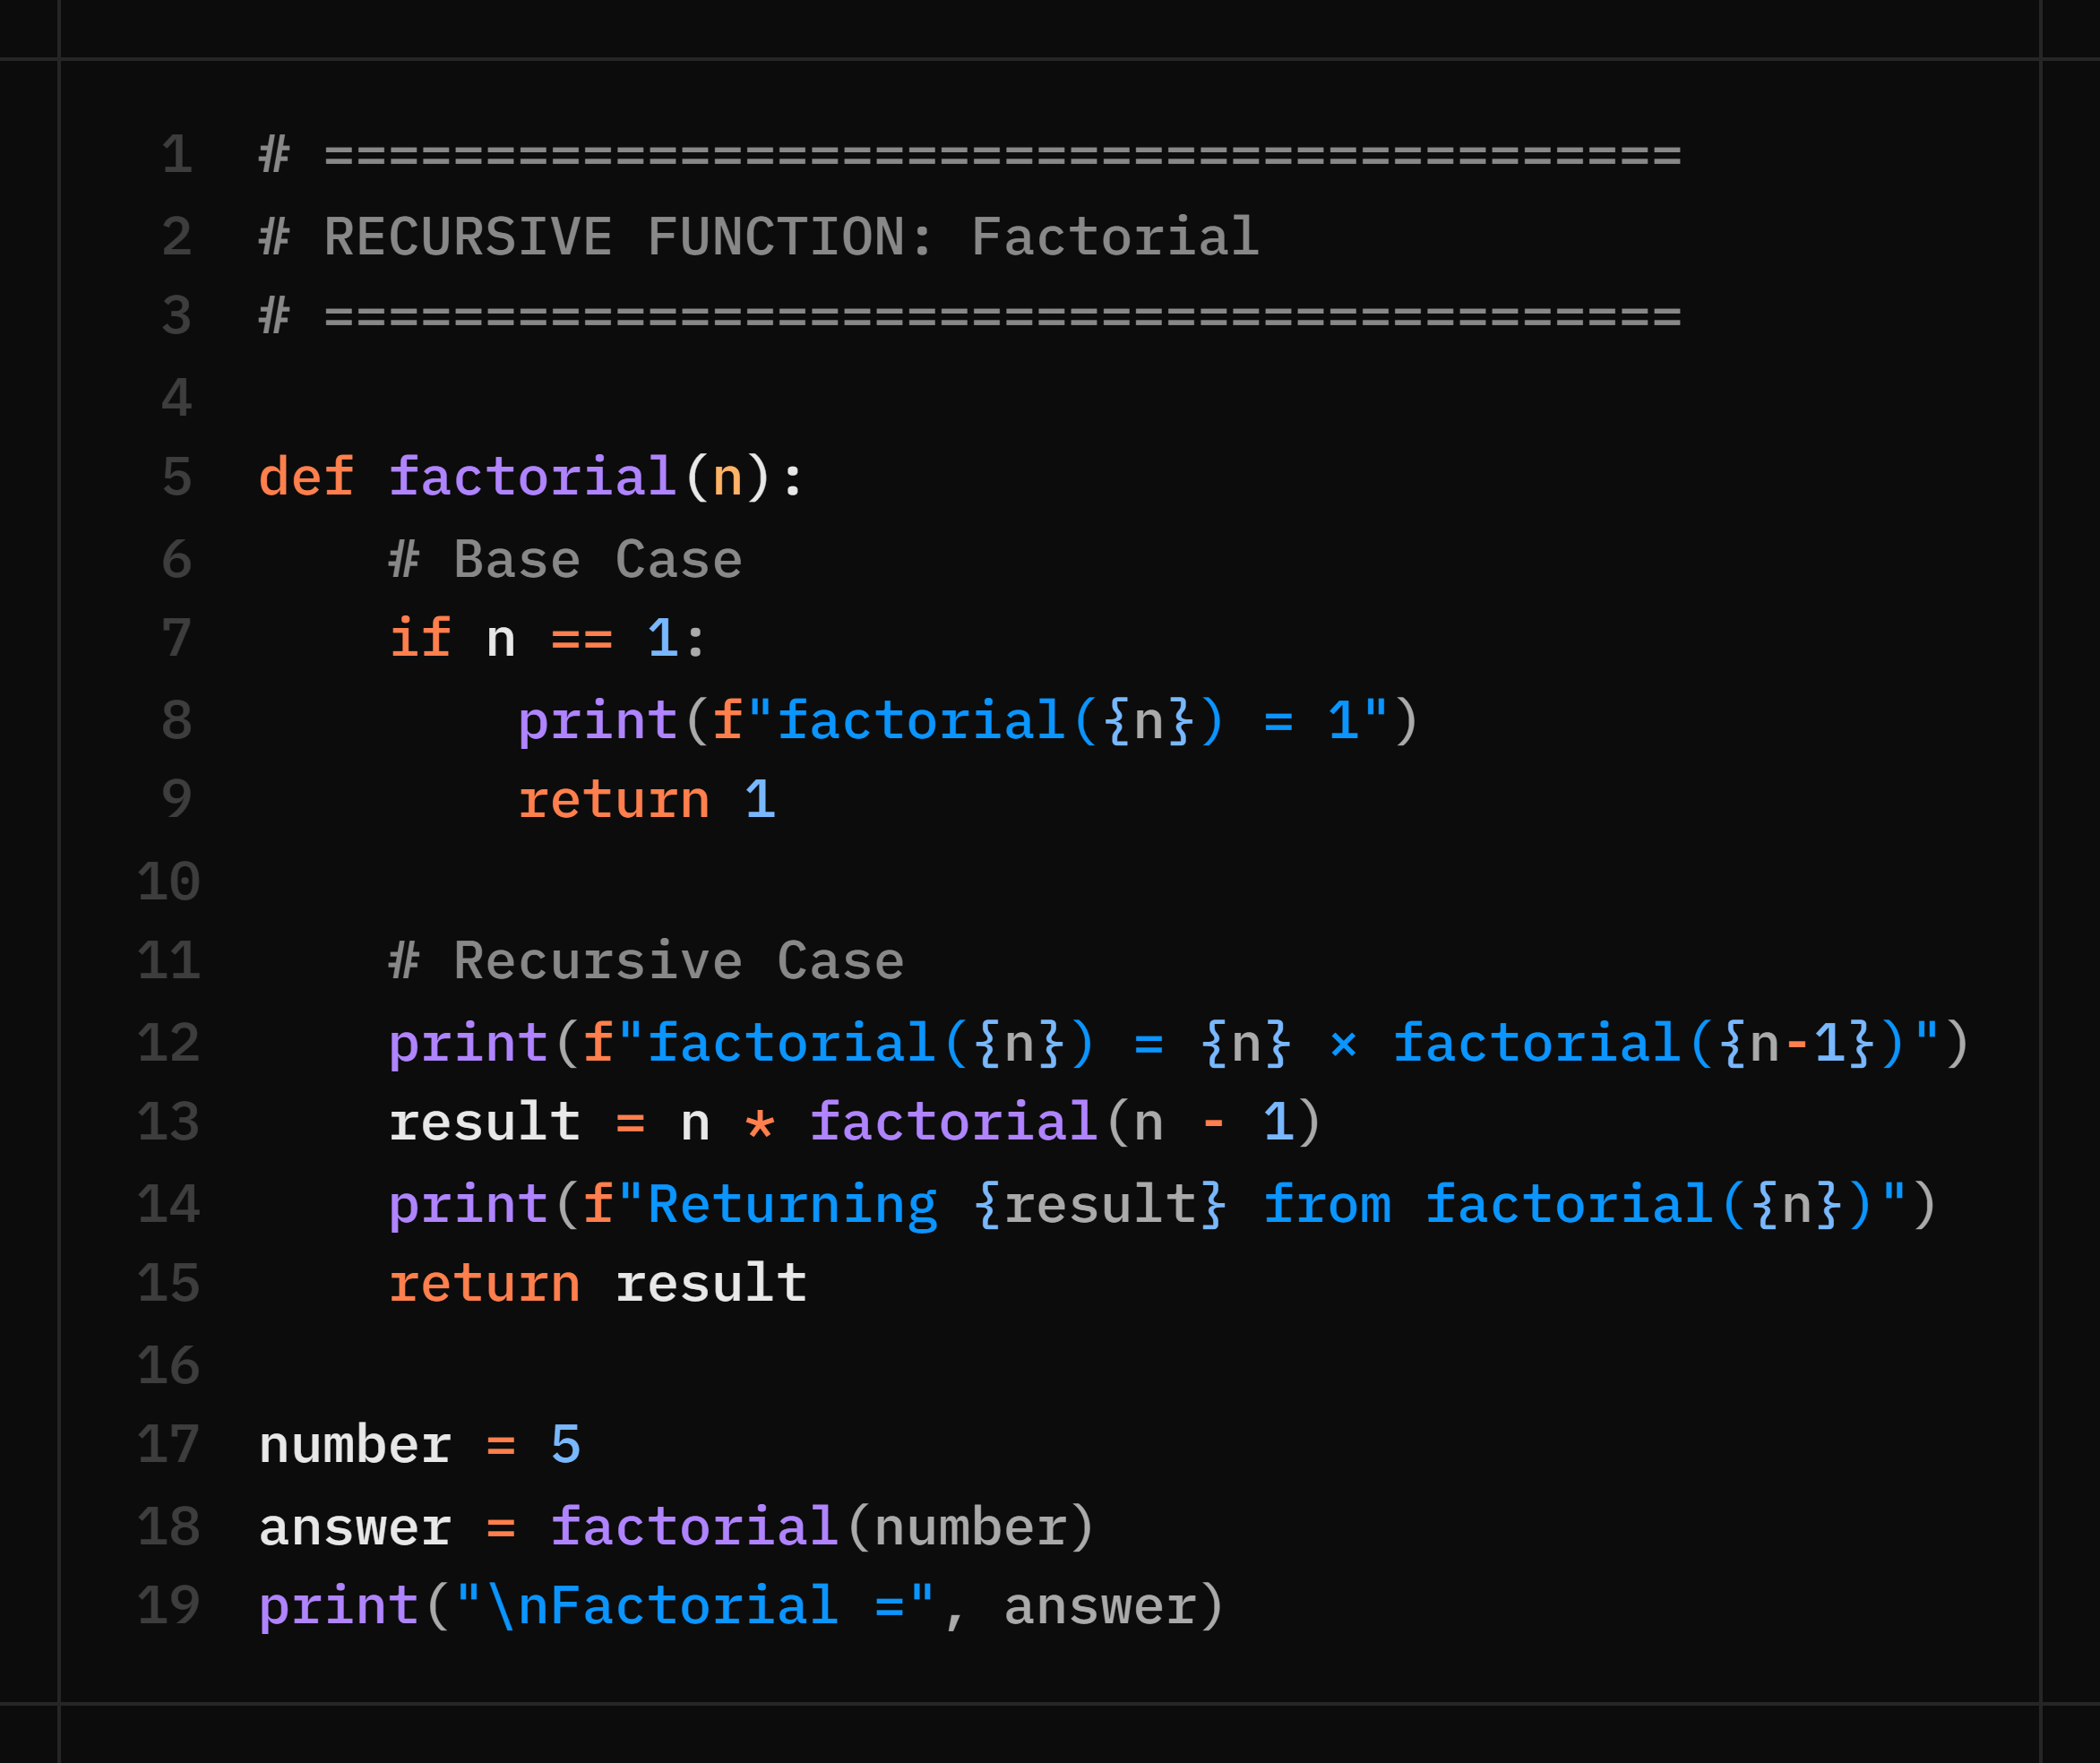
Recursive Function

Slide 51
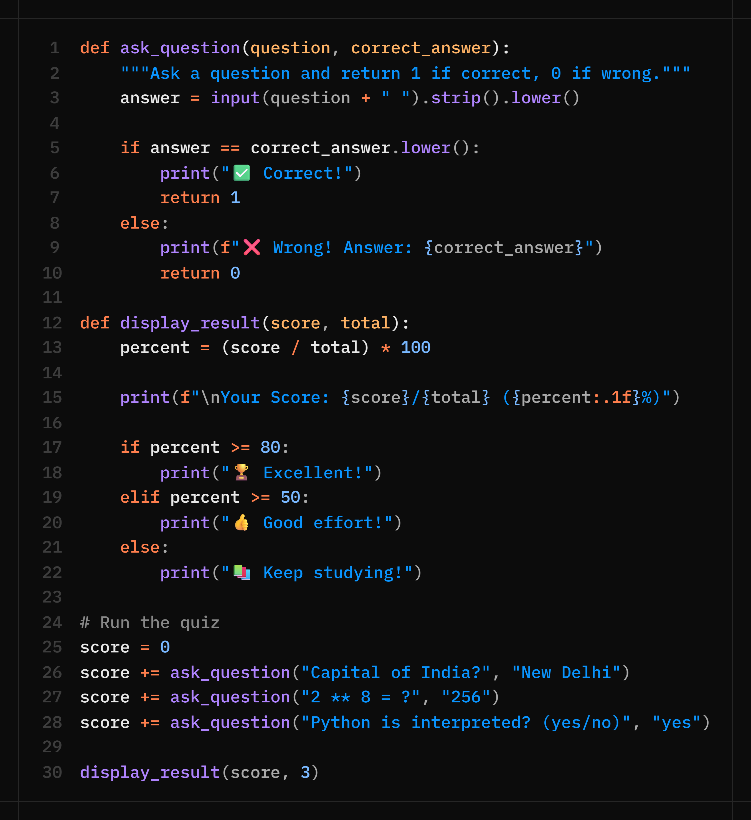
Day 3 Practical — Function-Based Quiz Scorer
Build a quiz where each question is evaluated by a function, and scores are tracked and reported at the end.

Slide 52
🧠 Practice Questions
Day 3 — Practice Questions
Q1. Write a function is_prime(n) that returns True if n is a prime number, False otherwise.
Q2. Write a function find_max(nums) that returns the largest number in a list WITHOUT using max().
Q3. Write a function celsius_to_fahrenheit(c) and call it for 0°C, 100°C, and 37°C.
Q4. What is the difference between return and print inside a function? Give an example of each.
Q5. Write a function count_vowels(word) that returns the number of vowels in the given string.
Q6. Write a function total(*numbers) that returns the sum of however many numbers are passed in. Call it with 2 numbers, then 5 numbers, then zero numbers — what does it return for zero?
Q7. Write a function print_profile(**details) that prints each key-value pair it receives, one per line. Call it like print_profile(name="John", age=20, city="Delhi").

Slide 53
Week 1 Recap — What You've Learned!
🐍
📦
💬
Python Setup
Variables & Types
Input / Output
Python 3.x + VS Code installed and running. You wrote your first program!
int, float, str, bool, None. Dynamic typing. type() function.
print(), input(), f-strings, type conversion (int, float, str).
➕
🔀
🎯
Operators
Control Flow
Functions
Arithmetic, comparison, logical, assignment operators and precedence.
if/elif/else for decisions. for and while loops with break/continue.
def, parameters, return values, default arguments, built-in functions.
Notes:
End-of-week recap! Ask students to write their 'today I learned' exit ticket. Read these before Week 2 starts to identify who needs extra support.

Slide 54
Coming Up Next ⚡
Week 2 — Data, Strings, Files & OOP
📋 Day 4 — Mon Jul 6 — Lists, Tuples, Dictionaries + Student Marks Program
✂️ Day 5 — Tue Jul 7 — String Handling: methods, patterns, palindrome checker
📁 Day 6 — Wed Jul 8 — File Handling, Error Handling + Module 1 Capstone Project!
🏛️ Day 7-8 — Thu/Fri — OOP: Classes, Objects, Inheritance, Encapsulation
🏠 Weekend Homework: Revisit all 3 days' code · Attempt bonus questions · Come with doubts!
Notes:
End the week on a high note! Tell them what they'll BUILD by end of Week 2 — a student records system saved to a file with OOP. It sounds impressive now!

Slide 55
🐍
Great Work Today!
You've taken your first step into the world of Python 🚀
Exit Ticket — Before you leave, write:
"Today I learned ___ and my one doubt is ___"
2b Academy · Python Bootcamp · July 2026
Notes:
Collect the exit tickets physically or ask them to type in a shared doc. Review them tonight and plan any re-teaching for tomorrow.

