Slide 1
Air quality monitoring using IOT

Slide 2
Objectives :
facilitate the background concentration(s) measurements,
monitor current levels as a baseline for assessment,
check the air quality relative to standards or limit values, − detect the importance of individual sources,
enable comparison of the air quality data from different areas and countries,
collect data for the air quality management, traffic and land-use planning purposes,
observe trends (related to emissions),
develop abatement strategies, − determine the exposure and assess the effects of air pollution on health, vegetation or building materials,
inform the public about the air quality and raise the awareness,

Slide 3
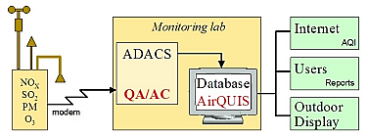
IOT Device design

Slide 4
Data sharing platform :
We create a web page for air quality monitoring.
In the web page contain all information of our device.
The web page is accessed easily and It’s highly secured.
In future the web page is developed into a software or applications.

Slide 5
Integration approach :
In an Internet of Things (IoT), physical objects (things) that are connected to the internet .
A software and sensors which allow them to exchange data with the rest of the world's systems.
The devices by means of the internet.

Slide 6
THANK YOU

