Slide 1

Your best quote that reflects your approach… “It’s one small step for man, one giant leap for mankind.”
DECODE - 11.0 HACKATHON
Board Infinity
- Neil Armstrong
BY :
M.GURUPRASAD REDDY

Slide 2
INTRODUCTION :
* The given SUPERMARKET STORE SALES DATASET contains 16 columns in that 9 are categorical and 7 are numerical data.
* We have to clean and process the data to find insights out of it
1
1. Describe the Data in your own words.
2. Check Datatypes of each column and Bring Date time together in one column.
3. Find the Null Values and Treat them Appropriately.
4. Count the No. of Branches and Cities.
5. Create a pie chart of gender.
6. Calculate Average Rating for each product line.
7. No. of products in each category.
8. Total Amount collected in each product line
9. Find out highest percentage of payment method
10. Find out the category with highest Rating.
11. State the conclusion of the project based on the anal
Problem Statements:
2
In this Hackathon we are going to find the solution to all of these given Problem Statements one by one .
3
The tools used in this project is Python(Jupyter Notebook)
Libraries are Pandas and numpy .

Slide 3
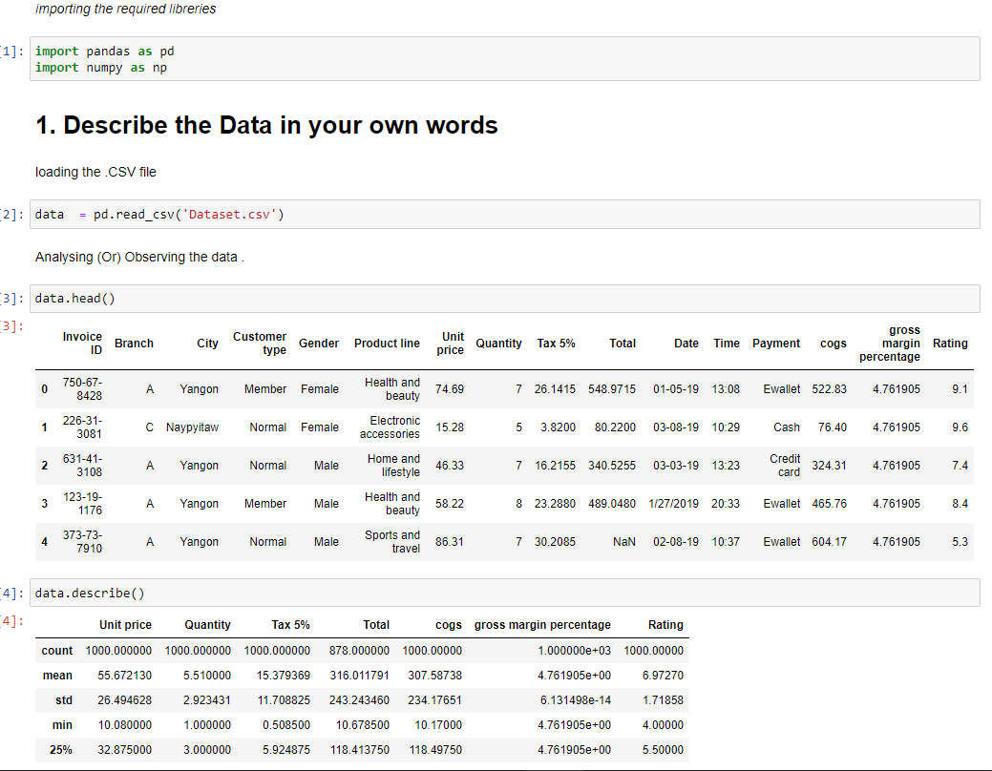
Here we are reading the given csv file into pandas dataframe
There are 16 fields in it .
These are the numerical fields in the data and the rest are categorial data fields .

Slide 4
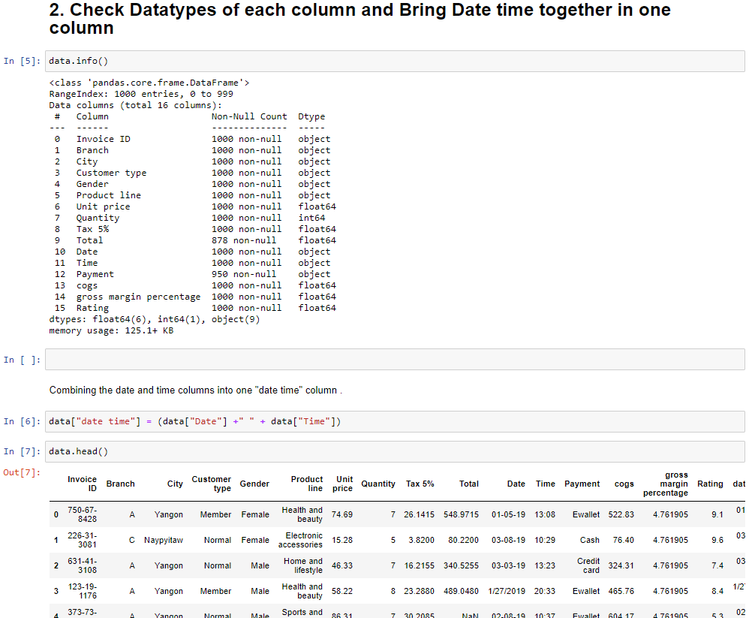
The date and time are in different columns so Here , we are combining them both into one
“date time” column .

Slide 5
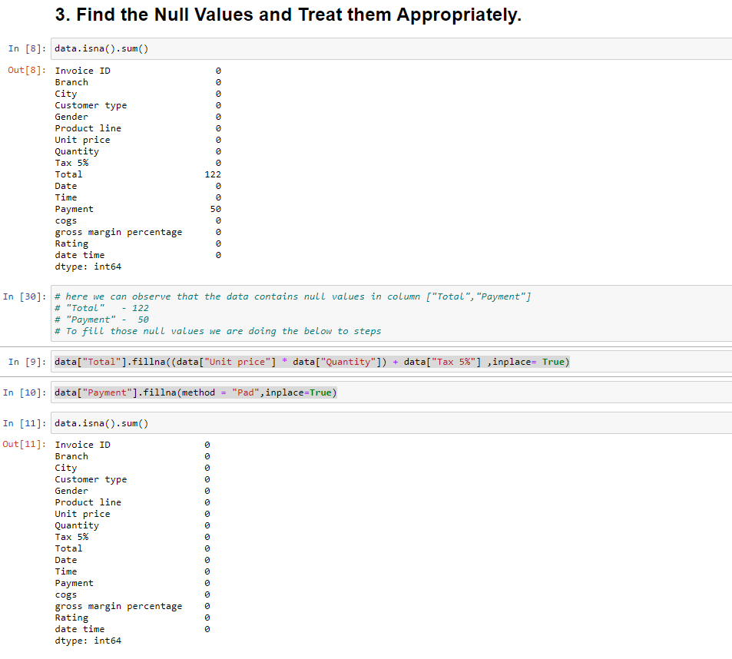
Here we can notice that there are some null values in columns “Total”(122) and in “Payment”(50) .
Here we treated null values with proper formula and method.
After treating those two fields here we can see that the data contains no null values now.

Slide 6
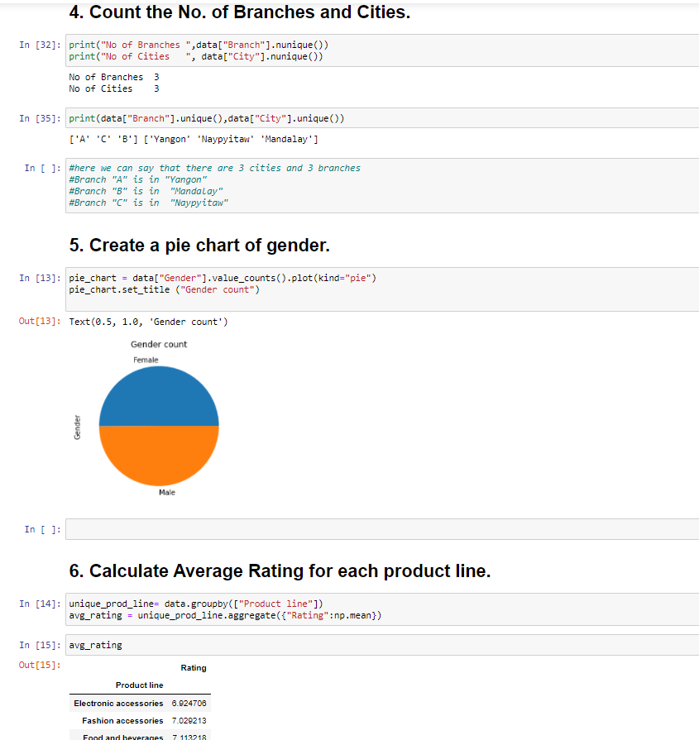
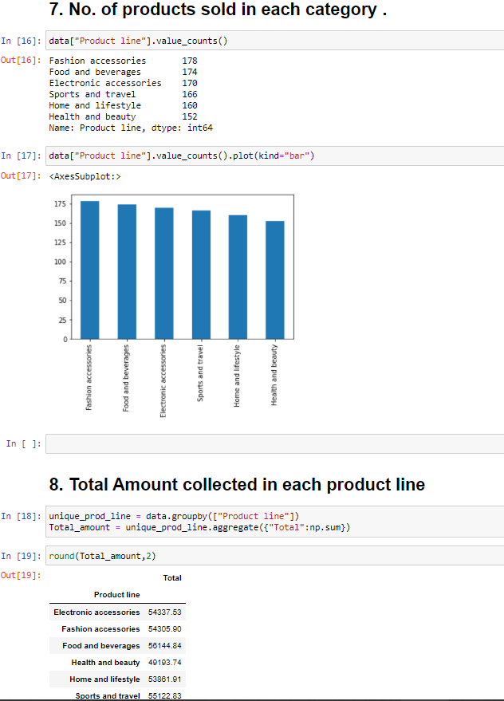

Slide 7
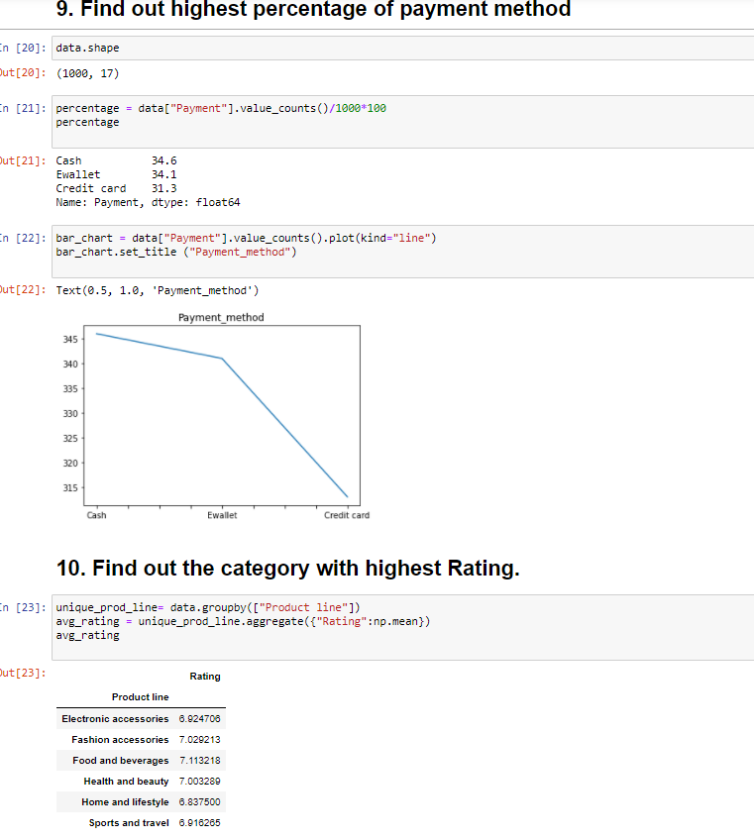
Most of the customers are paying their bills through cash but almost same number of customers are using ewallet and credit card .

Slide 8
CONCLUSION :
This Superstore has three branches in three different cities .
The number of customers visiting the store Gender wise is almost 50%male and 50% female .
The average rating of each product line is nearer to 7.
The maximum number of items were sold in "Fashion accessories" category.
Maximum amount were generated in Food and beverages category .
Health and Beauty category is generating less money when compared to other category so we should look into it and try to increase sales .
Most of the customer are paying their bills through cash (35%) , and Ewallet(34%) .
Almost equal no of customers are paying in Cash, Ewallet , Creditcard so we should make sure that all these payment options are working properly (by this we will get good customer satisfaction) .
Category wise highest rating received is 10 in "Electronic accessories"," Health and beauty", "Sports and travel".
Category wise highest average rating is in “Food and Beverages“ with 7.1 .

Slide 9


