Slide 1
Domain AgriTrace
Blockchain-Enabled Farm-to-Market Traceability and Transparent Price Discovery System.
From Farm to Market. Fair Prices. Trusted Produce.
TEAM 1
Presented by: Guru Prasanth S, Leun Hammi D, Jeyaprasanna M | Register Number: [9925009028, 99250040308, 99250040310]
| Department: [Mech, CSE(Ds)]
Supervisor: Dr. P. Chinnasamy | Designation: Associate Professor
Notes:
Good morning. My project is AgriTrace, a digital agricultural marketplace and traceability platform. The idea is to connect farmers and buyers more directly, improve price visibility, and make produce information easier to trust. It combines practical marketplace functions with agricultural information services and blockchain-supported records. Some fields on this title slide are intentionally editable placeholders for the final academic submission.

Slide 2
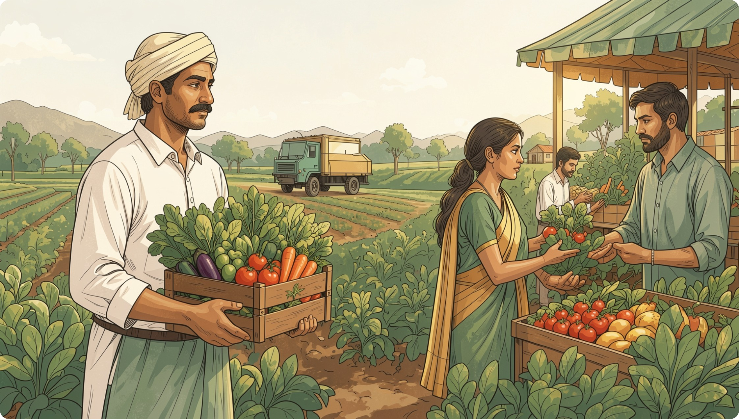
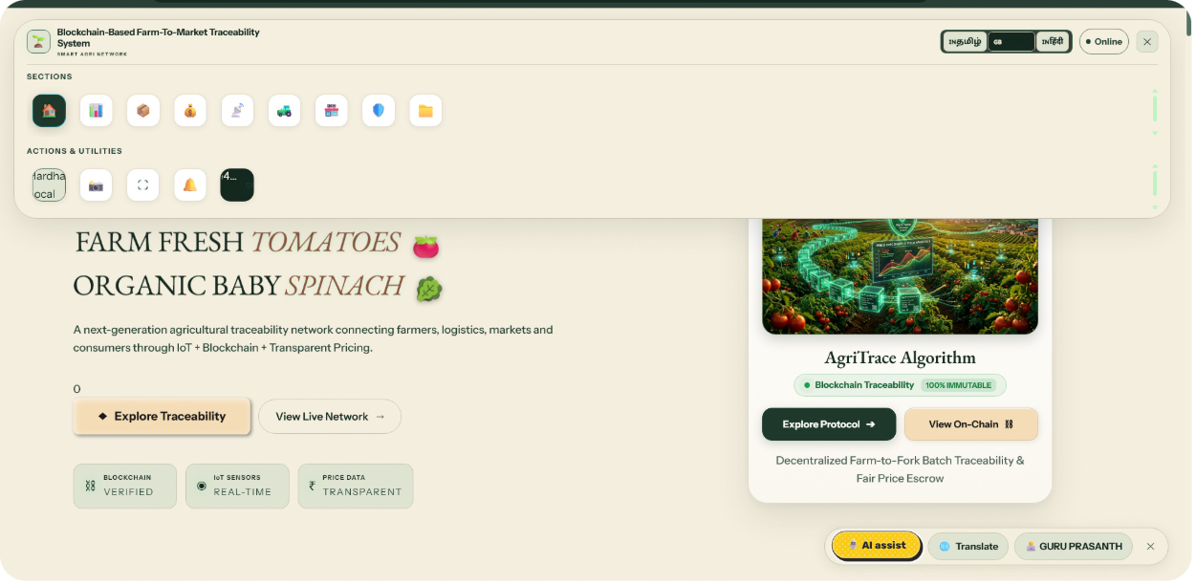
PROJECT RECAP
THE NEED FOR AGRITRACE
Existing challenges
AgriTrace solution
Multiple intermediaries can reduce direct buyer access.
Market prices are not always easy to compare.
Produce origin and handling details may be fragmented.
Agricultural information is spread across platforms.
Digital farmer-to-buyer marketplace with separate farmer and seller portals.
Transparent crop-price information and district-wise market comparison.
Government datasets, crop information, and blockchain-supported traceability.
QR-based verification where supported.
Visit my Web Application : https://guru-prasanths.github.io/AgriTrace-/
Farmer → AgriTrace platform → Buyer | Price transparency • Digital marketplace • Traceability
Notes:
AgriTrace responds to a practical set of challenges. Farmers may rely on several intermediaries and may not have a simple way to compare prices across markets. Buyers can also find it difficult to verify origin and handling information. The solution is a unified ecosystem: a marketplace for products, agricultural information services, price comparison, and traceability features. The central relationship is simple: a farmer uses the platform to reach buyers, buyers can compare and request produce, and supported records can be checked later.

Slide 3
PRESENTATION ROUTE
AGENDA – EXPLORING THE AGRITRACE ECOSYSTEM
Project overview and objectives
District-wise agricultural market price comparison
Farmer and seller authentication
Blockchain-based traceability and QR verification
Digital agricultural marketplace
AgriTrace Points and accessibility
Crop listings and order management
Technology architecture and future scope
Tamil Nadu agriculture datasets
Notes:
This is the structure of the presentation. I will first explain the project objectives and the user roles. Then I will move through the marketplace, product listings, and order management. After that, I will explain how agricultural datasets and district-wise price comparison support better decisions. Finally, I will cover traceability, AgriTrace Points, accessibility, the technology architecture, and future scope.

Slide 4








FUNCTIONAL ARCHITECTURE
AGRITRACE – SYSTEM WORKFLOW AND FUNCTIONAL ARCHITECTURE
Authentication
Listing
Marketplace
Orders
Farmer and Seller portals · email/password · Google authentication integration · role-based access
Crop name · images · quantity and unit · price and location · quality and availability
Browse · compare listings · submit requests or offers · connect with farmers
Track requests · manage status · coordinate interactions · record supported transaction details
Price discovery
Traceability
AgriTrace Points
Accessibility
Tamil Nadu datasets and official resources · tomato comparison across Salem, Madurai, Coimbatore, Erode
Produce Batch → Digital Record → Blockchain Transaction → QR Verification → Traceability Information
Eligible activities · completion rewards · configured daily eligibility · balance · transaction history
Simple navigation · responsive interface · readable text · language accessibility · voice assistance where implemented
Architecture HTML5 | CSS3 | JavaScript → Node.js | Express.js → PostgreSQL | Solidity | Hardhat | MetaMask | ethers.js → Government Agricultural Datasets / External Data Sources
Comparison fields Minimum, maximum, modal price, market, date, unit. Tomato values shown in any implementation are illustrative placeholders only.
Traceability boundary: supported records only, not a deployed production blockchain.
QR verification where supported
Notes:
Now I will explain the complete workflow. A farmer or seller first enters the appropriate portal and signs in using email and password, with Google authentication integration where configured. Role-based access keeps each user experience relevant. The farmer can then create a product listing with the crop name, images, quantity, unit, price, location, quality, and availability. Buyers browse listings, compare options, submit a request or offer, and connect with farmers. Order management records the request and status so both sides can coordinate. The datasets section provides access to official agricultural resources, while the price-comparison view can compare a crop such as tomato across Salem, Madurai, Coimbatore, and Erode using minimum, maximum, modal price, market, observation date, and unit. Any example values shown are illustrative placeholders, not real market prices. For supported produce records, a batch can be linked to a digital record and blockchain transaction, then accessed through a QR code. This is tamper-evident support for selected records, not a claim that every detail is stored on-chain or that a production blockchain is already deployed. AgriTrace Points can support eligible activities where configured. Accessibility focuses on simple navigation, responsive design, readable text, language access, and voice assistance where implemented. The architecture combines a web frontend, Node and Express backend, PostgreSQL database, Solidity and Hardhat tooling, MetaMask and ethers.js wallet connectivity, and external agricultural data sources.

Slide 5
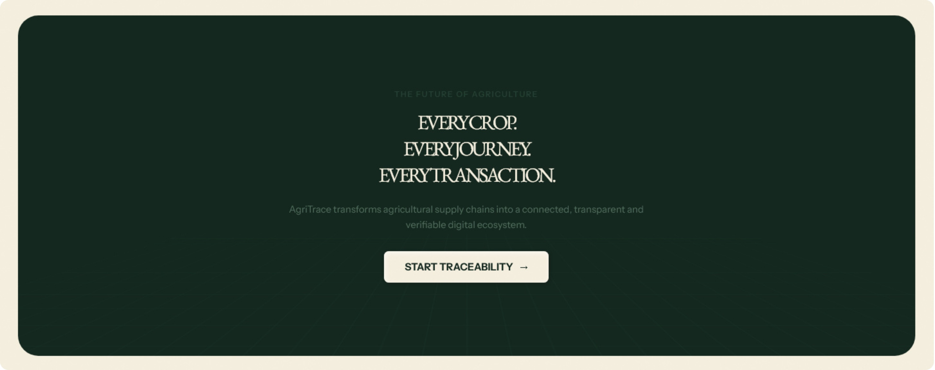
CLOSING
THANK YOU
CSE223
APPLIED BLOCKCHAIN : TEAM 1
Notes:
Thank you for listening. AgriTrace is designed as a practical digital ecosystem that can help farmers connect with buyers, compare market information, and provide more transparent records for supported produce. Its larger goal is to build trust while keeping the experience accessible to rural agricultural users. I welcome your questions and feedback.

