Slide 1

The Entrepreneurial Journey: From Idea to Impact
Welcome to this presentation, where we will explore key aspects of launching and sustaining an innovative startup. We'll cover everything from conceptualizing a unique idea to securing funding, developing a robust marketing strategy, and understanding the entrepreneurial decision-making process.

Slide 2
Nivethitha Selvakumar, Student ID: 241VMBR06364
Self-Declaration and Academic Scope
I, Nivethitha Selvakumar, certify that this assignment is my original work. This presentation addresses Units 5-8 of the MBA Semester II - Entrepreneurship (21VMB0C201) course, covering Marketing Plans, Financial Plans, Sources of Funding, and Entrepreneurial Competence.

Slide 3
Introducing "EcoLoop": A Circular Economy Platform
My startup idea is "EcoLoop," an innovative digital platform designed to facilitate a circular economy by connecting businesses and individuals for the reuse, repair, and recycling of materials. EcoLoop goes beyond traditional recycling by emphasizing the maximum extension of product lifecycles.
Services Offered:
Product Innovation:
Material Exchange Network: Connects businesses with surplus materials to those who can repurpose them.
AI-Powered Material Matching: Our unique AI algorithm matches available waste materials with potential reuse applications, optimizing resource allocation.
Repair & Upcycling Marketplace: A platform for skilled artisans and repair shops to offer services for broken items.
Lifecycle Tracking: Businesses can track the complete lifecycle of their products and materials on the platform, providing transparent sustainability metrics.

Slide 4
Feasibility Report: Analyzing EcoLoop's Potential
A comprehensive feasibility study reveals strong potential for EcoLoop, addressing critical market gaps and aligning with growing environmental consciousness.
Market Feasibility
Technical Feasibility
High demand for sustainable solutions; growing corporate ESG (Environmental, Social, and Governance) initiatives. Target market includes manufacturing, retail, and individual consumers.
Platform development is achievable with current technologies (AI, blockchain for transparency). Requires robust database and intuitive UX design.
Financial Feasibility
Operational Feasibility
Projected initial capital outlay for platform development and marketing. Positive ROI expected within 3-5 years, supported by subscription and transaction fees.
Requires a lean team for initial development, expanding to include customer support and partnership management. Scalable operations model.

Slide 5
Funding EcoLoop: The Strategic Choice
For EcoLoop, the preferred funding source would be a blend of Venture Capital (VC) funding and Impact Investment funds. This dual approach leverages financial growth with a commitment to environmental and social returns.
Venture Capital (VC) Funding
Impact Investment Funds
Scalability: VCs provide significant capital for rapid scaling, crucial for a platform aiming for widespread adoption.
Mission Alignment: These funds specifically seek ventures with positive social and environmental impact, aligning perfectly with EcoLoop's circular economy mission.
Expertise & Network: Beyond capital, VCs offer invaluable mentorship, industry connections, and strategic guidance, accelerating market penetration.
Patient Capital: Impact investors often provide longer-term capital, understanding that significant environmental change can take time to generate substantial financial returns.

Slide 6



EcoLoop's Marketing Blueprint: Reaching Our Audience
Our marketing strategy focuses on a multi-channel approach, segmenting our efforts to effectively reach both businesses and individual users, emphasizing EcoLoop's value proposition in sustainability and efficiency.
B2B Outreach
B2C Engagement
PR & Content
Direct sales teams, industry partnerships (e.g., manufacturing associations), trade shows, and targeted LinkedIn campaigns. Focus on ROI and ESG benefits.
Social media marketing (eco-influencers), community workshops on repair and upcycling, SEO-optimized content on sustainable living, and strategic partnerships with eco-friendly brands.
Press releases highlighting successful circular economy case studies, thought leadership articles on sustainability, and educational webinars on waste reduction.

Slide 7
Revenue Model & Pricing Strategy for EcoLoop
EcoLoop will utilize a hybrid revenue model combining subscription fees with transaction-based commissions, ensuring a stable income stream while promoting platform usage.
Revenue Streams
Pricing Strategy
Tiered Subscription (B2B): Businesses pay a monthly/annual fee based on usage, number of materials listed, and access to advanced analytics.
Value-Based Pricing: Pricing reflects the significant value provided in waste reduction, cost savings, and enhanced sustainability credentials for businesses.
Transaction Commission (B2C & B2B): A small percentage commission on successful material exchanges and repair/upcycling service bookings.
Freemium Model (B2C): Basic access for individuals is free, with premium features (e.g., unlimited listings, enhanced visibility) available for a small fee.
Premium Features: Additional revenue from features like certified material origin tracking, premium repair partner listings, and advanced sustainability reporting for businesses.
Competitive Benchmarking: Pricing will be competitive with existing B2B waste management solutions and B2C marketplaces, while emphasizing EcoLoop's unique circular economy focus.

Slide 8
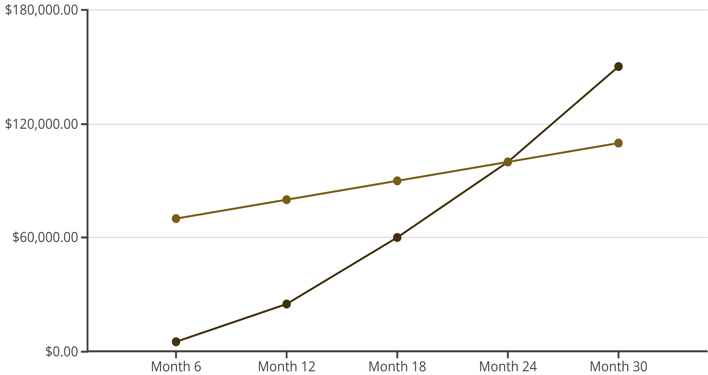
Breakeven Analysis: EcoLoop's Path to Profitability
Based on our financial projections, EcoLoop is expected to reach breakeven within 24 to 30 months from its official launch. This timeline accounts for initial development, aggressive user acquisition, and scaling operational costs.
Revenue
Costs
This projection is contingent on achieving key milestones, including securing seed funding, successful platform beta launch, and reaching a critical mass of active users and businesses.

Slide 9
The Entrepreneurial Decision Process: My Journey with EcoLoop
My entrepreneurial journey with EcoLoop embodies a dynamic decision-making process, characterized by adaptability, strategic foresight, and continuous learning.
Idea Generation & Validation
Opportunity Recognition
Brainstorming innovative features like AI-matching, followed by market research and feedback from potential users to validate the concept's viability.
Identifying the growing ecological crisis and the market gap for efficient circular economy solutions led to the EcoLoop concept.
Execution & Adaptation
Resource Mobilization
From platform development to marketing rollout, making agile decisions based on user feedback, market changes, and competitive landscape.
Strategizing funding sources, assembling a core team, and identifying necessary technological and human capital for development.

Slide 10
Key Takeaways & Next Steps for EcoLoop
Our journey demonstrates that successful entrepreneurship requires a blend of innovation, meticulous planning, and an unwavering commitment to impact.
Key Takeaways:
Next Steps:
Innovation is Key: EcoLoop's unique AI-matching differentiates it in the sustainability market.
Platform MVP Launch: Develop and launch a Minimum Viable Product to gather early user data.
Holistic Planning: Feasibility, marketing, and financial strategies are interconnected for success.
Seed Funding Round: Secure initial investment to scale development and marketing efforts.
Strategic Funding: Blending VC with impact investment fuels growth and mission alignment.
Pilot Partnerships: Forge strategic alliances with key businesses for material exchange trials.

