Slide 1
RECOMMENDING BEST RESTAURANTS FOR TOURISTS VISITING BANGALORE FROM VARIOUS COUNTRIES

Slide 2
Project Core
Helps tourists who are in Bangalore with variety of restaurants surrounding them
Helps tourists with most famous restaurants around them
Helps tourists with similar kind of restaurants when they move to different locations of Bangalore

Slide 3
Knowing Restaurants and most famous Restaurants
find out the variety of restaurant categories
Order the restaurants in terms of familiarity and display most popular restaurants in each neighborhood
Group similar neighborhoods, in order to know similar kind of cuisines in various places

Slide 4
Data acquisition and cleaning
Bangalore location coordinates
All neighborhood areas in and around Bangalore
Latitude and longitude values of all the neighborhoods

Slide 5
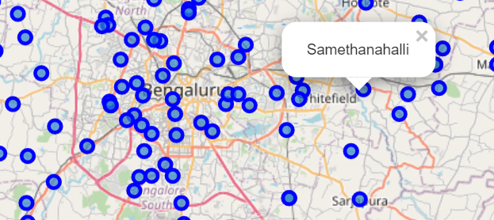
Using folium Map feature
Folium map feature is used to locate the neighborhoods with their latitude and longitude values

Slide 6
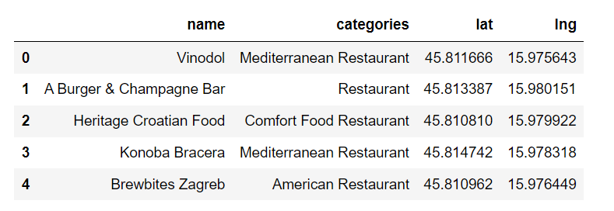
Foursquare location data
This feature is used for exploring venues and categories around the neighbors specified in dataset

Slide 7
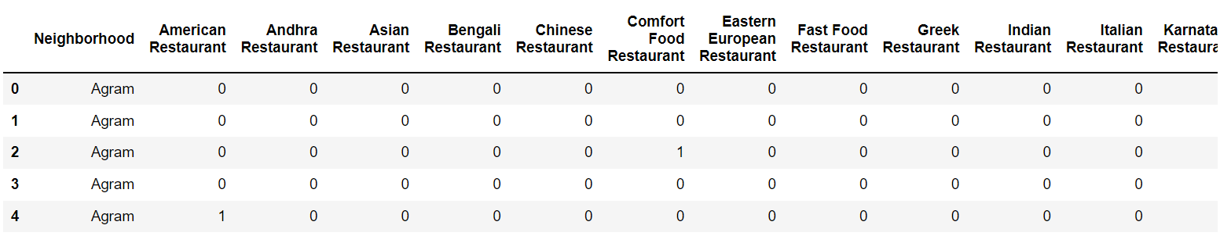
One Hot Encoding over venue category
This transforms the categorical variable into 0’s and 1’s for carrying out normalization

Slide 8
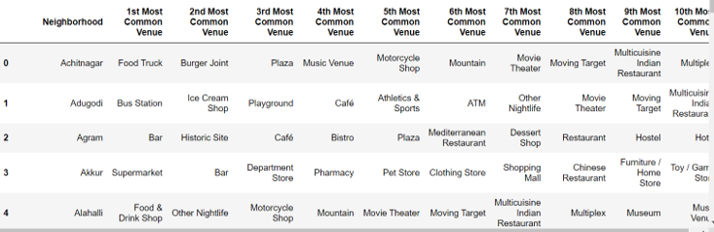
Result
The resulting data frame consists of top most common and famous restaurants/cuisines for each neighborhood based on which the tourists could choose the restaurant type

Slide 9
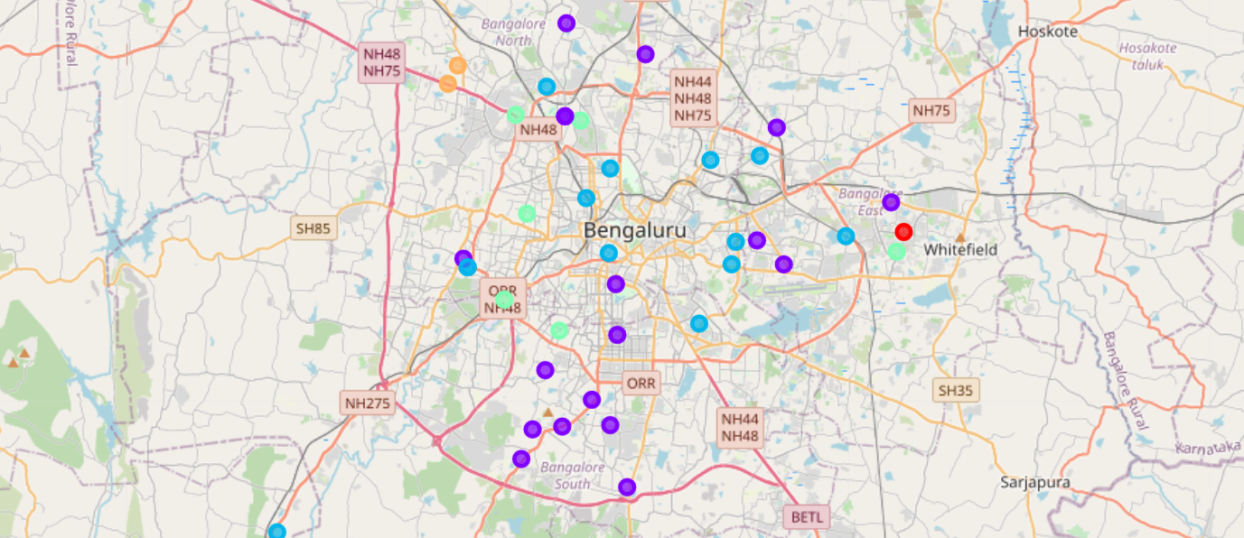
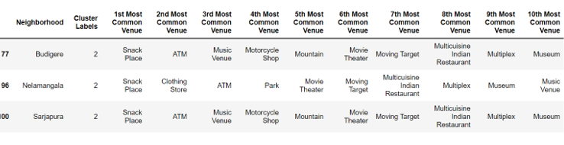
Result Continuation…
The similar neighborhoods are grouped in one cluster which helps tourists to know similar kind of cuisines in various places

Slide 10
Conclusion
helps in a great way for tourists/travelers who are coming from various countries to a particular city in India, Bangalore
They could feel comfortable with the food style, showing variety of restaurants/cuisines surrounding them
The clustering algorithm used would really be helpful when they travel to other areas of Bangalore knowing similar kind of restaurants in other localities

