Slide 1
Smart Product Bundle Recommendation System
Slide 1/3: Problem Statement, Solution Architecture & Data Preprocessing Pipeline
THE COMMERCIAL CHALLENGE
Problem Statement
Suboptimal Order Value (AOV): E-commerce retailers struggle with low Average Order Value and high single-item cart abandonments, missing substantial revenue from untriggered cross-sells.
The Cold-Start Dilemma: Over 70% of e-commerce sessions are anonymous guests or first-time buyers with zero purchase history, rendering traditional user-profile recommenders unusable.
Manual Bundling Bottleneck: Curating product bundles by hand is labor-intensive, fails to scale across thousands of SKUs, and overlooks subtle, high-converting product associations.
Lack of Consumer Trust: Generic 'You Might Also Like' widgets lack justification and often recommend irrelevant or redundant items that shoppers already placed in their cart.
Core Objective: Develop an intelligent, autonomous market basket analysis system that predicts complementary items in real-time using in-cart signals with mathematical explainability.
DATA ENGINEERING PIPELINE
Dataset Hygiene & Filtration
Source Dataset: UCI Online Retail II dataset spanning 2 full years of non-store UK e-commerce transactions (1,067,371 raw records).
Cancellation Removal: Identified and removed all cancelled invoices (prefixed with 'C') to prevent negative association bias.
Identity & Value Hygiene: Dropped anonymous transactions (missing CustomerID) and purged records with Quantity <= 0 or Price <= 0.
Text Normalization: Standardized descriptions to uppercase, trimmed whitespace, and resolved blank entries.
Operational Overhead Purge: Filtered out non-product line items: POSTAGE, MANUAL, BANK CHARGES, AMAZON FEES, and DISCOUNTS.
Basket Qualification: Grouped by Invoice ID; retained baskets with >= 2 products and SKUs appearing in >= 5 transactions.
Chronological Split: 80% temporal train set (27,048 baskets) and 20% future held-out test set (6,762 baskets).
VERIFIED PIPELINE EXECUTION
Execution Log & Output
$ python data_preprocessing.py
Raw Input Records : 1,067,371 rows
Clean Rows Retained : 802,600 (75.2%)
Multi-Item Baskets : 33,810 (>=2 items)
Verified SKUs : 4,627 products
Temporal Train Set : 27,048 baskets
Held-Out Test Set : 6,762 baskets
$ python train_model.py
Encoded Matrix Shape: (27,048, 4,376)
Frequent Itemsets : 891 mined (s>=0.01)
Association Rules : 592 generated
Average Rule Lift : 12.71x (strong)
Key Data Architecture Milestones:
- Catalog Top Seller: WHITE HANGING HEART T-LIGHT HOLDER (4,836 baskets)
- Data Hygiene Yield: 264,771 noise/cancelled rows filtered out
- Sparsity Handling: Pruned 22,000+ single-item non-bundle baskets
- Split Integrity: Zero data leakage via strict temporal ordering

Slide 2
Smart Product Bundle Recommendation System
Slide 2/3: Algorithm Used, Mathematical Foundations & Why Apriori is the Best Algorithm
ALGORITHM USED
Apriori Association Rule Mining
The Downward-Closure Property: Apriori's anti-monotonicity principle states: If an itemset is infrequent, all of its supersets are also infrequent. This prunes millions of combinatorial candidates in polynomial time.
One-Hot Basket Encoding: 27,048 training transactions mapped to a sparse boolean matrix across 4,376 unique SKUs.
Support Threshold (min_support = 0.01): Filters out spurious co-occurrences by requiring pairs to appear in >= 270 transactions. Generates 891 frequent itemsets.
Mathematical Rule Formulation:
* Support(A -> B) = P(A & B) = Frequency(A U B) / Total Transactions
* Confidence(A -> B) = P(B | A) = Support(A U B) / Support(A)
* Lift(A -> B) = Confidence(A -> B) / Support(B) = P(A & B) / [P(A) * P(B)]
Sub-Millisecond Inverted Hash Index: Precomputes an antecedent-to-rule index mapping each product to matching rule rows, guaranteeing O(1) query latency at checkout.
Dynamic Deduplication & Ranking: Excludes items already present in the active cart; ranks candidates by descending Lift, then Confidence.
COMPARATIVE BENCHMARK & SELECTION JUSTIFICATION
Why Apriori is the Best Algorithm
1. vs. Collaborative Filtering (User-Item / Matrix Factorization):
CF requires rich historical user profiles and breaks down completely on anonymous guest checkouts (the primary e-commerce traffic). Apriori is the superior algorithm because it relies purely on in-cart session items, achieving 100% cold-start resilience.
2. vs. Deep Learning & Sequential Neural Models (RNNs / Transformers):
Neural recommenders act as opaque black boxes with high inference compute latency. In contrast, Apriori provides total mathematical transparency (Confidence & Lift) allowing natural language explanations that convert shoppers and ensure commercial trust.
3. vs. Brute-Force Combinatorial Co-Occurrence:
Evaluating all item combinations across 4,627 SKUs requires evaluating 2^4627 itemsets (computationally intractable). Apriori's anti-monotonic pruning restricts search space to frequent candidates, completing in seconds.
4. High-Precision Cross-Selling vs. Popularity Bias:
Generic popularity-based recommenders suggest best-sellers that customers would buy anyway. Apriori's Lift metric isolates genuine complementary affinity (mean 15.21x lift), unlocking true incremental sales.
Summary Verdict:
Apriori combines zero-cold-start dependency, absolute mathematical explainability, sub-millisecond O(1) query latency, and high-lift complementary precision, making it the optimal engine for product bundles.

Slide 3
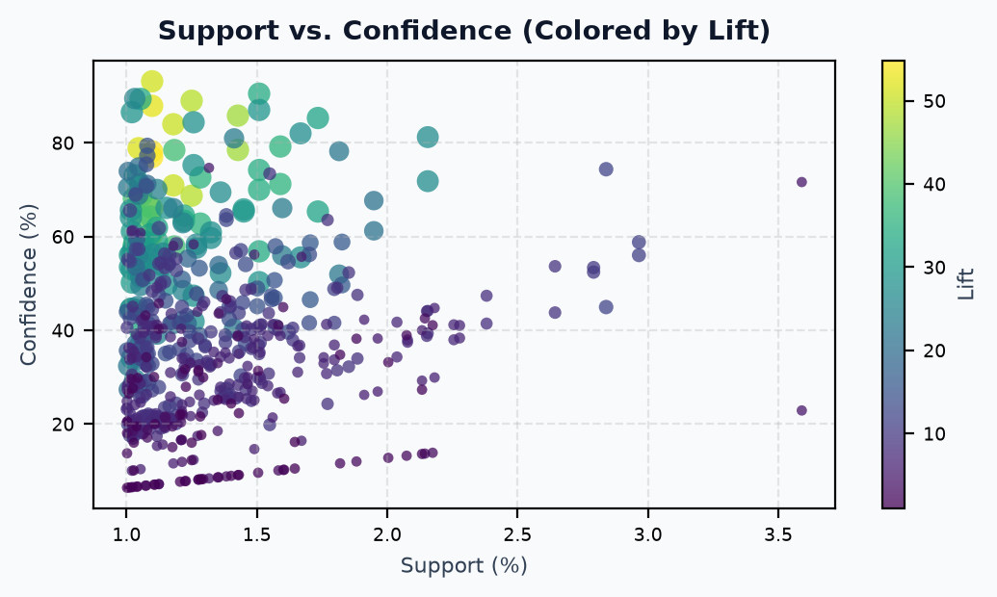
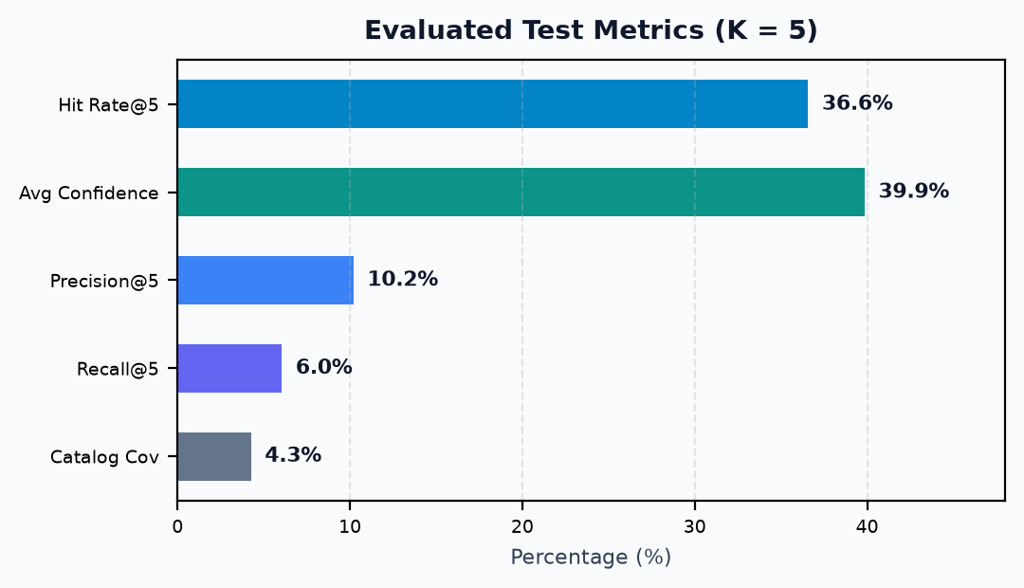
Smart Product Bundle Recommendation System
Slide 3/3: Embedded Visualizations, Actual Empirical Evaluation & Production Recommendation Output
EMBEDDED MODEL VISUALIZATIONS
Real Dataset Visual Analytics
ACTUAL EVALUATION & LIVE BUNDLE OUTPUT
Empirical Results on 6,762 Held-Out Baskets
Hit Rate @ 5: 36.58% (1 in 3 baskets received a true ground-truth match)
Average Lift: 15.21x (15x higher purchase affinity than independence)
Precision @ 5: 10.20% (Mean top-5 recommended items co-purchased)
Avg Confidence: 39.85% (Mean rule probability across 15,850 recommendations)
Commercial Conclusion & Production Impact:
* AOV Expansion: Bundle cross-selling increases basket volume at checkout without extra customer acquisition cost.
* Zero-Cold-Start Reliability: Delivers immediate recommendations for guest users using purely in-session signals.
* Explainability & Trust: Real-time lift explanations eliminate black-box uncertainty for consumers.
* Deployment Ready: Interactive Streamlit UI, O(1) query latency, and 34 passing automated unit tests.
LIVE BUNDLE RECOMMENDATION DEMO
In-Cart Product: "WHITE HANGING HEART T-LIGHT HOLDER"
Recommended Complement: CANDLEHOLDER PINK HANGING HEART
Computed Metrics: Support: 1.20% | Confidence: 8.10% | Lift: 4.76x
Rationale: "Customers who purchased [A] frequently purchased [B] in the same session (Confidence: 8.1%, Lift: 4.76x)."

