Slide 1
AQUATRACK UTILITIES • SUSTAINABILITY
WATER USAGE
INSIGHT
Understand usage. Detect unusual patterns.
Make conservation decisions with better evidence.
- By Guruprasad K
Business Insights Pitch | Data Science — DS Sprint
Synthetic academic dataset • January–June 2026
01

Slide 2
Executive summary
THE STORY IN FOUR NUMBERS
TOTAL RECORDED USAGE
HIGHEST LOCALITY
FLAGGED READINGS
PEAK MONTH
16,535.7 m³
Lakewood
36 records
June 2026
5,885.5 m³ recorded
Screening signal, not proof of a leak
2,978.5 m³ recorded
What the data suggests
DECISION REQUESTED
Lakewood is the best starting point for a consumption review.
Approve a small, monitored inspection and conservation pilot.
Commercial connections account for the larger recorded total.
Thirty-six unusual readings deserve a human review; they are not confirmed leaks.
Validate these findings against real utility records before operational use.
Average usage was lower in the post-repair windows for all five matched repairs.
Synthetic academic dataset • Jan–Jun 2026
02

Slide 3
The question and the data
WHAT WAS ANALYSED
BUSINESS QUESTION
Analysis approach
Which usage patterns may indicate unusual or inefficient water use?
Standardize connection IDs, category labels and dates.
Check duplicates, missing values, negative readings and unmatched records.
Source datasets
Meter readings: 10,793 source rows
Combine meter, connection and daily weather information.
Connections: 60 records
Create monthly summaries, anomaly flags and repair-window comparisons.
Billing: 360 billing-cycle records
Weather: 181 daily records
ANALYSIS WINDOW
INTEGRATED ROWS
Jan–Jun 2026
10,742
Maintenance: 6 records, including one unmatched connection ID
Data is synthetic and intended for assessment demonstration.
03

Slide 4
Preparation and predictive baseline
METHODS USED TO SUPPORT INVESTIGATION
DATA QUALITY
ENGINEERED FEATURES
ANOMALY SCREEN
18 duplicate meter rows removed
33 invalid/missing usage rows excluded
Connection labels standardized
Month and weekday
Days from repair
Connection-level usage baseline
Temperature and rainfall
36 unusually high readings flagged
Used to prioritize human review
Not an automatic leak diagnosis
Predictive baseline
MAE
RMSE
R²
Algorithm: Random Forest Regressor • Target: daily water usage (m³)
0.309 m³
0.746 m³
0.829
Inputs included connection type, locality, household-size band, temperature, rainfall, month and weekday. An 80/20 random train/test split was used.
These are exploratory baseline results on synthetic data. Validate on a future time period before deployment.
Model metrics reported in the supplied presentation's Round 3 analysis.
04

Slide 5
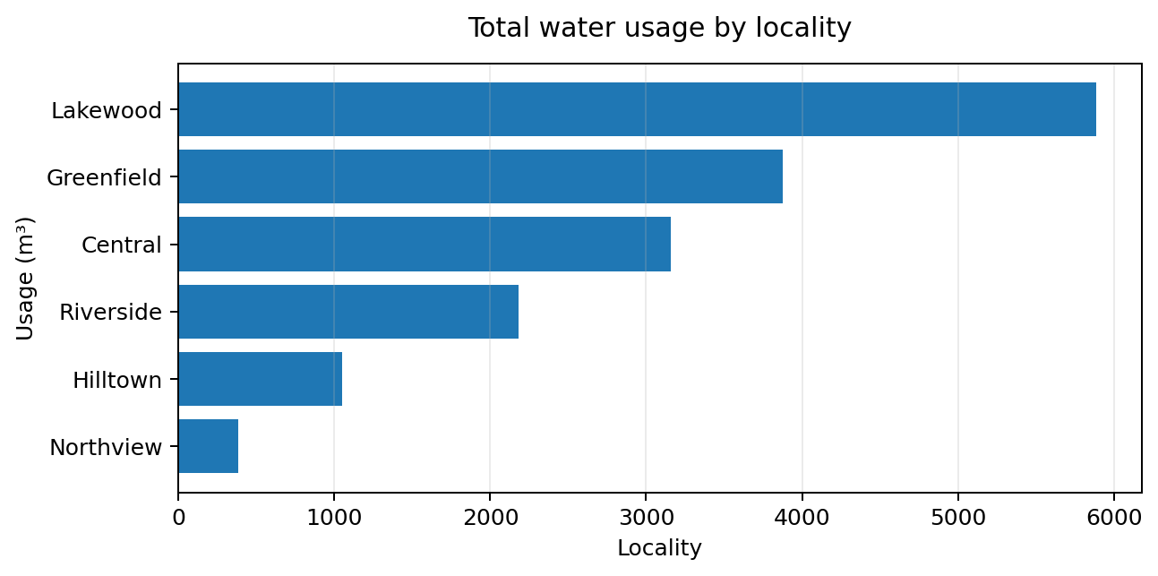
Finding 1 — Usage differs by locality
WHERE TO START THE REVIEW
HIGHEST RECORDED TOTAL
Lakewood
5,885.5 m³
LOWEST RECORDED TOTAL
Northview
382.0 m³
What this means
Use locality totals to prioritize meter audits, conservation outreach and follow-up checks.
Totals also depend on the number of connections and readings in each locality.
05

Slide 6
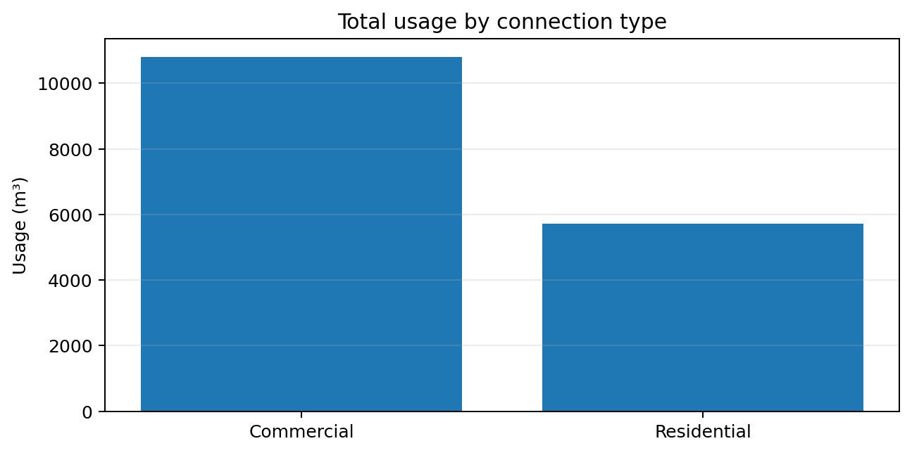
Finding 2 — Commercial usage is higher
COMPARE TOTALS AND TYPICAL READINGS
COMMERCIAL TOTAL
10,810.9 m³
Mean reading: 4.31 m³
RESIDENTIAL TOTAL
5,724.8 m³
Mean reading: 0.70 m³
Recommended action
Review high-use commercial accounts for efficiency opportunities, while comparing accounts fairly by size and usage pattern.
Totals alone do not measure per-customer efficiency.
06

Slide 7
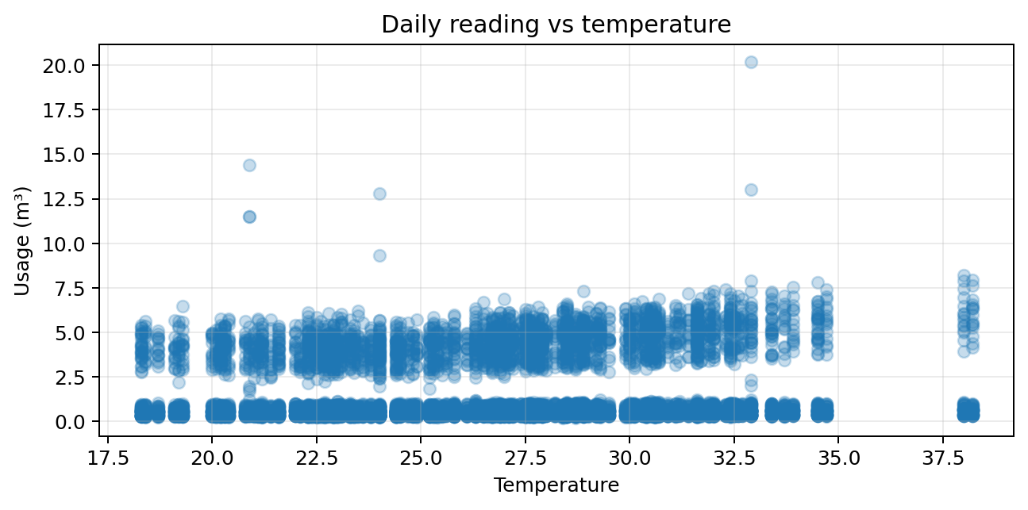
Finding 3 — Weather links are weak
AVOID OVER-INTERPRETING CORRELATION
TEMPERATURE CORRELATION
+0.063
Very weak positive linear relationship
RAINFALL CORRELATION
−0.025
Very weak negative linear relationship
What to do next
Collect more seasonal and contextual data before using weather to plan demand.
Correlations describe this generated dataset; they do not establish cause and effect.
07

Slide 8
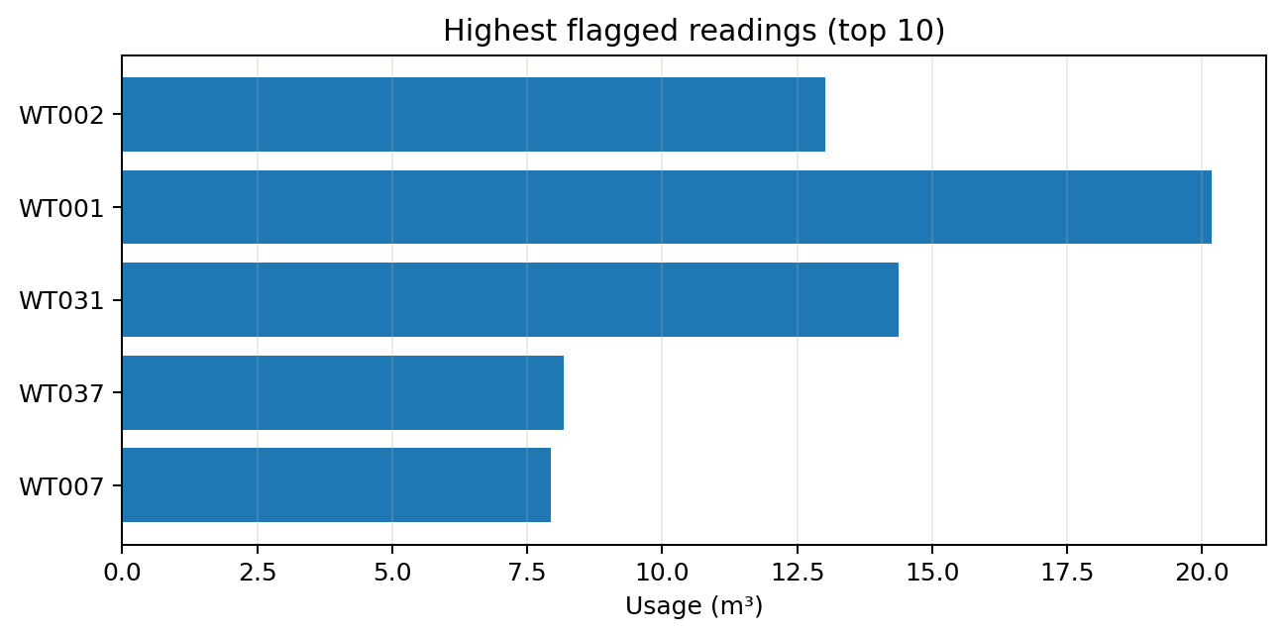
Finding 4 — Flagged readings need a closer look
ANOMALY DOES NOT MEAN CONFIRMED LEAK
FLAGGED READINGS
36 records
Statistical screening results
FLAGGED USAGE TOTAL
187.632 m³
Total usage across flagged records
Suggested review
Check dates, meter history, connection context and leak reports. Prioritize repeated or extreme readings for human review.
A statistical flag is a screening signal only, not proof of leakage.
08

Slide 9
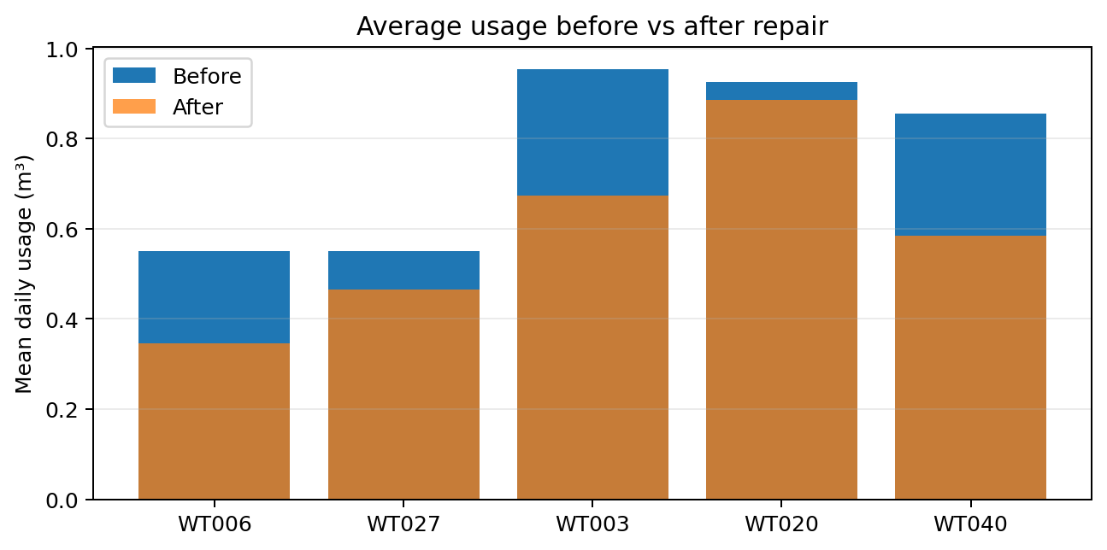
Finding 5 — Usage fell after matched repairs
BEFORE-AND-AFTER COMPARISON
AVERAGE BEFORE
0.767 m³
Across matched repair windows
AVERAGE AFTER
0.591 m³
Across matched repair windows
−23.6%
Mean percentage change across five repairs
The pattern is consistent with lower usage after repair, but it does not prove the repair caused the change.
Each window compares up to 30 days before and after repair; the repair date is excluded.
09

Slide 10
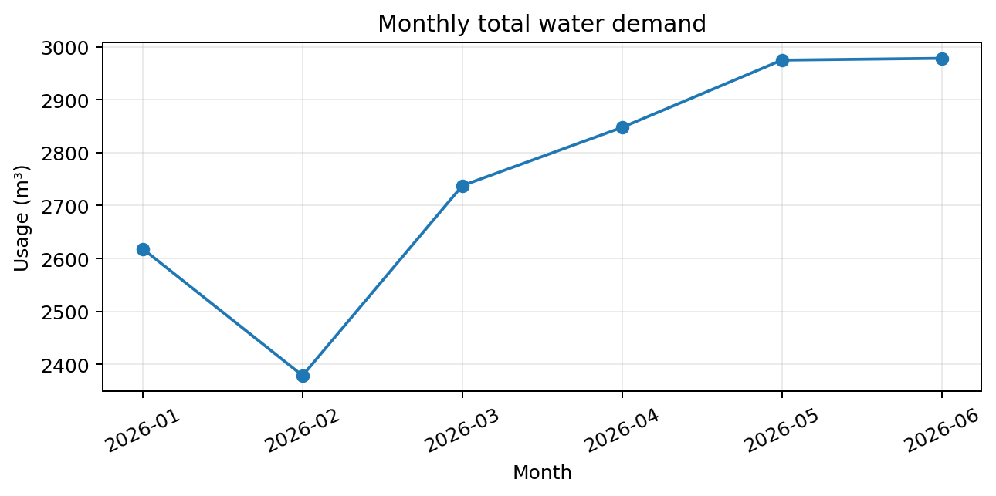
Finding 6 — Recorded demand rose toward June
MONTHLY WATER USAGE
PEAK MONTH
June 2026
2,978.5 m³
LOWEST MONTH
February 2026
2,378.6 m³
Planning implication
Plan meter checks and conservation messages ahead of periods when demand may rise. Confirm the trend with longer-term records.
The analysis covers six months of synthetic data; it is not a long-term forecast.
10

Slide 11
Recommendations and next actions
A PRACTICAL, LOW-RISK PILOT
01
Prioritize
Start with Lakewood and high-use commercial connections.
02
Investigate
Review flagged spikes against meter history, leak reports and maintenance records.
03
Validate repairs
Check whether lower usage persists after maintenance.
04
Conserve
Offer tailored conservation guidance to high-use connections and localities.
05
Improve the data
Resolve unmatched IDs and collect a longer time series before deployment.
Decision requested: approve a small, monitored inspection and conservation pilot before scaling.
12
11

