Slide 1
Project Title - Seasonal-Agriculture-Performance-Analysis
Student Name - Gurupada Nayak
College Name- Berhampur University
AICTE STU ID : STU6a3444cd3a0691781810381

Slide 2

PROBLEM STATEMENT
(Agricultural activities are influenced by seasonal variations in environmental conditions, farming practices, resource availability and market conditions. As a result, agricultural performance may differ from one season to another. However, raw agricultural data does not clearly explain how agricultural performance changes across seasons or what patterns can be observed in different seasonal conditions. The problem is to analyze the given agricultural dataset and investigate seasonal differences in agricultural performance by identifying meaningful patterns, trends, relationships and variations within the available data.

Slide 3
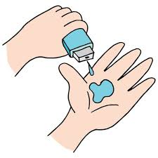
Project Description
Dataset: 4,000 farm records | 28 features | 3 seasons | 8 crops | 8 states
Seasons Covered:
Kharif (Jun-Nov) | Rabi (Nov-Apr) | Zaid (Apr-Jun)
Analysis Pipeline:
1. Data Cleaning -- Season-wise median imputation, IQR outlier detection
2. EDA -- Distribution plots, KDE curves, seasonal comparisons
3. Seasonal KPIs -- Yield, profit, profitability rate, environmental conds
4. Resource Usage -- Fertilizer, pesticide, water efficiency, irrigation
5. Economic Perf. -- Revenue, cost, profit, market price analysis
6. Crop Analysis -- Crop x Season heatmaps, top performers per season
7. Correlations -- 16-feature correlation matrix, yield drivers
8. Statistics -- Kruskal-Wallis, Mann-Whitney U, Chi-square tests
9. Anomaly Detect. -- Z-score outlier flagging, unusual pattern mining
10. Insights -- 10 evidence-based findings + 7 recommendations

Slide 4
WHO ARE THE END USERS?
1. Farmers & Agricultural Cooperatives
- Understand which season and crop combination is most profitable
- Optimize resource usage (fertilizer, water, pesticide) by season
2. Government & Agricultural Departments
- Design season-specific subsidy and support programmers
- Allocate irrigation and water resources more effectively
3. Agri-Finance Institutions & Insurers
- Assess seasonal risk profiles for credit and insurance products
- Identify high-risk Zaid season farms for targeted support
4. Agri-Tech Companies & Input Suppliers
- Align seed, fertilizer and pesticide supply chains with seasonal demand
5. Researchers & Policy Makers
- Use seasonal patterns to guide evidence-based agricultural planning

Slide 5

Technology Used
PROGRAMMING LANGUAGE
Python 3.10+
DATA MANIPULATION
pandas 2.x -- Data loading, cleaning, groupby aggregations
numpy -- Numerical operations, Z-score calculations
DATA VISUALISATION
matplotlib -- Histograms, bar charts, scatter plots, dashboards
seaborn -- Box plots, violin plots, heatmaps, KDE overlays
STATISTICAL ANALYSIS
scipy.stats -- Kruskal-Wallis, Mann-Whitney U, Chi-square, Pearson r
DEVELOPMENT ENVIRONMENT
Jupyter Notebook -- Interactive analysis, inline visualisations
DATA FORMAT
CSV (4,000 rows x 28 columns)
seasonal_agriculture_performance_dataset.csv

Slide 6
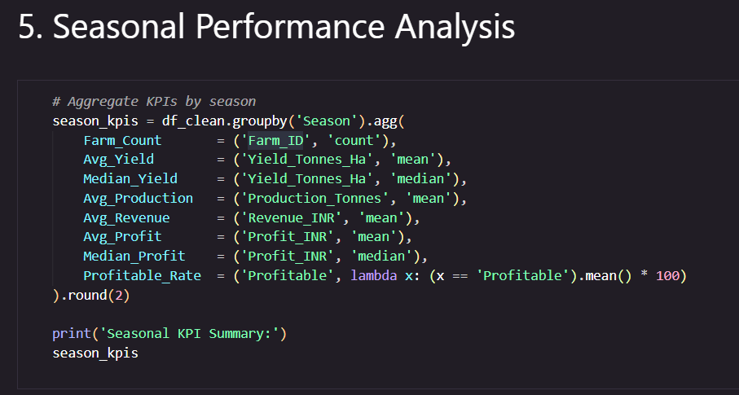
RESULTS

Slide 7
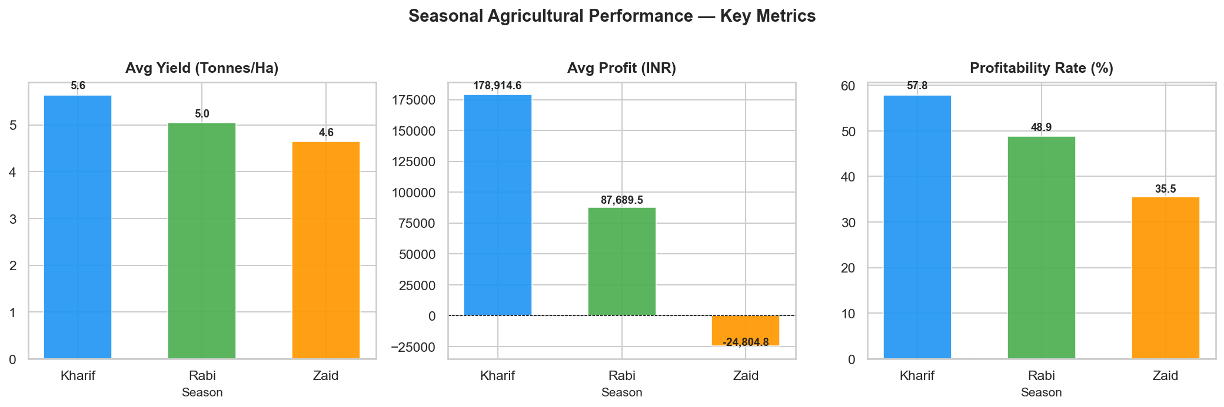
RESULTS

Slide 8
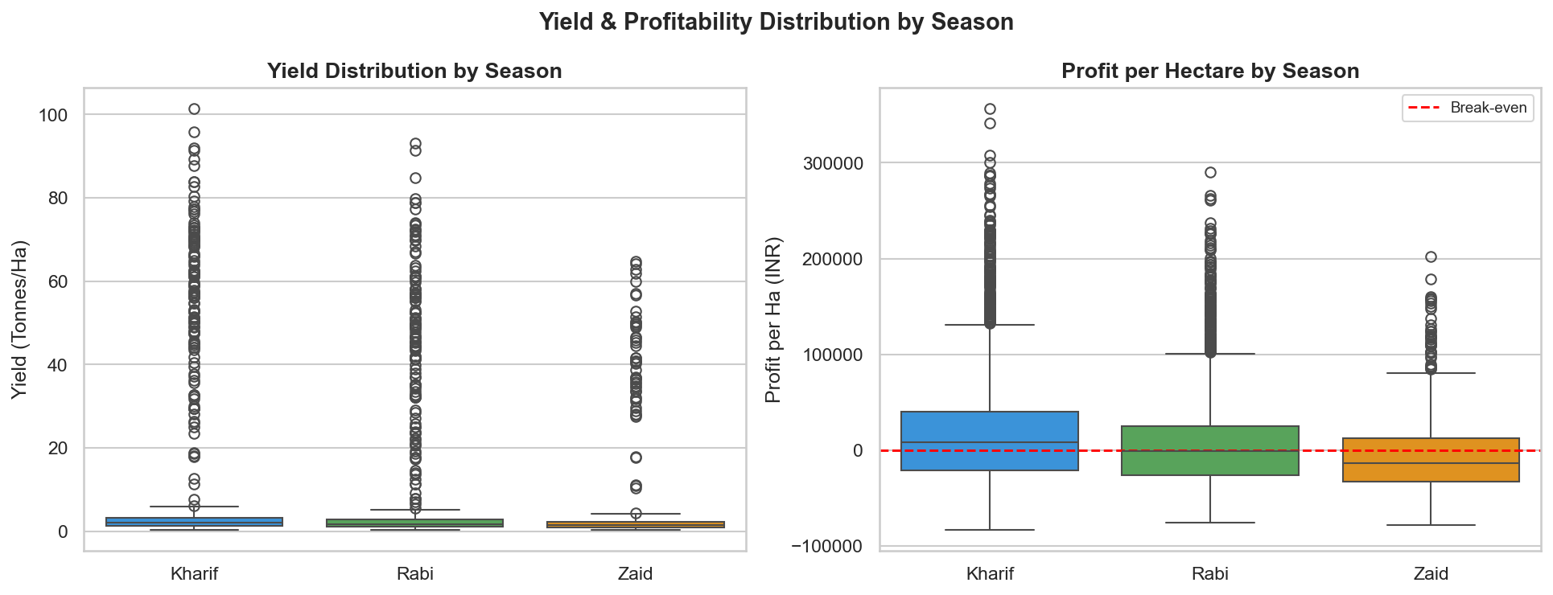
RESULTS

Slide 9
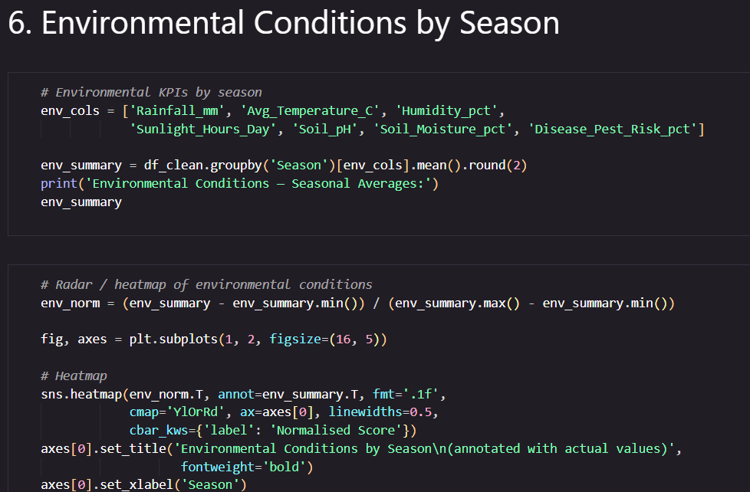
RESULTS

Slide 10
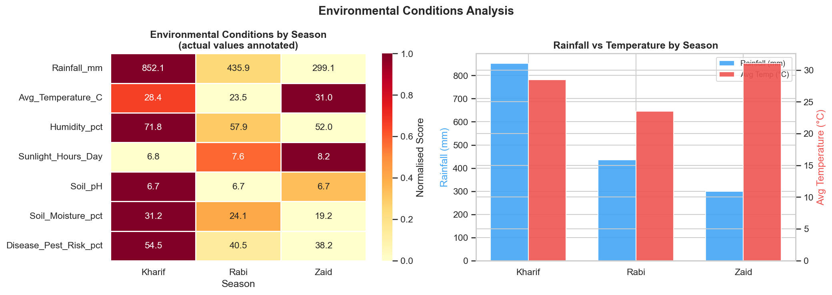
RESULTS

Slide 11
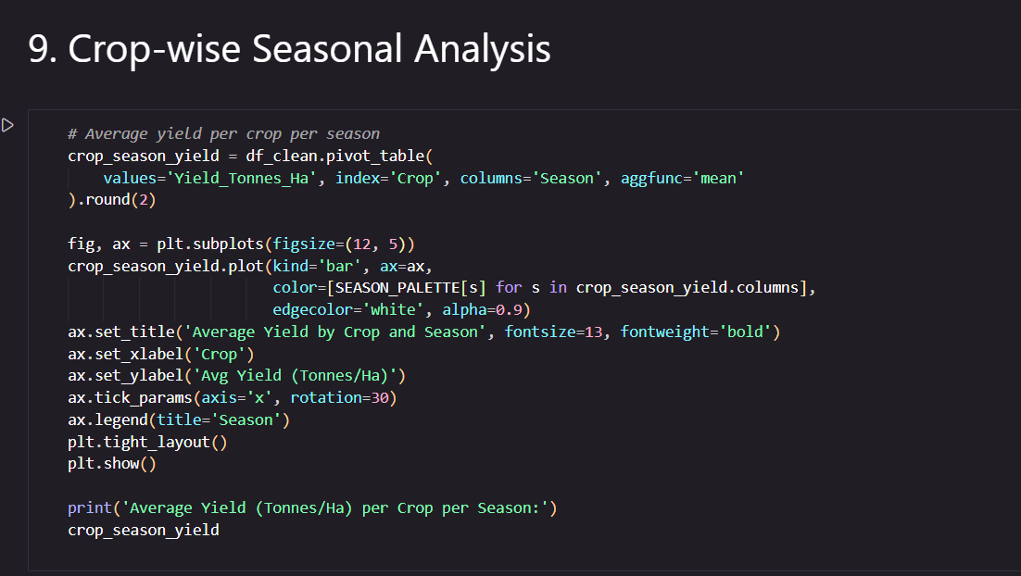
RESULTS

Slide 12
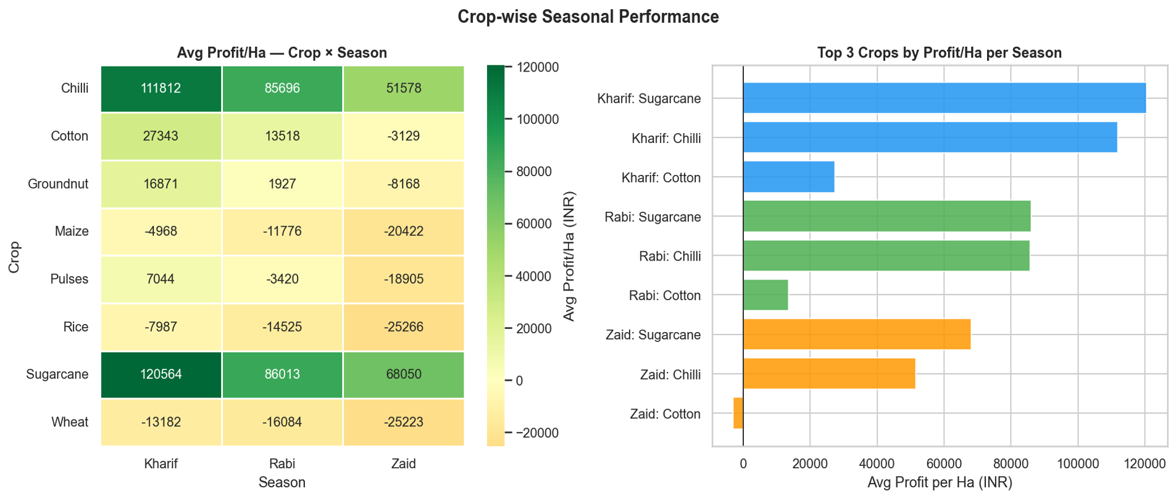
RESULTS

Slide 13
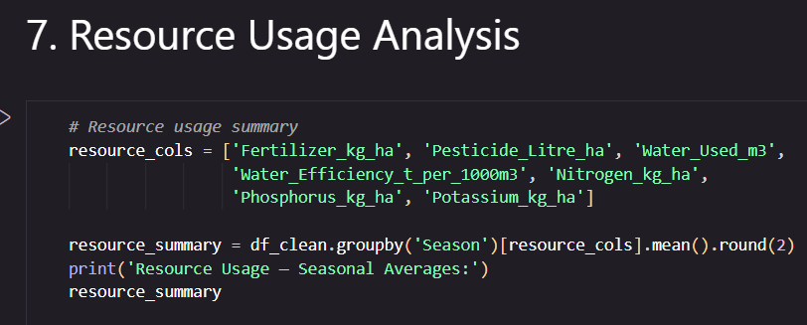
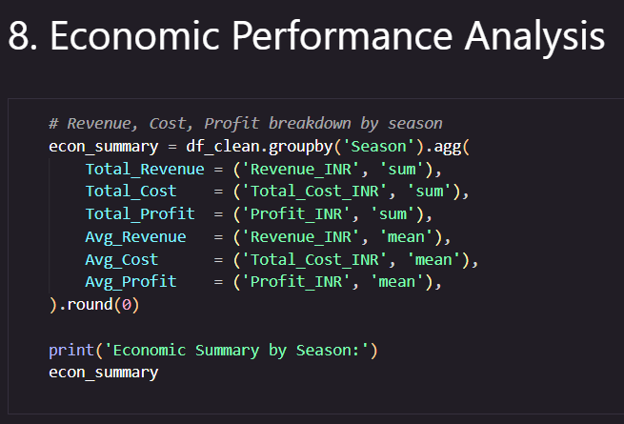
RESULTS

Slide 14
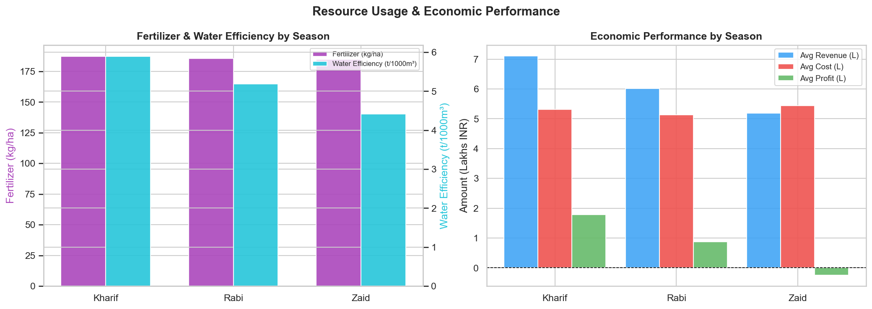
RESULTS

Slide 15
Future scope
1. Machine Learning Models
- Build predictive models (Random Forest, XGBoost) to forecast crop yield and profit based
on seasonal inputs.
2. Real-time Data Integration
- Connect with live weather APIs and satellite imagery for dynamic seasonal monitoring and
early warning systems.
3. Deep Seasonal Granularity
- Expand analysis to monthly or weekly intervals to capture micro-seasonal patterns within
Kharif, Rabi and Zaid.
4. Geo-spatial Analysis
- Add district-level maps to visualize yield and profit hotspots across all 8 states
5. Interactive Dashboard
- Develop a Power BI / Streamlit dashboard for farmers and government agencies to
explore seasonal insights in real-time.
6. Climate Change Impact Study
- Analize how changing rainfall and temperature trends are shifting seasonal
performance over multi-year datasets

Slide 16
GitHub Link
https://github.com/Guru1817/Seasonal-Agriculture-Performance-Analysis

Slide 17
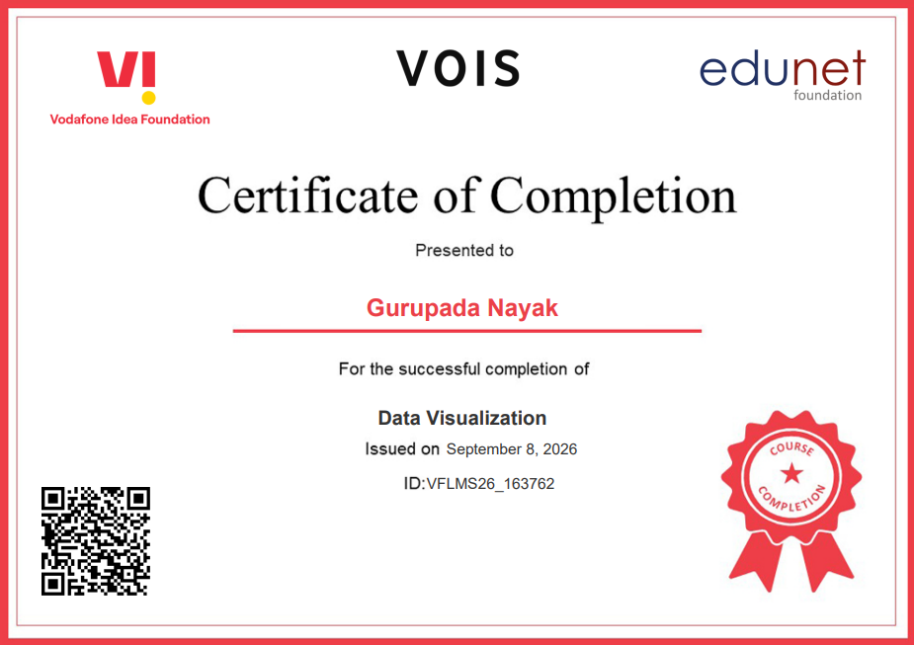
VOIS Course completion certificate - Course name- Data Visualization

Slide 18
Thank you
.
.

