Slide 1

Seasonal Agriculture Performance Analysis
VOIS AICTE Batch1 2026-2027
Major Project | Data Analytics | AICTE STU ID: XXXXXX

Slide 2

PROBLEM STATEMENT
Agricultural activities are influenced by seasonal variations in
environmental conditions, farming practices, resource availability
and market conditions. Agricultural performance differs across seasons.
RAW DATA does not clearly reveal:
- How performance changes across Kharif, Rabi and Zaid seasons
- What patterns exist in different seasonal conditions
- Which factors drive seasonal differences
OBJECTIVE: Analyze the agricultural dataset to investigate seasonal
differences by identifying meaningful patterns, trends, relationships
and variations — and develop data-driven recommendations.

Slide 3
Project Description
Dataset: 4,000 farm records | 28 features | 3 seasons | 8 crops | 8 states
Seasons Covered:
Kharif (Jun-Nov) | Rabi (Nov-Apr) | Zaid (Apr-Jun)
Analysis Pipeline:
1. Data Cleaning -- Season-wise median imputation, IQR outlier detection
2. EDA -- Distribution plots, KDE curves, seasonal comparisons
3. Seasonal KPIs -- Yield, profit, profitability rate, environmental conds
4. Resource Usage -- Fertilizer, pesticide, water efficiency, irrigation
5. Economic Perf. -- Revenue, cost, profit, market price analysis
6. Crop Analysis -- Crop x Season heatmaps, top performers per season
7. Correlations -- 16-feature correlation matrix, yield drivers
8. Statistics -- Kruskal-Wallis, Mann-Whitney U, Chi-square tests
9. Anomaly Detect. -- Z-score outlier flagging, unusual pattern mining
10. Insights -- 10 evidence-based findings + 7 recommendations

Slide 4

WHO ARE THE END USERS?
PRIMARY END USERS
1. Farmers & Agricultural Cooperatives
- Understand which season and crop combination is most profitable
- Optimise resource usage (fertiliser, water, pesticide) by season
2. Government & Agricultural Departments
- Design season-specific subsidy and support programmes
- Allocate irrigation and water resources more effectively
3. Agri-Finance Institutions & Insurers
- Assess seasonal risk profiles for credit and insurance products
- Identify high-risk Zaid season farms for targeted support
4. Agri-Tech Companies & Input Suppliers
- Align seed, fertiliser and pesticide supply chains with seasonal demand
5. Researchers & Policy Makers
- Use seasonal patterns to guide evidence-based agricultural planning

Slide 5

Technology Used
PROGRAMMING LANGUAGE
Python 3.10+
DATA MANIPULATION
pandas 2.x -- Data loading, cleaning, groupby aggregations
numpy -- Numerical operations, Z-score calculations
DATA VISUALISATION
matplotlib -- Histograms, bar charts, scatter plots, dashboards
seaborn -- Box plots, violin plots, heatmaps, KDE overlays
STATISTICAL ANALYSIS
scipy.stats -- Kruskal-Wallis, Mann-Whitney U, Chi-square, Pearson r
DEVELOPMENT ENVIRONMENT
Jupyter Notebook -- Interactive analysis, inline visualisations
DATA FORMAT
CSV (4,000 rows x 28 columns)
seasonal_agriculture_performance_dataset.csv

Slide 6
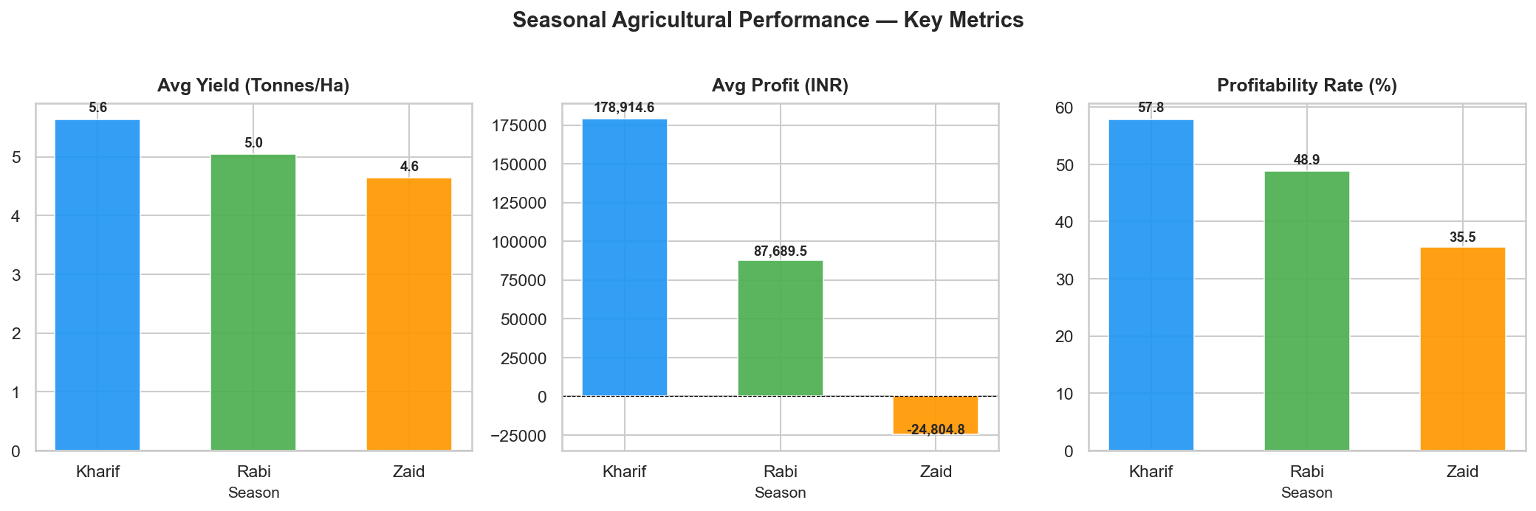
RESULTS
Seasonal KPI Overview | Dataset: 4,000 farms | 3 Seasons | 8 Crops | 8 States

Slide 7
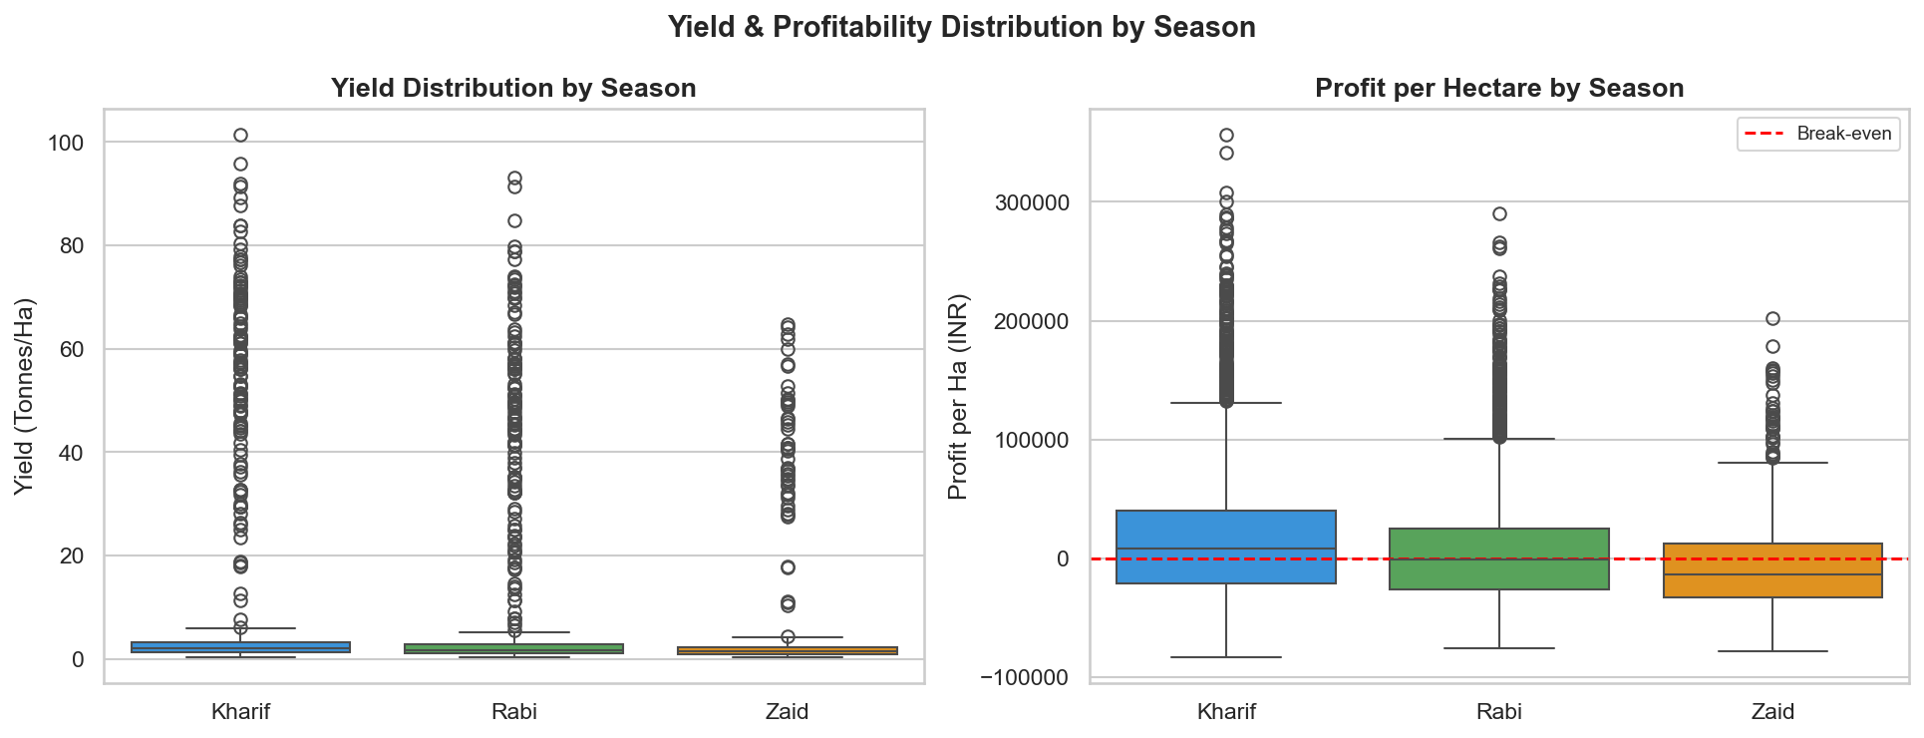
RESULTS
Kharif: Best yield & profit | Zaid: Negative median profit | Rabi: Stable but moderate

Slide 8
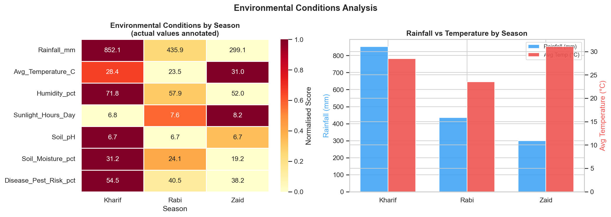
RESULTS
Kharif: Highest rainfall & humidity | Zaid: Highest temperature | Rabi: Moderate conditions

Slide 9
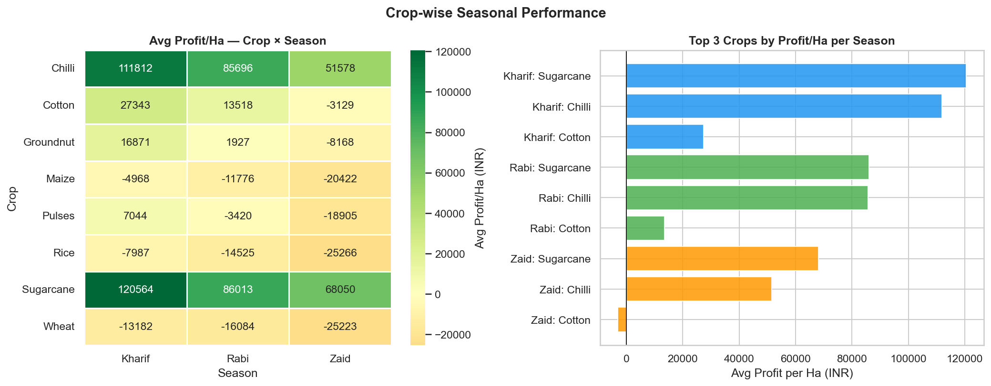
RESULTS
Sugarcane & Rice: Top performers in Kharif | Sugarcane: Only crop beating Zaid average yield

Slide 10
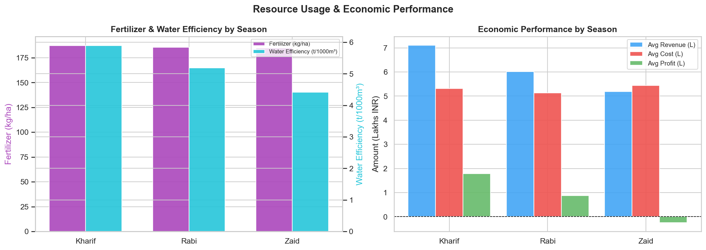
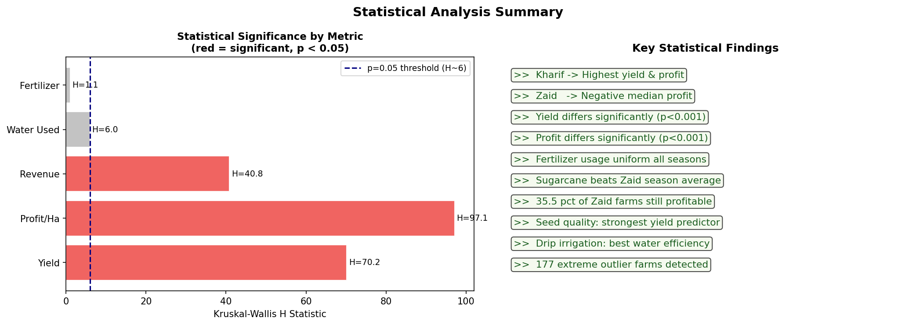
RESULTS
Resource Usage & Statistical Significance | Yield H=70.2 (p<0.001) | Profit H=97.1 (p<0.001)

Slide 11
Future scope
FUTURE SCOPE
1. Machine Learning Models
- Build predictive models (Random Forest, XGBoost) to forecast
crop yield and profit based on seasonal inputs
2. Real-time Data Integration
- Connect with live weather APIs and satellite imagery for
dynamic seasonal monitoring and early warning systems
3. Deep Seasonal Granularity
- Expand analysis to monthly or weekly intervals to capture
micro-seasonal patterns within Kharif, Rabi and Zaid
4. Geo-spatial Analysis
- Add district-level maps to visualise yield and profit hotspots
across all 8 states
5. Interactive Dashboard
- Develop a Power BI / Streamlit dashboard for farmers and
government agencies to explore seasonal insights in real-time
6. Climate Change Impact Study
- Analyse how changing rainfall and temperature trends are
shifting seasonal performance over multi-year datasets

Slide 12
GitHub Link
Project Repository
All source code, Jupyter Notebook, dataset and charts
are available at the GitHub repository below.
Notebook file:
Seasonal_Agriculture_Performance_Analysis.ipynb
Dataset:
seasonal_agriculture_performance_dataset.csv
https://github.com/AswiniKumar55/-Seasonal-Agriculture-Performance-Analysis-.git

Slide 13
VOIS Course completion certificate - Course name- Data Visualization
Please attach your VOIS Course Completion Certificate here.
Course: Data Visualization
Issued by: VOIS / AICTE

Slide 14
Thank you
.
.

