Slide 1
NutriMind: Building The Smartest AI Nutrition Assistant
CAPSTONE PROJECT
Presented By:-
NAME :- GURPREET SINGH
INSTITUTION NAME :- PRESIDENCY UNIVERSITY,BENGALURU
FIELD OF STUDY :- B.TECH (COMPUTER SCIENCE ENGINEERING)

Slide 2
OUTLINE
Problem Statement
Proposed System/Solution
System Development Approach
Algorithm & Deployment
Result (Output Image)
Conclusion
Future Scope
References

Slide 3
Problem Statement
The Challenge: Scaling Expert-Level Personalized Nutrition
In the rapidly growing digital health market, personalized nutrition is a core consumer demand. However, most digital tools offer only generic, one-size-fits-all meal plans. This approach fails to account for an individual's unique health goals, dietary restrictions, and medical conditions, leading to low user engagement and poor health outcomes. This creates a significant industry challenge: providing scalable, expert-level nutrition counseling that is both affordable and deeply personal. The crucial part is the development of an intelligent AI agent that can reason over large-scale dietary databases to generate dynamic, personalized meal plans and adaptive advice, effectively acting as a virtual nutrition expert for every user.

Slide 4
Proposed Solution
The proposed system, "NutriMind," aims to address the challenge of providing scalable, expert-level personalized nutrition guidance. This involves leveraging a multi-layered agentic AI architecture on the IBM watsonx platform to generate dynamic and adaptive meal plans accurately. The solution consists of the following components:
Data Collection:
Sourced a comprehensive "Daily Food and Nutrition Dataset" from Kaggle to serve as the foundational knowledge base.
Data Preprocessing:
Performed data cleansing and pre-processing using Microsoft Excel to handle duplicates, and correct inconsistencies, ensuring high data quality.
Retrieval-Augmented Generation:
Implemented a RAG pipeline to ground the AI in factual, verifiable nutritional data.
Utilized the powerful granite-embedding-278m-multilingual model to convert the cleaned dataset into a high-performance vector index for real-time information retrieval.
Prompt Engineering & Prototyping:
Leveraged the IBM watsonx Prompt Lab for rapid prototyping of the agent's core skills.
Engineered and tested complex prompts for meal plan generation and food swap recommendations against the granite-3-8b-instruct model to ensure high-quality outputs.

Slide 5
Proposed Solution
Agentic AI Architecture:
Developed the core "NutriMind" agent using the IBM watsonx Agent Lab, leveraging the LangGraph framework to orchestrate complex conversational flows.
Implemented a ReAct (Reason and Act) architecture to enable intelligent decision-making and tool selection.
Integrated the state-of-the-art llama-3-3-70b-instruct model as the primary reasoning engine for understanding complex user queries.
Equipped the agent with a multi-tool system, including the custom nutritional RAG database, Google Search, Wikipedia Search, and a WebCrawler for holistic, up-to-date responses
Deployment:
Developed a user-facing testing interface within the watsonx platform for real-time interaction and validation.
Deployed the final solution on the scalable and reliable IBM Cloud platform as a live AI service with a secure API endpoint for future application integration.
Evaluation:
Assessed the agent's performance through qualitative testing with a wide range of complex nutritional queries to validate response accuracy and relevance.
Result
The final agent successfully generated accurate, custom meal plans tailored to user-specific needs and provided context-aware suggestions on how to replace certain food items with healthier alternatives.

Slide 6
System Approach
The "System Approach" section outlines the overall strategy and methodology for developing and implementing the NutriMind AI system.
System Architecture:
Cloud Platform: IBM Cloud (Lite Tier)
AI Environment: IBM watsonx.ai Studio
Core AI Components:
IBM watsonx Agent Lab: For final agent assembly, tool integration, and deployment.
IBM watsonx Prompt Lab: For rapid prototyping, prompt engineering, and RAG pipeline development.
Technology & Models Used:
Reasoning Engine (LLM): llama-3-3-70b-instruct
Prototyping Model (LLM): granite-3-8b-instruct
Embedding Model (for RAG): granite-embedding-278m-multilingual
Agent Framework: LangGraph
Agent Architecture: ReAct (Reason and Act)
Data Pre-processing Tool: Microsoft Excel

Slide 7
Algorithm & Deployment
In the Algorithm section, we describe the advanced AI architecture chosen for generating personalized nutritional guidance. Here’s the structure for this section:
Algorithm Selection:
A ReAct (Reason and Act) agentic architecture was implemented, powered by the llama-3-3-70b-instruct model. This approach was justified by the need to handle complex, multi-step user queries that require both internal knowledge retrieval and external tool use, moving beyond the capabilities of a standard chatbot.
Data Input:
The primary input is the user's natural language query (e.g., "create a meal plan for me").
The secondary data source is a vectorized nutritional database, created from a pre-processed Kaggle dataset using the granite-embedding-278m-multilingual model. This serves as the agent's internal, factual knowledge base.
Training Process:
The agent's core "skills" were developed through a process of prompt engineering in the IBM watsonx Prompt Lab. Specific, detailed prompts for meal plan generation and food swap recommendations were prototyped and validated against the granite-3-8b-instruct model to ensure high-quality, reliable outputs.
Prediction Process:
The trained agent makes "predictions" (generates responses) by first using the ReAct framework to reason about the user's query. It then autonomously selects the appropriate tool—either querying the internal RAG database for nutritional facts or using external tools like Google Search for real-time information—before synthesizing the retrieved data into a final, comprehensive answer.

Slide 8
Result
The results of the "NutriMind" AI agent in terms of its accuracy and effectiveness in generating personalized nutritional guidance. Included are visualizations from the live demonstration and comparisons between a user's complex query and the agent's tailored output to highlight the model's performance.

Slide 9
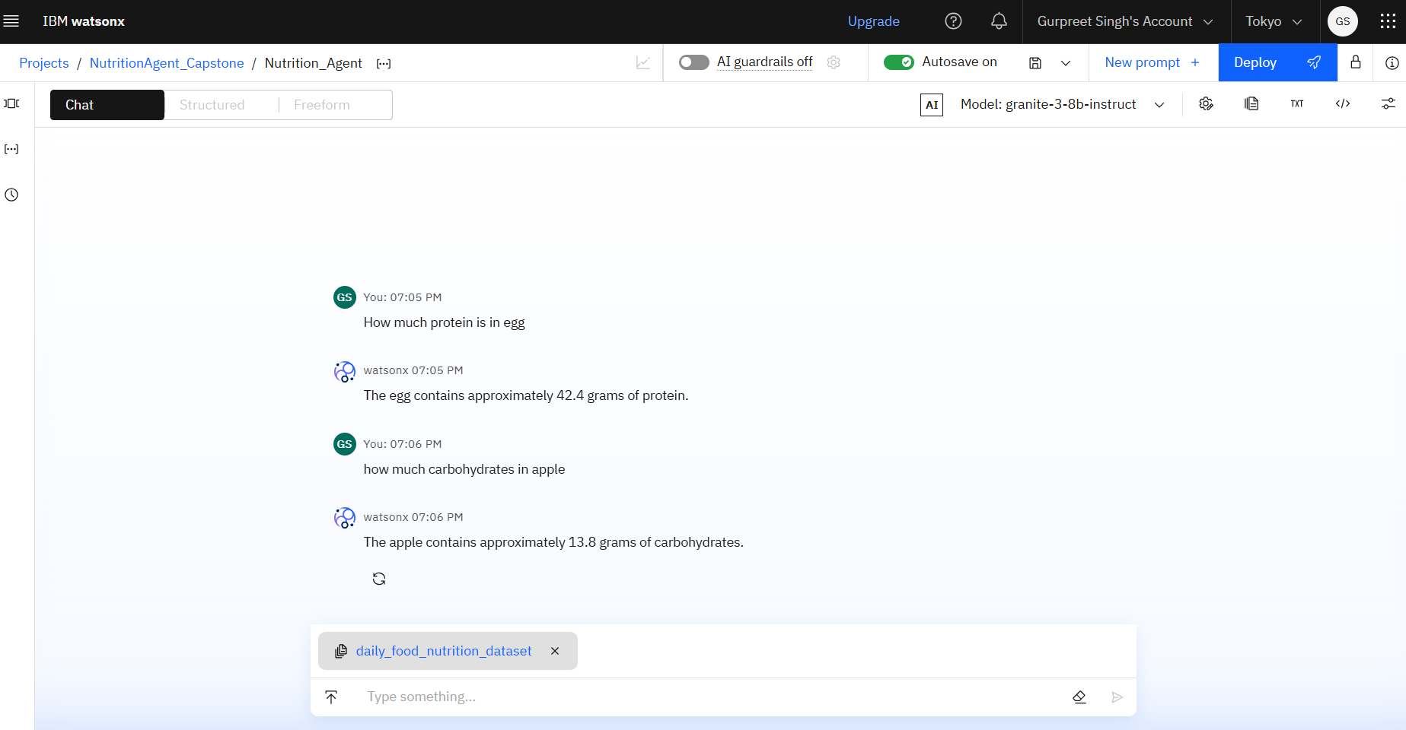
Result
This screenshot demonstrates the successful validation of the Retrieval-Augmented Generation (RAG) pipeline within the IBM watsonx Prompt Lab. The system, grounded with the daily_food_nutrition_dataset, is being queried for specific nutritional facts. Using the granite-3-8b-instruct model, the agent accurately retrieves precise data points, confirming the knowledge base is successfully integrated and the AI can provide fact-based, non-hallucinated answers.

Slide 10
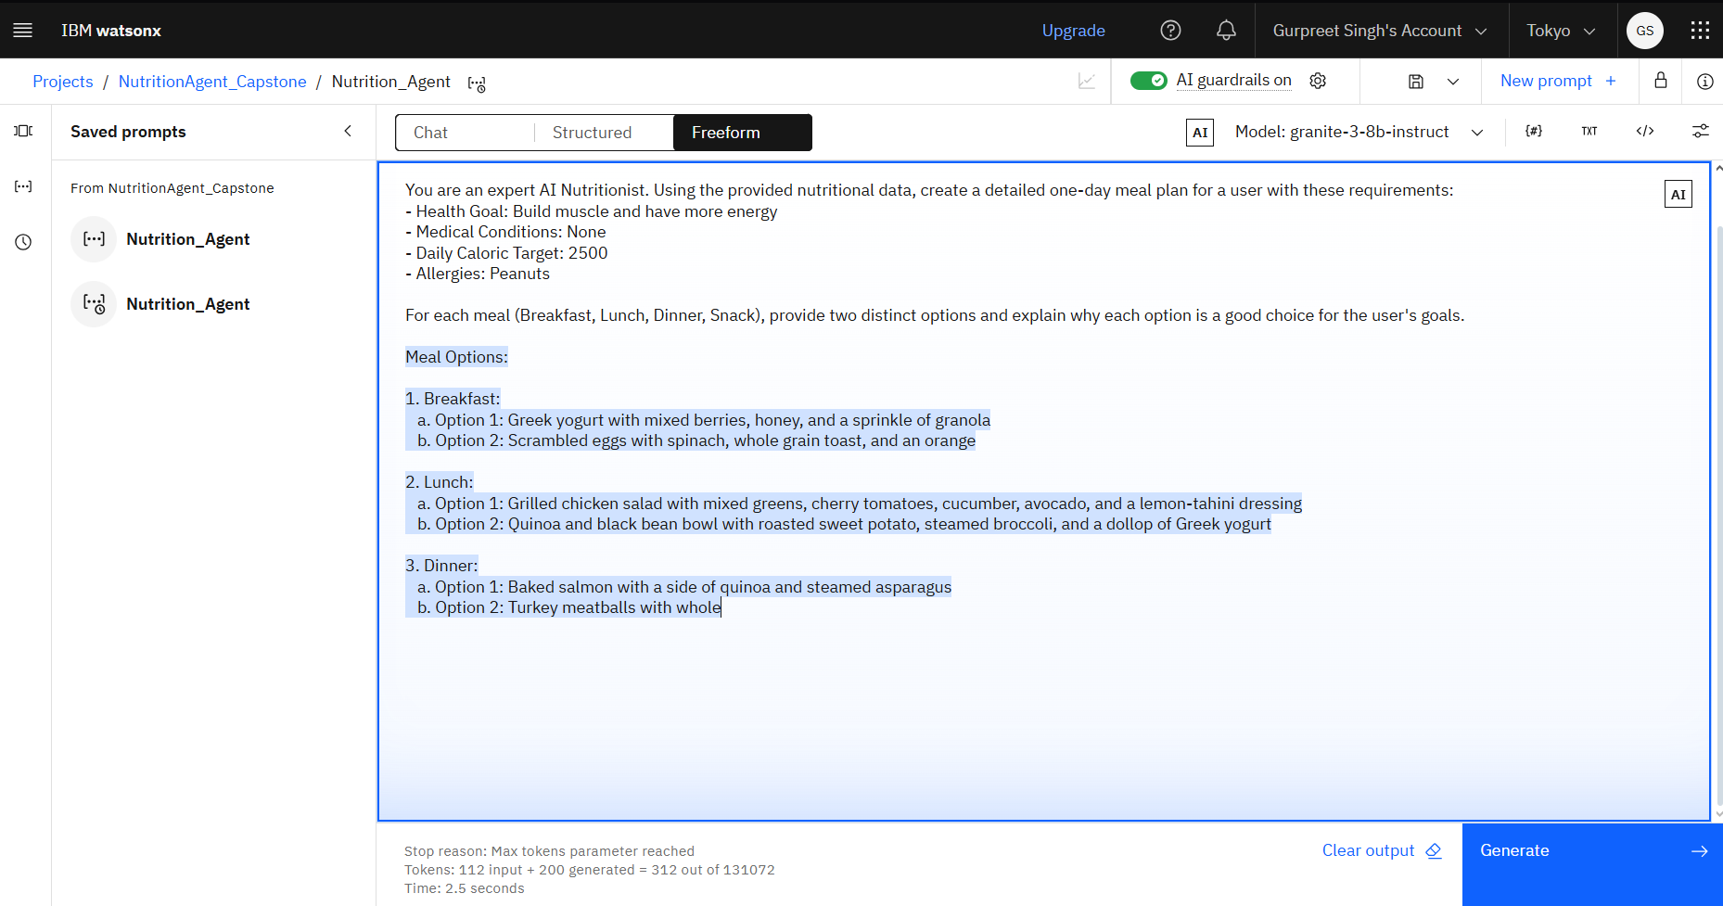
Result
This screenshot captures the successful generation of a personalized meal plan in the Prompt Lab. The granite-3-8b-instruct model was given a detailed persona and a complex user request with multiple constraints (Health Goal: Build muscle, 2500 Calorie Target, Peanut Allergy). The model's ability to generate a structured, multi-option meal plan for Breakfast, Lunch, and Dinner validates the core logic of the "NutriMind" agent.

Slide 11
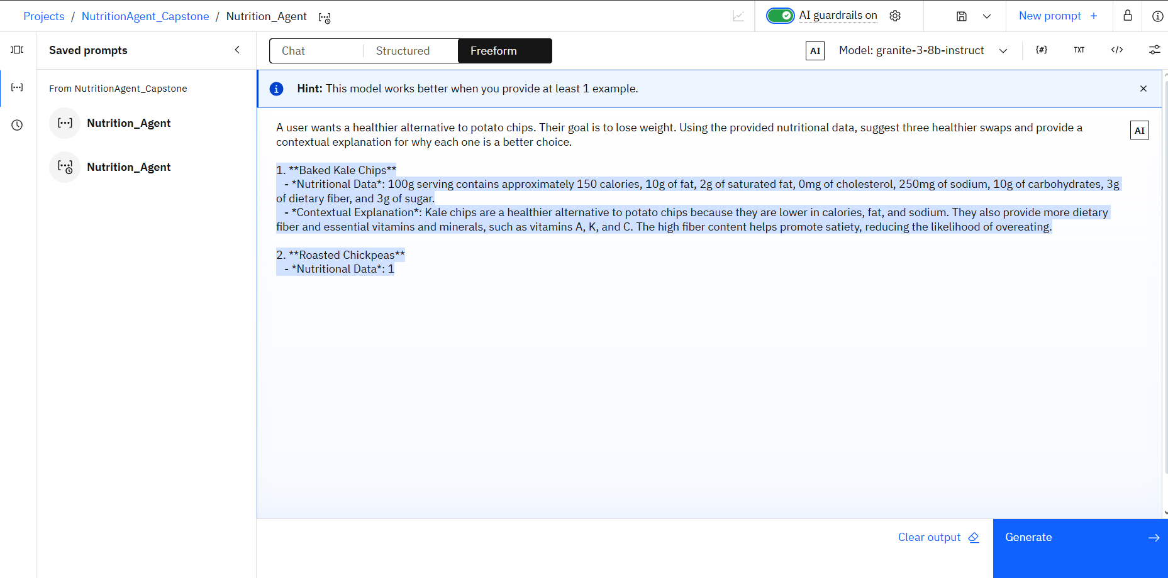
Result
This image showcases the IBM watsonx Prompt Lab in "Freeform" mode, where a core agent skill was engineered and tested. A complex prompt was provided to the granite-3-8b-instruct model, tasking it with suggesting and explaining healthier food swaps based on a user's goal. The model's successful generation of detailed alternatives like "Baked Kale Chips" demonstrates its ability to perform contextual reasoning based on the provided nutritional data.

Slide 12
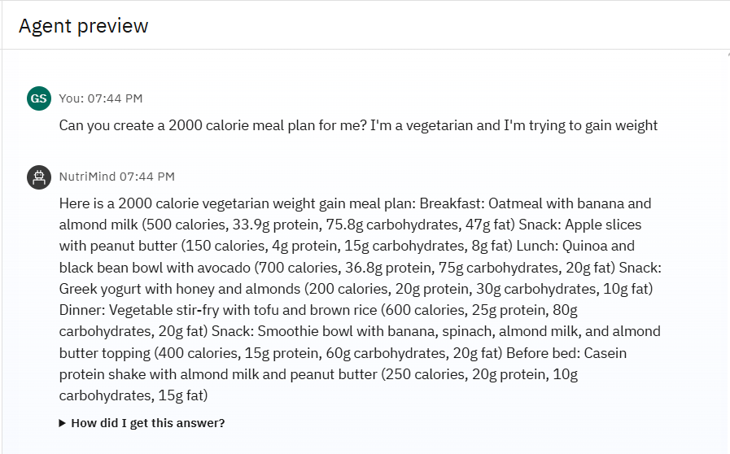
Result
This image displays a successful end-to-end test of the fully assembled "NutriMind" agent in the IBM watsonx Agent Lab preview. The agent was presented with a complex, multi-constraint user query: a 2000-calorie, vegetarian, weight-gain meal plan. The agent correctly interpreted the user's intent and generated a detailed, structured, and highly relevant response that meets all specified requirements, showcasing its core functionality.

Slide 13
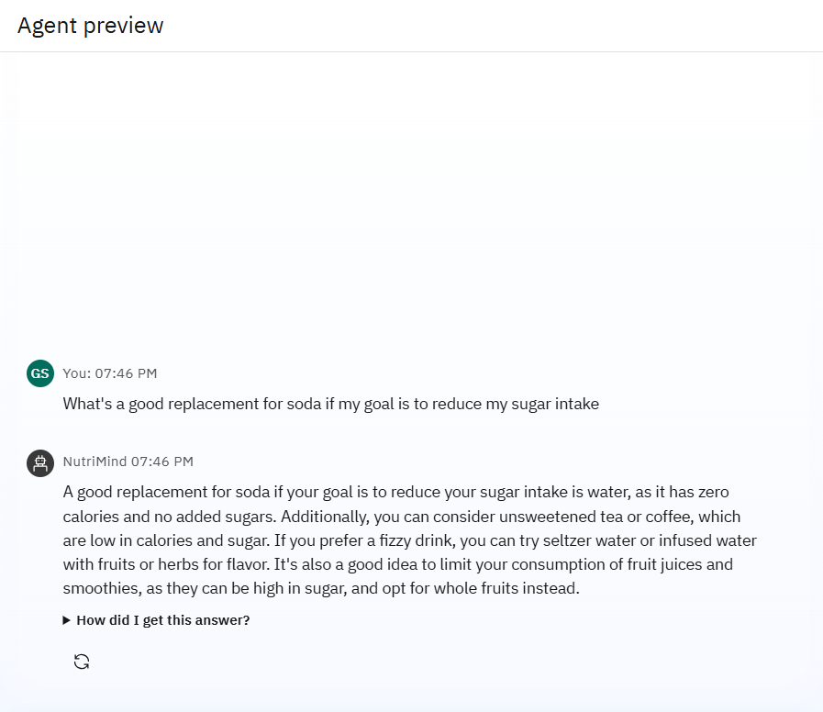
Result
This screenshot demonstrates the agent's ability to provide context-aware nutritional advice. When asked for a low-sugar replacement for soda, the "NutriMind" agent successfully swapped those items . The response is not only accurate (recommending water, tea, etc.) but also provides valuable contextual explanation by advising against high-sugar fruit juices, proving its capability to act as a true nutritional assistant.

Slide 14
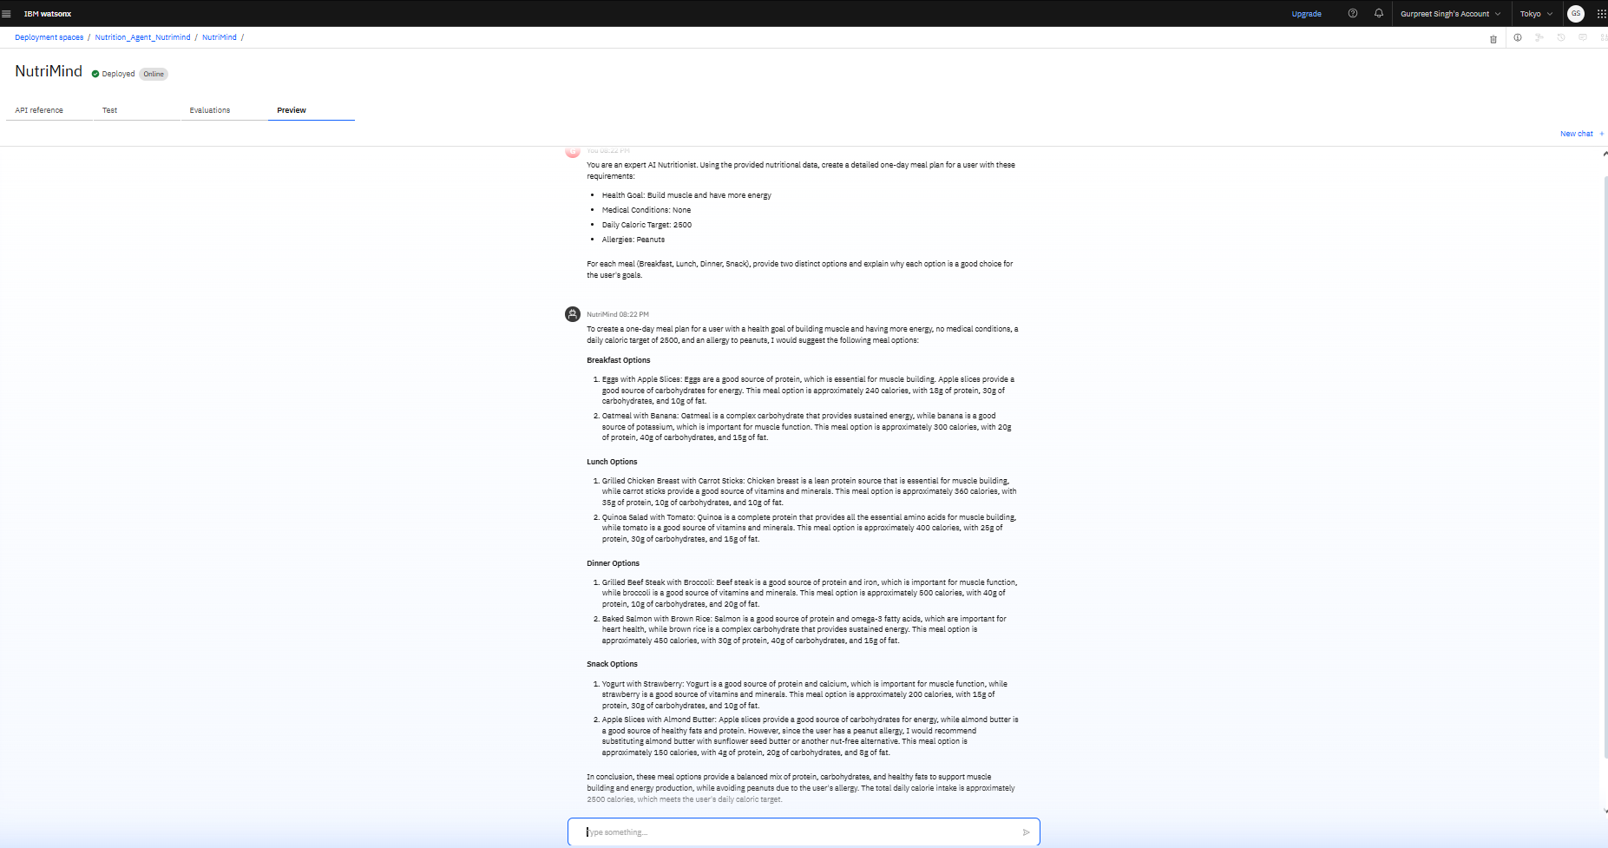
Result
This image captures the successful test of the final, deployed "NutriMind" AI service. The screenshot shows the live API's "Preview" interface, confirming that the agent is fully operational on IBM Cloud. The agent has successfully processed a complex, natural language request for a personalized meal plan, demonstrating its ability to synthesize information from its knowledge base and generate a detailed, structured, and actionable response. This validates the end-to-end functionality of the entire system, from data ingestion to final deployment.

Slide 15
Conclusion
Successfully developed a sophisticated, proof-of-concept AI Nutrition Assistant, "NutriMind," on the IBM watsonx platform.
Demonstrated a complex, multi-tool, RAG-powered agentic architecture capable of delivering personalized and context-aware nutritional guidance, which moves significantly beyond the capabilities of standard chatbots.
The project successfully integrates the complete end-to-end AI development lifecycle—from rigorous data pre-processing and advanced prompt engineering to the final assembly and deployment of an intelligent agent.

Slide 16
Future scope
Multimodal Input Integration:
Image Recognition: Integrate IBM Watson Visual Recognition to allow users to upload photos of food items or grocery labels. The service would identify the food, and its name would be passed as text to the NutriMind agent for analysis and recommendations.
Voice Commands: Incorporate IBM Watson Speech-to-Text to enable a hands-free, conversational experience, allowing users to ask questions and receive nutritional advice via voice.
Dynamic Feedback & Personalization Loop:
Implement a user profile database to store individual preferences, feedback, and dietary history.
The agent would query this database before generating recommendations to ensure it learns and adapts over time (e.g., "remembering" that a user dislikes a certain food).
Advanced Health Data Integration:
Connect the agent to health and fitness APIs (like from smartwatches or fitness trackers) to automatically pull in data on activity levels and caloric expenditure, leading to even more precise and dynamic meal planning.

Slide 17
References
Dataset:
Shamim, A. (2023). Daily Food and Nutrition Dataset. Kaggle. Retrieved August 4, 2025, from https://www.kaggle.com/datasets/adilshamim8/daily-food-and-nutrition-dataset
Core AI Methodologies:
Lewis, P., et al. (2020). Retrieval-Augmented Generation for Knowledge-Intensive NLP Tasks. This foundational paper introduced the RAG technique used to ground the agent in factual nutritional data. Link: https://arxiv.org/abs/2005.11401
Yao, S., et al. (2023). ReAct: Synergizing Reasoning and Acting in Language Models. This paper details the ReAct architecture, which was implemented to enable the agent to reason about a user's query and intelligently select the correct tool.Link: https://arxiv.org/abs/2210.03629
Platform & Technology Documentation:
IBM. (2025). IBM watsonx.ai Documentation. This was the primary technical resource for developing and deploying the agent on the IBM Cloud platform. Retrieved August 4, 2025, from https://cloud.ibm.com/docs/watsonx-ai.

Slide 18
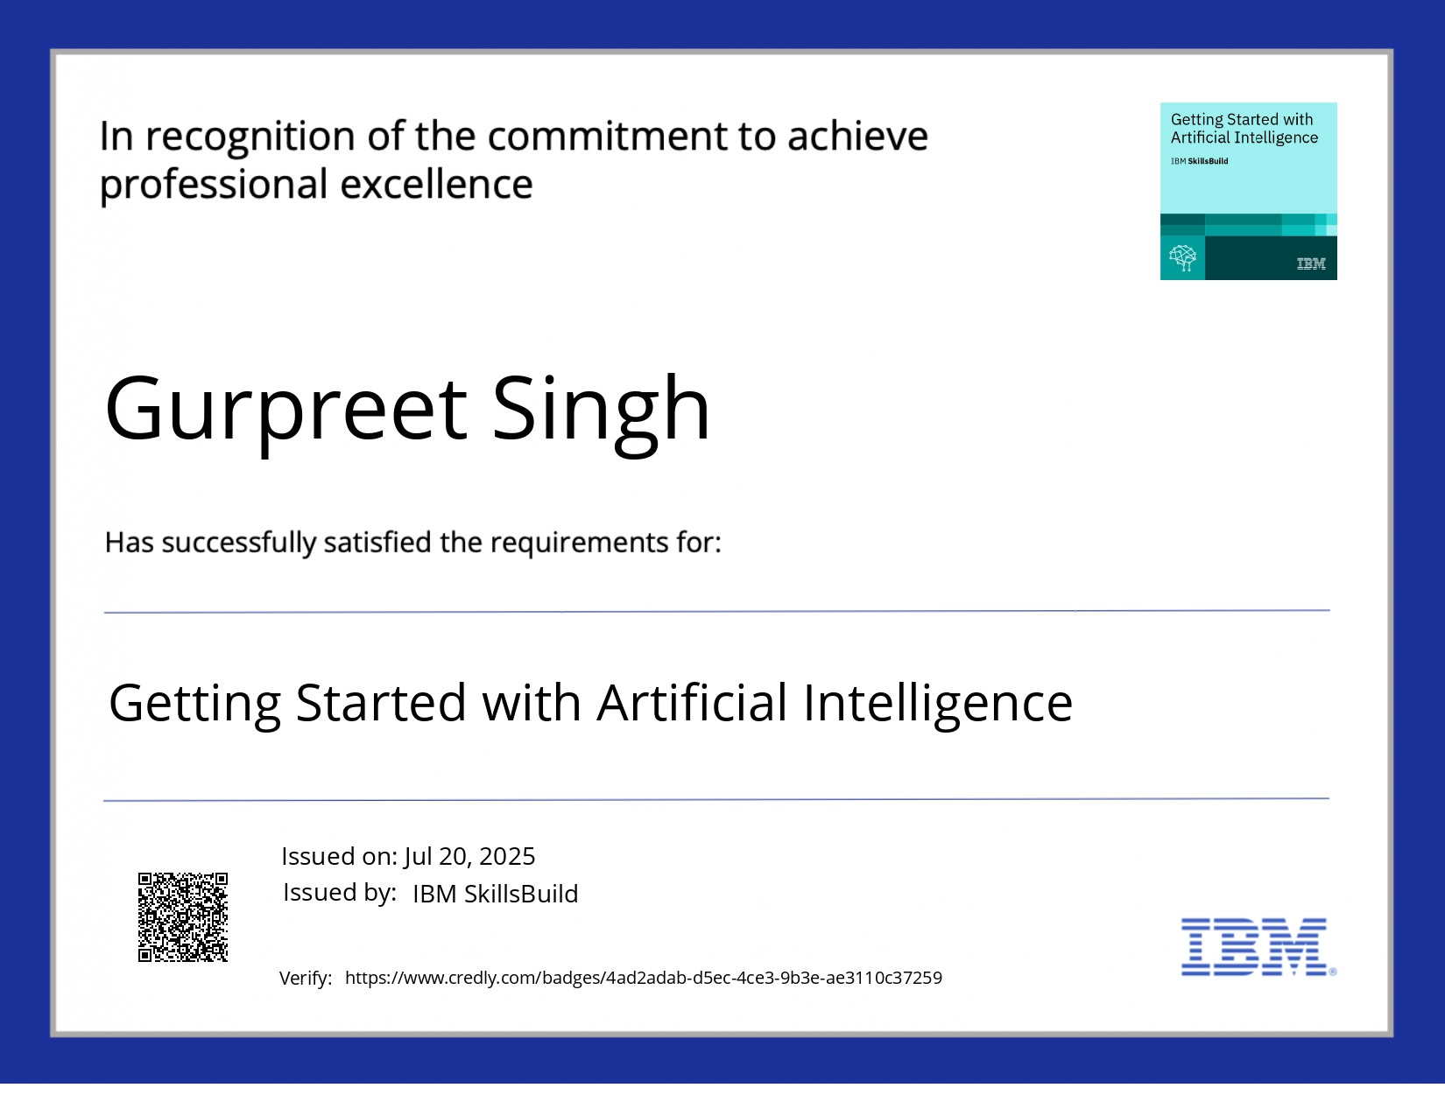
IBM Certifications

Slide 19
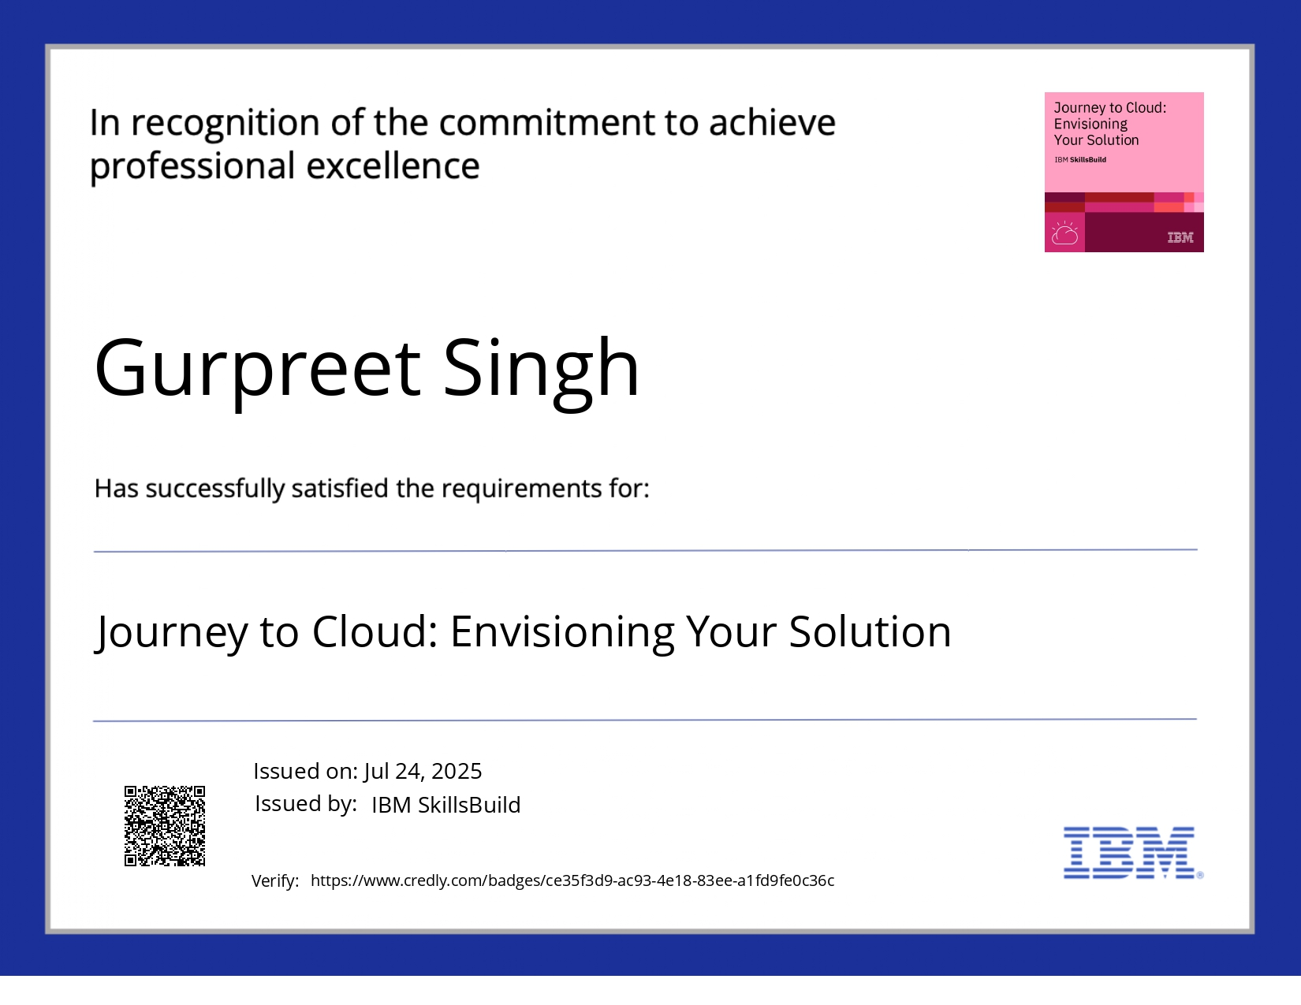
IBM Certifications

Slide 20
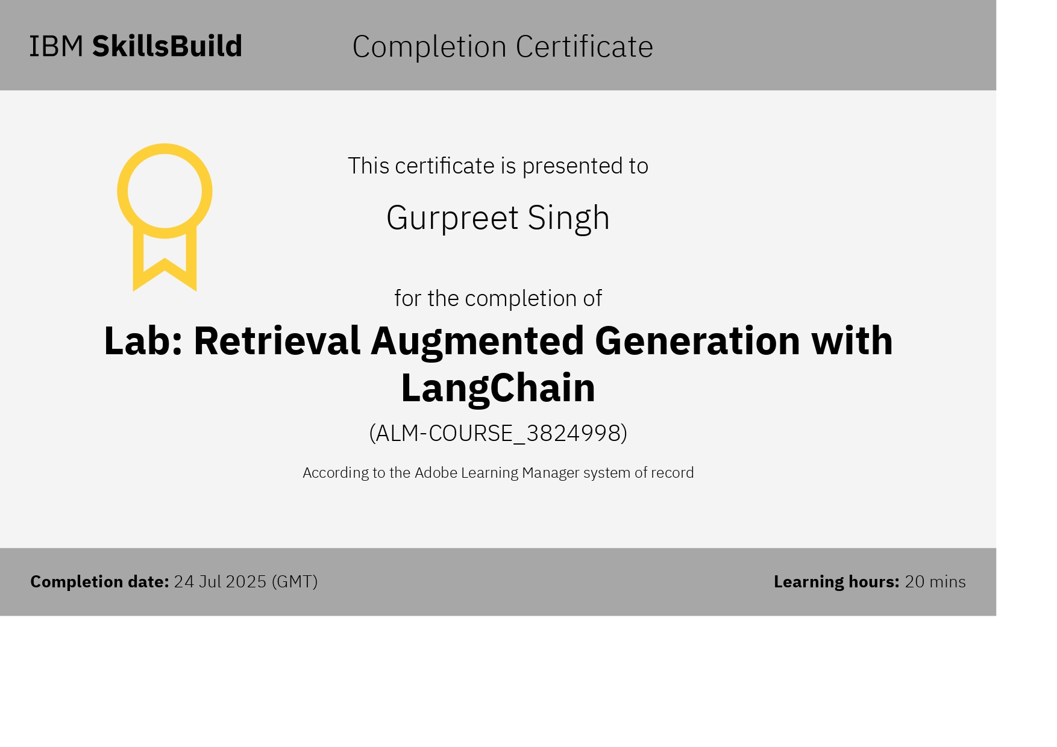
IBM Certifications

Slide 21
THANK YOU

