Slide 1
Employee Data Analysis using Excel
STUDENT NAME: A. Guru varshini
REGISTER NO: 312201191
DEPARTMENT: BCOM ( Bank management )
COLLEGE : DRBCCC Hindu College
Pattabiram , chennai -72

Slide 2
PROJECT TITLE
EMPLOYEE DATA ANALYSIS USING EXCEL

Slide 3


AGENDA
Problem Statement
Project Overview
End Users
Our Solution and Proposition
Dataset Description
Modelling Approach
Results and Discussion
Conclusion
3/21/2024 Annual Review

Slide 4

PROBLEM STATEMENT
Identify the specific area of performance that is Problematic, such as low productivity, high absenteeism, or poor quality of work.

Slide 5

PROJECT OVERVIEW
Employee Performance, Operational Management, Indonesia, West Java
.

Slide 6

WHO ARE THE END USERS?
An employee
2 . Their manager 3 . Supervisor 4 . HR

Slide 7

OUR SOLUTION AND ITS VALUE PROPOSITION
1. Conditional formatting 2.Filter-removee 3.Formula-performance 4.pivot-summary 5.Graph-data visualization

Slide 8
Dataset Description
* Employees kayyal * Employees ID * Employees Name * Performce Level * Gender

Slide 9

THE "WOW" IN OUR SOLUTION
[1] Cahayani, Ats. (2005), Strategi dan Kebijakan Sumber Daya Manusu, PT. Indeks. Anggota KAPI Jakarta [2] Limawandoyo, EA, Simanjutak, A. (2013), Pengelolaam Dan Pengembangan Sumber Daya Manusia Pada PT Aneka Sejahtera Engineering, Jumal Manajemen Bisnis Perta, 1(2), pp. 1-12. [3] MacDuffie, JP, (1995), Human Resource Bundles and Manufacturing Performance Organizational Logic and Flexible Production Systems in The World Automotive Industry, Industrial & Labour Relations Review, 48 (2), pp. 197-221 [4] Mardatillah, Y1, Nasution, H, nhat, A. (2013), Evaluasi Kinerja Manajemen Sumber Daya Manusia PT XYZ Dengan Human Resource Scorecard, e-Jurnal Teknik Industri FT USU, 1(1), pp. 23-27. [5] Susilowati, P., Hatagaol, P., Pasaribu, 8, Djohar, 5. (2013) Pengaruh Aspek Pengelolaan Sumber Daya Manusia terhadap Peningkatan Kinerja Organisasi di Industri Otomotif di Indonesia, Jumal Manajemen Teknolog, 12/11 pp. 21-39 161 Sedarmayanti, (2009), Sumber Daya Manus
3/21/2024 Annual Review
9
Notes:
Hi

Slide 10
terhadap Peningkatan Kinerja Organisasi di Industri Otomotif di Indonesia, Jumal Manajemen Teknolog, 12/11 pp. 21-39 161 Sedarmayanti, (2009), Sumber Daya Manusia dan Produktivitas Kerja, CV. MandarMaju, Bandung [7] Widarsono, Agus, (2009), Human Resources Scorecard, Linking People, Strategy And Performance (Suatu Model Pengukuran Kinerja SDM), Fakultas Pendidikan Ekonomi & Bisnis Universitas Pendidikan Indonesia (UPY BHMN): Bandung 18) Zacharatos, A, Hershcovis, M.S, Turner, N., and Barling, J., (2007), Human Resource Management in The North American Automotive Industry: A Meta-Analytic Review, Personnel Review, 36 (2).pp 231-254

Slide 11
MODELLING
The population in the study were all plant division employees, accounting and finance, marketing at PT XYZ. Totally 21 people. Because the population is relatively small, the research method uses a census. Method where all employees of the plant division, accounting and finance; and marketing at PT XYZ was used as a respondent in the study. The distribution of the number of employees in each division are: Table 1. Distribution of samples No 1 Division Plant 2 3 Accounting and Finance Marketing Amount 6 3 Total 12 21
11

Slide 12
NO | DIVISION | AMOUNT
1 | PLANT | 6
2 | ACCOUNTING AND FINANCE | 3
3 | MARKETING | 12
 | TOTAL | 21

Slide 13
RESULTS
Aspect | PLANT | AKUNTI G FINANCE | MARKETING
SOCIAL ATTITUDE | 4 | 3.7 | 4.5
PERFORMANCE | 4,3 | 4,3 | 4
INITIATIVE | 4,5 | 4,7 | 3,9
KNOWLEDGE | 4,3 | 3,3 | 4,4
SKILL | 4,5 | 4,3 | 4,7
ATTITUDE ON WORK | 4,8 | 4 | 3,9
BEHAVIOUR | 4,3 | 4 | 4,2
INTERPERSONAL SKILLS | 3,8 | 3,3 | 4,5
BUSINESS ORIENTED | 4 | 4,7 | 4,2
PRODUCTIVE Y-1 | 4,8 | 4,7 | 3,4
PRODUCTIVE Y | 4,5 | 4,7 | 4,4
13
Notes:
Gshsjshshsh

Slide 14
Based on table 2, it can be observed that the average performance of each employee, in each division, is categorized as Good (Score 4). Thus it can be concluded that the performance of the four divisions is quite good and can support the company activities in achieving its objectives. Figure 2 below shows the strengths of each aspect of the supervisor’s assessment.

Slide 15
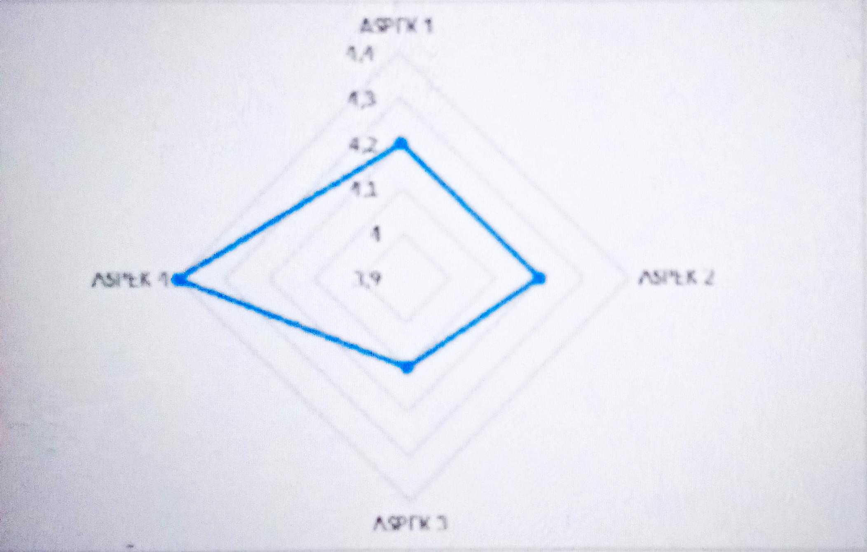

Slide 16
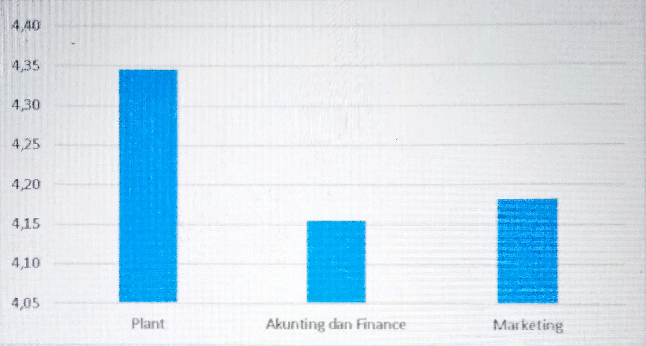
Shows that the greatest strength of employees is in the fourth aspect, namely the productivity of this year and the previous year (Y-1). While the lowest aspect is the third aspect, namely business orientation and interpersonal skills.

Slide 17
conclusion
Based on observations and questionnaires of the research, it can be concluded that: Evenness of skills is needed so that each division can run optimally and can work well, so the company needs to add training activities for employees. In each Division, the achievement of goals is quite good/high, especially the Plant division. This is because the SOP that is applied is almost completely implemented, besides that the supervision system is run properly so that it can create a comfortable working atmosphere for employees. It still has the same direction (advancing Betawi culture).

