Slide 1

BADERIA GLOBAL INSTITUTE OF ENGINEERING & MANAGEMENT, JABALPUR
Semester: V
Branch: Computer Science and Engineering
Course Code: CS508 Course Name: Minor Project - I
Presentation on
EDUTRACK
Project Allocation & Tracking System
ENROLLMENT NUMBER & NAME
0246CS231088 – Gurudas Bhardwaj

Slide 2
Table of Contents
Introduction
Problem Statement
Literature Survey / Existing Systems
Project Objectives
Proposed Solution
Technology Stack
Feasibility Study
Tentative Timeline (Gantt Chart)
Expected Outcomes
References

Slide 3
Problem Statement
Current Challenges in Academic Project Management
Informal & Manual Processes
• Classroom announcements
• Spreadsheet-based tracking
• Communication via WhatsApp/Email
• 25–30 admin hours/semester
Repeated Topics & Poor Coordination
• Students work in isolation
• Same topics repeated every year (E- commerce, Library management , etc)
• Accreditation data difficult to compile
Guide Selection & Workload Challenges
• 15–20 students per guide (some faculty)
• Others handle only 3–5
• No workload transparency during selection
• Faculty overload or underutilization
Lack of Transparency
• Approval status unclear
• No milestone tracking
• Faculty monitoring difficult
• Evaluation confusion
IMPACT: Delayed approvals • Duplicate efforts • Unfair guide allocation • Poor academic supervision
Baderia Global Institute of Engineering and Management, Jabalpur

Slide 4
Primary Goal : Deliver a campus-centric, role-based web application that digitizes allocation and end-to-end progress tracking of Minor/Major projects within the department.
Specific Objectives
Centralized proposal submission with unique-topic checks (basic duplicate detection via keyword matching).
Guide selection with workload visibility: Students choose guides based on real-time capacity data; faculty approve/reject proposals.
Milestone-based tracking: deadlines, statuses, evidence uploads (PDF/DOCX).
Role-based portals with RBAC: Student, Faculty Guide, Administrator.
Structured feedback and evaluation workflow (rubric-based forms).
Dashboards: guide workload, delayed groups, completion %, topic duplication alerts.
Notifications and reminders (in-app + email).
Secure authentication (JWT) and password hashing; file type/size validation.
Reports/exports (CSV/PDF) for allocations and progress.
Audit trail for proposal decisions and milestone changes.
Scope Boundary (Not in this phase)
No native mobile apps (Android/iOS) — responsive web only.
No integration with LMS (Moodle/Google Classroom) or university grading systems.
No plagiarism scanning services (e.g., Turnitin/Copyscape).
No video conferencing/scheduling module.
No advanced AI/ML for topic similarity (only basic keyword checks).
No blockchain certificates or industry mentor portal.
No multi-language UI — English only.
No SSO/identity federation; standard email/password auth.
Deployment limited to departmental/institutional server; public cloud hardening out of scope.

Slide 5
Literature Survey
Current Solutions
Manual Systems
  Spreadsheets, emails, paper records
  Time-consuming & error-prone
Learning Management Systems
  Moodle, Canvas, Google Classroom
  Course-oriented, not project lifecycle
Generic Project Tools
  Trello, Jira, Asana
  Designed for industry, not academics
THE GAP
Too expensive (per-user licensing)
Generic design, not academic-centric
Complex setup & maintenance
Lack of Group-Centric Management
No duplicate topic detection
No clear role separation
EDUTRACK’S COMPETATIVE EDGE
Campus-centric academic workflow
Zero licensing (open-source MERN)
Simple & intuitive UI
Guide selection with workload visiablity
Duplicate topic detection
Role-based access (Admin / Faculty / Student)
Milestone-based tracking

Slide 6
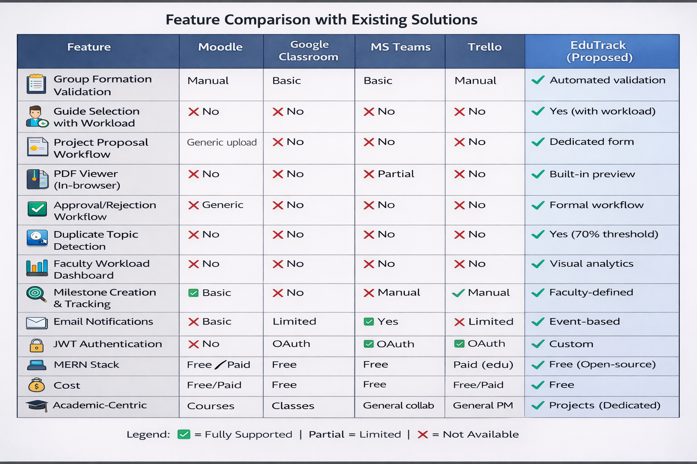

Slide 7
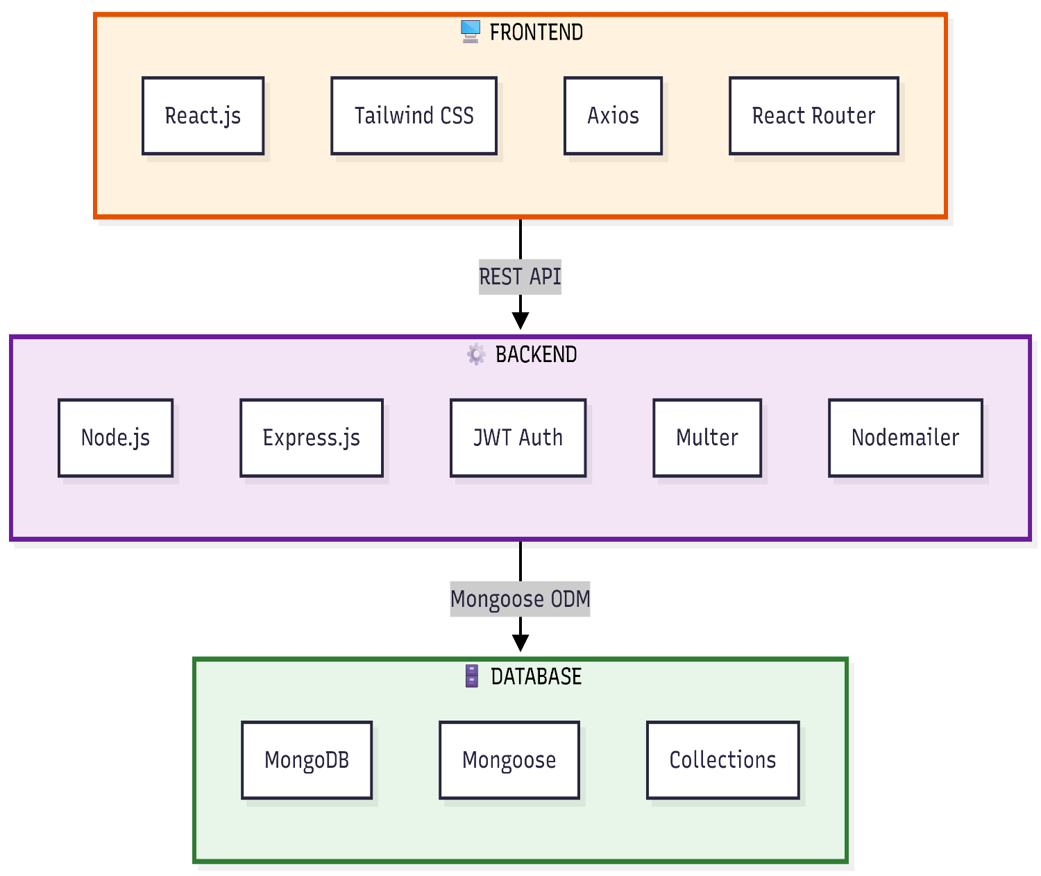
TECHNOLOGY STACK
• Frontend: React.js (v18), Tailwind CSS, React Router, Axios,
React Hook Form, Recharts (data visualization)
• Backend: Node.js (v20), Express.js, JWT (authentication), bcryptjs (password hashing), Multer (file uploads), Nodemailer (email service)
• Database: MongoDB (v7), Mongoose ODM, MongoDB Atlas (cloud hosting)
• Deployment:
- Frontend: Vercel/Netlify (free hosting)
- Backend: Render/Railway (free tier)
- Database: MongoDB Atlas (512MB free)

Slide 8
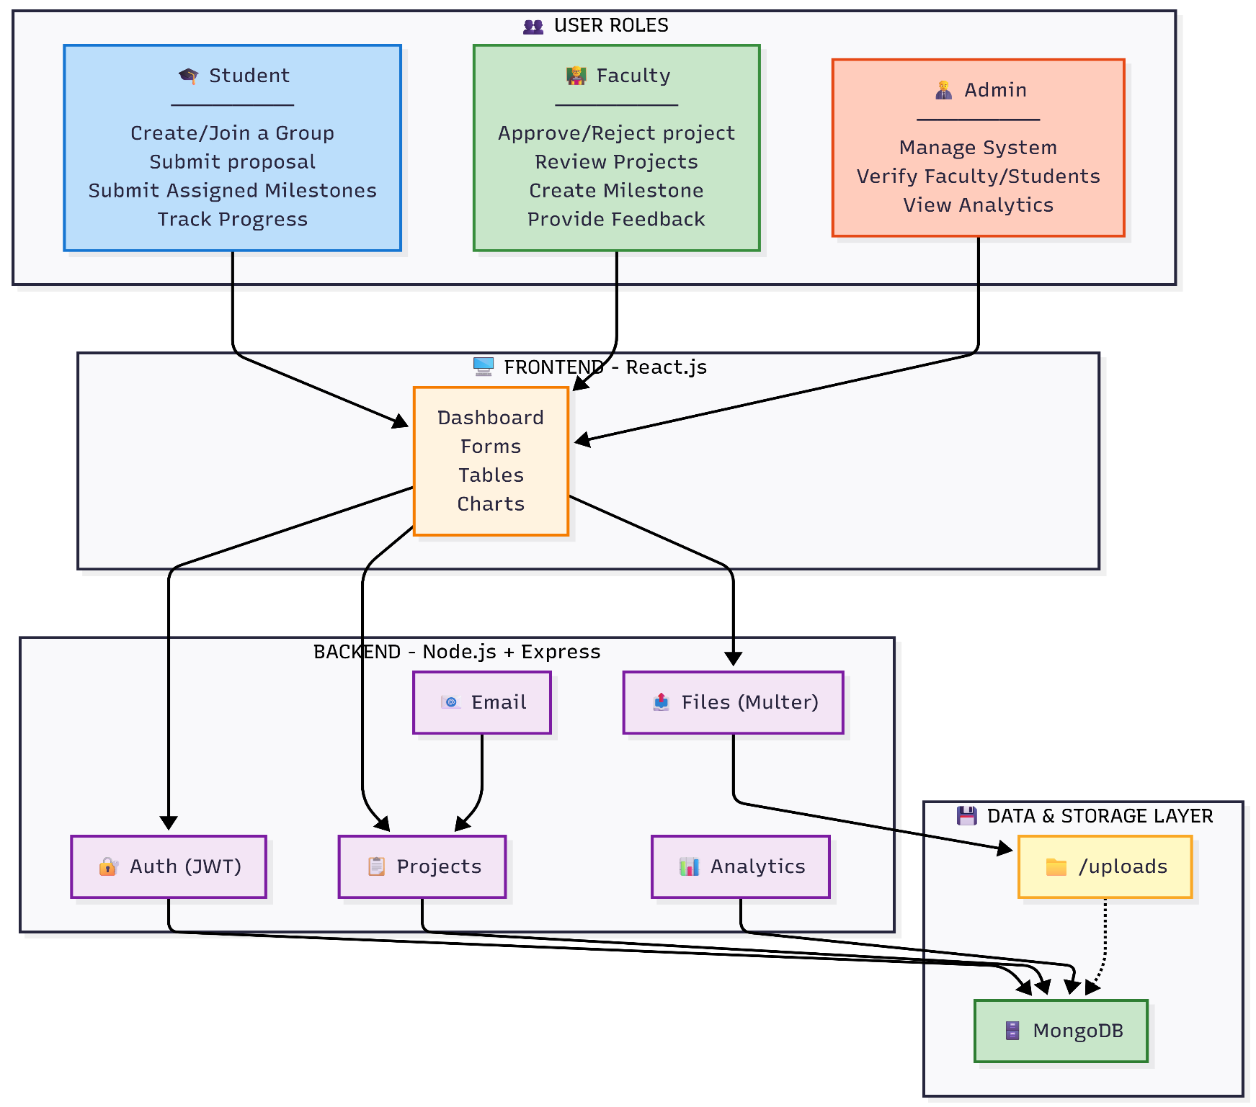
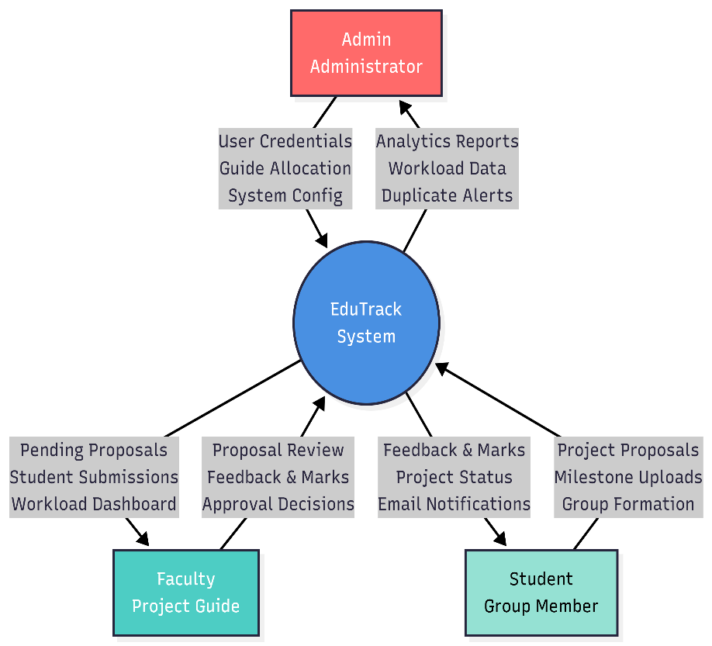
Proposed Solution
Work Flow of The System
Context Diagram Showing System Boundries

Slide 9
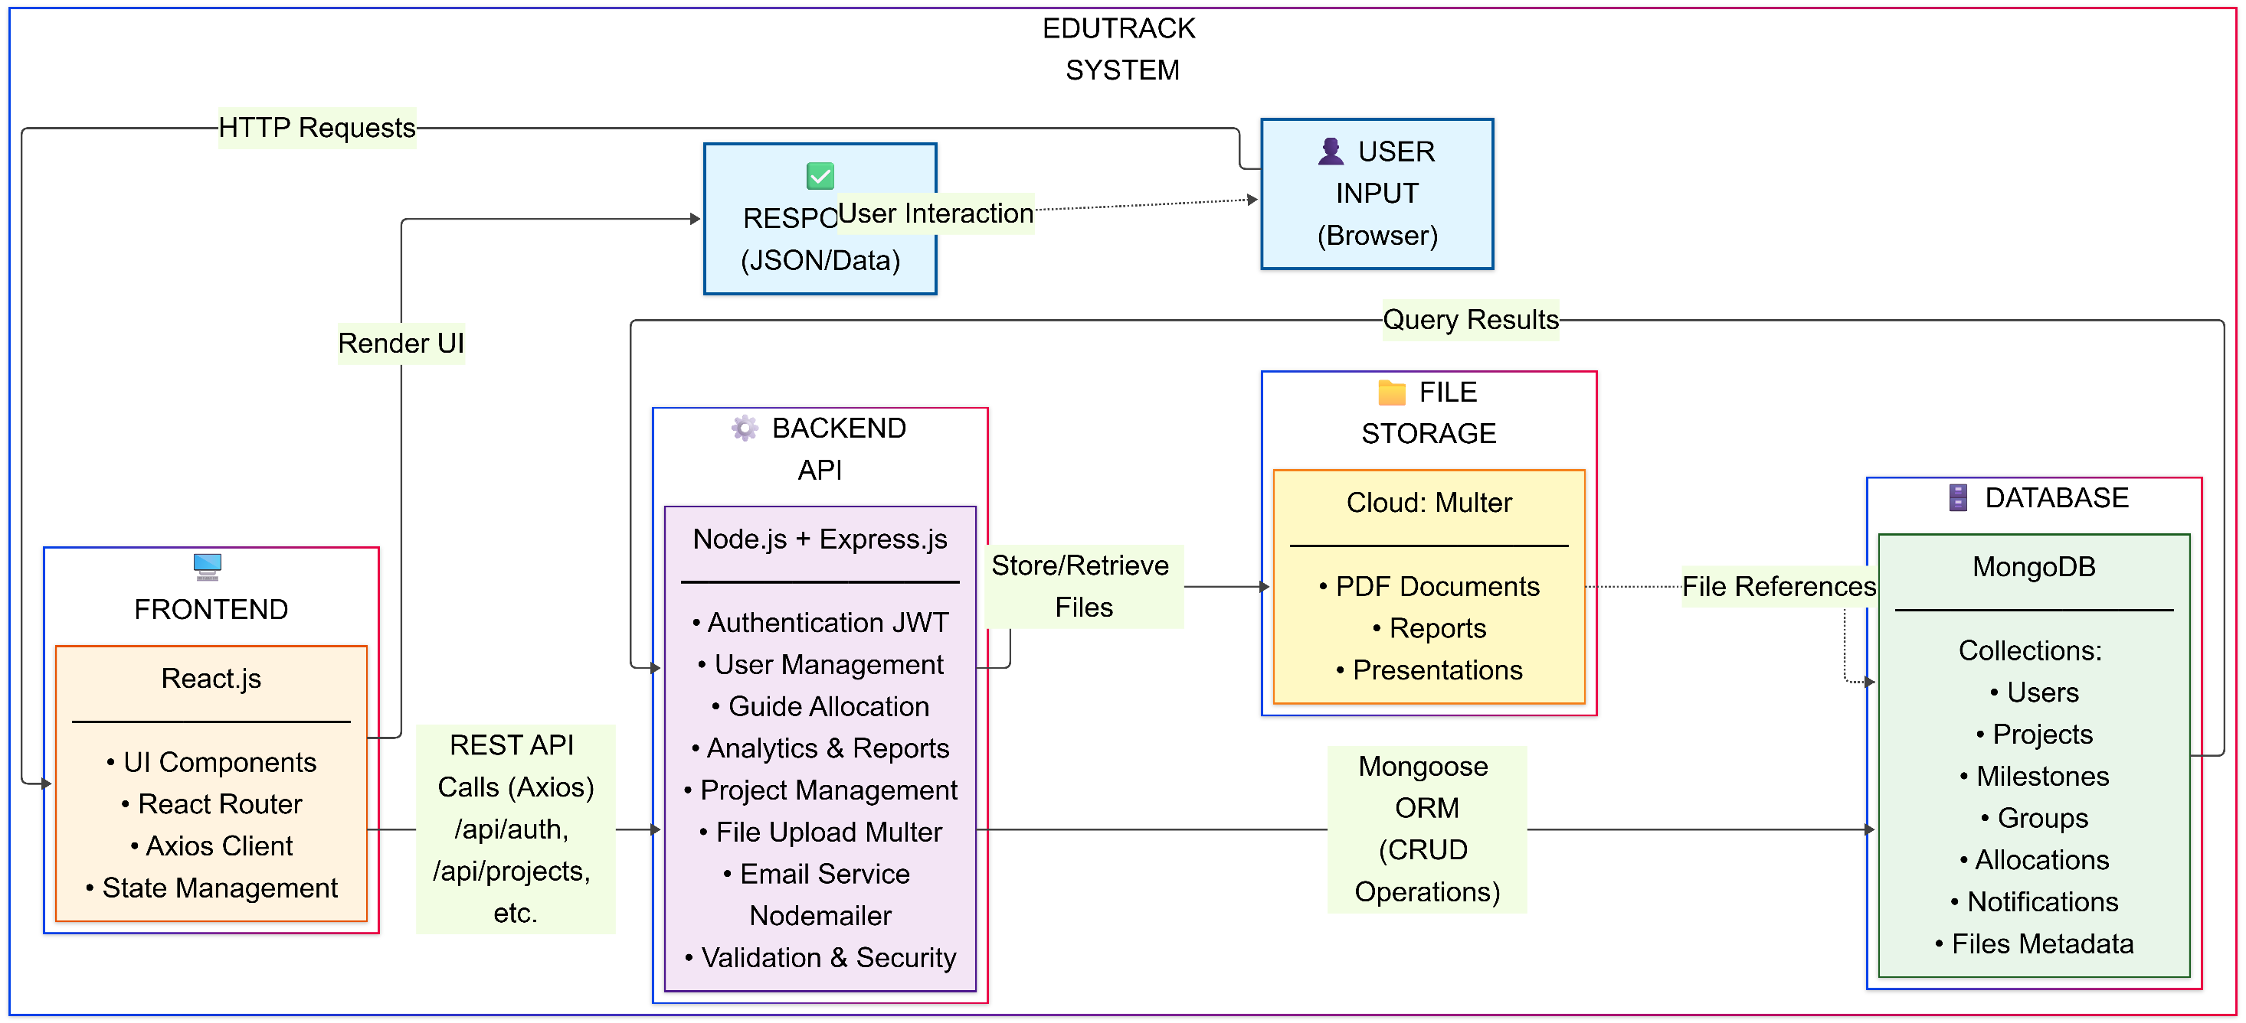

Slide 10
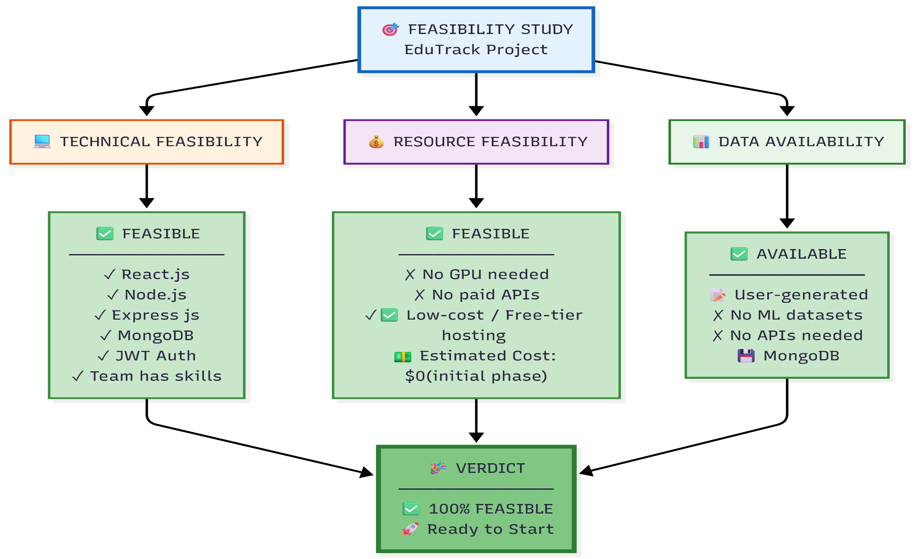
Feasibility Study

Slide 11
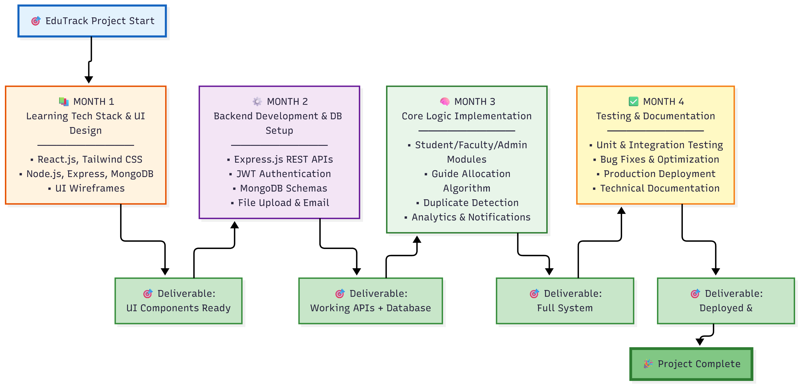
Tentative Timeline

Slide 12
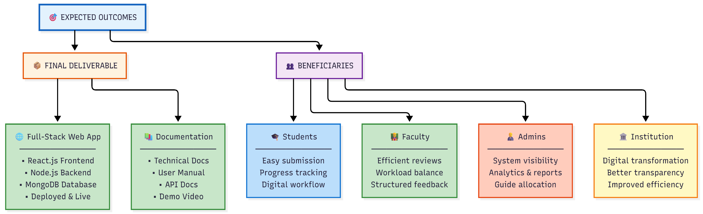
Expected Outcomes:
Digitization of academic project management with improved transparency, efficiency, and balanced faculty workload.

Slide 13
REFERENCES
Key references that informed the EduTrack project design:
RESEARCH PAPERS:
R. Patel and S. Mehta, "Academic Project Tracking and Evaluation: A Systematic Review of Digital Solutions," in 2022 International Conference on Educational Technology (ICET), Singapore, 2022, pp. 45-52.
J. Li, Y. Zhang, and H. Chen, "Cloud-Based Student Information Management System Using MERN Stack," in 2023 IEEE International Conference on Cloud Computing Technology and Science (CloudCom), Naples, Italy, 2023, pp. 89-96.
TECHNICAL DOCUMENTATION:
Meta Open Source, "React Documentation - Getting Started," React, Available: https://react.dev/learn. [Accessed: Jan. 18, 2025].
MongoDB Inc., "MongoDB Manual - Introduction to MongoDB," MongoDB Documentation, Available: https://docs.mongodb.com/manual/. [Accessed: Jan. 12, 2025].
BOOKS:
A. Kumar and S. Sharma, MERN Stack Development: Building Modern
Web Applications, 2nd ed., New Delhi: Wiley India, 2021.

