Slide 2
Agenda

Slide 3
Other <<Similar Sessions >>
Only if we have similar tech sessions on other halls by other speakers

Slide 4
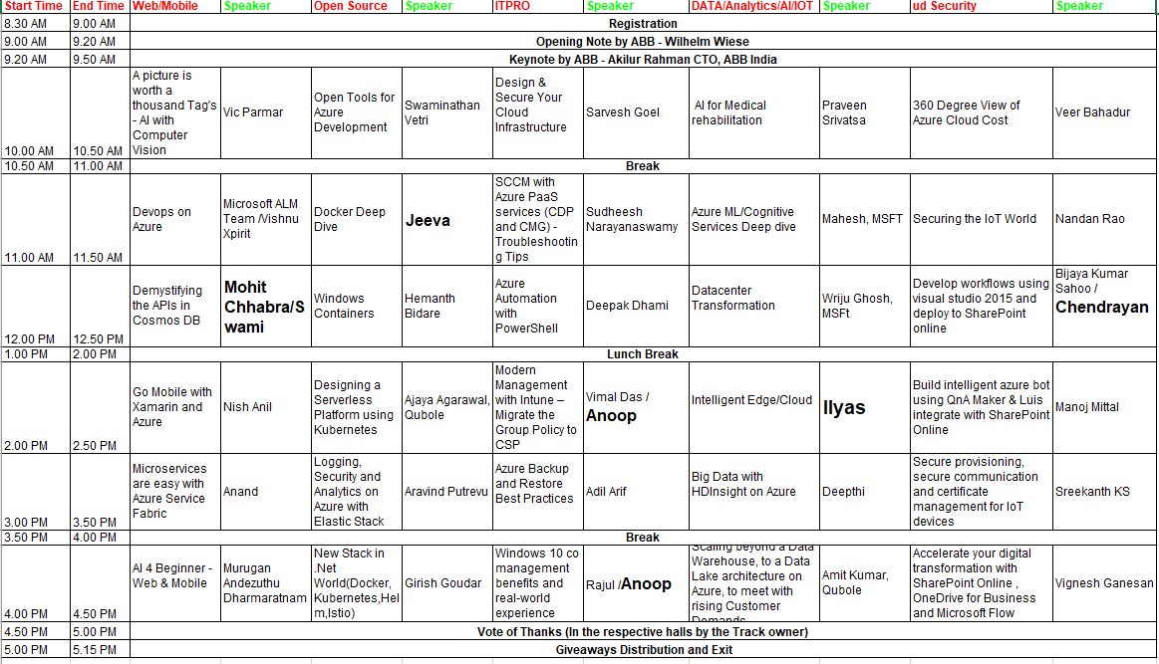
GAB 2018 Agenda

Slide 5




Our Supporters

Slide 6





Collaborating Communities
aOS Bangalore
OSS Bangalore

Slide 7
Thanks

