Slide 1
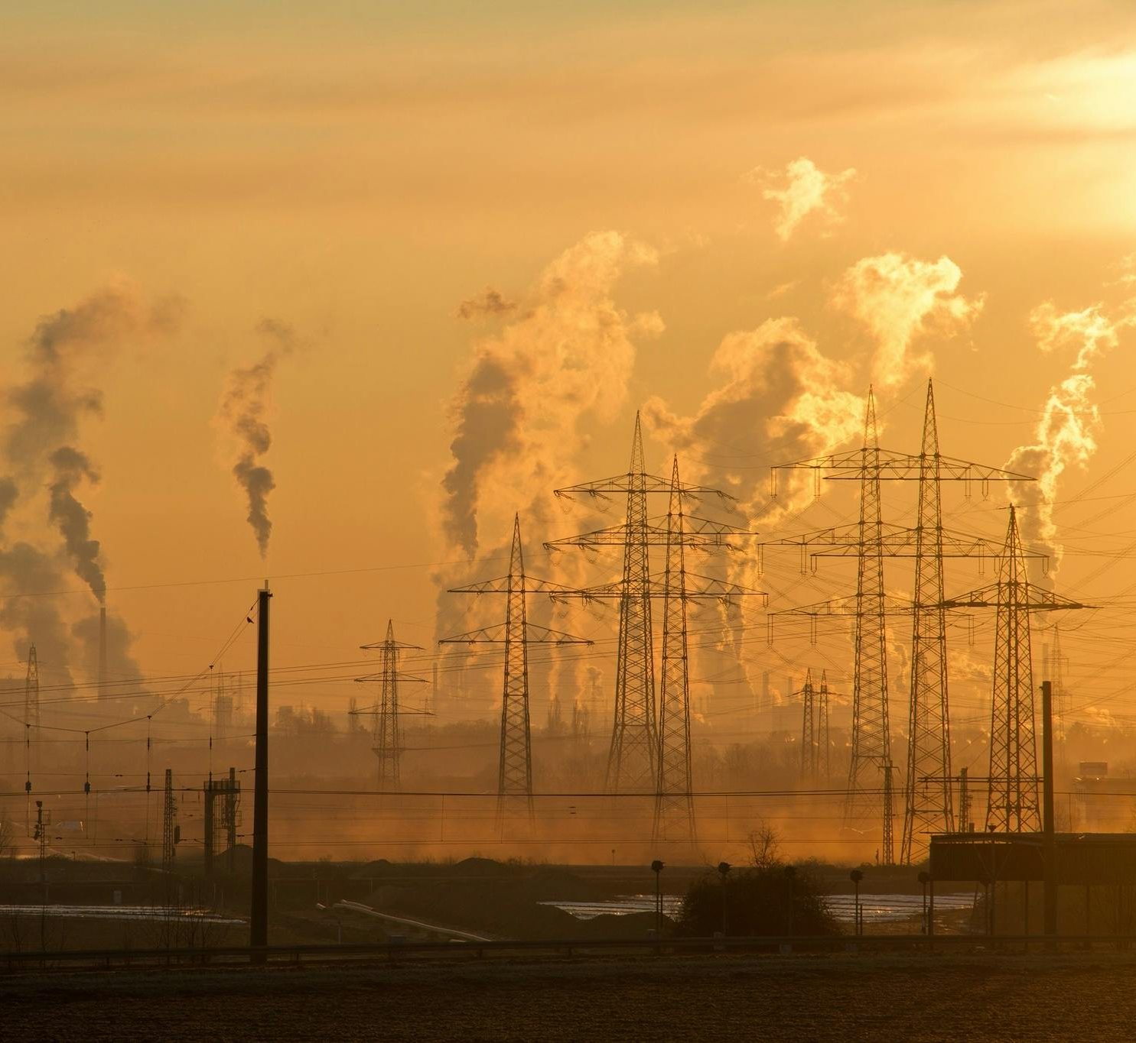
Air Quality Prediction using Machine Learning
Guruprasad Velikadu Krishnamoorthy
and Hemalatha Subbiah
DSC630 - Bellevue University

Slide 2
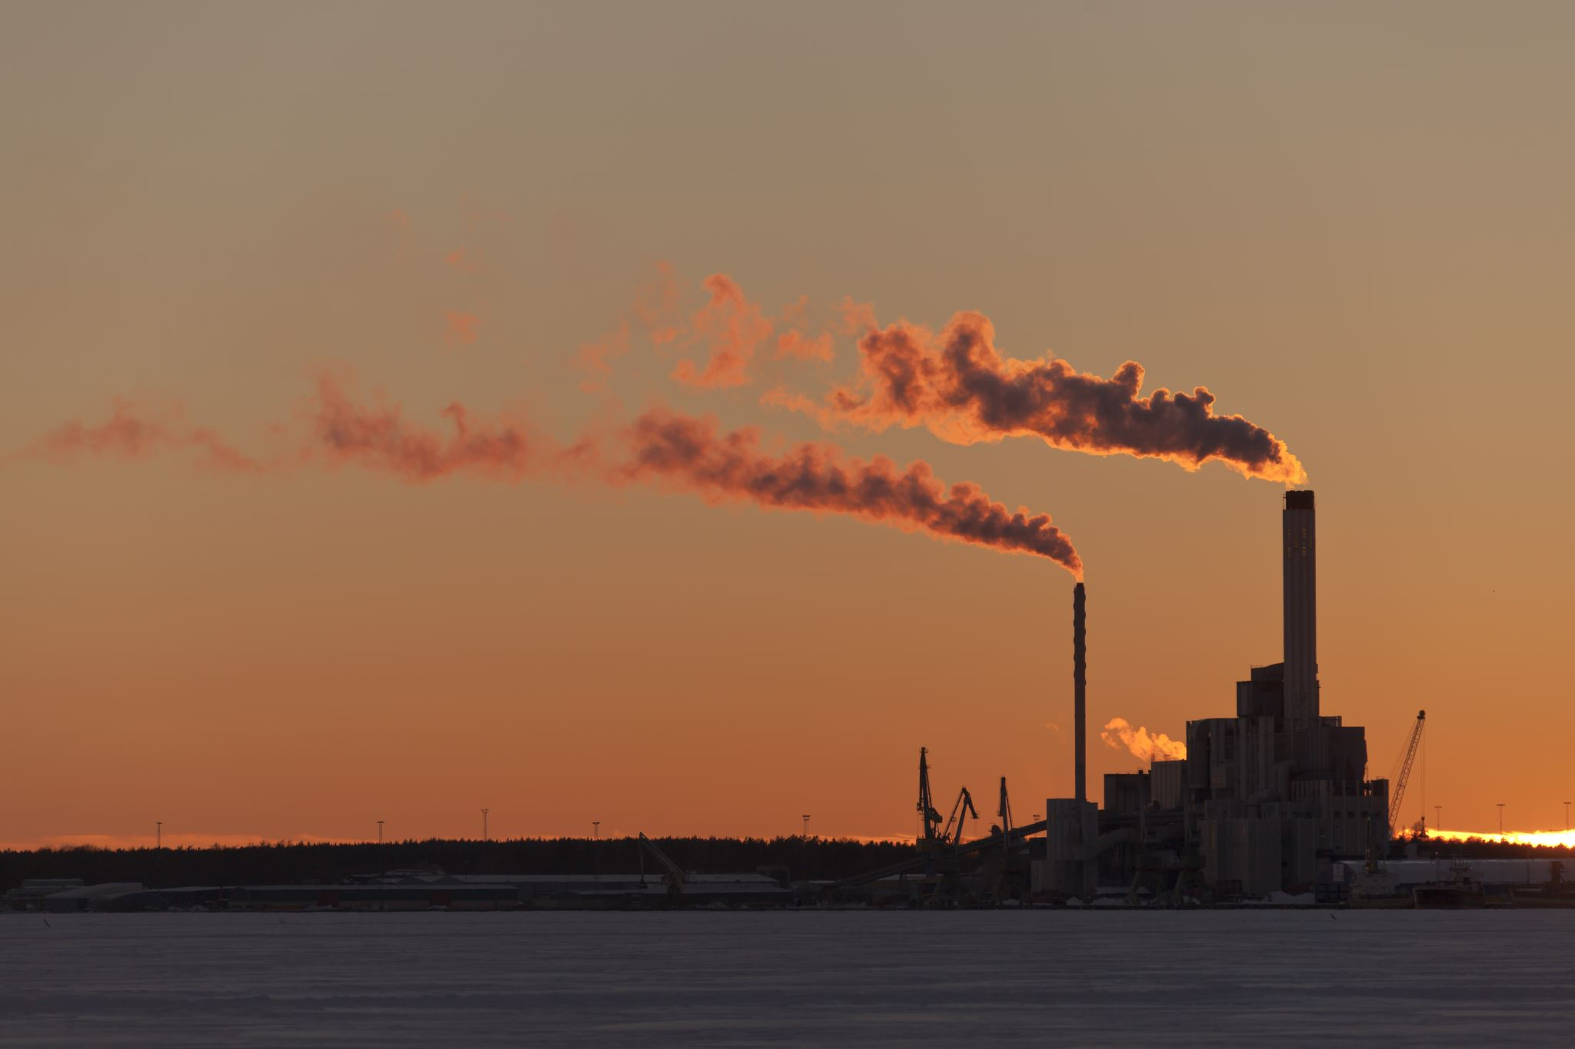
Air Pollution
Air Pollution is a very common environmental Health Hazard that refers to the release of pollutants into the air that are dangerous to human health and to the entire planet.
Some of the common causes of Air Pollution are:
Emissions from Factories
Vehicle exhausts
Agricultural processes
Natural causes such as Wildfires, Volcanoes, etc.
Air Quality Index
Air Quality Index (AQI) is an index that measures and quantifies the extent of Air Pollution in an area. Its value ranges from 0 to 500, with 0 to 50 considered safe while 300- 500 are considered extremely dangerous.

Slide 3

The Problem Statement
To be able to predict the Air Quality Index in real-time based on the pollutant concentration and environmental factors.
How Machine Learning Can Be Used?
Regression or Classification models can be built to predict the Air Quality index based on the Pollutant Concentration levels.
Effects of interactions between the variables and linear and non-linear relationship patterns between the variables can be studied.
Meterological parameters such as Temperature, Wind, Pressure, etc can be used to simulate the models to predict the pollutant concentration and AQI levels.
Data can be processed in real-time to alert the authorities and issue warnings to the public in extreme cases to avoid a certain area due to poor air quality.

Slide 4
Steps Involved in this Project
In the first step, the source of the data will be identified
The data is then explored to identify the patterns and relationships between the variables.
01
Data Collection
02
Data Exploration
In this step data cleansing such as duplicate checks, null handling, and feature selections are done. The datasets are also merged.
In this step, the dataset will be split into train and test sets and the models will be trained using R and Python.
Data Cleansing & Preparation
Model Building in R
And Python
03
04
The Model results along with the chosen metrics will be analyzed and the best model will be chosen.
Analyzing the Model outcome
05
06
Results
The final results will then be published.

Slide 5
Source of the Data The Data files are taken from the Environmental Protection Agency (EPA) website. Various Datasets each containing the concentration of pollutants, gases, and meteorological parameters for the year 2022 are used in the study.
Ozone Concentration Dataset
Carbon Monoxide Concentration Dataset
NO2 and SO2 Concentration Datasets
Particulate Matter PM2.5 and PM10 Concentrations
Temperature and Pressure Datasets
Wind Speed and Humidity Datasets

Slide 6
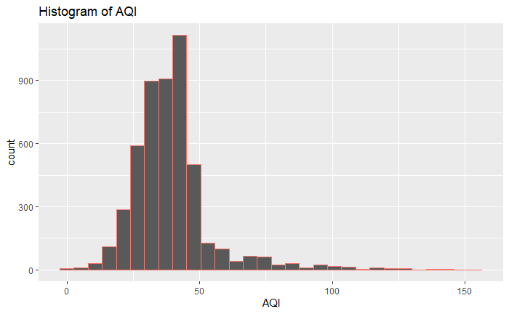
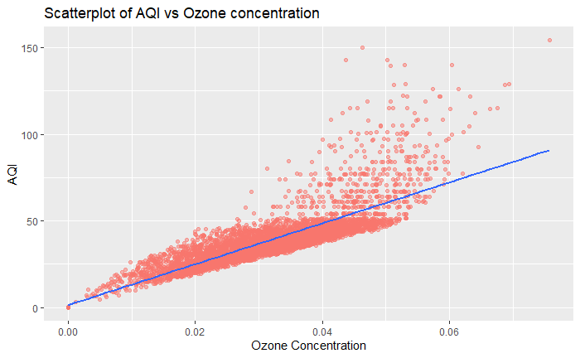
Data Exploration
The Histogram of AQI indicates most of the AQI is situated between the 20 and 50 range. There is a long tail indicating the presence of outliers above AQI of 100.
The Scatter plot of Ozone Concentration versus AQI on the Ozone dataset suggests a strong positive relationship between the two variables.

Slide 7
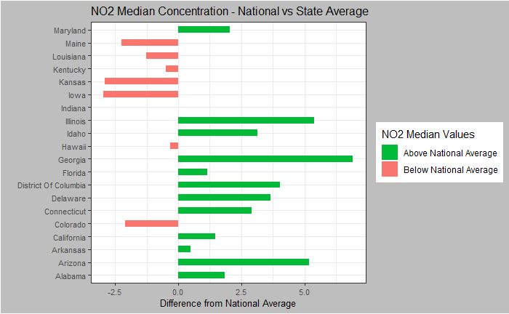
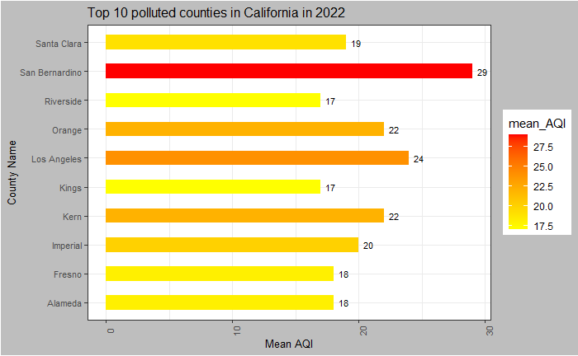
Data Exploration (continued)
The Bar plot indicates that the NO2 Median values of most of the U.S. states such as Georgia, and Arizona are above the national average. While Kansas, Iowa, and Maine are the lowest.
The Bar Plot of County analysis in California suggests that San Bernardino is the most polluted followed by Los Angeles County.

Slide 8
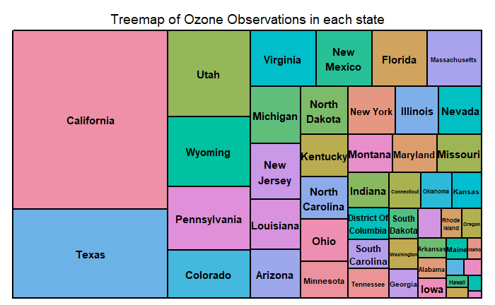
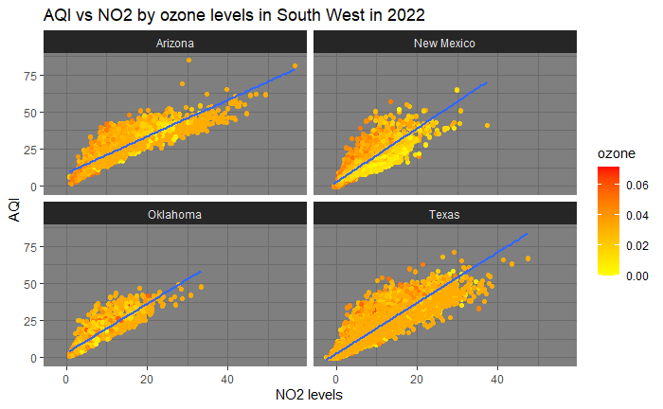
Data Exploration (continued)
The Tree Map built on the Dataset suggests that California and Texas had the greatest number of observations. This is similar to the observations in the individual datasets.
Facet Scatter plot of AQI vs NO2 levels based on the Ozone levels in Southwest states suggests that the relationship is similar throughout the region.

Slide 9
The Process of Data Preparation
Data Format Conversion by handling the factors and strings.
Merging the datasets based on common fields such as the Date of observation, City, county, and State.
Feature selection using Correlation Matrix and Feature Reductions using Principal Component Analysis.
Renaming columns, Null Handling, and Duplicate Checks

Slide 10
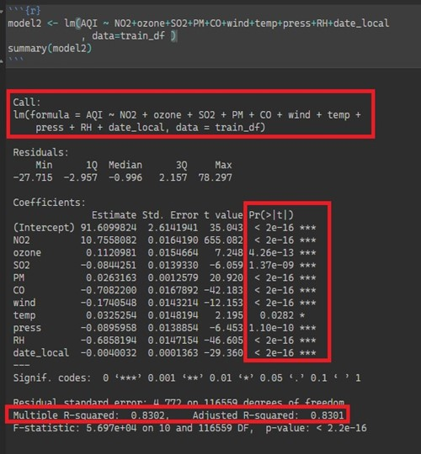
Model Building in R
Linear Regression Model was built in R by merging all datasets.
The features were scaled using standard scaling. The Dataset was split into Test and Train sets in the ratio 30:70.
The Model results indicate that R-squared and Adjusted R-squared are very close suggesting that the model is a good representation of the data
Root Mean Square Error (RMSE) which measures the average difference between the values predicted by the model versus the actual was used to measure the Performance metrics of the model. The value of RMSE was around 4.7 for both train and test datasets.

Slide 11

Model Building in Python
Multiple Regression models were built in Python using algorithms such as
Linear Regression
Decision Tree Regression
Random Forest Regression
K Neighbors Regression
Gradient Boost Regression
The Merged dataset from all sources was split into Train and test sets and the Trained model was used to make Predictions on the Test set.
Feature selection and Feature reduction methods such as Pearson’s Feature reduction and Principal Component Analysis methods were applied to the datasets before the models were built.
Metrics such as Mean Squared Error (MSE), Root Mean Squared Error (RMSE), Mean Absolute Error (MAE), and R-squared (R2) were used to evaluate the model performance.

Slide 12
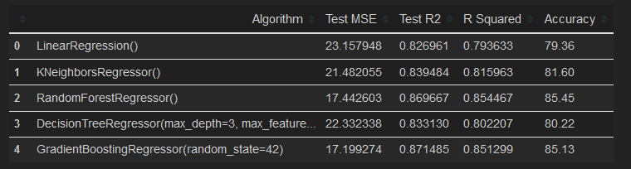
Model Building in Python (Contd)
The Regression model results were better with the Random Forest Regressor and Gradient Boost Algorithms regarding R2 statistic.
These algorithms also had lower Mean Squared Error and Higher Accuracy than the rest.
The models returned similar results using the PCA Feature reduction method

Slide 13

Model Outcome and Conclusion
The model results from R and Python suggest that NO2 and CO are better predictors for AQI in comparison with other pollutants.
Though ozone was not a strong predictor for AQI as per the model, the effects of ozone cannot be undermined as it can have detrimental effects on Air quality, so it was included during the model building.
Additional models such as Clustering can be built to identify the clusters of regions with higher AQI. Also clustering based on the period of the year can be built to identify patterns in the period of the year when the air in those regions is most polluted.

Slide 14
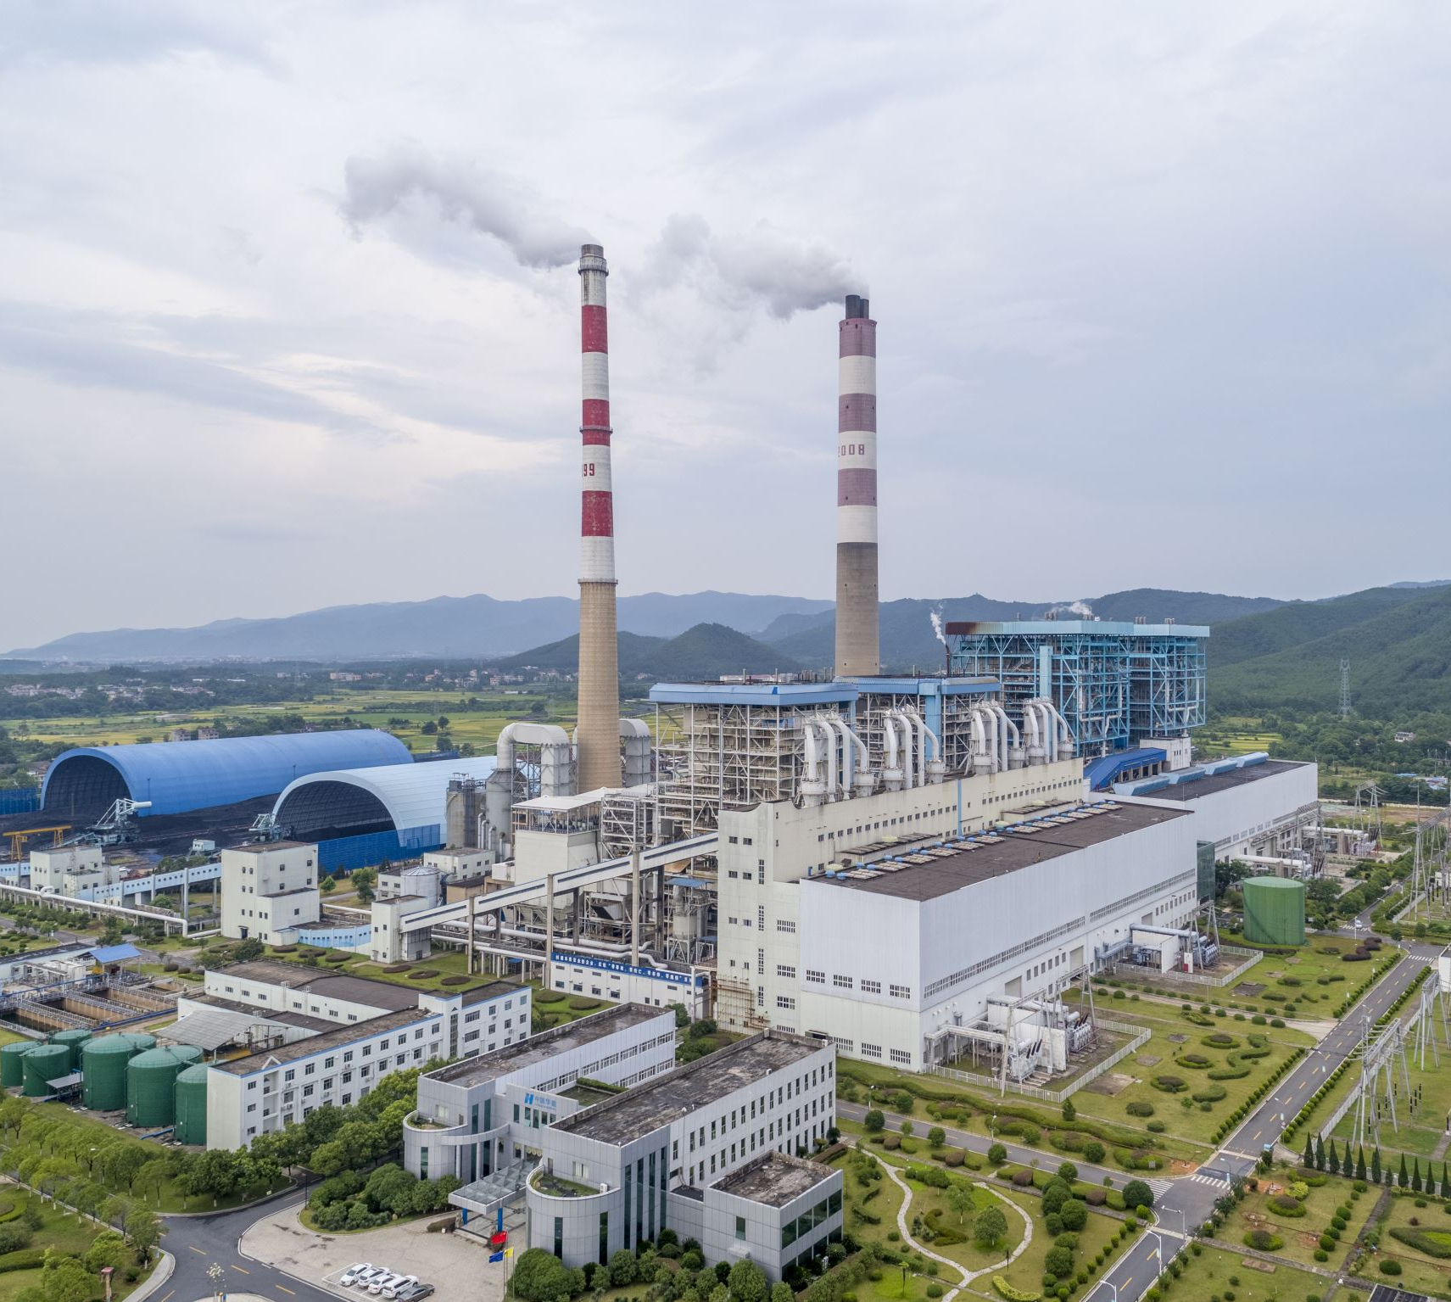
Ethical Concerns
Though gas-powered vehicle emissions and industrial smoke have played a significant role in air pollution, they cannot be entirely replaced by sustainable solutions, as they can lead to many job losses affecting many families employed by the manufacturing industries. Care must be taken while publishing the results, keeping in mind the impact it can have on families.
While determining the acceptable levels of greenhouse gases and pollutants for humans, careful assessment should be made while determining the values, as the acceptable levels for humans may cause significant damage to other ecosystems and species.
The acceptable levels should also be carefully assessed with international considerations in mind, as the gas emissions and pollutants from the developed countries are no longer a local issue. These impacts are already seen on the other side of the world, with extreme floods and drought conditions that were not seen in the past.

Slide 15
References
https://www.nps.gov/subjects/air/sources.htm
https://www.airnow.gov/education/students/what-is-the-aqi/
https://www.ncbi.nlm.nih.gov/pmc/articles/PMC8586941/
https://www.amacad.org/publication/ethical-dimensions-global-environmental-issues

Slide 16

Thank you

